Slide 1
Covalent Compounds

Slide 2
Information
Developing and Using Models
Planning and Carrying Out Investigations
Constructing Explanations and Designing Solutions
1. Patterns
3. Scale, Proportion, and Quantity

Slide 3
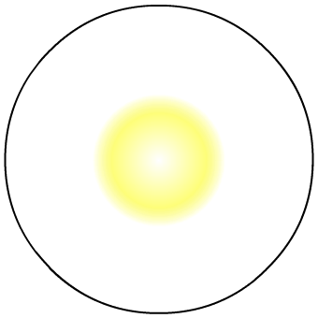
What are covalent bonds?
When atoms share pairs of electrons, they form covalent bonds.
This type of chemical bond is very strong.
Cl
Cl
covalent bond = shared electrons
Where can covalent bonds be found?
simple covalent molecules (e.g. Cl₂, H₂O, CH₄)
polymers (e.g. polyethene, polypropene)
giant covalent structures (e.g. diamond, silicon dioxide)
What properties do covalent compounds have in common?
Notes:
Teacher notes
For more information about covalent bonds, please refer to the Covalent Bonding presentation.

Slide 4
Properties of covalent molecules
Notes:
Teacher notes
You may wish to inform students that graphite, a covalent compound, can conduct electricity. Students may also be under the impression that water conducts electricity. This is due to the mineral ions that are often present in water.

Slide 5
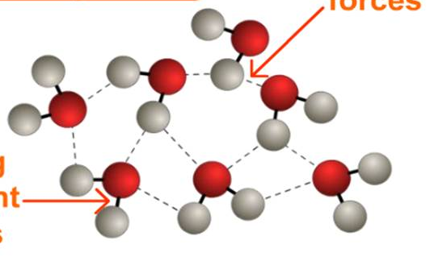
Thermal properties of simple molecules
The covalent bonds between atoms within a molecule are strong. However, the intermolecular forces between the molecules are weak and easy to break.
weak intermolecular forces
When a simple covalent substance is heated, the intermolecular forces between the molecules are broken.
strong covalent bonds
This means that substances that consist of simple covalent molecules have relatively low melting and boiling points, and are usually liquids or gases at room temperature.
Notes:
Teacher notes
The thin dotted lines in the image show the weak intermolecular forces between the molecules.
The thick solid lines show the strong covalent bonds within the molecules.
This slide covers the Science and Engineering Practice:
Constructing Explanations and Designing Solutions: Apply scientific ideas, principles, and/or evidence to provide an explanation of phenomena and solve design problems, taking into account possible unanticipated effects.

Slide 6
Investigating intermolecular forces
Plan an investigation to find out how the strength of the intermolecular forces in a simple covalent substance depends on the size of the molecules in the substance.
You should consider:
which substances you will use (remember you are investigating the effect of molecule size)
what property you will measure to infer the strength of the intermolecular forces – how will you judge the strength of the forces from this property?
how you will measure the property you have chosen.
Notes:
This slide covers the Science and Engineering Practice:
Planning and Carrying Out Investigations: Plan and conduct an investigation individually and collaboratively to produce data to serve as the basis for evidence, and in the design: decide on types, how much, and accuracy of data needed to produce reliable measurements and consider limitations on the precision of the data (e.g., number of trials, cost, risk, time), and refine the design accordingly.

Slide 7
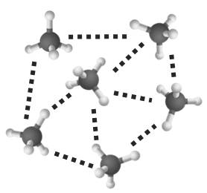
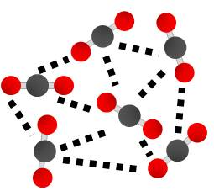
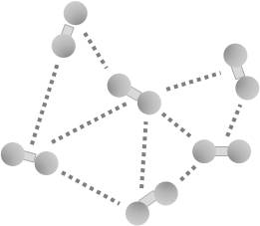
Intermolecular forces
The intermolecular forces increase as the size of the molecules increases.
size and intermolecular forces increase
This means it takes more energy to break the intermolecular forces between larger molecules. As a result, larger molecules have higher melting and boiling points.
 | Melting point (°C) | Boiling point (°C) | Relative formula mass
H₂ | –259.16 | –252.87 | 2
CH₄ | –182.5 | –161.6 | 16
CO₂ | –78 | –57 | 44
Notes:
Teacher notes
You may wish to remind students that the relative formula mass is calculated by adding together the relative atomic masses.
The atomic mass of an element can be found in the periodic table.
This slide covers the Science and Engineering Practices:
Developing and Using Models: Develop, revise, and/or use a model based on evidence to illustrate and/or predict the relationships between systems or between components of a system.
Constructing Explanations and Designing Solutions: Apply scientific ideas, principles, and/or evidence to provide an explanation of phenomena and solve design problems, taking into account possible unanticipated effects.

Slide 8
Electrical properties of simple molecules
Simple covalent molecules do not contain charged particles
and have no overall electric charge.
The shared electrons fill up the outer shells so there are
no free electrons to carry charge.
This means that covalent molecules do not conduct electricity.
 | Covalent | Ionic | Metallic
Charged particles?
Free electrons?
Conduct electricity?
Only when
dissolved or
melted

Slide 9
Properties of simple covalent molecules
What properties do simple covalent molecules have?
low melting and boiling points
do not conduct electricity
usually liquids or gases at room temperature
poor conductors of heat
The properties of covalent molecules are related to the different types of bond they contain, the strength of the intermolecular forces, and whether the molecule contains charged particles.
Notes:
Teacher notes
Ensure students recognize that it is the molecules that have these properties, not the atoms themselves.

Slide 10
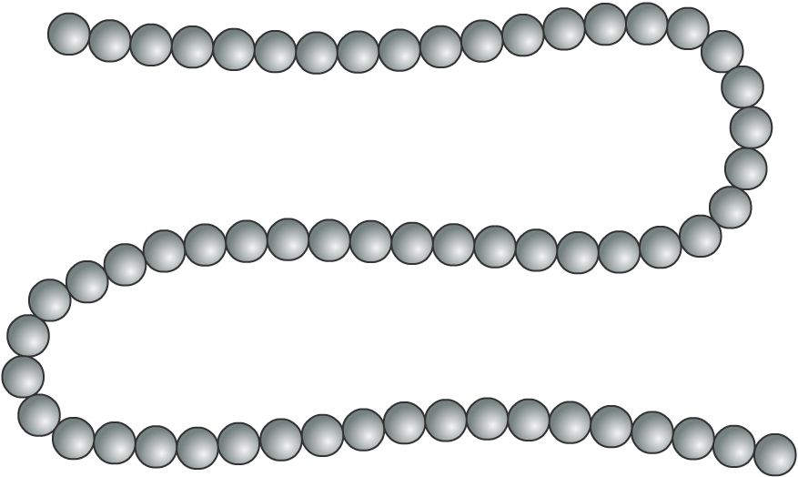
What are polymers?
Sometimes, hundreds of simple covalent molecules join together to form a long chain.
The chains are called polymers, and are very
large molecules. The molecules that join together to make a polymer are called monomers.
Plastics are synthetic polymers that can be shaped by heat or pressure. Natural polymers include DNA, rubber and proteins.

Slide 11
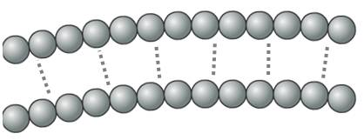
Chain length
As with simple covalent molecules, the intermolecular (IM) forces increase as the molecules get larger. This means that the IM forces are stronger between polymers with longer chains.
short chain =
weak IM forces
long chain =
strong IM forces
It takes more energy to break the IM forces between longer chain polymers, so these polymers will be harder, stronger and have higher melting points.
Notes:
Teacher notes
The dotted lines between the chains in the images represent the intermolecular forces.
This slide covers the Science and Engineering Practice:
Constructing Explanations and Designing Solutions: Apply scientific ideas, principles, and/or evidence to provide an explanation of phenomena and solve design problems, taking into account possible unanticipated effects.

Slide 12
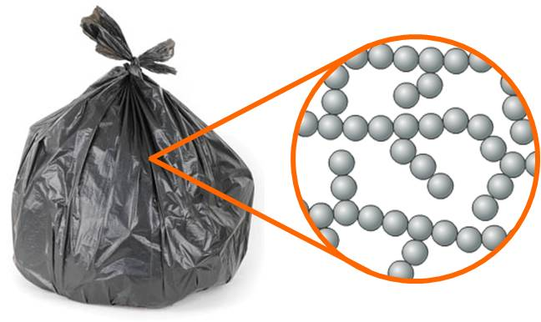
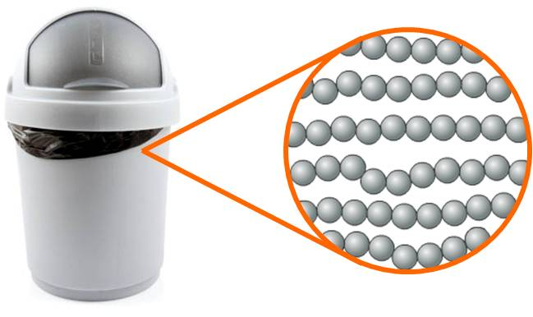
Branching
Different processes can be used to produce different types of polymers. Using high pressure results in branching chains. Using a metal catalyst creates polymers with lined-up chains and a crystalline structure.
Branching chains make plastics light, soft and easy to melt (e.g. low-density polyethene).
Lined-up chains make plastics dense, rigid and harder to melt (e.g. high-density polyethene).
Notes:
Photo credits: bag © tkemot; bin © Sandra van der Steen, both at Shutterstock.com 2018

Slide 13
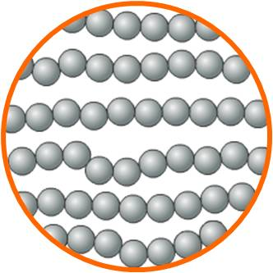
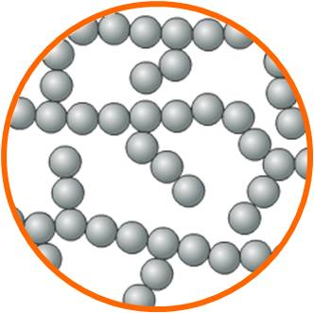
Crystalline structure
In high-density polyethene (HDPE) the chains are unbranched, so they can be closely packed together and lined up. This produces a crystalline structure.
The branches in low-density polyethene (LDPE) stop the chains from lining up regularly, and prevent a crystalline structure.
The crystalline structure of HDPE makes it denser than LDPE. The intermolecular forces between the chains in HDPE are stronger than in LDPE. This makes HDPE more rigid, and gives it a higher melting point than LDPE.

Slide 14
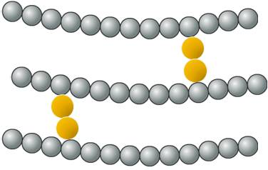
Cross-linking
Chemicals can be added to form cross-links between the chains of a polymer. A cross-link is a chemical bond (covalent or ionic) that joins one polymer chain to another.
For example, sulfur chains form
cross-links between the polymer chains in rubber during vulcanization.
The cross-links stop the chains from sliding over each other, so the polymer is less flexible.
The intermolecular forces between the chains in a non-cross-linked polymer are much weaker than the chemical bonds in a cross-link. The chemical bonds require much more energy to break, so cross-linked polymers have higher melting points.
Notes:
Teacher notes
During vulcanization, sulfur chains form cross-links between the polymer chains in rubber.
Before vulcanization, rubber is soft and sticky when it’s warm, but becomes hard and brittle when it’s cold.
After vulcanization, rubber becomes tougher, and is elastic over a much greater range of temperatures.
If there are more sulfur cross links, the vulcanized rubber will be more rigid.
Vulcanized rubber has many uses, including elastic bands and tyres.

Slide 15
Thermosetting plastics and thermoplastics

Slide 16
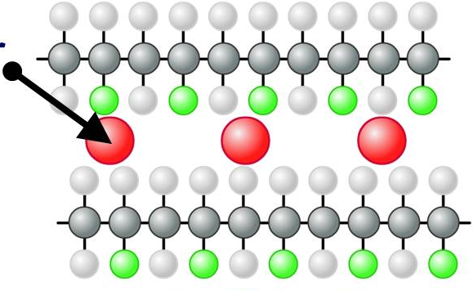
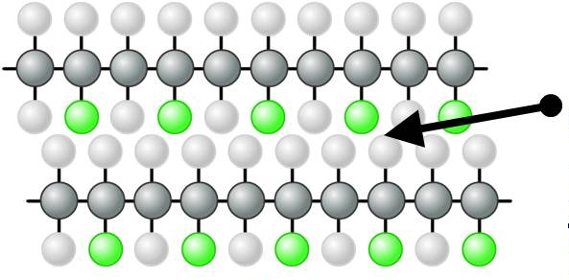
Plasticizers
The flexibility of a polymer can be changed by adding a plasticizer. A plasticizer is a molecule that fits between the chains and pushes them apart.
plasticizer
chains packed tightly together
plasticized
unplasticized
The increased distance between the polymer chains reduces the strength of the intermolecular forces, and allows the chains to slide over each other.
This makes the plasticized polymer softer and more flexible.

Slide 17
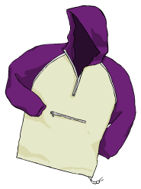
uPVC and PVC
uPVC stands for unplasticized polyvinyl chloride.
It is an unplasticized polymer, so it is rigid.
uPVC is also strong, light and durable, so it is a good material for making window frames.
PVC stands for polyvinyl chloride.
The polymer chains are the same as in uPVC, but with plasticizers added between the chains.
PVC is flexible, so it can be used for making clothing and electrical cable insulation.

Slide 18
Changing the properties of plastics
Notes:
Teacher notes
PVC stands for polyvinyl chloride.
Vulcanization is the process where sulfur chains form cross-links between the polymer chains in rubber.
Before vulcanization, rubber is soft, sticky and has very few uses.
After vulcanization, rubber is tougher, more elastic, and has a wide range of uses, including tyres and elastic bands.

Slide 19
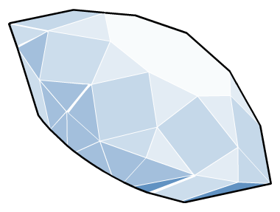
What are giant covalent structures?
In some substances, such as diamond, graphite and sand, millions of atoms are joined together by covalent bonds.
The bonds in these substances do not form molecules, but vast networks of atoms called giant covalent structures.
All the bonds in these structures are covalent. As a result, giant covalent structures have very high melting and boiling points, and are usually hard.
Notes:
This slide covers the Science and Engineering Practice:
Constructing Explanations and Designing Solutions: Apply scientific ideas, principles, and/or evidence to provide an explanation of phenomena and solve design problems, taking into account possible unanticipated effects.

Slide 20
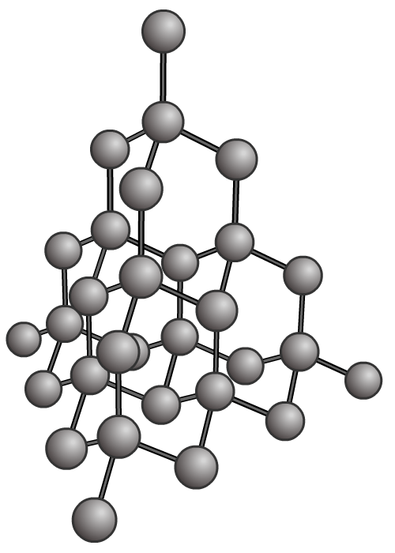
What is the structure of diamond?
Diamond is a giant covalent structure made of carbon atoms.
Each carbon atom is joined to four more carbon atoms by covalent bonds.
C
C
C
C
C
In diamond, all the electrons in the outer shell of each carbon atom are involved in forming covalent bonds.
Notes:
Teacher notes
For more information about diamond and graphite, please refer to the Giant Covalent Structures presentation.

Slide 21
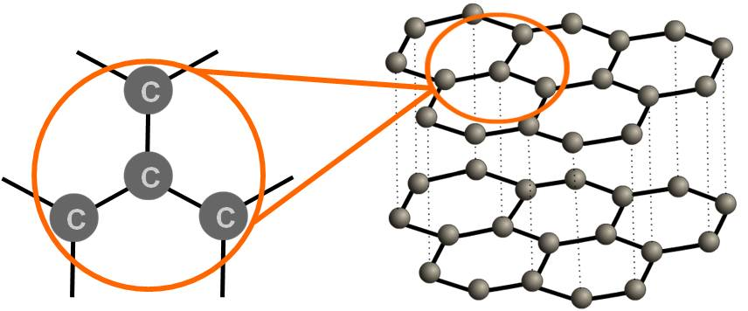
What is the structure of graphite?
Graphite is also a giant covalent structure made of carbon atoms. However, it has a different structure than diamond.
Graphite is made of layers of carbon atoms. Each carbon atom is joined to three more carbon atoms by covalent bonds.
In graphite, only three of the four electrons in the outer shell of each carbon atom are involved in covalent bonds.
The fourth electron becomes delocalized, and can move between the layers.
Notes:
Teacher notes
Each carbon atom forms three covalent bonds to other carbon atoms within the layer.
Three of its outer shell electrons are involved in this bonding, and the fourth electron is “spare.”
The spare electron is delocalized, which means it is shared between the carbon atoms throughout the whole layer.
The delocalized electrons are free to move anywhere within the layer, and are no longer associated with any particular atom or pair of atoms.
The electrons do not move from one layer to another – the dotted lines in the diagram do not represent the movement of electrons, they are used to show the weak intermolecular forces between the layers.
For more information about diamond and graphite, please refer to the Giant Covalent Structures presentation.

Slide 22
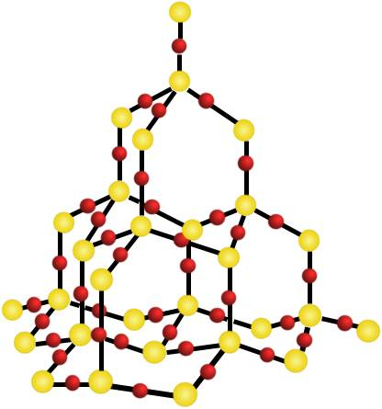
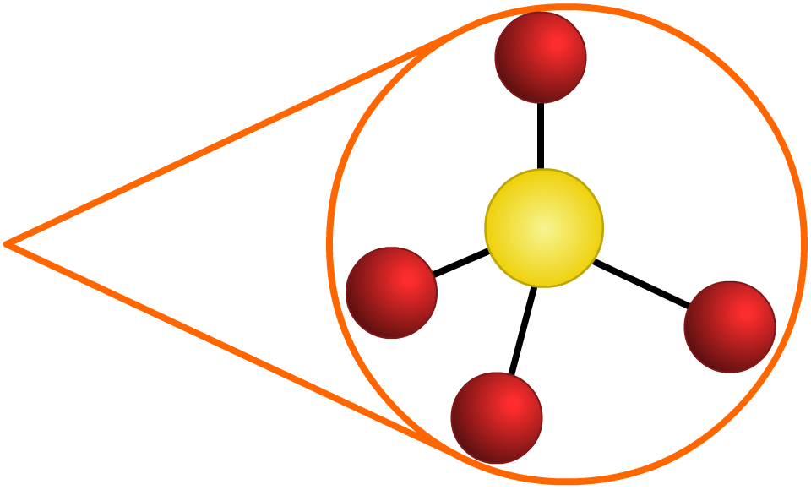
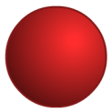
What is the structure of sand?
Sand is mostly composed of the mineral quartz. Quartz has a giant covalent structure made up of silicon and oxygen atoms.
Each silicon atom is bonded to four oxygen atoms.
Each oxygen atom is bonded to two silicon atoms.
O
Si
Si
O
O
O
Si
O
There are two oxygen atoms for each silicon atom, so the chemical formula is SiO₂ (silicon dioxide).

Slide 23
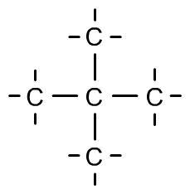
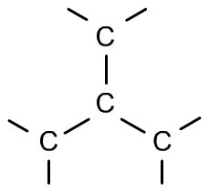
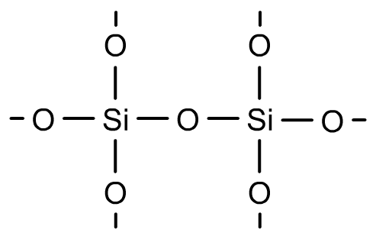
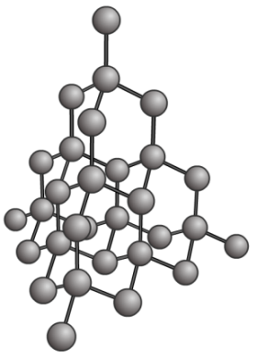
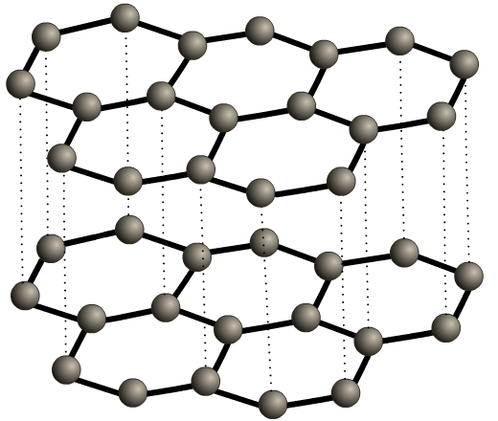
Drawing giant covalent structures
How can we draw giant covalent structures?
Diamond (C) | Graphite (C) | Silicon dioxide (SiO₂)
The 2D structural formula makes it easier to see which atoms are bonded together. The ball and stick model is better for showing the 3D arrangement of the structure.
Notes:
Teacher notes
For more information about structural formulae and ball and stick models, please refer to the Covalent Bonding presentation.

Slide 24
Properties of giant covalent structures
properties | diamond | graphite | silicon dioxide
melting and boiling points?
conduct electricity?
hard or soft?
flexible or brittle?
high
high
high
no
yes
no
hard
soft and slippery
hard
brittle
brittle
brittle
Most giant covalent structures are hard and brittle. They have high melting and boiling points, and do not conduct electricity.
Graphite is the only covalently bonded substance that can conduct electricity.

Slide 25
Simple or giant covalent structure?
Notes:
Teacher notes
This drag and drop activity could be used as a plenary exercise to check students’ ability to identify which structures are simple covalent and which are giant covalent. Class voting or the use of colored traffic light cards could be make this a whole-class exercise.

