Slide 1
Density and Changes of State

Slide 2
Information
Developing and Using Models
Planning and Carrying Out Investigations
Using Mathematics and Computational Thinking
Constructing Explanations and Designing Solutions
1. Patterns
3. Scale, Proportion, and Quantity
4. Systems and System Models
5. Energy and Matter

Slide 3
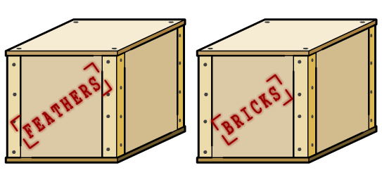
Size isn’t everything
Which is heavier, a ton of bricks or a ton of feathers?
They weigh the same! But what about a liter of feathers and a liter of bricks?
For the same volume, different materials can have very different masses.
This is because different materials have different densities.

Slide 4
Defining density
Density tells us how much mass there is in a certain volume. It is a property of a material.
The relationship between density, volume and mass can be summed up in the following equation:
mass
m
density =
or
ρ =
volume
V
Density, ρ, is measured in kilograms per meter cubed (kg/m³).
Mass, m, is measured in kilograms (kg).
Volume, V, is measured in meters cubed (m³).
Density is the mass per unit volume of a material, or the number of kilograms (kg) contained in 1 m³ of the material.
Notes:
This slide covers the Science and Engineering Practices:
Developing and Using Models: Develop and/or use a model (including mathematical and computational) to generate data to support explanations, predict phenomena, analyze systems, and/or solve problems.
Using Mathematics and Computational Thinking: Use mathematical, computational, and/or algorithmic representations of phenomena or design solutions to describe and/or support claims and/or explanations.

Slide 5
Density as a property of a material
The density of a material does not change when we change the volume of an object.
For example we could take a 1 m³ block of material that weighs 1,000 kg. Its density is: 1,000 ÷ 1 = 1,000 kg/m³.
If we stick another identical block onto this, the volume is now doubled to 2 m³ but so is the mass. The density can be calculated again: 2,000 ÷ 2 = 1,000 kg/m³. It stays the same!
mass = 1,000 kg
volume = 1 m³
mass = 2,000 kg
volume = 2 m³
density = 1,000 kg/m³
density = 1,000 kg/m³
Notes:
This slide covers the Science and Engineering Practice:
Using Mathematics and Computational Thinking: Apply techniques of algebra and functions to represent and solve scientific and engineering problems.

Slide 6
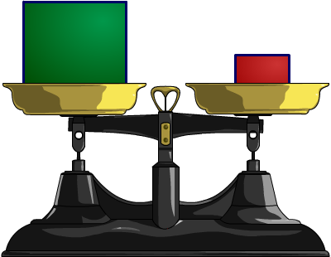
Comparing densities of materials
We can easily compare the density of different materials using a balance.
1,000 ml
We can see that the density of the red object is 10 times
that of the green.
100 g
100 ml
100 g
They have the same mass but it is contained in a much smaller volume for the red object.

Slide 7
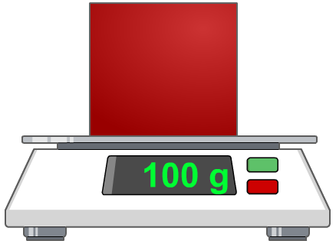
Measuring mass
In order to calculate the density of an object, the volume and mass of the object must first be measured.
Measuring mass is easy. We can use an electronic balance.

Slide 8
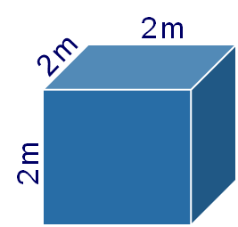
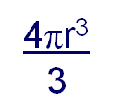
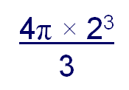
Measuring volumes
Measuring the volume of regular shapes can be done using mathematical formulae.
For example, for a cube we can simply multiply the lengths of the sides. For a sphere we can use a mathematical formula. The dimensions of an object can be measured using a ruler, a Vernier calliper or a micrometer, depending on the size.
r = 2 m
volume = 2 × 2 × 2 = 8 m³
volume =
=
= 33.5 m³
We can then divide the mass by the volume to find the density.
Notes:
This slide covers the Science and Engineering Practice:
Using Mathematics and Computational Thinking: Apply techniques of algebra and functions to represent and solve scientific and engineering problems.

Slide 9
Measuring irregular volumes
There is no mathematical formula to find the volume of irregular shapes. Instead a simple experiment can be used to determine the volume.
We can use the fact that, when an object is placed under water, it always displaces a volume of water equal to its own.
This means that if we can measure the volume of water displaced, we know the volume of the object as well.

Slide 10
The displacement method
Notes:
This slide covers the Science and Engineering Practices:
Planning and Carrying Out Investigations: Select appropriate tools to collect, record, analyze, and evaluate data.
Using Mathematics and Computational Thinking: Apply techniques of algebra and functions to represent and solve scientific and engineering problems.

Slide 11
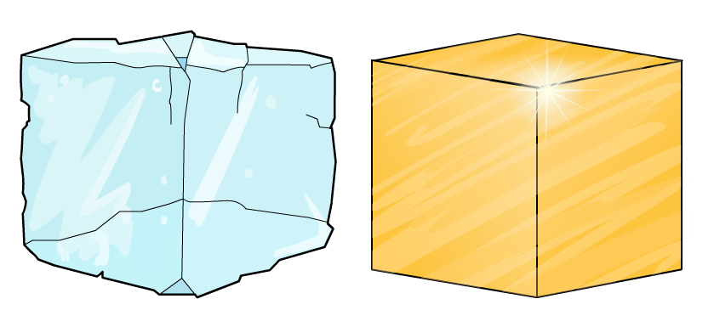
What affects density?
Density can be measured for any material, but what causes different materials to have different densities?
Why is 1 m³ of gold heavier than 1 m³ of water?
The difference is caused by the arrangement and mass of the particles that they are made of.

Slide 12
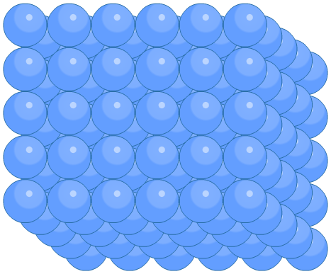
The particle model
All materials are made of particles. At the smallest level, these particles are atoms.
The properties of a material will be determined by these particles.
The type of particle, the way they are arranged and the strength of the bond between particles will all affect a material’s properties.

Slide 13
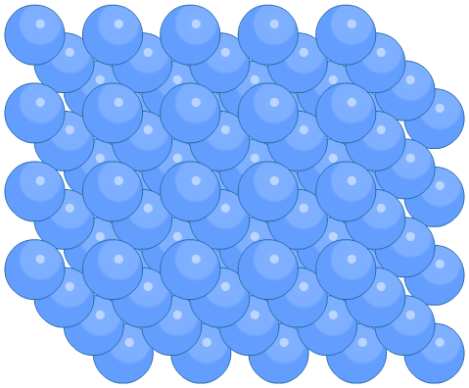
Density and the particle model
The density of a material depends on how close the particles in the material are to one another and the mass of the particles.
Particles could be heavy or light, compact or spaced apart.
The densest materials contain heavy particles that are packed tightly together.

Slide 14
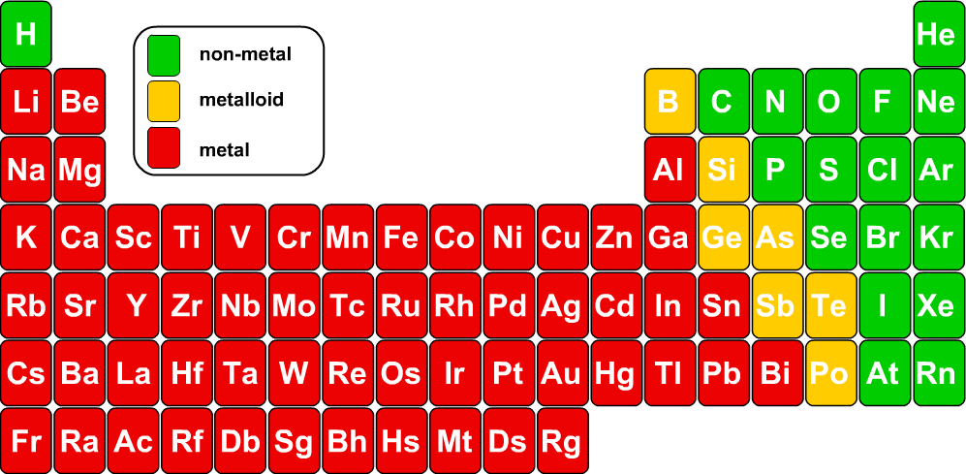
The mass of atoms
Each element on the periodic table has a mass number.
This is a relative measure of the mass of the different atoms.
density increases
The density of elements usually increases as you move down a group. This is not always the case though, as not all atoms are packed as tightly as they could be.

Slide 15
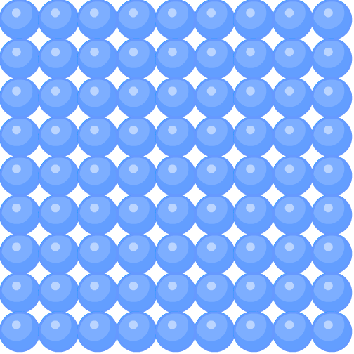
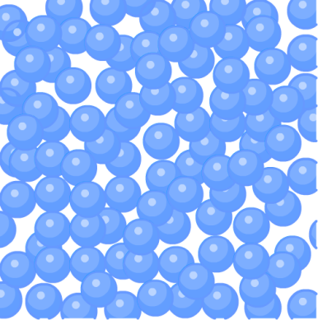
States of matter
The particle model can also be used to explain the properties of different states of matter.
solid
liquid
gas
The properties will depend on the arrangement and movement of particles.
The state of a substance depends on temperature, but different substances can have different states at the same temperature. For example, water is a liquid at room temperature, while iron is a solid.

Slide 16
Solids
In solids, particles are in a regular arrangement.
They are fixed in position and are touching. The particles vibrate but do not have enough energy to break the bonds holding them together.
Because of this, solids:
keep their shape
cannot be compressed.
solid
Notes:
This slide covers the Science and Engineering Practices:
Developing and Using Models: Use a model to provide mechanistic accounts of phenomena.
Constructing Explanations and Designing Solutions: Apply scientific ideas, principles, and/or evidence to provide an explanation of phenomena and solve design problems, taking into account possible unanticipated effects.

Slide 17
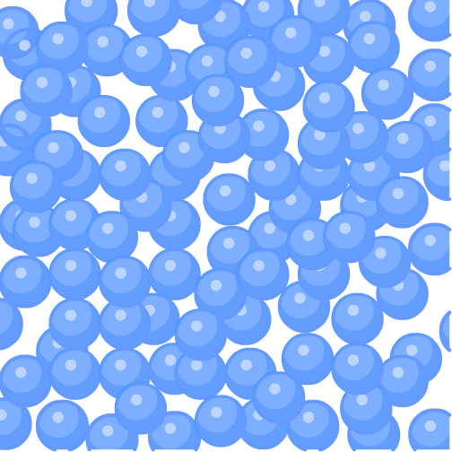
Liquids
In liquids, particles are not held in a fixed position.
They are still touching but move around randomly. They have enough energy to break the bonds that would hold them in a fixed position.
Because of this, liquids:
take the shape of their container
can be poured
cannot be compressed.
liquid
Notes:
This slide covers the Science and Engineering Practices:
Developing and Using Models: Use a model to provide mechanistic accounts of phenomena.
Constructing Explanations and Designing Solutions: Apply scientific ideas, principles, and/or evidence to provide an explanation of phenomena and solve design problems, taking into account possible unanticipated effects.

Slide 18
Gases
In gases, the particles have enough energy to break the bonds that would hold them together.
They move quickly and freely. There is a lot of space between the particles.
Because of this, gases:
spread out to fill a container
can be compressed.
gas
Notes:
This slide covers the Science and Engineering Practices:
Developing and Using Models: Use a model to provide mechanistic accounts of phenomena.
Constructing Explanations and Designing Solutions: Apply scientific ideas, principles, and/or evidence to provide an explanation of phenomena and solve design problems, taking into account possible unanticipated effects.

Slide 19
Density and the states of matter
The particle model can explain the differences in density between the states of matter.
solid
liquid
gas
In a solid, the particles are packed tightly together, so a substance is usually at its most dense when it is in its solid state. In gases, there is a lot of space between particles, so a substance is at its least dense when it is a gas.
Water is an unusual case. The particles in liquid water are closer together than the particles in solid ice, so water is at its most dense when it is a liquid.

Slide 20
Changing state
A substance can change state when it is heated or cooled.
melting
boiling
solid
liquid
gas
freezing
condensation
sublimation
Changing the state of a substance changes the arrangement and movement of the particles in the substance.

Slide 21
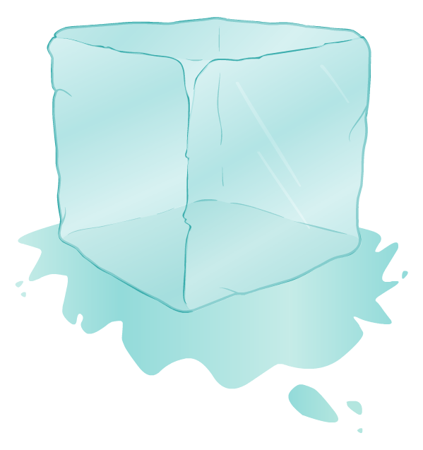
Changes of state
When a substance changes state, the arrangement and movement of the particles in the substance change, but the total number of particles does not change.
This means that the mass of a substance does not change when the substance changes state.
Changes of state are physical changes. Unlike chemical changes, they are reversible and the substance recovers its original properties when the change is reversed.

