Slide 1
Electronegativity

Slide 2
Information
Constructing Explanations and Designing Solutions
1. Patterns
2. Cause and Effect

Slide 3
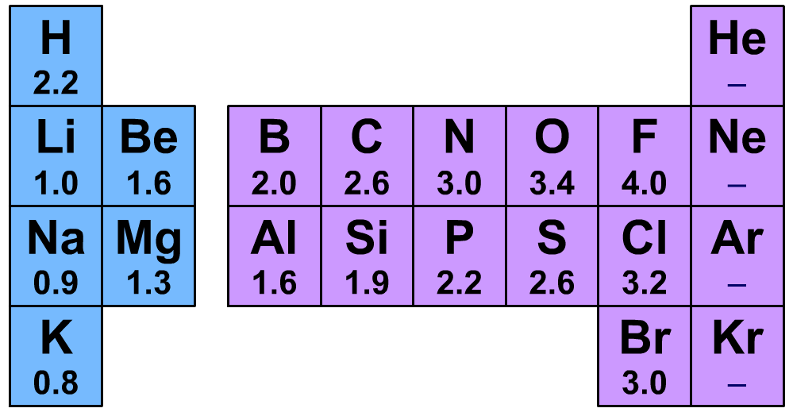
What is electronegativity?
In a covalent bond between two different elements, the electron density is not shared equally.
This is because different elements have differing abilities to attract the bonding electron pair. This ability is called an element’s electronegativity.
Electronegativity values for some common elements. Values given here are measured on the Pauling scale.
Notes:
Teacher notes
Elements in group 8 do not commonly form bonds, so electronegativity values have not been measured.
Electronegativity was first proposed in 1932 by the American chemist Linus Pauling (1904–1994). It is after him that the scale used here for measuring electronegativity is named. While the Pauling scale is the most common, there are other measures of electronegativity in use.

Slide 4
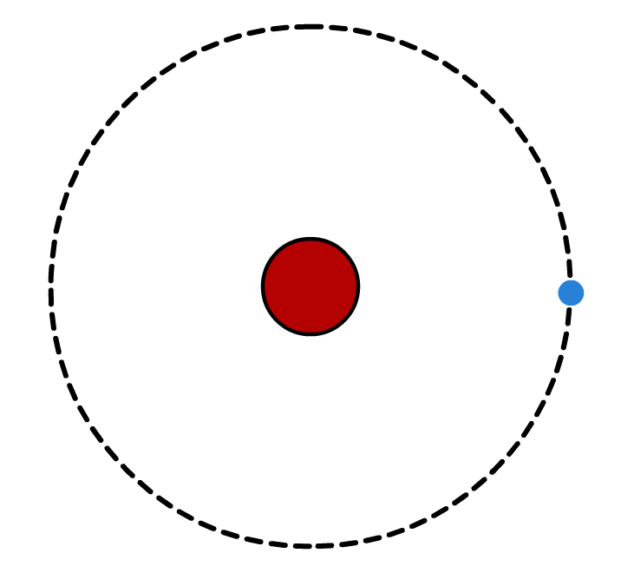
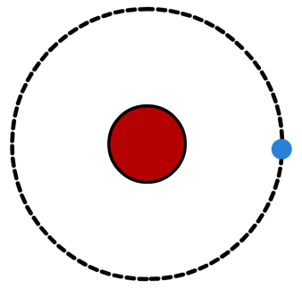
Electronegativity and atomic radius
The electronegativity of an element depends on a combination of two factors:
Atomic radius As the radius of an atom increases, the bonding pair of electrons become further from the nucleus. They are therefore less attracted to the positive charge of the nucleus, resulting in a lower electronegativity.
higher electronegativity
lower electronegativity
Notes:
Teacher notes
Note that the inner electron levels have not been included in the diagram.
This slide covers the Science and Engineering Practice:
Constructing Explanations and Designing Solutions: Apply scientific ideas, principles, and/or evidence to provide an explanation of phenomena and solve design problems, taking into account possible unanticipated effects.

Slide 5
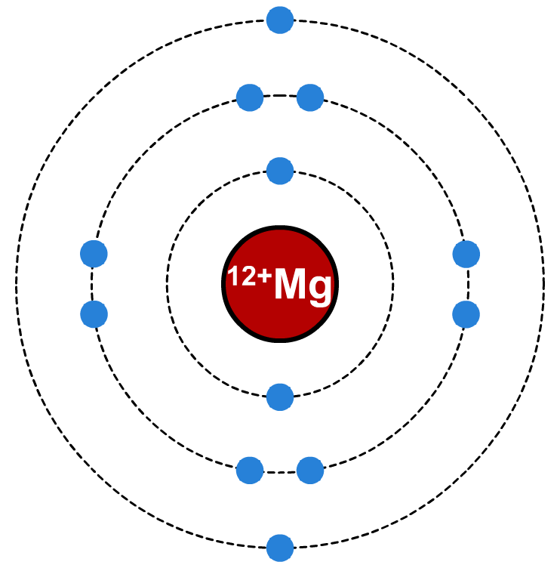
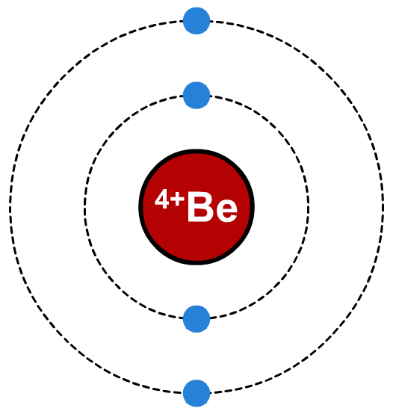
Electronegativity, protons and shielding
The number of unshielded protons
The greater the number of protons in a nucleus, the greater the attraction to the electrons in the covalent bond, resulting in higher electronegativity.
However, full energy levels of electrons shield the electrons in the bond from the increased attraction of the greater nuclear charge, thus reducing electronegativity.
greater nuclear charge increases electronegativity…
…but extra shell of electrons increases shielding.
Notes:
This slide covers the Science and Engineering Practice:
Constructing Explanations and Designing Solutions: Apply scientific ideas, principles, and/or evidence to provide an explanation of phenomena and solve design problems, taking into account possible unanticipated effects.

Slide 6
Electronegativity trends: across a period
Electronegativity increases across a period because:
​The atomic radius decreases.
​The charge on the nucleus increases without significant extra shielding. New electrons do not contribute much to shielding because they are added to the same principal energy level across the period.
Notes:
Teacher notes
Fluorine, with a Pauling electronegativity value of 4.0, has the highest electronegativity of all the elements.
This slide covers the Science and Engineering Practice:
Constructing Explanations and Designing Solutions: Apply scientific ideas, principles, and/or evidence to provide an explanation of phenomena and solve design problems, taking into account possible unanticipated effects.

Slide 7
Electronegativity trends: down a group
Electronegativity decreases down a group because:
​The atomic radius increases.
​Although the charge on the nucleus increases, shielding also increases significantly. This is because electrons added down the group fill new principal energy levels.
Notes:
This slide covers the Science and Engineering Practice:
Constructing Explanations and Designing Solutions: Apply scientific ideas, principles, and/or evidence to provide an explanation of phenomena and solve design problems, taking into account possible unanticipated effects.

Slide 8
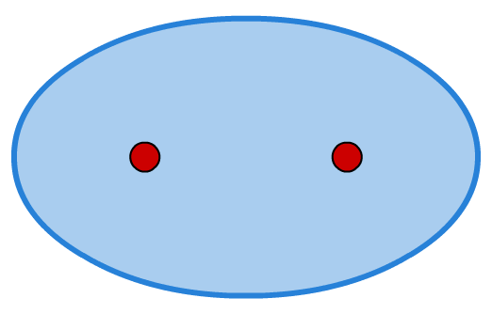
Non-polar bonds
If the electronegativity of both atoms in a covalent bond is identical, the electrons in the bond will be equally attracted to both of them.
cloud of electron density
This results in a symmetrical distribution of electron density around the two atoms.
Bonding in elements (e.g. O2 or Cl2) is always non-polar because the electronegativity of the atoms in each molecule is the same.
both atoms are equally good at attracting the electron density
Notes:
This slide covers the Science and Engineering Practice:
Constructing Explanations and Designing Solutions: Apply scientific ideas, principles, and/or evidence to provide an explanation of phenomena and solve design problems, taking into account possible unanticipated effects.

Slide 9
Polar bonds
Notes:
This slide covers the Science and Engineering Practice:
Constructing Explanations and Designing Solutions: Apply scientific ideas, principles, and/or evidence to provide an explanation of phenomena and solve design problems, taking into account possible unanticipated effects.

Slide 10
Effect of electronegativity on polarization
The greater the electronegativity difference between the two atoms in a bond, the greater the polarization of the bond.
This can be illustrated by looking at the hydrogen halides:
element
H
F
Cl
Br
I
Pauling elecronegativities
2.2
4.0
3.2
3.0
2.7
molecule
H–F
H–Cl
H–Br
H–I
electronegativity difference between atoms
1.8
1.0
0.8
0.5
decreasing polarization

Slide 11
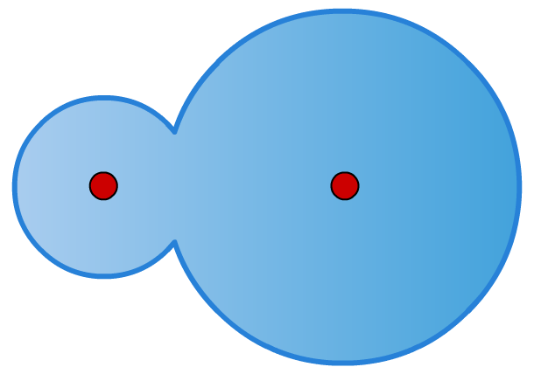
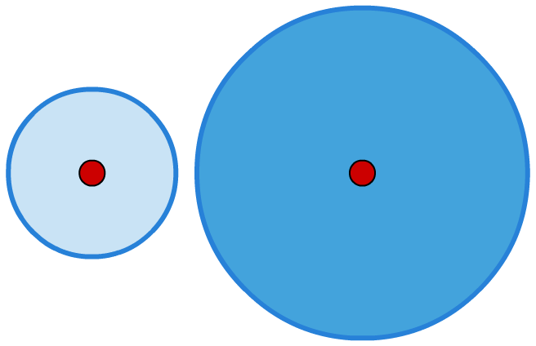
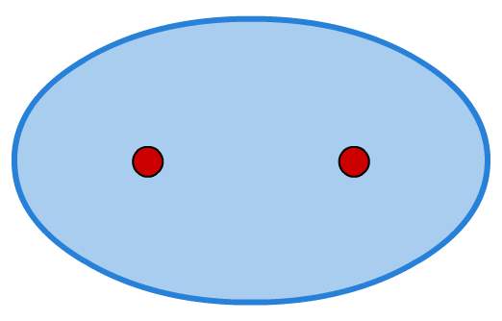
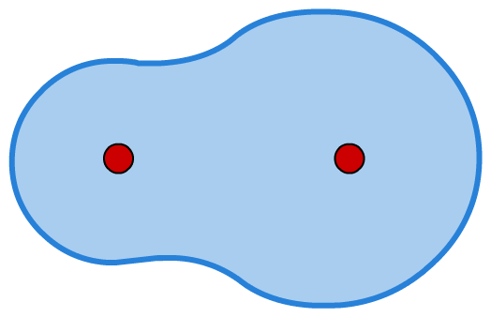
Ionic or covalent?
Rather than saying that ionic and covalent are two distinct types of bonding, it is more accurate to say that they are at the two extremes of a scale.
Less polar bonds have more covalent character.
More polar bonds have more ionic character. The more electronegative atom attracts the electrons in the bond enough to ionize the other atom.
increasing polarization

Slide 12
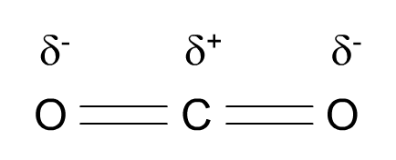
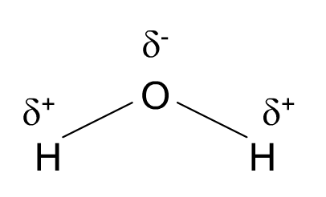
Polar molecules
Molecules containing polar bonds are not always polar.
Non-polar molecules
Polar molecules
If the polar bonds are arranged symmetrically, the partial charges cancel out and the molecule is non-polar.
If the polar bonds are arranged asymmetrically, the partial charges do not cancel out and the molecule is polar.

Slide 13
Identifying polar molecules

