Slide 1
Elements and The Periodic Table

Slide 2
Information
Asking Questions and Defining Problems
Developing and Using Models
Planning and Carrying Out Investigations
1. Patterns
4. Systems and System Models
5. Energy and Matter
7. Stability and Change

Slide 3
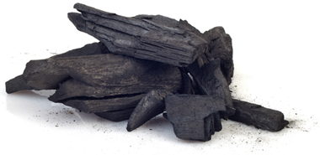
How many elements are there?
There are currently 117 elements that have been discovered, 94 of which are naturally occurring. The remaining 23 elements only exist under laboratory conditions.
Each element is made up of very tiny particles called atoms. Each element is made up of just one particular type of atom, which is different to the atoms in any other element.
How many elements can you name?
Gold is an element made up only of gold atoms.
Carbon is an element made up only of carbon atoms.

Slide 4
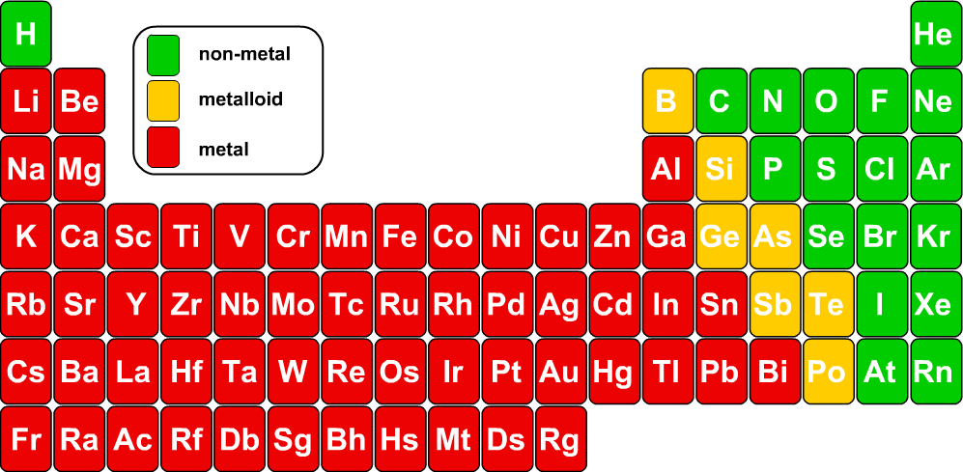
The periodic table
All known elements are shown in the periodic table.
Can you spot any patterns in how the elements are arranged in the periodic table?
Notes:
This presentation is accompanied by the worksheet Elements and The Periodic Table.
This slide covers the Science and Engineering Practice:
Asking Questions and Defining Problems: Ask questions that arise from examining models or a theory, to clarify and/or seek additional information and relationships.

Slide 5
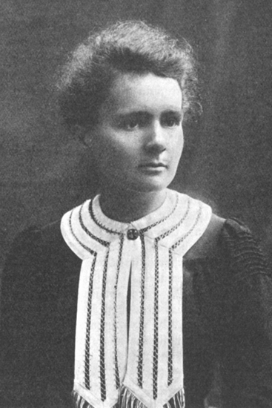
Who discovered the elements?
Some elements, such as silver and gold, have been known about for a very long time. However, many of the elements were only discovered more recently.
British scientist Joseph Priestley discovered oxygen when he experimented with heating gases.
Humphrey Davy used electrolysis to isolate elements such as sodium and potassium for the first time.
Marie Curie discovered radioactive elements like polonium and radium.
What were these elements named after?
Notes:
Teacher notes
Polonium was named after Poland, where Marie Curie was born. Radium was named after the Latin word for “ray” because it is highly radioactive.
Photo credit: Marie Curie © Jupiterimages Corporation 2018

Slide 6
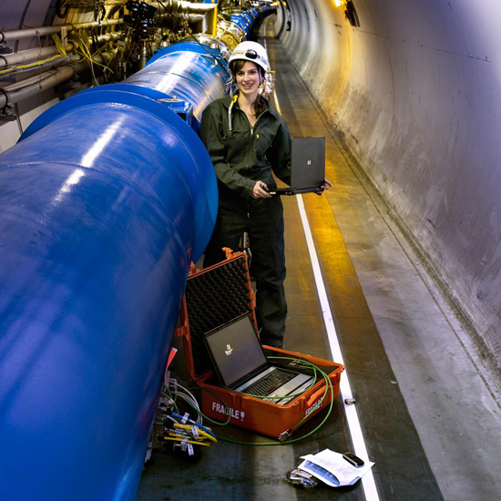
How are artificial elements made?
The first element to be artificially created was technetium, which was discovered in 1937 by Italian scientists working with the naturally-occurring element molybdenum.
Since then, other artificial elements have been made in particle accelerators. CERN is one of the world’s largest particle accelerators. It is underground, below the French-Swiss border, and is run by scientists from all over Europe.
Most artificial elements are very unstable and usually only exist for milliseconds before they break apart.
Notes:
Teacher notes
The name technetium comes from the Greek word for artificial. Students who are interested in CERN can learn more on their website: http://home.web.cern.ch/students-educators
This weblink was working at the time of publication. Boardworks is not responsible for the content of external sites.
Photo credit: © CERN
Image shows an engineer checking the electronics of the cryogenic instrumentation under a dipole magnet.

Slide 7
Symbols for elements
Each element can be represented by a symbol. For many elements, the symbol is the start of the name, for example H = hydrogen or Li = lithium.
Can you think of any other symbols like this?
Some of the symbols are not as obvious: Pb = lead.
Can you think of other elements with unexpected symbols?
The first letter of an element’s symbol is always a capital letter, e.g. N (not n) for nitrogen.
If there are two letters in the element’s symbol, the second letter is always a small letter, e.g. Co (not CO) for cobalt.

Slide 8
Chemical symbols game

Slide 9
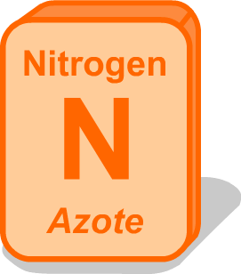
Why are symbols important?
Why might scientists find it easier to use symbols for elements rather than names?
Elements have different names in different languages, e.g. in Portuguese, nitrogen is called “azote,” and iron is called “ferro.”
Symbols are quicker to write than names, and can be easily used in chemical formulae, diagrams and equations.
The current system for naming elements and compounds was devised by the International Union of Pure and Applied Chemistry (IUPAC) so that scientists all around the world could communicate without confusion.
Notes:
Teacher notes
Compounds also have different names in different languages. This is why it is so important to have standard symbols for elements and compounds.
This slide covers the Science and Engineering Practice:
Asking Questions and Defining Problems: Ask questions that arise from examining models or a theory, to clarify and/or seek additional information and relationships.

Slide 10
Who invented the periodic table?
Notes:
This slide covers the Science and Engineering Practice:
Developing and Using Models: Develop, revise, and/or use a model based on evidence to illustrate and/or predict the relationships between systems or between components of a system.

Slide 11
Mendeleev and the periodic table
Notes:
This slide covers the Science and Engineering Practice:
Developing and Using Models: Develop, revise, and/or use a model based on evidence to illustrate and/or predict the relationships between systems or between components of a system.

Slide 12
How are the elements arranged?
Notes:
Teacher notes
This five-stage sequence shows how the elements are arranged in the periodic table.
Pupils could try to arrange the elements themselves before the whole sequence is shown. They could do this by writing out the elements in a line as in the first stage and then cutting them up and arranging them however they think is appropriate, before being shown the rest of the sequence.
Appropriate prompts, if carrying out this exercise, would be:
Where are elements with similar properties found?
Where are the unreactive gases found?
Where are the reactive gases found?
Where are the reactive metals found?
Think about how the elements might be best arranged, with these similar properties in mind.
This slide covers the Science and Engineering Practice:
Developing and Using Models: Develop, revise, and/or use a model based on evidence to illustrate and/or predict the relationships between systems or between components of a system.

Slide 13
Arranging the periodic table
Arranging all the elements by their atomic number and their properties led to the creation of the periodic table.

Slide 14
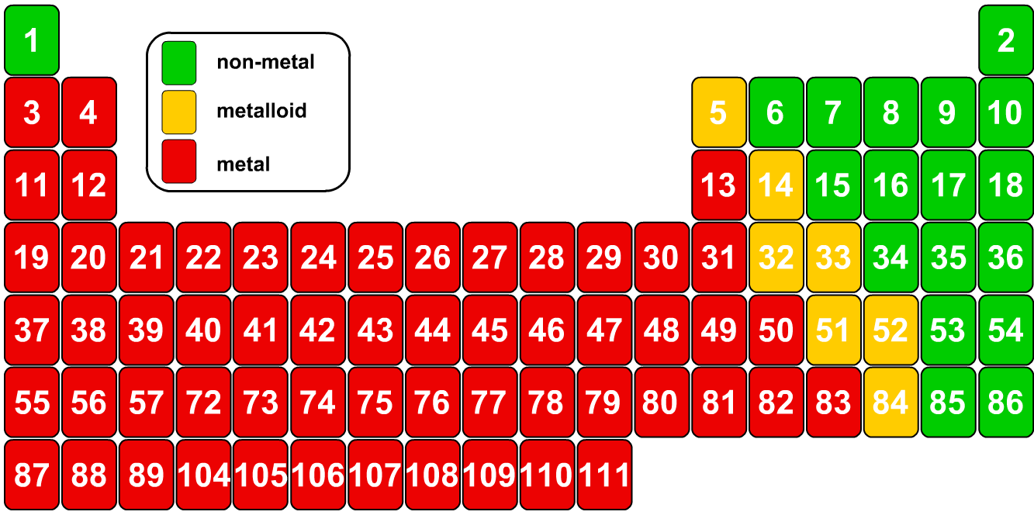
Missing elements!
In this periodic table, the symbols are replaced by atomic numbers. Some numbers are missing – where are they?
Two more rows of elements fit here. They are called the lanthanides and actinides.
Notes:
Teacher notes
Lanthanides and actinides do not have the same pattern of repeated properties like the other elements, so they are usually written separately.
It also keeps the periodic table to a sensible width, which fits easily on wall charts and in books.
This slide covers the Science and Engineering Practice:
Asking Questions and Defining Problems: Ask questions that arise from examining models or a theory, to clarify and/or seek additional information and relationships.

Slide 15
Metals, non-metals and metalloids 1
Metals are on the left and in the centre of the periodic table.
Non-metals are located mostly on the right.
Metalloids are located between metals and non-metals in the periodic table. Metalloids sometimes behave like metals and sometimes like non-metals.
Notes:
Teacher notes
For more information about metals and non-metals, please refer to the Metals and Non-Metals presentation.

Slide 16
Metals, non-metals and metalloids 2

Slide 17
Columns of elements
What are the columns of elements called?
1
2
groups
3
4
5
6
7
0

Slide 18
Rows of elements
What are the rows of elements called?
periods
1
2
3
4
5
6
7

Slide 19
Names of groups in the periodic table

Slide 20
Electrons and groups
Elements in the same group in the periodic table have very similar properties.
helium
This is because elements in a group have the same number of electrons in their outer shell and so react in a similar manner.
neon
argon
Elements in Group 0 (at the far right of the periodic table) are called the noble gases.
krypton
xenon
These elements are very unreactive, or stable, because they have full outer electron shells.
radon
Group 0
noble gases
Notes:
This slide covers the Science and Engineering Practice:
Developing and Using Models: Develop, revise, and/or use a model based on evidence to illustrate and/or predict the relationships between systems or between components of a system.

Slide 21
Electron trends in the periodic table
Trends down a group:
the number of outer shell electrons is the same
the number of complete electron shells increases by one.
The number of a group is the same as the number of electrons in the outer shell of elements in that group, except for group 0.
Trends across a period:
the number of outer shell electrons increases by one
the number of complete electron shells stays the same.
The point at which a new period starts is the point at which electrons begin to fill a new shell.
Notes:
This slide covers the Science and Engineering Practice:
Developing and Using Models: Develop, revise, and/or use a model based on evidence to illustrate and/or predict the relationships between systems or between components of a system.

Slide 22
Trends in groups of the Periodic Table

Slide 23
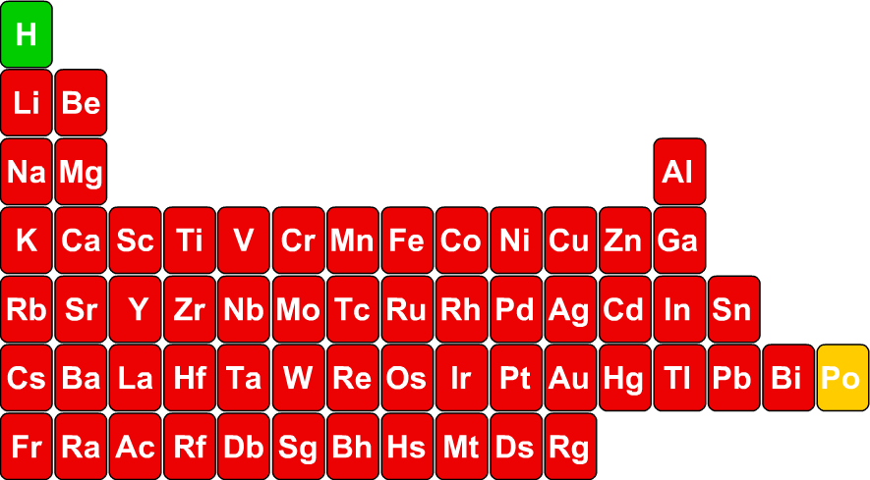
Patterns: the reactivity of metals
What happens to the reactivity of metals along a period?
What happens to the reactivity of metals down a group?
Which is the most reactive metal?
Notes:
This slide covers the Science and Engineering Practices:
Asking Questions and Defining Problems: Ask questions that arise from examining models or a theory, to clarify and/or seek additional information and relationships.
Developing and Using Models: Develop, revise, and/or use a model based on evidence to illustrate and/or predict the relationships between systems or between components of a system.

Slide 24
Which metal is more reactive?
Notes:
Teacher notes
This quiz could be used as a introductory or summary activity to check students’ understanding of the reactivity of the metals in the periodic table. Colored traffic light cards could be used with this activity to increase class participation.

Slide 25
Reacting with water
Notes:
Teacher notes
This virtual experiment illustrates how each of the alkali metals reacts with water. You may want to show the reaction for two or three of these metals and then ask students to predict the other reactions using what they have learned about the reactivity trends in the periodic table.
This slide covers the Science and Engineering Practice:
Planning and Carrying Out Investigations: Make directional hypotheses that specify what happens to a dependent variable when an independent variable is manipulated.

Slide 26
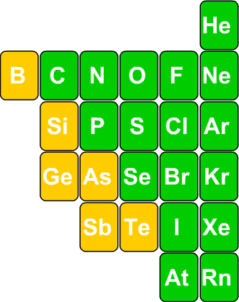
Patterns: the reactivity of non-metals
Group 0 elements (noble gases) are the most unreactive of all elements.
For the remaining non-metals, reactivity increases up a group and along a period from left to right.
Which is the most reactive non-metal?
very unreactive
Notes:
This slide covers the Science and Engineering Practice:
Developing and Using Models: Develop, revise, and/or use a model based on evidence to illustrate and/or predict the relationships between systems or between components of a system.

Slide 27
Which non-metal is more reactive?
Notes:
Teacher notes
This quiz could be used as a introductory or summary activity to check students’ understanding of the reactivity of non-metals in the periodic table. Colored traffic light cards could be used with this activity to increase class participation.

Slide 28
Halogen reaction with iron wool
Notes:
Teacher notes
This virtual experiment compares the reactivity of the halogens with iron wool. It could be used as a precursor to running the practical in the lab, or as a summary activity. When using this activity, it should be made clear that, with iodine, the reaction takes several minutes of strong heating before it reacts. This is illustrated by the stopwatch, but is not shown in real time.
This slide covers the Science and Engineering Practice:
Planning and Carrying Out Investigations: Make directional hypotheses that specify what happens to a dependent variable when an independent variable is manipulated.

Slide 29
Groups and periods

Slide 30
Electrons and groups

Slide 31
Complete the sentences
Notes:
Teacher notes
This completing sentences activity could be used as a introductory or summary activity on the periodic table.

