Slide 1
Exothermic and Endothermic Reactions

Slide 2
Information
Planning and Carrying Out Investigations
Analyzing and Interpreting Data
Constructing Explanations and Designing Solutions
1. Patterns
4. Systems and System Models
5. Energy and Matter

Slide 3
Energy conservation
Energy cannot be created or destroyed.
This means there is no change in the amount of energy in the universe at the end of a reaction. The energy is conserved.
During a chemical reaction, changes in energy can be observed in a system and its surroundings.
reactants
The energy can be converted into a different form, such as heat, which is released to the environment.
heat
The amount of energy released is equal to the difference in energy between the reactants and the products.
products

Slide 4
Exothermic and endothermic reactions
When chemical reactions occur, energy is transferred to or from the surroundings.
What are exothermic and endothermic reactions?
Exothermic reactions release energy – the temperature increases:
ex = out (as in “exit”)
thermic = relating to heat.
Endothermic reactions absorb energy – the temperature decreases:
en = in (as in “entrance”).
Most chemical reactions are exothermic.

Slide 5
Temperature change in reactions
Notes:
Teacher notes
Before viewing the animation, encourage students to come up with a hypothesis for what will happen when sodium hydroxide is added to hydrochloric acid. Ask students to share their hypotheses and their rational, then view the animation. After the animation, ask each student to evaluate their hypothesis.
This slide covers the Science and Engineering Practices:
Planning and Carrying Out Investigations: Make directional hypotheses that specify what happens to a dependent variable when an independent variable is manipulated.
Planning and Carrying Out Investigations: Select appropriate tools to collect, record, analyze, and evaluate data.
Analyzing and Interpreting Data: Analyze data using tools, technologies, and/or models (e.g., computational, mathematical) in order to make valid and reliable scientific claims or determine an optimal design solution.
Constructing Explanations and Designing Solutions: Make a quantitative and/or qualitative claim regarding the relationship between dependent and independent variables.

Slide 6
Energy level diagrams
Energy level diagrams (reaction profiles) are useful for analyzing chemical reactions. How to draw them:
1.
Draw and label the axes.
2.
Draw a line for the reactants starting at x = 0.
reactants
3.
Draw a line for the products at x > 0.
Compared to the reactants, the y-coordinate of the product line can be:
products
lower (exothermic reaction)
higher (endothermic reaction).
Notes:
Teacher notes
Make it clear to the students that this particular energy level diagram represents an exothermic reaction but the rules for drawing endothermic energy level diagrams are the same.
Ask the students why exothermic reactions have a products line that is lower on the y-axis than that of the reactants – it shows that the energy change of the reaction is negative as the reaction has released energy to its surroundings (as heat) i.e. it is exothermic.

Slide 7
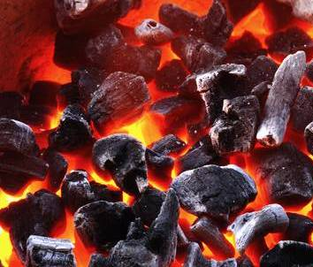
Exothermic reactions
Exothermic reactions release thermal energy (heat) into their surroundings. Exothermic reactions can occur spontaneously and some are explosive.
What are some examples of exothermic reactions?
Many oxidation reactions, including combustion.
Neutralization of acids with alkalis.
Reactions of metals with acids.
The Thermite process, used to weld steel.
Everyday uses such as self-heating cans and hand warmers.
Notes:
Teacher notes
The Thermite Process is a displacement reaction between aluminum and iron oxide. It is used in welding iron and steel.
Photo credit: © SOMMAI, Shutterstock.com 2018

Slide 8
Exothermic or endothermic? (1)
Notes:
This slide covers the Science and Engineering Practice:
Planning and Carrying Out Investigations: Select appropriate tools to collect, record, analyze, and evaluate data.

Slide 9
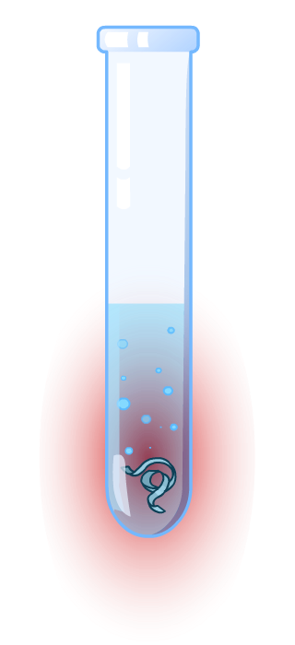
Exothermic reactions: energy transfer
What happens to the energy in the reaction between magnesium and hydrochloric acid?
No external heat source is used, so the heat released during the reaction must come from the reactants.
During the reaction, chemical energy in the reactants is converted to thermal energy (heat). This causes the temperature of the reaction mixture to rise.
This thermal energy is eventually lost to the surroundings and the temperature of the reaction mixture returns to normal.
Notes:
This slide covers the Science and Engineering Practice:
Constructing Explanations and Designing Solutions: Apply scientific ideas, principles, and/or evidence to provide an explanation of phenomena and solve design problems, taking into account possible unanticipated effects.

Slide 10
Exothermic reactions: energy levels

Slide 11
Choosing a fuel
The combustion of fuel is an exothermic reaction. It releases usable energy.
From the table, which fuel would you choose to run a car?
fuel
energy released (kJ/g)
petroleum
44.0
natural gas
52.0
ethanol
40.0
coal
27.0
Generally, the more energy released, the better the fuel.
Notes:
Teacher notes
Heat energy is often measured in joules (J), kilojoules (kJ) or kilojoules per gram (kJ/g).
1 kJ = 1,000 J

Slide 12
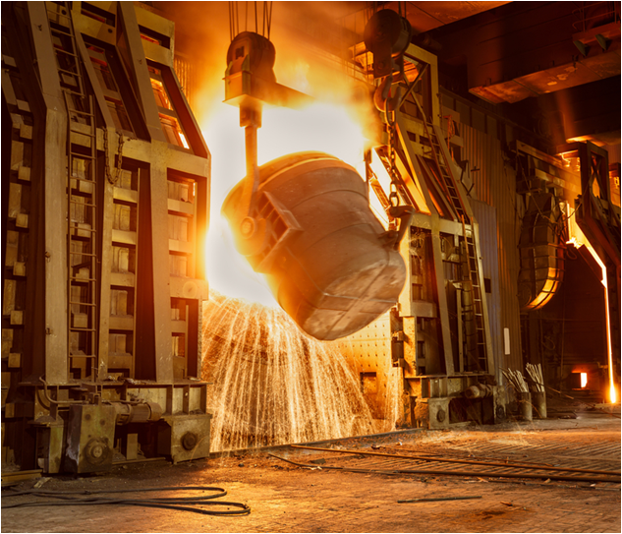
Controlling reactions
Why is it useful to know if a reaction is exothermic or endothermic?
Many industrial processes release heat. If uncontrolled, these highly exothermic reactions can lead to overheating and large explosions!
In order to allow the correct safety precautions to be put in place, manufacturers must know the total amount of energy released during a process.
Coolants and ventilation are often used to control reaction temperatures.
Notes:
Photo credit: © Zhao jian kang, Stutterstock.com 2018

Slide 13
Exothermic reactions: summary
Notes:
Teacher notes
This completing sentences activity could be used as an introductory or summary activity on exothermic reactions.

Slide 14
Endothermic reactions
Endothermic reactions absorb thermal energy. This means they cause a decrease in temperature.
What are some examples of endothermic reactions?
thermal decomposition, e.g. of calcium carbonate in a blast furnace
photosynthesis
the reaction of citric acid with sodium hydrogen carbonate (baking soda)
some sports injury packs
Notes:
Teacher notes
Endothermic reactions must absorb energy in order to proceed. This means they cannot occur spontaneously. Melting, boiling and evaporation are examples of endothermic changes of state, but not chemical reactions.

Slide 15
Exothermic or endothermic? (2)
Notes:
This slide covers the Science and Engineering Practice:
Planning and Carrying Out Investigations: Select appropriate tools to collect, record, analyze, and evaluate data.

Slide 16
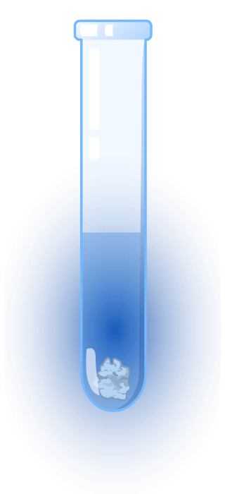
Endothermic reactions: energy transfer
What happens to the energy in the reaction between ammonium nitrate and water?
During the reaction, thermal energy from the reaction mixture is converted to chemical energy in the products.
This causes the temperature of the reaction mixture to fall.
Thermal energy from the surroundings is transferred to the reaction mixture, and the temperature eventually returns to normal.
Notes:
This slide covers the Science and Engineering Practice:
Constructing Explanations and Designing Solutions: Apply scientific ideas, principles, and/or evidence to provide an explanation of phenomena and solve design problems, taking into account possible unanticipated effects.

Slide 17
Endothermic reactions: energy levels

Slide 18
Endothermic reactions: summary
Notes:
Teacher notes
This completing sentences activity could be used as an introductory or summary activity on endothermic reactions.

Slide 19
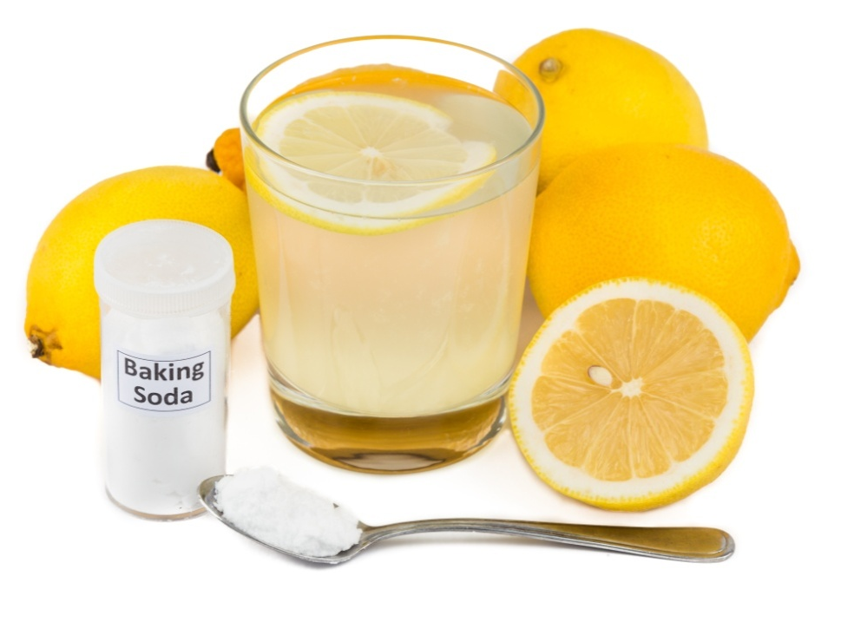
Cooling down
On a hot day, you can use endothermic reactions to help you cool down!
Add some baking soda (sodium hydrogen carbonate) to lemon juice, or other citric acid.
What do you think will happen?
The mixture will fizz and the temperature will decrease, giving you a refreshing drink without the need for ice!
Why does the temperature of the liquid decrease?
Notes:
Teacher notes
The temperature of the liquid decreases because the reaction taking place is endothermic.
Photo credit: © ThamKC, Stutterstock.com 2018

Slide 20
Energy transfer: true or false?
Notes:
Teacher notes
This true-or-false activity could be used as an introductory or summary activity on energy transfer, or at the start of the lesson to gauge students’ existing knowledge of the subject matter. Colored traffic light cards (red = false, yellow = don’t know, green = true) could be used to make this a whole-class exercise.

