Slide 1
Extracting Metals

Slide 2
Information
Developing and Using Models
Planning and Carrying Out Investigations
Constructing Explanations and Designing Solutions
Engaging in Argument from Evidence
2. Cause and Effect
5. Energy and Matter

Slide 3
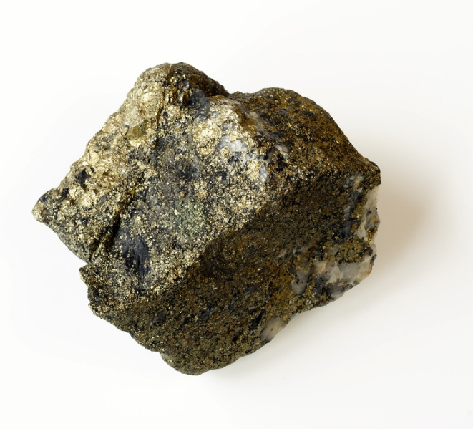
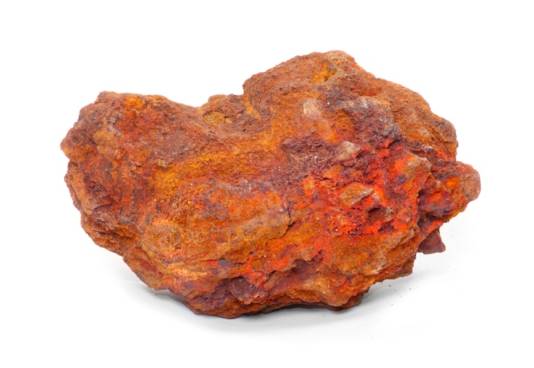
Where do metals come from?
Some unreactive metals, like gold, silver and copper, are found in the Earth’s crust as pure substances.
Native metals are metals found in a pure form.
Most metals are actually found combined with other elements as compounds in ores. These metals must be extracted from their ores before they can be made useful.
Highly reactive metals, such as titanium, require complicated extraction, which can increase the cost of the pure metal.
Notes:
Photo credit: gold © Elzbieta Sekowska and Iron ore © Kletr both at Shutterstock.com 2018

Slide 4
Methods of extracting metals
Metals that are found combined with other elements as compounds in ores must be extracted from their ores before they can be used.
There are two main methods of extracting metals from their ores:
electrolysis (using electricity)
reduction with carbon.
The method of extraction which is most appropriate depends on the reactivity of the metal being extracted.

Slide 5
The reactivity series and metal extraction
The reactivity of a metal determines how it is extracted.
potassium
increasing reactivity
sodium
Metals above carbon in the reactivity series must be extracted using electrolysis.
calcium
magnesium
aluminum
(carbon)
zinc
Metals less reactive than carbon can be extracted from their ores by reduction.
iron
lead
(hydrogen)
Copper, silver, gold and platinum can occur as native metals and do not need to be extracted. Sometimes copper needs to be extracted from an ore.
copper
silver
gold
platinum
Notes:
Teacher notes
It should be highlighted to students that, although carbon and hydrogen are not metals, they are included in the reactivity series. This is because the reactivity of metals in some reactions can be predicted by comparison with carbon and hydrogen:
Metals less reactive than carbon can be extracted by reduction
Metals less reactive than hydrogen will not react with acids.
This slide is accompanied by the worksheet Extracting Metals.
This slide covers the Science and Engineering Practice:
Developing and Using Models: Develop, revise, and/or use a model based on evidence to illustrate and/or predict the relationships between systems or between components of a system.

Slide 6
Reacting metals with acid
Notes:
Teacher notes
Copper, silver and gold are below hydrogen in the reactivity series. This means they are very unreactive, and so will not react with acids.
Lead is unreactive and will only very slowly react with cold acid. In fact, the reaction is so slow that it appears no reaction is occurring at all. Heating the acid increases the rate of the reaction between the lead and the acid.
This slide covers the Science and Engineering Practice:
Planning and Carrying Out Investigations: Plan an investigation or test a design individually and collaboratively to produce data to serve as the basis for evidence as part of building and revising models, supporting explanations for phenomena, or testing solutions to problems. Consider possible variables or effects and evaluate the confounding investigation’s design to ensure variables are controlled.

Slide 7
Displacement reactions
Notes:
This slide covers the Science and Engineering Practice:
Planning and Carrying Out Investigations: Plan an investigation or test a design individually and collaboratively to produce data to serve as the basis for evidence as part of building and revising models, supporting explanations for phenomena, or testing solutions to problems. Consider possible variables or effects and evaluate the confounding investigation’s design to ensure variables are controlled.

Slide 8
Reduction of metal oxides
Metals are often found combined with oxygen as oxides. To obtain the metal, the oxygen must be removed.
During reduction, either oxygen is removed from a substance or electrons are gained by a substance.
During oxidation, either oxygen is added to a substance, or electrons are removed from a substance.
Reduction of the metal oxide is used to extract the metal:

Slide 9
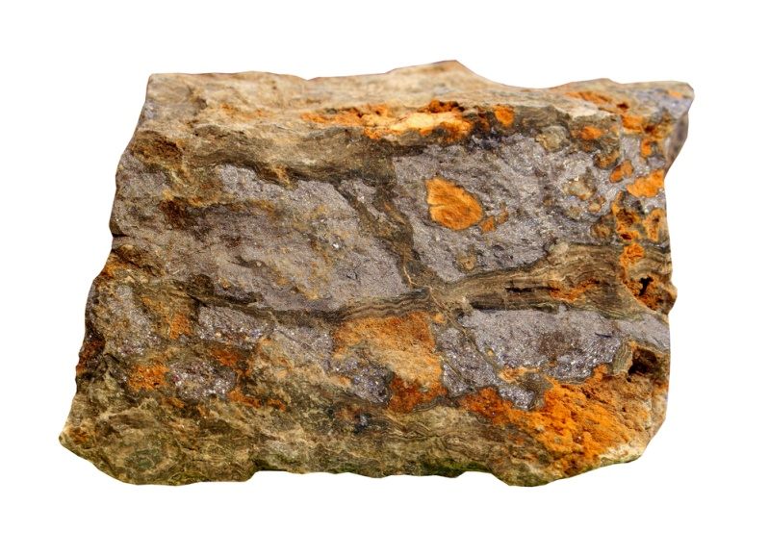
Extracting metals using carbon
Carbon can be used to extract some metals from their metal oxides by reduction.
For example, the extraction of lead from lead oxide:
This is a displacement reaction, and occurs because carbon is more reactive than lead.
In this reaction, the lead oxide is reduced in this reaction while the carbon is oxidized.
Notes:
Teacher notes
This reaction may be known as a “redox” reaction as both reduction and oxidation are taking place. The lead oxide loses oxygen to form lead, and is therefore reduced; the carbon gains oxygen to form carbon monoxide and is therefore oxidized. Students may need to be reminded that only metals that are less reactive than carbon (i.e. below carbon in the reactivity series) can be extracted by reduction.
Photo credit: © Zelenskaya, Shutterstock.com 2018

Slide 10
Metal oxides and carbon
Notes:
Teacher notes
This virtual experiment illustrates how metal oxides behave when heated with carbon powder. It could be used as a precursor to running the practical in the lab, or as a summary exercise. When using this experiment, it should be made clear that, although carbon is used to extract iron from iron ore, extremely high temperatures are required.
This slide covers the Science and Engineering Practice:
Planning and Carrying Out Investigations: Plan an investigation or test a design individually and collaboratively to produce data to serve as the basis for evidence as part of building and revising models, supporting explanations for phenomena, or testing solutions to problems. Consider possible variables or effects and evaluate the confounding investigation’s design to ensure variables are controlled.

Slide 11
Extraction of zinc by reduction
Zinc oxide, ZnO, reacts with carbon at very high temperatures to form molten zinc and carbon monoxide.
This is also a displacement reaction, and occurs because carbon is more reactive than zinc.
reduction
ZnO(s) + C(s)
Zn(l) + CO(g)
The more reactive carbon displaces the zinc atom, causing the zinc–oxygen bond to break while a new carbon–oxygen bond forms.
In this reaction, what is oxidized and what is reduced?
Notes:
Teacher notes
The carbon atom gains oxygen and is therefore oxidized, while zinc oxide loses oxygen and is therefore reduced.

Slide 12
Reducing metals with carbon activity
Notes:
Teacher notes
This drag and drop activity provides the opportunity for informal assessment of students’ understanding of reduction using carbon. Students may need to be reminded of the order of the reactivity series before completing this activity. Students may need to be reminded that only metals that are less reactive than carbon (i.e. below carbon in the reactivity series) can be extracted by reduction.

Slide 13
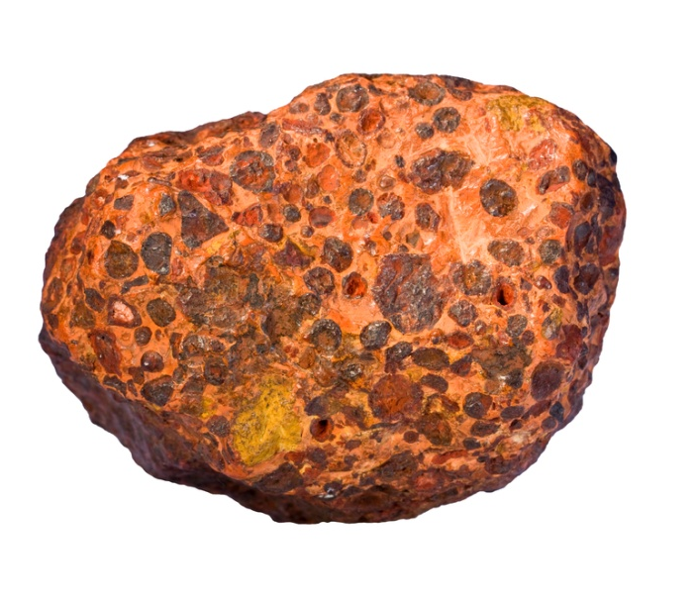
What is electrolysis?
Electrolysis is a process that uses electricity to separate the elements in a compound. Electrolysis is expensive and so it is only used to extract reactive metals that cannot be extracted in other ways.
Aluminum is a reactive metal that is found in the ore bauxite as aluminum oxide (Al₂O₃).
Electrolysis breaks down the Al₂O₃ into aluminum and oxygen. As the aluminum loses oxygen, reduction takes place.
What is the word equation for the extraction of aluminum?
aluminum oxide
aluminum
+
oxygen
Notes:
Teacher notes
For more information about electrolysis, please refer to the Electrolysis presentation.
Photo credit: bauxite © www.sandatlas.org, Shutterstock.com 2018

Slide 14
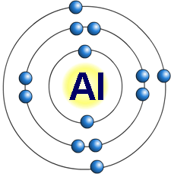
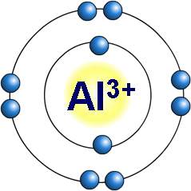
Ionic substances
Electrolysis involves breaking down ionic compounds into simpler substances using electricity.
An ionic substance contains charged particles called ions. An ion is an atom that has gained or lost electrons and so carries a positive or negative charge.
aluminum atom
loses 3 electrons
Ions with a positive charge, such as metal ions, have lost electrons. Ions with a negative charge have gained electrons.
aluminum ion
In electrolysis, the ionic substance must be dissolved in water or melted so that the ions are free to move.
Notes:
Teacher notes
An atom that loses electrons has more protons than electrons and so has a positive overall charge. This is called a positive ion. Metal atoms, such as sodium, magnesium and iron, form positive ions.
An atom that gains electrons has more electrons than protons and so has a negative overall charge. This is called a negative ion. Non-metal atoms, such as chlorine, oxygen and nitrogen, form negative ions.
This slide covers the Science and Engineering Practice:
Constructing Explanations and Designing Solutions: Apply scientific ideas, principles, and/or evidence to provide an explanation of phenomena and solve design problems, taking into account possible unanticipated effects.

Slide 15
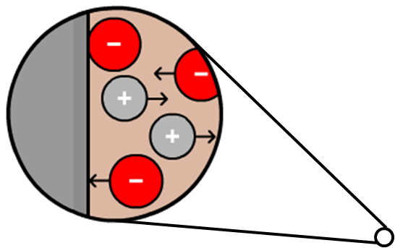
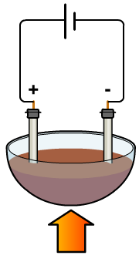
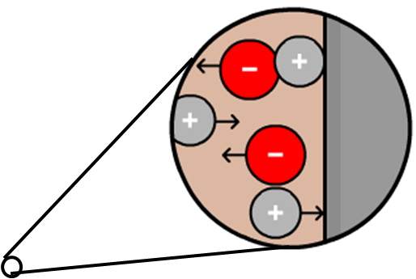
Oxidation and reduction
In electrolysis, electrodes are used to pass a current through a substance. The substance that the current passes through and splits up is called the electrolyte.
The electrolyte contains positive and negative ions.
What happens to these ions during electrolysis?
Negative ions move
to the positive electrode and lose electrons.
This is oxidation.
Positive ions move
to the negative electrode and gain electrons.
This is reduction.
heat
Notes:
Teacher notes
Opposite charges attract. This means that the negative ion is attracted to the positive electrode, and the positive ion is attracted to the negative electrode.
For more information on the role of electrodes and the movement of ions during electrolysis, please refer to the Electrolysis presentation.
This slide covers the Science and Engineering Practice:
Constructing Explanations and Designing Solutions: Apply scientific ideas, principles, and/or evidence to provide an explanation of phenomena and solve design problems, taking into account possible unanticipated effects.

Slide 16
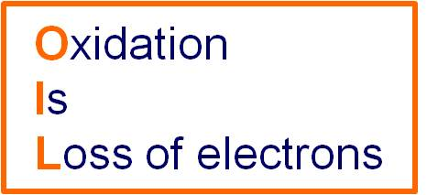
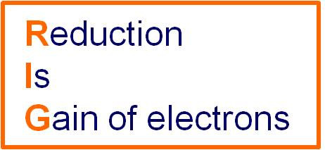
OILRIG
An easy way to remember what happens to the electrons during oxidation and reduction is to think OILRIG.
Equations written to show what happens to electrons during oxidation and reduction are called half-equations:
aluminum oxide
aluminum
+
oxygen
2Al₂O₃ (l)
4Al (l)
+
3O₂ (g)
Oxidation:
Reduction:
2O^{2–} O₂ + 4e–
Al³⁺ + 3e– Al

Slide 17
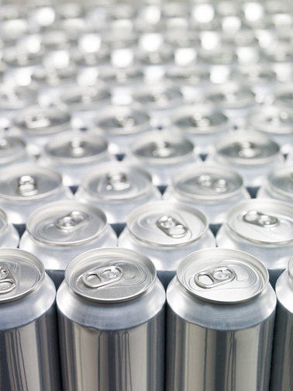
Extracting aluminum
Electrolysis is used to extract aluminum from its ore.
Why is it not possible to extract aluminum by heating its ore with carbon?
Aluminum is more reactive than carbon and its ore has a very high melting point (2,050 °C). This means aluminum cannot be extracted by reduction with carbon.
In electrolysis, the ore is dissolved in a compound called cryolite (Na₃AlF₆), which lowers the melting point to 1,000 °C.
Notes:
Teacher notes
It is not possible to extract aluminum by heating its ore with carbon because aluminum is more reactive than carbon, as can be seen in the reactivity series. The ore of aluminum is largely made up of aluminum oxide, which has a very high melting point. This makes heating it with carbon not practical.
Photo credit: © Gemenacom, Shutterstock.com 2018

Slide 18
Extracting aluminum from bauxite
Notes:
Teacher notes
This virtual experiment illustrates how aluminum can be extracted from its ore using electrolysis. Students may need to be reminded of how ions are formed before viewing this animation.
Aluminum oxide from the ore bauxite is mixed with cryolite. This decreases the melting point of the ore.
Graphite electrodes are made up of carbon. The oxygen reacts with the carbon in the electrodes, forming carbon dioxide.
This slide covers the Science and Engineering Practice:
Constructing Explanations and Designing Solutions: Apply scientific ideas, principles, and/or evidence to provide an explanation of phenomena and solve design problems, taking into account possible unanticipated effects.

Slide 19
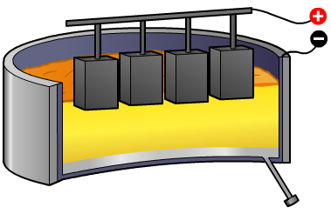
Redox equations – aluminum
What processes occur at the electrodes during the electrolysis of aluminum oxide (Al₂O₃)?
At the negative electrode:
Al³⁺ + 3e– Al (reduction)
At the positive electrode:
2O^{2–} O₂ + 4e– (oxidation)
What is the overall equation for this extraction by electrolysis?
aluminum oxide aluminum + oxygen
2 Al₂O₃ (l) 4 Al (l) + 3 O₂ (g)
Notes:
Teacher notes
This reaction may be known as a “redox” reaction as both reduction and oxidation are taking place.

Slide 20
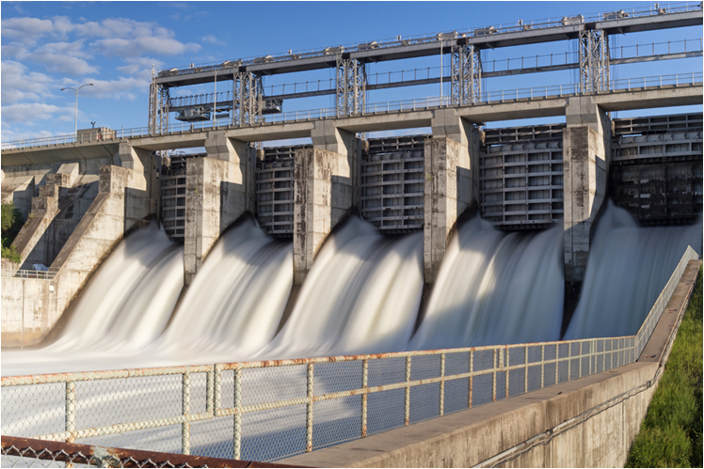
The economics of electrolysis
Extracting aluminum from its ore using electrolysis requires large amounts of electrical energy. This is very expensive.
The energy is needed to melt the aluminum oxide in the ore and to extract the aluminum by electrolysis.
To reduce energy use, aluminum extraction plants are often located near sources of renewable electricity, such as hydroelectric dams.
Notes:
Teacher notes
Hydroelectric dams generate renewable electricity using flowing water to move turbines. This causes magnets to rotate, which generates electricity. This is a renewable source of electricity as it uses water from rivers, of which there is a plentiful supply.
Photo credit: © Kat72, Shutterstock.com 2018

Slide 21
Extracting aluminum summary
Notes:
Teacher notes
This completing sentences activity provides the opportunity for some informal assessment of students’ understanding of how aluminum is extracted.

Slide 22
Metal extraction activity
Notes:
Teacher notes
This completing sentences activity could be used as an introductory or summary activity on metal extraction.

Slide 23
Comparing extraction methods
The majority of the world’s zinc is obtained by electrolysis of zinc sulfate, while only 15% is obtained by reduction with carbon.
The table below compares the extraction of metals by reduction and electrolysis:
electrolysis
reduction
temperature
30–35 °C
1,000 °C
purity of zinc
99.99%
>95%
greenhouse gas production
SO₂
SO₂ and CO
Which method would you choose?
Notes:
Teacher notes
Zinc sulfate is formed by dissolving zinc oxide in sulfuric acid.
Students could discuss as a class which is the better method based on the information given. Extraction by electrolysis may be favored over reduction as it requires less energy (lower temperatures are needed) and does not produce carbon monoxide or carbon dioxide as a by‐product.
This slide covers the Science and Engineering Practice:
Engaging in Argument from Evidence: Evaluate competing design solutions to a real-world problem based on scientific ideas and principles, empirical evidence, and logical arguments regarding relevant factors (e.g. economic, societal, environmental, ethical considerations).

