Slide 1
Hydrocarbons

Slide 2
Information
Constructing Explanations and Designing Solutions
Engaging in Argument from Evidence
1. Patterns
6. Structure and Function

Slide 3
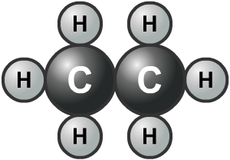
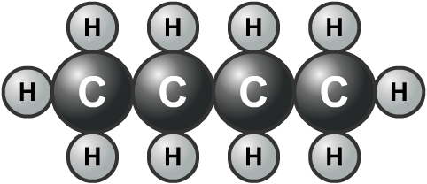
What are hydrocarbons?
Some compounds only contain the elements carbon and hydrogen. They are called hydrocarbons.
Examples of hydrocarbons include alkanes and alkenes.
Different hydrocarbons vary in their chain length (the number of carbon atoms) and saturation (the number of hydrogen atoms).
Notes:
Teacher notes
For more information about alkanes and alkenes, please refer to the Alkanes and Alkenes presentations respectively.
This presentation is accompanied by the worksheet Hydrocarbons.
The worksheet accompanying this slide covers the Science and Engineering Practice:
Constructing Explanations and Designing Solutions: Apply scientific ideas, principles, and/or evidence to provide an explanation of phenomena and solve design problems, taking into account possible unanticipated effects.

Slide 4
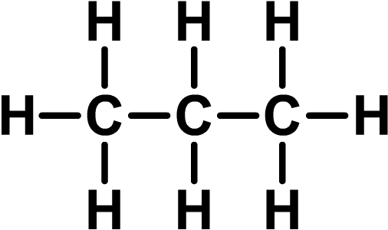
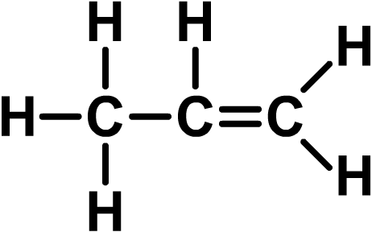
Saturated or unsaturated?
Hydrocarbons which contain chains of carbon atoms joined by single carbon–carbon covalent bonds are called saturated hydrocarbons.
Hydrocarbons which contain chains of carbon atoms joined by one or more carbon–carbon double bonds are called unsaturated hydrocarbons.
A saturated hydrocarbon.
An unsaturated hydrocarbon.
Notes:
Teacher notes
In displayed formulae, “–” represents a covalent bond.

Slide 5
Saturated or unsaturated - review

Slide 6
Properties of hydrocarbons
The length of a hydrocarbon chain and the level of saturation contribute to their different properties, including:
viscosity
boiling point
flammability.
Many of the compounds in crude oil are hydrocarbons. These are separated and converted into useful products, such as fuels.
The properties of hydrocarbons determine how they are used as fuels.

Slide 7
What is viscosity?
Some hydrocarbon fuels are thin and runny. Others are thick and sticky. The runniness of a liquid is called viscosity.
For example, the residue produced by fractional distillation has a very high viscosity and cannot be easily poured. Gasoline, on the other hand, has a low viscosity and pours easily.
The longer the hydrocarbon chains in a fuel, the more viscous the fuel will be.
Notes:
Teacher notes
For more information about fractional distillation, please refer to the Fractional Distillation presentation.

Slide 8
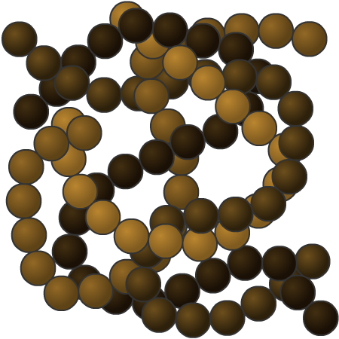
Molecule size and viscosity
Why are fuels with large hydrocarbon molecules more viscous than fuels with small hydrocarbon molecules?
The longer chains of large hydrocarbon molecules are easily entangled.
Smaller molecules have shorter chains and are less likely to become entangled.

Slide 9
Predicting the viscosity of fuels
Notes:
Photo credit: © Anteromite, Shutterstock.com 2018

Slide 10
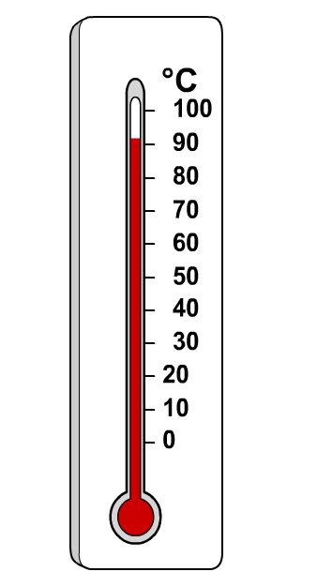
Boiling point of hydrocarbons
Long chains of hydrocarbons become easily entangled, and form more interactions with each other than shorter chains.
It takes more energy to separate these longer chains.
This means that a fuel containing long hydrocarbons will have a higher boiling point than a fuel of shorter hydrocarbons.
Fuels that have a low boiling point evaporate easily.
As the length of the hydrocarbon chain increases, the boiling point increases.
Notes:
This slide covers the Science and Engineering Practice:
Constructing Explanations and Designing Solutions: Apply scientific ideas, principles, and/or evidence to provide an explanation of phenomena and solve design problems, taking into account possible unanticipated effects.

Slide 11
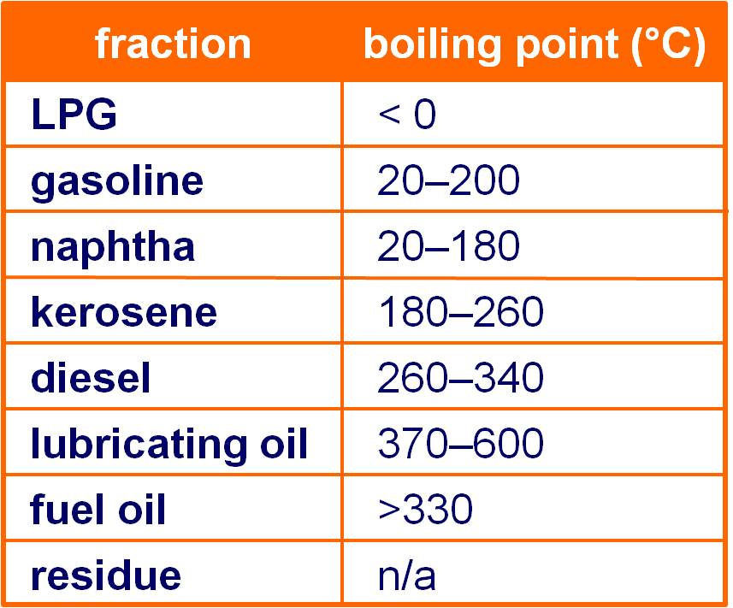
Hydrocarbons in crude oil
Crude oil is split into fractions of hydrocarbons of similar size, and therefore boiling point, during fractional distillation.
The varying boiling points of the fractions are used in industry to separate them.
What might be a problem when separating some of these fractions?
Notes:
Teacher notes
The boiling point of each fraction is often a range as there is a mixture of compounds in each fraction.
Gasoline and naptha have mostly the same boiling points, and the boiling points of gasoline and kerosene overlap. This can cause problems when separating these fractions.

Slide 12
Flammability of hydrocarbons
In order for a fuel to burn, it must react with oxygen in the air.
The more unstable a fuel is, the easier it mixes with air, and the easier it will ignite and burn.
Fuels that ignite and burn easily are flammable.
Generally, the smaller the molecules in a fuel, the more flammable it is.
Notes:
Teacher notes
Small, short chain hydrocarbons make better fuels because they are more unstable, less viscous and are more easily ignited. Large hydrocarbons may be subjected to catalytic cracking in order to reduce the size of the molecules.

Slide 13
Properties
Notes:
Photo credit: © gallimaufry, Shutterstock.com 2018

Slide 14
What is combustion?
Combustion is a rapid reaction between a substance and oxygen that releases heat and light energy. When a substance burns, it is said to combust.
A fuel is a substance that reacts with oxygen (combusts) to release useful energy.
Hydrocarbons, such as those found in crude oil, make good fuels, particularly if the molecules in the compound are small.

Slide 15
The products of combustion
Notes:
Teacher notes
This virtual experiment illustrates how the products of the combustion of a hydrocarbon can be determined. It should be made clear to students that air is sucked through the apparatus while the candle is burning.

Slide 16
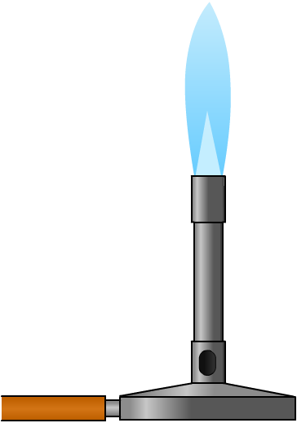
Complete combustion
During the combustion of a hydrocarbon fuel, the carbon and hydrogen are oxidized.
Complete combustion occurs when there is enough oxygen available for all of the carbon atoms in the fuel to burn and form carbon dioxide.
The blue flame of a Bunsen burner is an example of the complete combustion of the hydrocarbon methane.
What are the products of the complete combustion of a hydrocarbon?
Notes:
Teacher notes
Students may need to be reminded that oxidation is the addition of oxygen.
It is important to recognize that complete combustion only takes place in a Bunsen burner if the air hole is open, allowing air to be drawn through the chimney, where it can react with the natural gas. The orange flame of a Bunsen burner (sometimes known as the safety flame), is an example of incomplete combustion. To achieve an orange flame, the air hole of the Bunsen burner must be closed, meaning that the natural gas can only react with the air at the point of combustion (i.e. at the mouth of the chimney).

Slide 17
Complete combustion of methane
Methane is a hydrocarbon found in natural gas. Methane will combust in oxygen to produce carbon dioxide and water.
What is the balanced symbol equation for this reaction?
Propane is a hydrocarbon fuel with the formula C₃H₈. What is the balanced symbol equation for the complete combustion of propane?
Notes:
Teacher notes
Complete combustion of propane: C₃H₈ + 5O₂ → 3CO₂ + 4H₂O

Slide 18
Incomplete combustion
What happens if there is not enough oxygen?
When oxygen supplies are low, carbon and carbon monoxide are produced instead of carbon dioxide.
The general equation for the reaction is:
Carbon monoxide is a poisonous gas. It reduces the transport of oxygen around the body by binding to hemoglobin.
Carbon is released as soot, which can damage car engines.
Notes:
Teacher notes
Students may need to be reminded that hemoglobin carries oxygen around the body. A decrease in oxygen supply to cells results in damage to the cells and organs which can result in chest pain, seizures and loss of consciousness.

Slide 19
Combustion equations

Slide 20
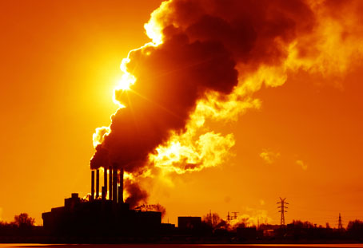
Fuels and the environment
Most fuels contain hydrogen and carbon, but many also contain sulfur and other substances. Any impurities in the fuel will end up as a product, many of which contribute to global warming.
Some products of burning fuels include:
carbon dioxide (CO₂)
water vapor (H₂O)
carbon monoxide (CO)
sulfur dioxide (SO₂)
oxides of nitrogen (NO)
particulates.
What environmental impact might these have?
Notes:
Teacher notes
Students could discuss some of the environmental impacts of the different products of combustion:
Carbon dioxide – A greenhouse gas which causes an increase in the Earth’s temperature by trapping heat in the atmosphere.
Sulfur dioxide – An acidic gas which combines with water in the atmosphere to form acid rain. This can cause breathing problems and damage to ecosystems.
Nitrogen oxide – Can combine with water vapor to form acid rain.
Particulates – Can cause breathing problems.
For more information about atmospheric gases and their affect on the environment, please refer to the Earth Sciences: Pollution presentation.
Photo credit: © Dudarev Mikhail, Shutterstock.com 2018

Slide 21
Nitrogen oxides
As hydrocarbons burn in internal combustion engines, high temperatures are created.
At these temperatures, nitrogen in the air combines with oxygen to form nitrogen monoxide (NO):
NO can react with oxygen to give nitrogen dioxide (NO₂):
The nitrogen dioxide is released and reacts with water vapor to form acid rain.

Slide 22
Acid rain

Slide 23
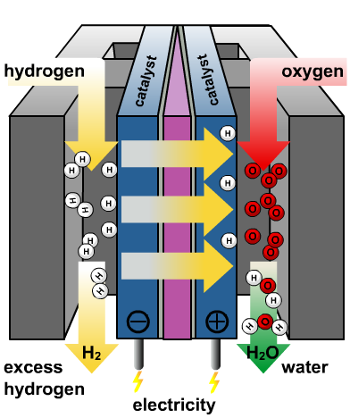
Alternative fuels - hydrogen fuel cells
Gasoline, kerosene and diesel oil are non-renewable fossil fuels obtained by the fractional distillation of crude oil.
Environmentally friendly alternatives to fossil fuels have been developed. For example, hydrogen fuel cells.
Hydrogen fuel cells combine hydrogen with oxygen from the air to form water and electrical energy.
The hydrogen needed for a fuel cell to work can be easily replenished.
Methane, a non-renewable fossil fuel, has also shown potential for use in fuel cells.
Notes:
Teacher notes
Hydrogen fuel cells will continue to function as long as there is hydrogen, and this fuel can be replenished easily and quickly at an appropriate filling station.
Methane is found in natural gas.

Slide 24
Advantages and disadvantages
Notes:
Teacher notes
Students could be asked to think of more advantages and disadvantages of using hydrogen fuel cells instead of gasoline or diesel to power cars.
Advantages:
if the hydrogen that is used is produced by the electrolysis of water, no harmful greenhouse gases are produced
fuel cells do not create any noise, as opposed to gasoline or diesel engines, which can be quite noisy.
Disadvantages:
currently, fossil fuels are still used in the production, storage and transportation of hydrogen, making the fuel cells not as environmentally-friendly as they could be
cars powered with hydrogen fuel cells will need to be “refuelled” more frequently than cars using gasoline or diesel
few fuel cell products are available as the technology is still being developed.
This slide covers the Science and Engineering Practice:
Engaging in Argument from Evidence: Evaluate competing design solutions to a real-world problem based on scientific ideas and principles, empirical evidence, and logical arguments regarding relevant factors (e.g. economic, societal, environmental, ethical considerations).

