Slide 1
Identifying Gases

Slide 2
Information
Planning and Carrying Out Investigations
2. Cause and Effect

Slide 3
Why test for gases?
Many chemical reactions produce gases.
The gas produced can be used as an indicator that a particular reaction is occurring and can be collected for further analysis.
How do you know what gases are produced?
Most gases are colorless and odorless.
We therefore need methods to test for the presence of the different gases.

Slide 4
Testing for hydrogen
Hydrogen is produced in many different reactions.
It is a colorless, odorless gas.
As hydrogen is neutral, litmus paper and universal indicator cannot be used to test for it.
A different method of identification is used that makes use of hydrogen’s ability to burn in the presence of oxygen.
When hydrogen burns in oxygen, energy is released and a “squeaky pop” sound can be heard.

Slide 5
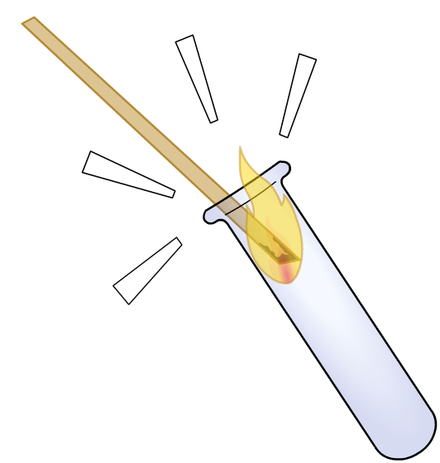
The “squeaky pop” test
A lighted splint is held at the end of an open test tube containing the gas.
pop!
The hydrogen present burns rapidly in the presence of the flame and oxygen.
The characteristic “pop” sound confirms the presence of hydrogen.
This test is called the “squeaky pop” test and is a good way of identifying hydrogen.
Some condensation may also be seen on the test tube. Why is this?
Notes:
Teacher notes
The water produced in the reaction forms condensation on the side of the test tube.
This slide covers the Science and Engineering Practice:
Planning and Carrying Out Investigations: Select appropriate tools to collect, record, analyze, and evaluate data.

Slide 6
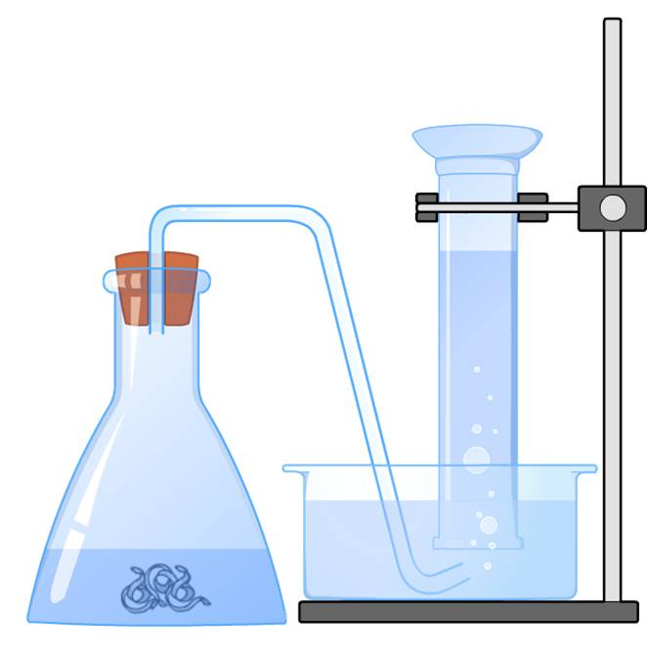
Collecting hydrogen gas
Testing for the presence of hydrogen gas is useful in reactions involving metals.
hydrogen gas
When a metal reacts with an acid, a gas is produced.
The “squeaky pop” test shows that this gas is hydrogen.
For example, the reaction of magnesium (Mg) with hydrochloric acid (HCl):
magnesium

Slide 7
Testing for oxygen (1)
Oxygen is a colorless, odorless gas.
Similar to hydrogen, oxygen is neutral, which means that litmus paper and universal indicator cannot be used.
The ability for a substance to combust in the presence of oxygen is used when testing for oxygen.
A smoldering splint is inserted into the test tube containing the gas.
The splint relights into a flame in the presence of oxygen.
Why doesn’t the splint relight outside of the test tube?
Notes:
Teacher notes
The splint is first lit and then blown out to produce a smoldering/glowing end.
There is not enough oxygen in the surrounding air for combustion to occur.
This slide covers the Science and Engineering Practice:
Planning and Carrying Out Investigations: Select appropriate tools to collect, record, analyze, and evaluate data.

Slide 8
Testing for oxygen (2)
Air has only 21% oxygen. This is not enough for combustion to occur.
When held in the test tube of oxygen gas, the splint is exposed to almost pure oxygen.
This allows combustion to occur and the splint to relight.
Sometimes a “pop” can be heard, so it is easy to mistake this for the presence of hydrogen.
The pop heard in hydrogen testing, however, is much more violent, and can result in the flame being extinguished.

Slide 9
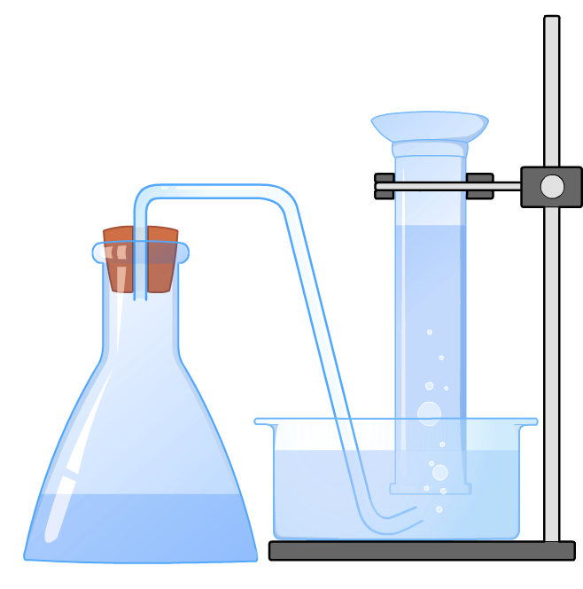
Collecting oxygen
Oxygen can be made in a lab from hydrogen peroxide in the presence of a catalyst.
Hydrogen peroxide decomposes (breaks down) to form oxygen and water.
oxygen gas
The gas is collected over water using an upside down tube.
The oxygen collects at the top of the tube and pushes the water down.
hydrogen peroxide
Notes:
This slide covers the Science and Engineering Practice:
Planning and Carrying Out Investigations: Select appropriate tools to collect, record, analyze, and evaluate data.

Slide 10
Calcium oxide and calcium hydroxide
Calcium oxide is the product of the thermal decomposition of limestone.
Calcium oxide is used to make calcium hydroxide.
Calcium hydroxide is made by adding water to calcium oxide.
What is the word equation for this reaction?

Slide 11
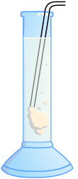
Testing for carbon dioxide
Fully dissolving calcium hydroxide in water forms limewater. Limewater is used to test for carbon dioxide.
When carbon dioxide gas is bubbled through limewater, the limewater becomes cloudy. This is because the carbon dioxide reacts with the calcium hydroxide to form calcium carbonate and water.
The solid calcium carbonate (limestone) is held in suspension, which gives the limewater a milky white appearance.
Notes:
This slide covers the Science and Engineering Practice:
Planning and Carrying Out Investigations: Select appropriate tools to collect, record, analyze, and evaluate data.

Slide 12
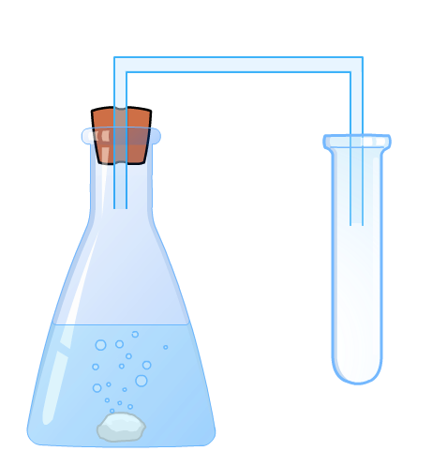
Collecting carbon dioxide
Carbon dioxide can be collected in a lab by reacting calcium carbonate with an acid, such as hydrochloric acid.
As carbon dioxide is more dense than air, a downward delivery method can be used.
The carbon dioxide collects at the base of the upright tube, and the less dense air is pushed to the top.
carbon dioxide
calcium carbonate
Notes:
This slide covers the Science and Engineering Practice:
Planning and Carrying Out Investigations: Select appropriate tools to collect, record, analyze, and evaluate data.

Slide 13
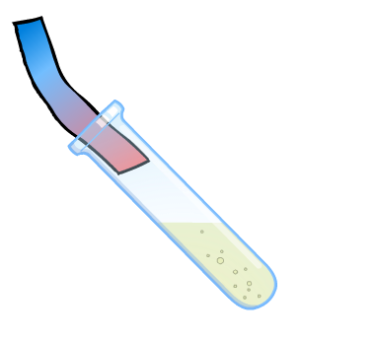
Testing for chlorine
Chlorine is a strong smelling green gas that dissolves to form an acidic, bleaching solution.
In small amounts, it appears pale yellow/green and can be very hard to see.
Litmus paper is used to test for the presence of chlorine gas. This involves a color change.
Damp litmus paper turns red in the presence of chlorine gas.
Dissolved chlorine then bleaches the litmus paper white.
Notes:
Teacher notes
Litmus paper indicates the acidity or alkalinity of a substance. Blue litmus paper turns red in the presence of an acidic substance. As the litmus paper is damp, the chlorine gas dissolves and eventually bleaches the paper.
This slide covers the Science and Engineering Practice:
Planning and Carrying Out Investigations: Select appropriate tools to collect, record, analyze, and evaluate data.

Slide 14
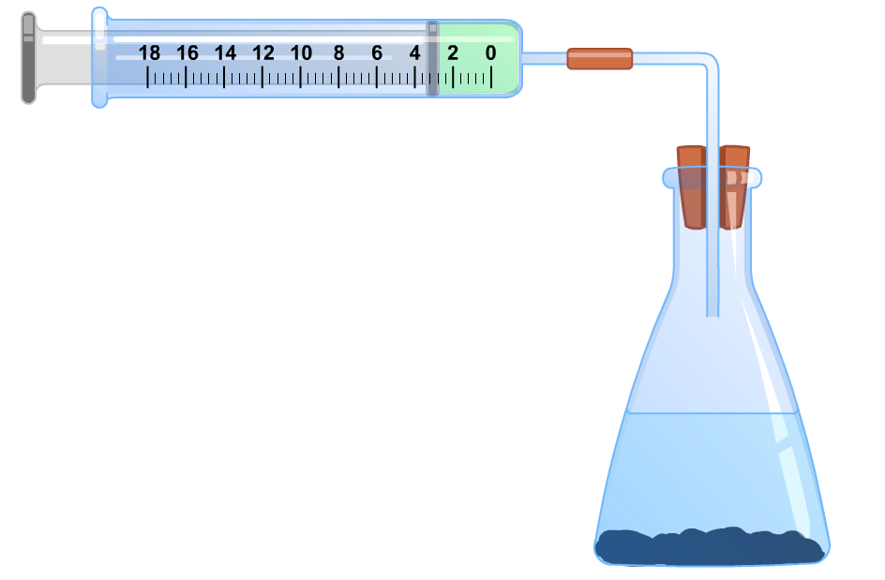
Collecting chlorine gas
In the reaction of hydrochloric acid and potassium manganate, chlorine gas can be collected in a gas syringe.
plunger
gas syringe
The volume of chlorine gas produced can be measured.
hydrochloric acid
As the volume of gas increases, the plunger moves out of the syringe.
potassium manganate
Notes:
Teacher notes
Chlorine gas can also be collected using a downward delivery method as it is more dense than air. The chlorine gas will sink to the bottom of a tube and push the less dense air upward.
In the reaction of potassium manganate and hydrochloric acid, manganese chloride, chlorine gas and water are produced.
This slide covers the Science and Engineering Practice:
Planning and Carrying Out Investigations: Select appropriate tools to collect, record, analyze, and evaluate data.

