Slide 1
Intermolecular Forces

Slide 2
Information
Developing and Using Models
Analyzing and Interpreting Data
Constructing Explanations and Designing Solutions
1. Patterns
3. Scale, Proportion, and Quantity
6. Structure and Function

Slide 3
Types of intermolecular force
The molecules in simple covalent substances are not entirely isolated from one another. There are forces of attraction between them. These are called intermolecular forces.
There are three main types of intermolecular force:
London dispersion forces: for example, found between I2 molecules in iodine crystals.
permanent dipole–dipole forces: for example, found between HCl molecules in hydrogen chloride.
hydrogen bonds: for example, found between H2O molecules in water.
Notes:
This presentation is accompanied by the worksheet Intermolecular Forces.

Slide 4
London dispersion forces
Notes:
This slide covers the Science and Engineering Practice:
Developing and Using Models: Develop, revise, and/or use a model based on evidence to illustrate and/or predict the relationships between systems or between components of a system.

Slide 5
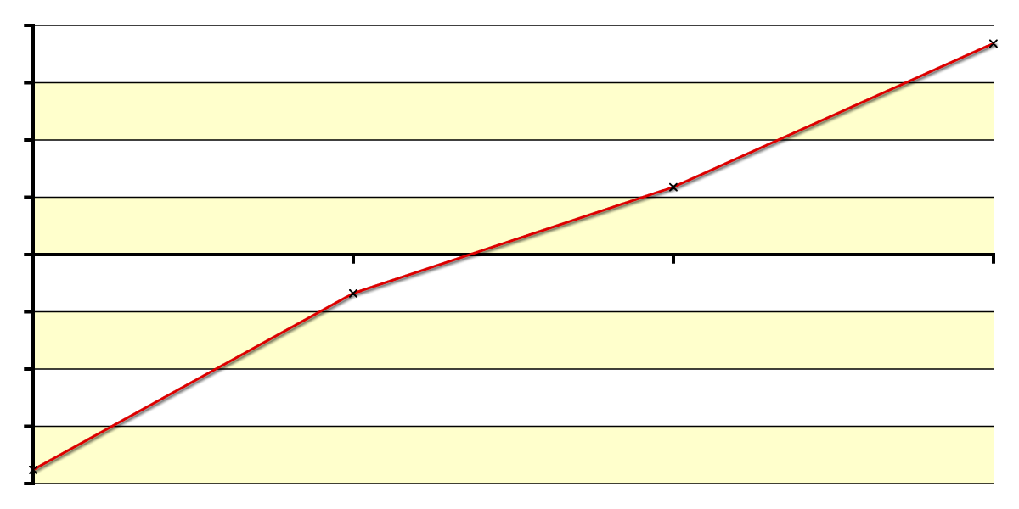
Strength of London dispersion forces (1)
The strength of London dispersion forces increases as molecular size increases.
200
150
100
50
boiling point (°C)
0
–50
This is illustrated by the boiling points of group 7 elements.
–100
–150
–200
F2
Cl2
Br2
I2
element
Atomic radius increases down the group, so the outer electrons become further from the nucleus. They are attracted less strongly by the nucleus and so temporary dipoles are easier to induce.
Notes:
This slide covers the Science and Engineering Practices:
Analyzing and Interpreting Data: Analyze data using tools, technologies, and/or models (e.g., computational, mathematical) in order to make valid and reliable scientific claims or determine an optimal design solution.
Constructing Explanations and Designing Solutions: Apply scientific ideas, principles, and/or evidence to provide an explanation of phenomena and solve design problems, taking into account possible unanticipated effects.

Slide 6
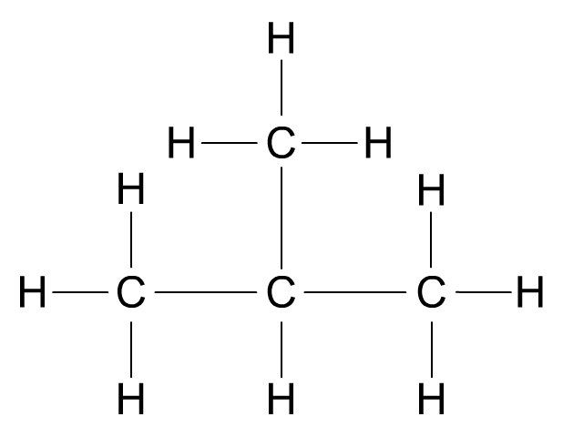
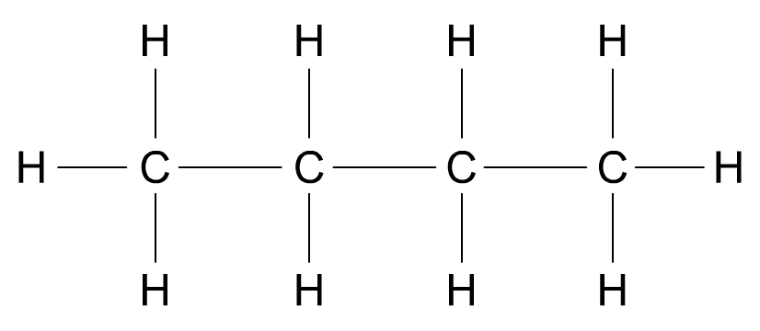
Strength of London dispersion forces (2)
The points of contact between molecules also affect the strength of London dispersion forces.
butane (C4H10)
boiling point = 272 K
2-methylpropane (C4H10)
boiling point = 261 K
Straight chain alkanes can pack closer together than branched alkanes, creating more points of contact between molecules. This results in stronger London dispersion forces.
Notes:
This slide covers the Science and Engineering Practice:
Constructing Explanations and Designing Solutions: Apply scientific ideas, principles, and/or evidence to provide an explanation of phenomena and solve design problems, taking into account possible unanticipated effects.

Slide 7
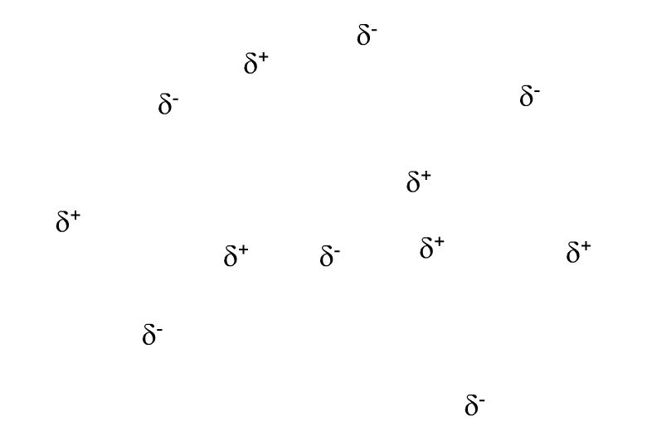
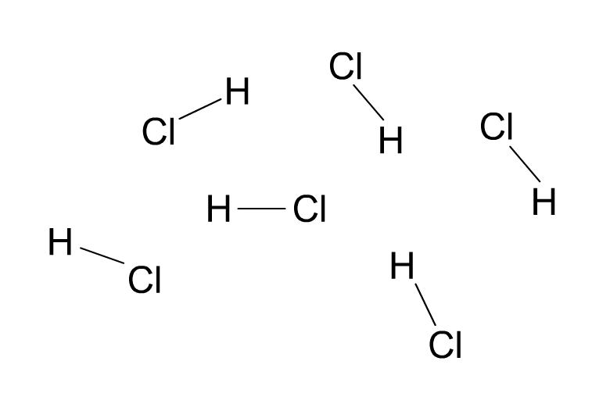
Permanent dipole–dipole forces
If molecules contain bonds with a permanent dipole, the molecules may align so that there is electrostatic attraction between the opposite charges on neighboring molecules.
Permanent dipole–dipole forces (dotted lines) occur in hydrogen chloride (HCl) gas.
The permanent dipole–dipole forces are approximately one hundredth the strength of a covalent bond.
Notes:
Teacher notes
Students could be reminded that molecules need to be polar, i.e. have an overall dipole, for permanent dipole–dipole forces to occur.

Slide 8
Permanent dipole–dipole or not?
Notes:
Teacher notes
Students could also be asked to categorize the following:
phosphine (PH₃) = exhibits permanent dipole–dipole forces
hydrogen sulfide (H₂S) = exhibits permanent dipole–dipole forces
chlorine (Cl₂) = does not exhibit permanent dipole–dipole forces
ozone (O₃) = does not exhibit permanent dipole–dipole forces

Slide 9
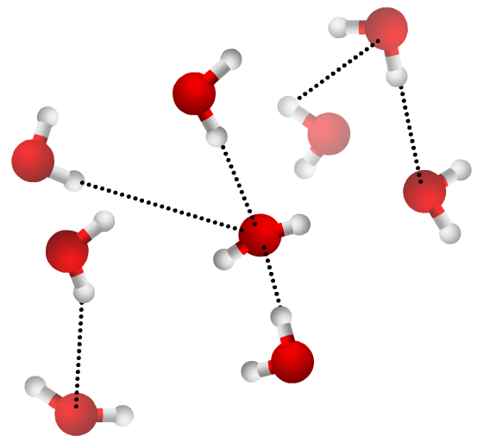
What is hydrogen bonding?
When hydrogen bonds to nitrogen, oxygen or fluorine, a larger dipole occurs than in other polar bonds.
This is because these atoms are highly electronegative due to their high nuclear charge and small size. When these atoms bond to hydrogen, electrons are withdrawn from the H atom, making it slightly positive.
The H atom is very small, so the positive charge is more concentrated, making it easier to link with other molecules.
Hydrogen bonds are therefore particularly strong examples of permanent dipole–dipole forces.
Notes:
Teacher notes
Hydrogen bonds are about one tenth the strength of a covalent bond.

Slide 10
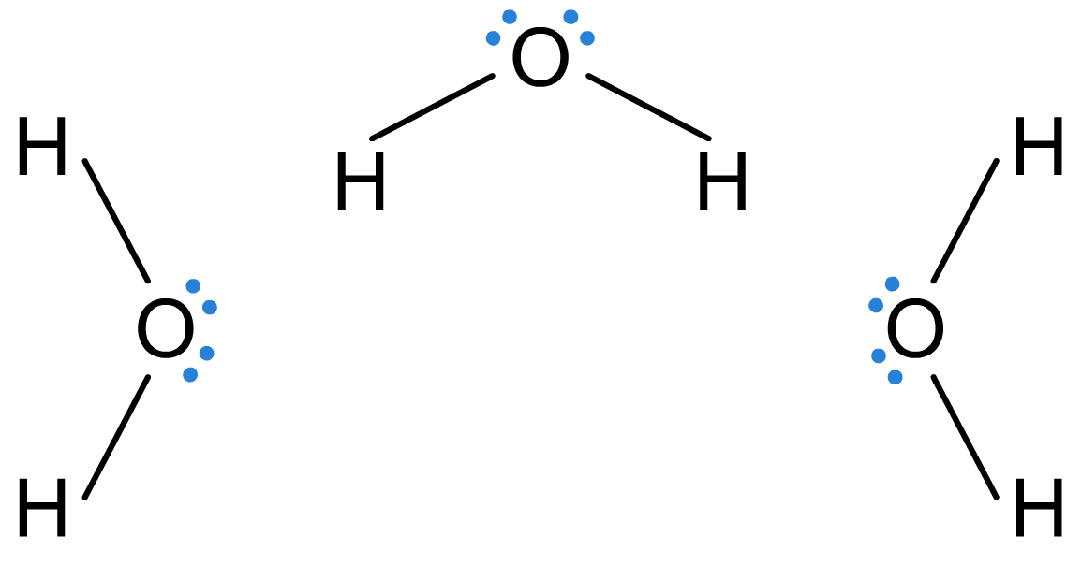
Hydrogen bonding
In molecules with OH or NH groups, a lone pair of electrons on nitrogen or oxygen is attracted to the slight positive charge on the hydrogen on a neighboring molecule.
hydrogen bond
lone pair
Hydrogen bonding makes water’s melting and boiling points higher than might be expected. It also means that alcohols have much higher boiling points than alkanes of a similar size.
Notes:
This slide covers the Science and Engineering Practice:
Developing and Using Models: Develop, revise, and/or use a model based on evidence to illustrate and/or predict the relationships between systems or between components of a system.

Slide 11
Hydrogen bonding and boiling points
Notes:
This slide covers the Science and Engineering Practice:
Analyzing and Interpreting Data: Analyze data using tools, technologies, and/or models (e.g., computational, mathematical) in order to make valid and reliable scientific claims or determine an optimal design solution.

Slide 12
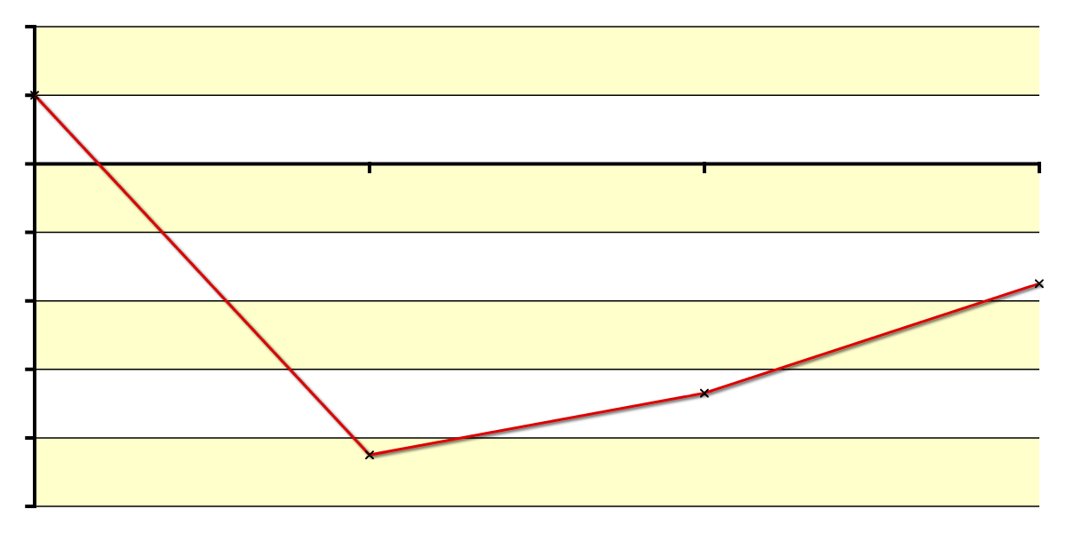
Boiling points of the hydrogen halides
The boiling point of hydrogen fluoride is much higher than that of other hydrogen halides, due to fluorine’s high electronegativity.
40
20
0
–20
boiling point (°C)
–40
–60
–80
–100
HF
HCl
HBr
HI
This means that hydrogen bonding between molecules of hydrogen fluoride is much stronger than the permanent dipole–dipole forces between molecules of other hydrogen halides. More energy is therefore required to separate the molecules of hydrogen fluoride.
Notes:
This slide covers the Science and Engineering Practices:
Analyzing and Interpreting Data: Analyze data using tools, technologies, and/or models (e.g., computational, mathematical) in order to make valid and reliable scientific claims or determine an optimal design solution.
Constructing Explanations and Designing Solutions: Apply scientific ideas, principles, and/or evidence to provide an explanation of phenomena and solve design problems, taking into account possible unanticipated effects.

Slide 13
Permanent dipole–dipole forces

