Slide 1
Metals and Non-Metals

Slide 2
Information
Developing and Using Models
Constructing Explanations and Designing Solutions
1. Patterns
7. Stability and Change

Slide 3
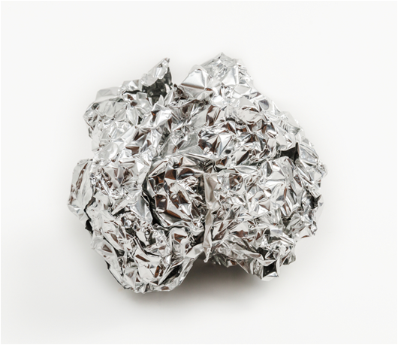
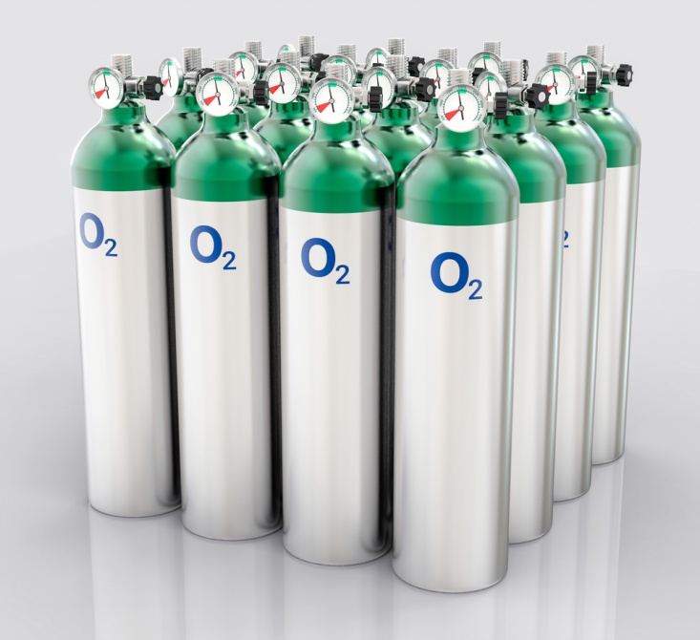
Different types of elements
There are different types of elements in the periodic table.
The majority of elements are metals.
Some elements are known as non-metals.
Metals and non-metals have completely different chemical and physical properties.
Notes:
Photo credits: aluminum foil © Sittirak Jadlit , oxygen canisters © IvanC7, all at shutterstock.com 2018

Slide 4
Physical properties (1)
Property
Metals
Non-metals
Appearance
Shiny
Dull
Physical state (at 25 °C)
Solid (except Hg)
Solid, gas (except Br)
Density
High density
Low density
Boiling point
High
Low
Conductivity
Good electrical and heat conductor
Poor electrical and heat conductor
Can you name any exceptions to the trends above?
Notes:
Teacher notes
Note that:
25 °C is room temperature.
Melting point is also high for metals and low for non-metals.
Students could discuss some exceptions to the trends listed in the table, for example:
Metal – Hg (mercury) is a liquid at room temperature
Non-metal – Br (bromine) is liquid at room temperature, C (carbon) is solid and can exist in different forms (diamond, graphite and fullerenes). These have different properties (e.g. graphite and tube fullerenes conduct electricity whereas diamond does not).

Slide 5
Physical properties (2)
Property
Metals
Non-metals
Strength
Strong
Weak
Flexibility
Malleable (bend without breaking)
Brittle (shatter when hit)
Ductile (drawn into wires)?
Yes
No
Sound
Sonorous (ring when hit)
Dull sound (when hit)
It is clear that metals and non-metals have very different properties.

Slide 6
Properties and structure
Why do metals and non-metals have contrasting properties?
The properties of metals and non-metals depend on their structure.
The structure of a metal or non-metal is determined by the arrangement of electrons in its atoms. This is known as the electronic structure.
Notes:
Teacher notes
For more information about the structure and properties of metals, please refer to the Properties of Metals and Alloys presentation.

Slide 7
Periodic table: metals and non-metals
The properties of metals and non-metals are highly dependent on their electronic structure.
The electronic structure of an element can be determined by looking at their position in the periodic table.
Where are the following different types of elements grouped in the periodic table?
metals
on the left and center
non-metals
on the right (except hydrogen)
Notes:
This slide covers the Science and Engineering Practice:
Developing and Using Models: Develop, revise, and/or use a model based on evidence to illustrate and/or predict the relationships between systems or between components of a system.

Slide 8
Location of metals and non-metals
Notes:
Teacher notes
Highlight that transition metals are in the centre of the periodic table (between groups 2 and 3). They exhibit more complicated and unusual properties compared to alkali metals. The metals focused on in this presentation are alkali metals.
For more information about transition metals, please refer to the Transition Metals presentation.
This slide covers the Science and Engineering Practice:
Developing and Using Models: Develop, revise, and/or use a model based on evidence to illustrate and/or predict the relationships between systems or between components of a system.

Slide 9
Patterns of electron arrangement
Consider the electron configurations of the first 20 elements in the periodic table.
1
2
3
4
5
6
7
0
1
1
2
2
2,1
2,2
2,3
2,4
2,5
2,6
2,7
2,8
3
2,8,1
2,8,2
2,8,3
2,8,4
2,8,5
2,8,6
2,8,7
2,8,8
4
2,8,8,1
2,8,8,2
What is the pattern of outer shell electrons in a group?
What is the pattern of outer shell electrons across a period?
What is the pattern of full electron shells in a group?
Notes:
Teacher notes
A group is a column of the period table. A period is a row of the periodic table.
There are the same number of outer shell electrons for every element in a group.
Across a period, the number of outer shell electrons increases by 1 until the outer shell is full. The elements in a period all have the same number of shells.
The number of complete electron shells increases by 1 as you go one element down a group.
For more information about electronic structure, please refer to the Electronic Structure presentation.
This slide covers the Science and Engineering Practice:
Developing and Using Models: Develop, revise, and/or use a model based on evidence to illustrate and/or predict the relationships between systems or between components of a system.

Slide 10
Electron trends in the periodic table
Trends down a group:
the number of outer shell electrons is the same
the number of complete electron shells increases by one.
The group number is the same as the number of electrons in the outer shell of elements in that group, except for group 0.
Trends across a period:
the number of outer shell electrons increases by one
the number of complete electron shells stays the same.
The point at which a new period starts is the point at which electrons begin to fill a new shell.
Notes:
Teacher notes
For more information about electron trends in the periodic table, please refer to the Elements and the Periodic Table presentation.
This slide covers the Science and Engineering Practice:
Developing and Using Models: Develop, revise, and/or use a model based on evidence to illustrate and/or predict the relationships between systems or between components of a system.

Slide 11
Atomic structure and reactivity
Elements in the same group in the periodic table have similar chemical properties. They have the same number of electrons in their outer shell and so react in a similar manner.
Metals and non-metals have a very different number of electrons in their outer shell.
Metals have an almost empty outer electron shell.
Non-metals have an outer electron shell which is almost complete.
How does this affect their chemical properties e.g. bonding and reactivity?
Notes:
This slide covers the Science and Engineering Practice:
Constructing Explanations and Designing Solutions: Apply scientific ideas, principles, and/or evidence to provide an explanation of phenomena and solve design problems, taking into account possible unanticipated effects.

Slide 12
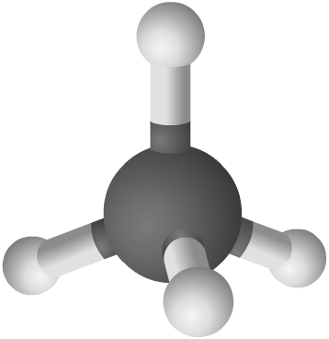
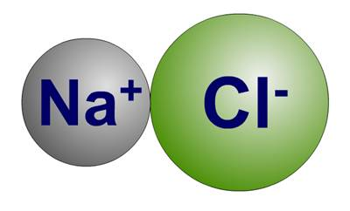
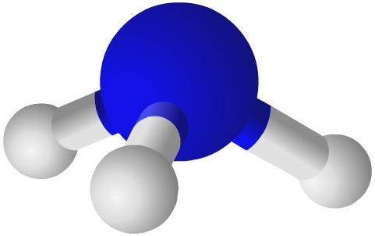
Chemical bonding
Elements are made up of just one type of atom. Sometimes, elements chemically react and form bonds with each other, forming molecules.
Different types of bonds are formed depending on the types of atoms involved:
ionic bonding occurs between metal and non-metal atoms.
covalent bonding occurs between non-metal atoms only.
Bonding involves a change to the outer shell electrons of an atom.
Notes:
Teacher notes
The molecules shown in the images (L-R) are ammonia (covalent, NH₃), NaCl (ionic) and methane (covalent, CH₄).

Slide 13
Ion formation
An ion is an atom or group of atoms that has an electrical charge, either positive or negative.
Atoms have an equal number of protons and electrons and so do not have an overall charge.
During ionic bonding:
metals will lose electrons
non-metals will gain electrons.
The atoms now have an unequal number of protons and electrons and so have an overall charge, forming ions.

Slide 14
Electrons and groups
Notes:
Teacher notes
Point out to students that the non-metal elements to the right of the periodic table can also form covalent bonds as well as being able to form negative ions for ionic bonding.
For more information about alkali metals and halogens, please refer to the Group 1: Alkali Metals and Group 7: Halogens presentations respectively.
This slide covers the Science and Engineering Practices:
Developing and Using Models: Develop, revise, and/or use a model based on evidence to illustrate and/or predict the relationships between systems or between components of a system.
Constructing Explanations and Designing Solutions: Apply scientific ideas, principles, and/or evidence to provide an explanation of phenomena and solve design problems, taking into account possible unanticipated effects.

Slide 15
How does an ionic bond form?
Notes:
Teacher notes
This two-part interactive animation shows how bonding occurs in two ionic compounds – sodium chloride and magnesium oxide. It shows how the ions are formed, which electrons are transferred and how this leads to the formation of the ionic lattices.
This slide covers the Science and Engineering Practices:
Developing and Using Models: Develop, revise, and/or use a model based on evidence to illustrate and/or predict the relationships between systems or between components of a system.
Constructing Explanations and Designing Solutions: Apply scientific ideas, principles, and/or evidence to provide an explanation of phenomena and solve design problems, taking into account possible unanticipated effects.

Slide 16
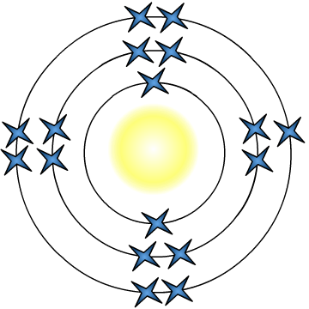
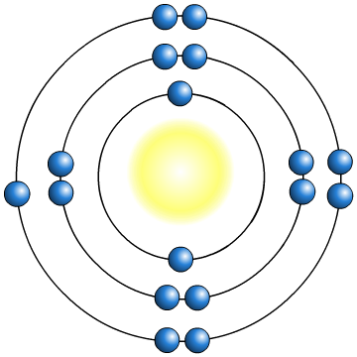
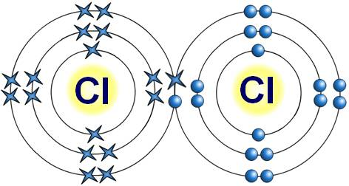
What is a covalent bond?
Non-metal elements usually just need one or two electrons to fill their outer shells. How do they form a bond?
Cl
incomplete outer shells
Cl
The two non-metal atoms cannot form a bond by transferring electrons from one to another. Instead, they share electrons.
Each atom now has a full, stable outer shell.
The shared electrons join the atoms together. This is called a covalent bond.
Notes:
Teacher notes
For more information about covalent bonding, please refer to the Covalent Bonding and Covalent Compounds presentations.
This slide covers the Science and Engineering Practice:
Constructing Explanations and Designing Solutions: Apply scientific ideas, principles, and/or evidence to provide an explanation of phenomena and solve design problems, taking into account possible unanticipated effects.

Slide 17
Comparing covalent and ionic bonding
Notes:
Teacher notes
This drag and drop activity provides the opportunity for informal assessment of students’ understanding of the differences between covalent and ionic bonding. Appropriately colored voting cards could be used with this activity to increase class participation.

Slide 18
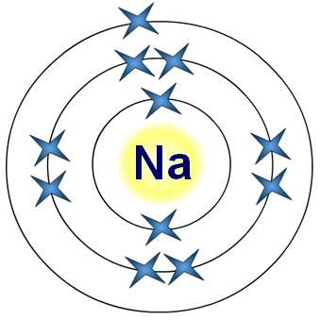
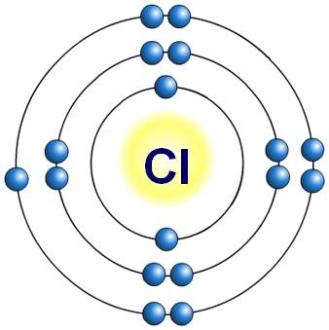
Summary: metal and non-metal bonding
Metals:
Have an almost empty outer shell.
An element that reacts to form positive ions.
Involved in ionic bonding only.
On the left of the periodic table.
Non-metals:
Have an outer shell which is almost full.
An element that does not form positive ions.
Can be involved in both types of bonding: ionic (as the negative ion) or covalent bonding.
On the right of the periodic table.

Slide 19
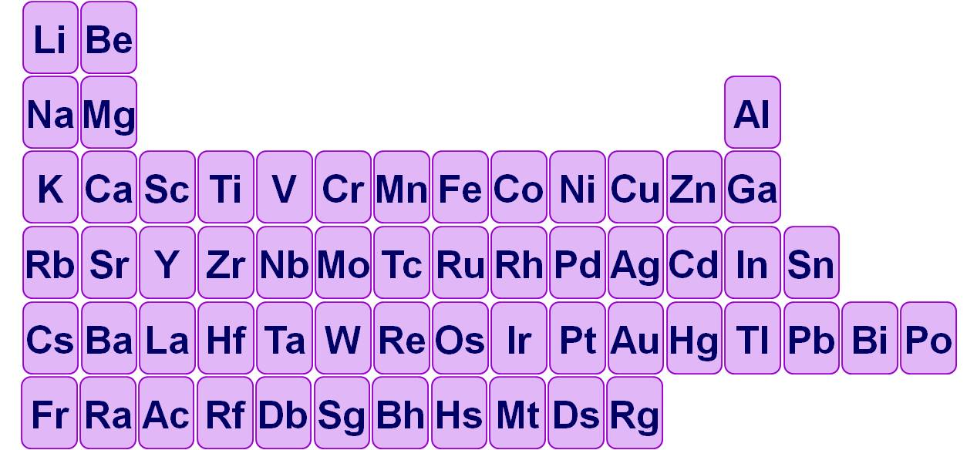
Reactivity of metals
What happens to the reactivity of metals along a period?
What happens to the reactivity of metals down a group?
Which is the most reactive metal?
Notes:
Teacher notes
The reactivity of metals decreases across a period from left to right. This is because it becomes more difficult to lose an electron across the table due to higher nuclear charge and the number of electron shells remaining the same. This results in a greater attraction between the negatively-charged outer electron and positively-charged nucleus.
For more information about the reactivity of metals, please refer to the The Reactivity Series presentation.
This slide covers the Science and Engineering Practice:
Developing and Using Models: Develop, revise, and/or use a model based on evidence to illustrate and/or predict the relationships between systems or between components of a system.

Slide 20
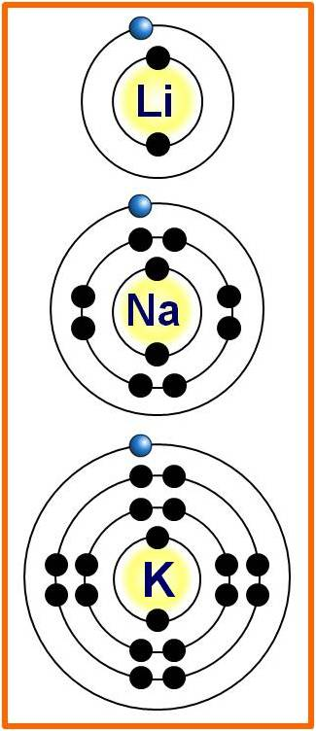
How does electron structure affect reactivity?
The reactivity of metals increases going down the group. This can be explained by looking at group 1 – the alkali metals.
The atoms of each element get larger going down the group.
This means that the outer shell electron gets further away from the nucleus.
The further an electron is from the positive nucleus, the easier it can be lost in reactions.
This is why the reactivity of the alkali metals increases going down group 1.
Notes:
Teacher notes
The further an electron is from the nucleus, the easier it is lost. This is because the attraction between the negatively-charged electrons and the positively-charged nucleus is smaller when the electrons are further from the nucleus.
This slide covers the Science and Engineering Practice:
Constructing Explanations and Designing Solutions: Apply scientific ideas, principles, and/or evidence to provide an explanation of phenomena and solve design problems, taking into account possible unanticipated effects.

Slide 21
Which metal is more reactive?
Notes:
Teacher notes
This quiz could be used as an introductory or summary activity to check students’ understanding of the reactivity of the metals in the periodic table. Colored traffic light cards could be used with this activity to increase class participation.

Slide 22
What is the order of reactivity?
Notes:
Teacher notes
This ordering activity could be used as an introductory or summary activity on the order of reactivity of the alkali metals.

Slide 23
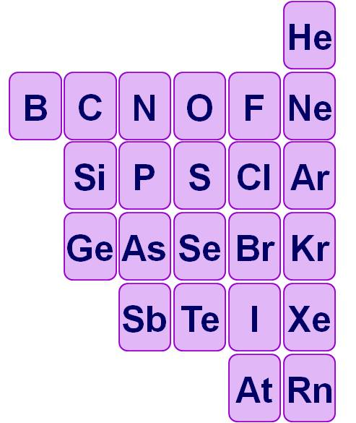
Reactivity of non-metals
Group 0 elements are the most unreactive of all elements.
For the remaining
non-metals, reactivity increases up a group and along a period from left to right.
Which is the most reactive non-metal?
very
unreactive
Notes:
Teacher notes
Group 0 elements are known as noble gases. These are non-metals but are not covered in detail in this presentation as they are highly unreactive. They also exhibit unusual properties compared to most non-metals.
The reactivity of non-metals increases across the period from left to right. This is because the nuclear charge increases but the number of shells remains the same. This means that the non-metal elements to the right of the group find it easier to gain an electron.
For more information about noble gases, please refer to the Group 0: Noble Gases presentation.
This slide covers the Science and Engineering Practice:
Developing and Using Models: Develop, revise, and/or use a model based on evidence to illustrate and/or predict the relationships between systems or between components of a system.

Slide 24
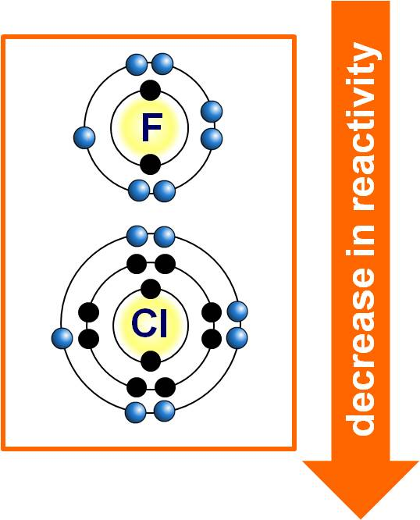
Electron structure and reactivity
The reactivity of non-metals decreases going down the group. This can be explained by looking at group 7 – the halogens.
The atoms of each element get larger going down the group.
This means that the outer shell gets further away from the nucleus and is shielded by more electron shells.
The further the outer shell is from the positive attraction of the nucleus, the harder it is to attract another electron to complete the outer shell.
Notes:
This slide covers the Science and Engineering Practice:
Constructing Explanations and Designing Solutions: Apply scientific ideas, principles, and/or evidence to provide an explanation of phenomena and solve design problems, taking into account possible unanticipated effects.

Slide 25
Which non-metal is more reactive?
Notes:
Teacher notes
This quiz could be used as an introductory or summary activity to check students’ understanding of the reactivity of non-metals and semi-metals in the periodic table. Colored traffic light cards could be used with this activity to increase class participation.

