Slide 1
Properties of Metals and Alloys

Slide 2
Information
Developing and Using Models
Constructing Explanations and Designing Solutions
Obtaining, Evaluating and Communicating Information
4. Systems and System Models
6. Structure and Function

Slide 3
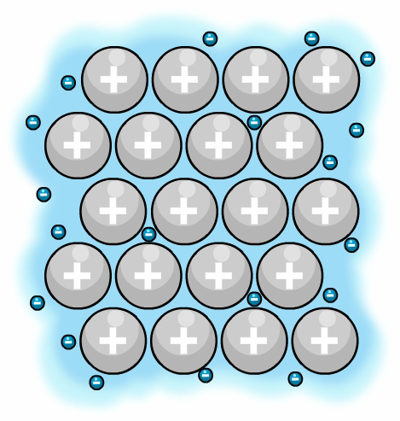
What is the structure of metals?
Metal particles are held together by strong metallic bonds and are arranged in tightly packed layers, forming a regular lattice structure.
sea of electrons
The outer electrons of the metal atoms are detached and create a “sea of electrons.”
These electrons are delocalized and are free to move through the structure. The metal atoms become positively charged ions and are attracted to the sea of electrons. This strong attraction is known as metallic bonding.
metal ions
Notes:
Teacher notes
Please note that this diagram is not drawn to scale. It should be stressed to students that an electron is tiny compared to a metal ion. This means that the electrons are able to pass between the metal ions.
This presentation is accompanied by the worksheet Properties of Metals and Alloys.

Slide 4
Metallic structures
Notes:
This slide covers the Science and Engineering Practice:
Developing and Using Models: Use a model to provide mechanistic accounts of phenomena.

Slide 5
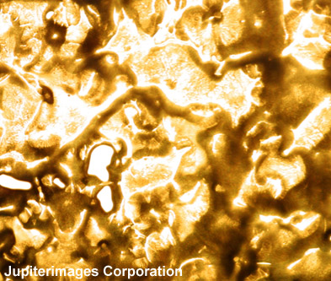
Why do metals have high melting points?
The properties of metals are related to their structure.
Metals often have high melting and boiling points. Gold, for example, has a melting point of 1,064 °C and a boiling point of 2,807 °C.
This is due to the strong attraction between the positively-charged metal ions and the sea of electrons.
In metal extraction and other industrial processes, furnaces often run continuously to maintain the high temperatures needed to work with molten metals.
Notes:
This slide covers the Science and Engineering Practice:
Constructing Explanations and Designing Solutions: Apply scientific ideas, principles, and/or evidence to provide an explanation of phenomena and solve design problems, taking into account possible unanticipated effects.
Photo credit: molten gold © JupiterImages Corporation 2018

Slide 6
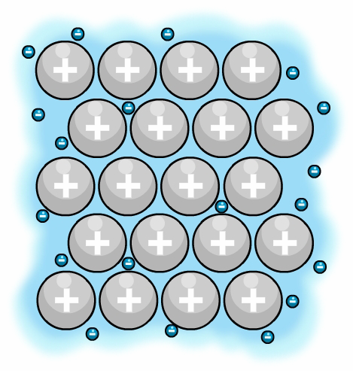
How do metals conduct heat?
Delocalized electrons in metallic bonding allow metals to conduct heat.
When a metal is heated, the delocalized electrons gain kinetic energy.
These electrons then move faster and so transfer the gained energy throughout the metal.
This makes heat transfer in metals very efficient.
heat
Notes:
This slide covers the Science and Engineering Practice:
Constructing Explanations and Designing Solutions: Apply scientific ideas, principles, and/or evidence to provide an explanation of phenomena and solve design problems, taking into account possible unanticipated effects.

Slide 7
How do metals conduct electricity?
Delocalized electrons in metallic bonding also allow metals to conduct electricity.
The delocalized electrons are free to move through the metal structure.
When a potential difference is applied, the electrons flow through the metal and “carry” electric charge.
Electrical conductivity relies on mobile charge. Therefore metals are good conductors of electricity.
electricity
Notes:
This slide covers the Science and Engineering Practice:
Constructing Explanations and Designing Solutions: Apply scientific ideas, principles, and/or evidence to provide an explanation of phenomena and solve design problems, taking into account possible unanticipated effects.

Slide 8
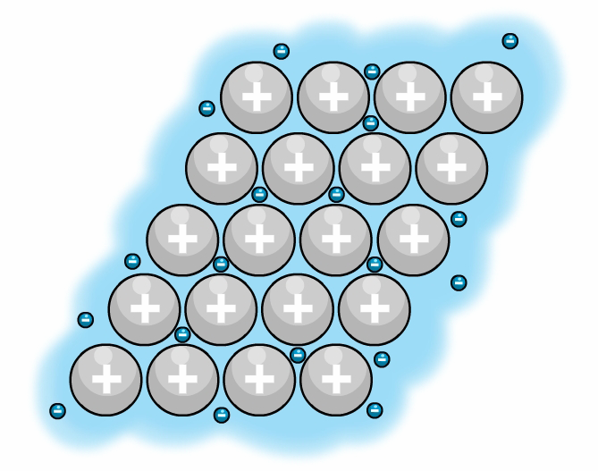
Why are metals strong?
Metals are usually strong and not brittle. When a force is applied to a metal, the layers of metal ions are able to slide over each other, and so the structure does not shatter.
metal before it is hit
metal after it is hit
force
force
The metallic bonds do not break because the delocalized electrons are free to move throughout the structure.
This also explains why metals are malleable (easy to shape) and ductile (can be drawn into wires).
Notes:
This slide covers the Science and Engineering Practice:
Developing and Using Models: Use a model to provide mechanistic accounts of phenomena.

Slide 9
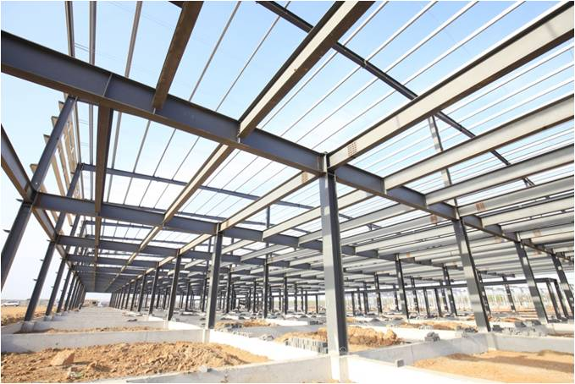
What is an alloy?
An alloy is a mixture containing one or more metal elements.
Steel is a common example of an alloy. It contains iron mixed with carbon and other elements. Adding other elements to a metal changes its structure and therefore its properties.
The final alloy may have very different properties to the original metal.
By changing the amount of each element in an alloy, materials scientists can custom-make alloys to fit a given job. Most metals in everyday use are alloys.
Notes:
This slide covers the Science and Engineering Practice:
Obtaining, Evaluating, and Communicating Information: Communicate scientific and/or technical information or ideas (e.g. about phenomena and/or the process of development and the design and performance of a proposed process or system) in multiple formats (including orally, graphically, textually, and mathematically).
Photo credit: © zhengzaishuru, Shutterstock.com 2018

Slide 10
Using metals and alloys
Notes:
Teacher notes
This activity asks students to determine which metals or alloys are most suited to a given purpose, using data provided. The activity could be extended by asking students to explain why the other metals given as potential answers for each question would not be suitable materials for the purpose.
Photo credits: (church bells) © Alma Pater. This image is reproduced under the terms of the Creative Commons License. A copy of the license can be read at this address http://creativecommons.org/licenses/by/3.0/deed.en; (radiation shield) © Sergey Kamshylin, Shutterstock.com 2018; (drums) © Photos.com 2018; (keel) © Templar5. This image is reproduced under the terms of the Creative Commons License. A copy of the license can be read at this address http://creativecommons.org/licenses/by/3.0/deed.en

Slide 11
Types of alloys in everyday use
Notes:
This slide covers the Science and Engineering Practice:
Obtaining, Evaluating, and Communicating Information: Communicate scientific and/or technical information or ideas (e.g. about phenomena and/or the process of development and the design and performance of a proposed process or system) in multiple formats (including orally, graphically, textually, and mathematically).

Slide 12
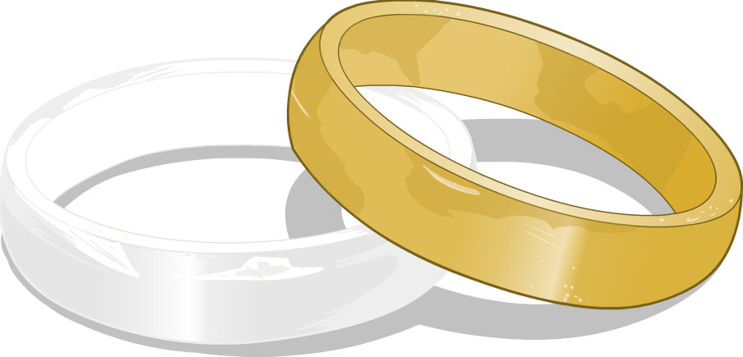
Pure gold?
Although pure gold is sometimes used in electronics, gold jewelry is often a mixture of gold and other metals.
Pure gold is quite soft. Adding small amounts of other metals makes gold hard enough to use in jewelry. Alloying gold with different metals also affects its color.
The familiar yellow gold is an alloy of gold with copper, silver and zinc. Adding more copper than silver gives redder shades.
White gold is an alloy of gold with a metal such as nickel, platinum or palladium.
Notes:
This slide covers the Science and Engineering Practice:
Obtaining, Evaluating, and Communicating Information: Communicate scientific and/or technical information or ideas (e.g. about phenomena and/or the process of development and the design and performance of a proposed process or system) in multiple formats (including orally, graphically, textually, and mathematically).

Slide 13
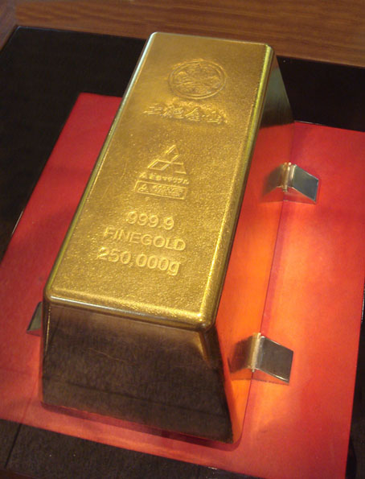
What is 24 carat gold?
The carat scale is widely used by jewelers to refer to the purity of gold in a piece of jewelry.
24 carat gold is pure (99.9%) gold.
18 carat gold is 75% gold and 25% other metals.
12 carat gold is 50% gold.
9 carat gold jewelry is just 37.5% gold.
Notes:
Teacher notes
Another technique which is used to measure the purity of gold and other precious metals is the millesimal fineness system. This measures the number of gold atoms per thousand atoms. Pure gold has a millesimal fineness of 999, 18 carat gold has a millesimal fineness of 750 and so on.
Photo credit: © PHGCOM. This image is reproduced under the terms of the Creative Commons License. A copy of the license can be read at this address http://creativecommons.org/licenses/by/3.0/deed.en
This image shows the world’s largest gold bar, on display at the Toi gold mine in Japan in 2005. At the time, the gold bar was valued at 400 million yen (approximately $3,684,000 USD).

Slide 14
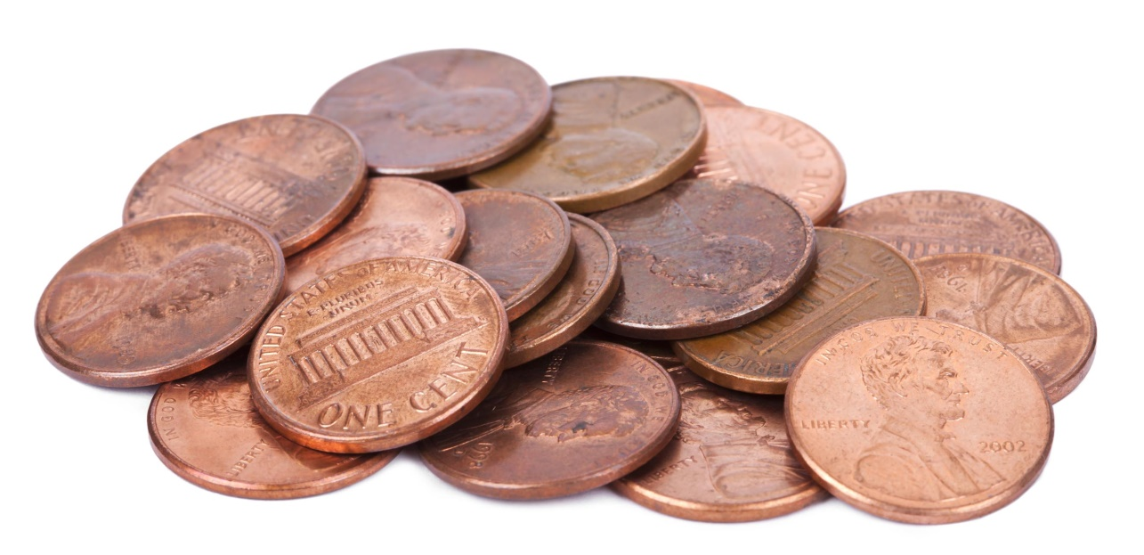
Copper coins
Copper coins used to be made from pure copper. However, as the value of copper increased, the metal used to make the coins became worth more than the actual coins.
Now most “copper” coins are made from copper alloys.
Since 1982, the US penny has been made mostly of zinc. It is copper-plated so that it still appears to be made of copper.
Notes:
Teacher notes
You may like to ask students why copper makes a good metal for coins. Possible answers may include:
copper is strong and does not tarnish easily
copper has antibacterial properties and is a non-allergenic metal, making it safe for people to handle.
This slide covers the Science and Engineering Practice:
Obtaining, Evaluating, and Communicating Information: Communicate scientific and/or technical information or ideas (e.g. about phenomena and/or the process of development and the design and performance of a proposed process or system) in multiple formats (including orally, graphically, textually, and mathematically).
Photo credit: elbud © zhengzaishuru, Shutterstock.com 2018

Slide 15
Aluminum
Aluminum is a very low density metal, which means it is very light for its size. Aluminum is also very resistant to gradual destruction and weakening from corrosion.
These properties make aluminum an excellent material to make airplanes. However, aluminum is also very soft.
Aluminum is combined with other metals to make an alloy that is stronger than pure aluminum, but still benefits from its properties.
Notes:
Teacher notes
Corrosion is the gradual destruction of metals by chemical reactions with substances in the environment. Over time, corrosion changes the appearance of a material as it breaks down and becomes weaker. Aluminum is very resistant to corrosion.
Aluminum is combined with other metals, such as copper, iron, magnesium, tin and zinc, to make an alloy.
This slide covers the Science and Engineering Practice:
Obtaining, Evaluating, and Communicating Information: Communicate scientific and/or technical information or ideas (e.g. about phenomena and/or the process of development and the design and performance of a proposed process or system) in multiple formats (including orally, graphically, textually, and mathematically).

Slide 16
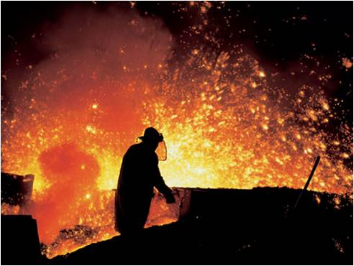
Iron and steel
Iron that has been extracted from its ore in a blast furnace is only about 96% pure. The impurities make the iron brittle.
Most of the iron extracted in the blast furnace will be used to make steel. This is an alloy of iron that contains other elements, including carbon, nickel and chromium.
Steel is stronger than pure iron and can be used for many things, from saucepans to suspension bridges.
Notes:
Teacher notes
For more information about extracting iron in a blast furnace, please refer to the Extracting Metals presentation.
This slide covers the Science and Engineering Practice:
Obtaining, Evaluating, and Communicating Information: Communicate scientific and/or technical information or ideas (e.g. about phenomena and/or the process of development and the design and performance of a proposed process or system) in multiple formats (including orally, graphically, textually, and mathematically).
Photo credit: © VysokePece1. This image is in the public domain.

Slide 17
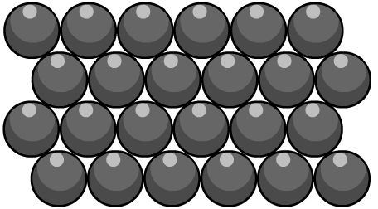
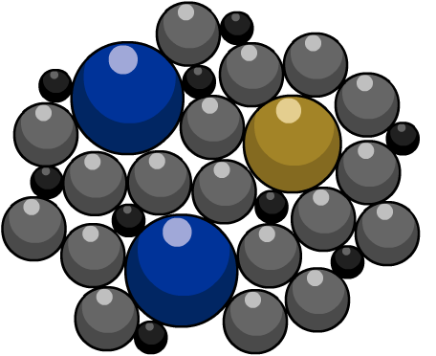
Why is steel stronger than iron?
The atoms in pure iron are arranged in densely-packed layers. These layers can slide over each other, making pure iron a very soft material.
When other elements are added to iron to make steel, their atoms distort the regular structure of the iron atoms.
This makes it more difficult for the layers of iron atoms to slide over each other. As a result, the alloy is stronger than pure iron.

Slide 18
Types of steel
Notes:
Teacher notes
This activity provides information about five important types of steel. The activity could be extended by asking students to suggest or research other types of steel.
Note that high carbon steel is strong but brittle. Low carbon steel is softer and more easily shaped.
This slide covers the Science and Engineering Practice:
Obtaining, Evaluating, and Communicating Information: Communicate scientific and/or technical information or ideas (e.g. about phenomena and/or the process of development and the design and performance of a proposed process or system) in multiple formats (including orally, graphically, textually, and mathematically).
Photo credits: airplane/shuttle (small and large image): NASA. These images are in the public domain; all other images © Photos.com 2018

