Slide 1
Rate of Reaction

Slide 2
Information
Analyzing and Interpreting Data
Using Mathematics and Computational Thinking
3. Scale, Proportion, and Quantity
7. Stability and Change

Slide 3
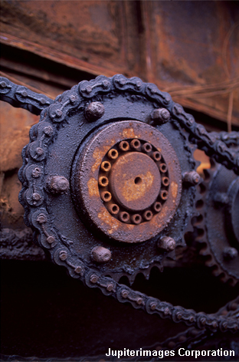
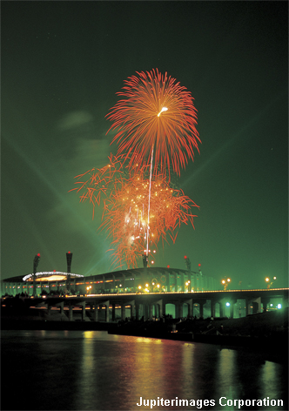
What does rate of reaction mean?
The speed of different chemical reactions varies hugely. Some reactions are very fast and others are very slow.
The speed of a reaction is called the rate of the reaction.
What is the rate of these reactions?
rusting
baking
explosion
slow
fast
very fast
Notes:
This presentation is accompanied by the worksheet Rate of Reaction.
Photo credits: all © Jupiterimages Corporation 2018

Slide 4
How is rate of reaction calculated?
The rate of a reaction can be found by measuring the amount of reactant used, or product formed, over time.
amount of reactant used
amount of product formed
rate of reaction =
OR
time
time
Rates of reaction can be written using several units, including:
g/s or g/min
cm³/s or cm³/min.
Notes:
This slide covers the Science and Engineering Practice:
Using Mathematics and Computational Thinking: Apply ratios, rates, percentages, and unit conversions in the context of complicated measurement problems involving quantities with derived or compound units (such as mg/mL, kg/m3, acre-feet, etc.).

Slide 5
Example rate calculation
If a reaction produces 24 g of product in three minutes, what is the rate of reaction?
24 g
rate of reaction =
3 min
= 8 g/min
OR
24 g
rate of reaction =
3 × 60 s
= 0.13 g/s
Notes:
This slide covers the Science and Engineering Practice:
Using Mathematics and Computational Thinking: Apply ratios, rates, percentages, and unit conversions in the context of complicated measurement problems involving quantities with derived or compound units (such as mg/mL, kg/m3, acre-feet, etc.).

Slide 6
How can rate of reaction be measured?
Measuring the rate of a reaction means measuring the change in the amount of a reactant or the amount of a product.
What can be measured to calculate the rate of reaction between magnesium and hydrochloric acid?
hydrochloric acid
magnesium chloride
magnesium
+
+
hydrogen
the amount of hydrochloric acid used up (cm³/min)
the amount of magnesium chloride produced (g/min)
the amount of hydrogen produced (cm³/min)
Notes:
Teacher notes
The amount of magnesium used up could also be measured to calculate the rate of reaction, but this is more difficult experimentally and there would be too many sources of error.

Slide 7
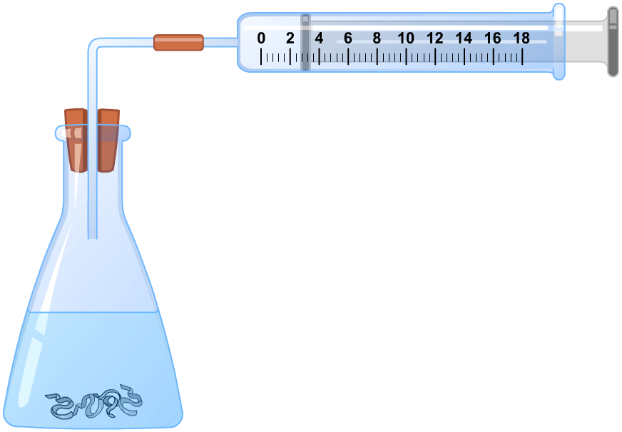
Measuring gas formation (1)
What equipment is needed to investigate the rate of hydrogen production?
glass tube
rubber connecter
gas syringe
conical
flask
rubber bung
hydrochloric
acid
magnesium

Slide 8
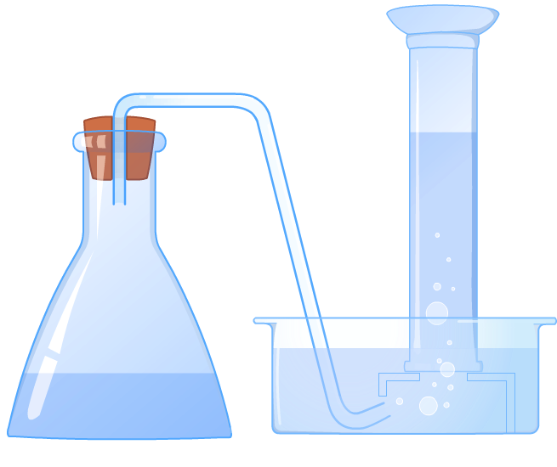
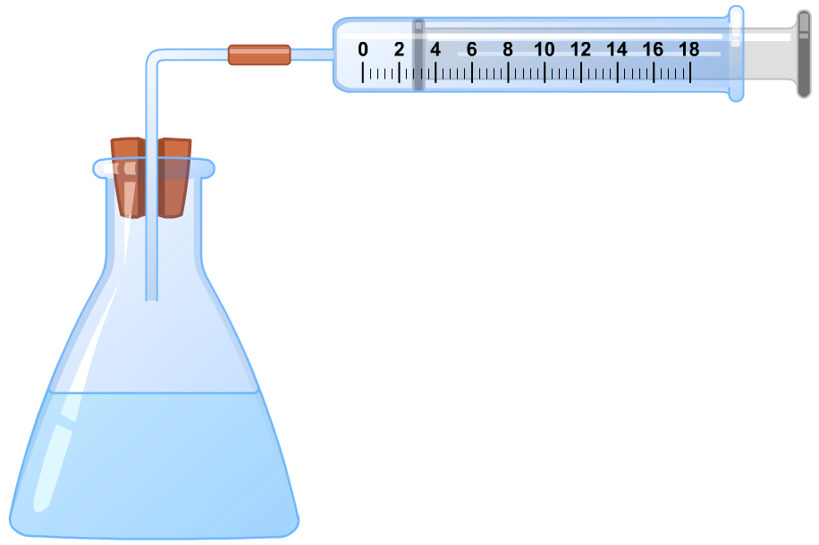
Measuring gas formation (2)
One way of measuring how much gas is produced in a reaction is to use an upturned measuring cylinder filled with water. As the gas bubbles into the measuring cylinder, it displaces the water.
Another method is to use a gas syringe. This technique works well for all gases.

Slide 9
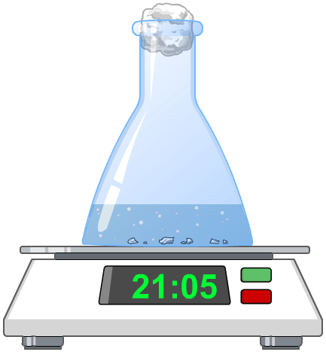
Measuring mass change
Mass change can also be measured to investigate the rate of gas production. This can be done at different times throughout the reaction by following the experiment on a set of scales.
This allows a graph to be drawn of the amount of product formed against time.
This method can be used for the formation of gases but is also useful for liquids and solids.
Notes:
Teacher notes
For an example of a rate of reaction experiment that measures the mass change, please refer to the Changing Reaction Rates presentation.

Slide 10
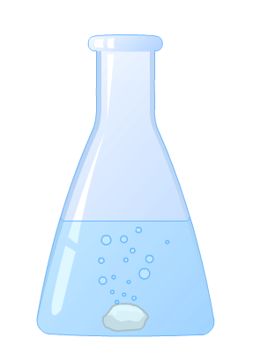
Measuring physical factors
Rate can be measured by just observing an experiment.
For some reactions, we might observe the formation or loss of a color.
The formation or loss of a solid can also be observed over time.
These are more descriptive ways of measuring the rate of reaction.

Slide 11
Measuring concentration
The rate of reaction can also be determined by measuring concentration.
This can either be:
how fast the concentration of the reactants is falling.
how fast the concentration of the products is increasing.
The unit for the rate of reaction for this experiment is a unit of concentration per unit time, mol dm^{–3} s^{–1}.
Notes:
Teacher notes
These units are simply units of concentration per unit time (i.e. how fast the concentration of the substances is falling/increasing).

Slide 12
Interpreting tabular data
The two tables below show the results of two reactions between calcium carbonate and dilute hydrochloric acid, which forms carbon dioxide.
Experiment A
Experiment B
time (s)
volume CO₂ (cm³)
time (s)
volume CO₂ (cm³)
0
0
0
0
5
15
5
7
10
26
10
20
15
37
15
30
20
52
20
42
25
60
25
53
30
60
30
60
Which experiment had the faster rate of reaction?
Notes:
This slide covers the Science and Engineering Practice:
Analyzing and Interpreting Data: Analyze data using tools, technologies, and/or models (e.g., computational, mathematical) in order to make valid and reliable scientific claims or determine an optimal design solution.

Slide 13
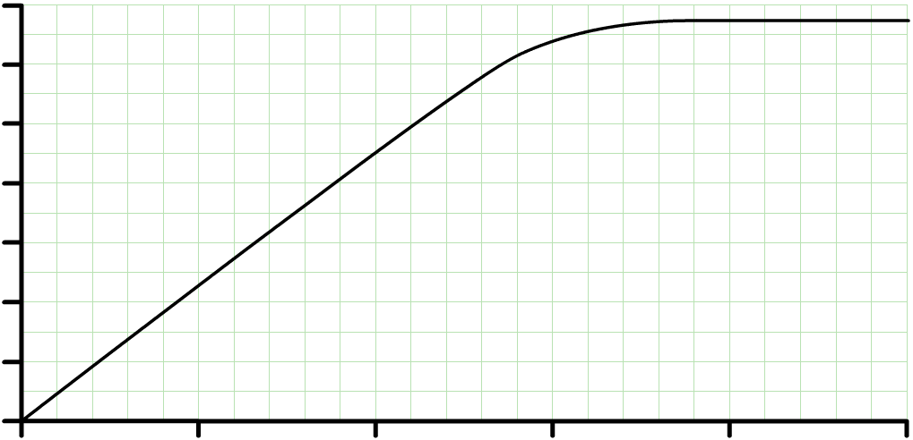
Rate graphs
The mass, volume or observation of the products is measured at regular time intervals.
A graph can then be plotted of the changing reaction condition against time.
70
The rate of reaction is equal to the gradient (slope) of the graph.
60
50
40
hydrogen produced (cm³)
30
20
Calculating the rate at different points shows how the rate changes with time.
10
0
0
10
20
30
40
time (seconds)
Notes:
This slide covers the Science and Engineering Practice:
Analyzing and Interpreting Data: Apply concepts of statistics and probability (including determining function fits to data, slope, intercept, and correlation coefficient for linear fits) to scientific and engineering questions and problems, using digital tools when feasible.

Slide 14
Graphing rates of reaction
Notes:
Teacher notes
This animated graph summarizes the qualitative information provided by the gradient of a graph that plots the amount of product in a reaction against time.
This slide covers the Science and Engineering Practice:
Analyzing and Interpreting Data: Apply concepts of statistics and probability (including determining function fits to data, slope, intercept, and correlation coefficient for linear fits) to scientific and engineering questions and problems, using digital tools when feasible.

Slide 15
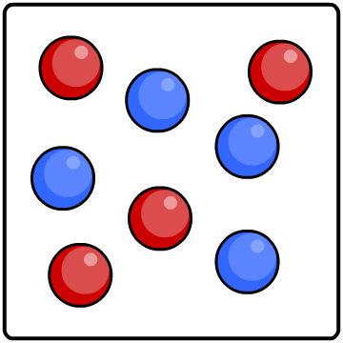
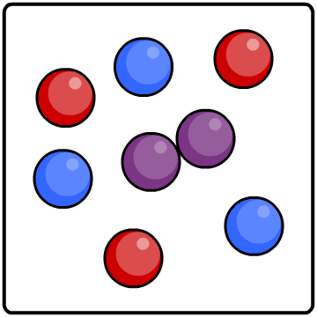
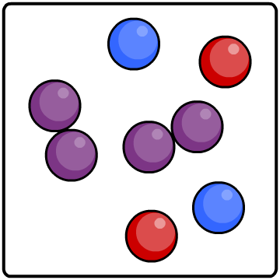
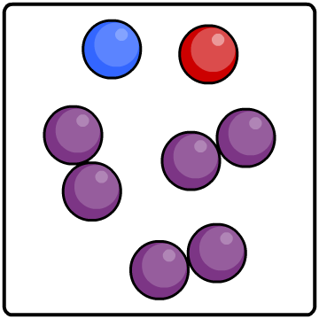
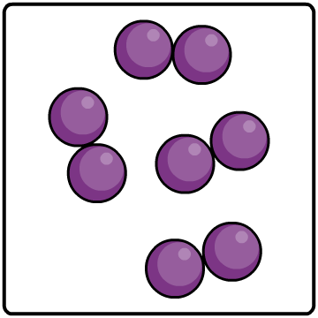
Slower and slower
Reactions do not proceed at a steady rate. They start off at a certain speed, then get slower and slower until they stop.
As the reaction progresses, the concentration of reactants decreases.
This reduces the frequency of collisions between particles and so the reaction slows down.
0%
25%
50%
75%
100%
reactants
percentage completion of reaction
product

Slide 16
Reactant–product mix (1)
Notes:
Teacher notes
This animated graph follows on from the graph on the previous slide, and illustrates how the change in the rate of a reaction can be explained in terms of changing amounts of reactants and product.
This slide covers the Science and Engineering Practice:
Analyzing and Interpreting Data: Apply concepts of statistics and probability (including determining function fits to data, slope, intercept, and correlation coefficient for linear fits) to scientific and engineering questions and problems, using digital tools when feasible.

Slide 17
Reactant–product mix (2)
Notes:
Teacher notes
This drag and drop activity provides the opportunity for an informal assessment of students’ understanding of how the rate of reaction varies with the relative amounts of reactants and product.
This slide covers the Science and Engineering Practice:
Analyzing and Interpreting Data: Apply concepts of statistics and probability (including determining function fits to data, slope, intercept, and correlation coefficient for linear fits) to scientific and engineering questions and problems, using digital tools when feasible.

Slide 18
Calculating rate of reaction from graphs
How can the rate of reaction be calculated from the graph?
70
60
x
rate of reaction
50
40
= gradient (slope)
30
y
change in y
20
=
10
change in x
0
0
10
20
30
40
50
time (seconds)
The gradient of the graph is equal to the rate of reaction.
45 cm³
rate of reaction =
=
2.25 cm³/s
20 s
Notes:
This slide covers the Science and Engineering Practices:
Analyzing and Interpreting Data: Apply concepts of statistics and probability (including determining function fits to data, slope, intercept, and correlation coefficient for linear fits) to scientific and engineering questions and problems, using digital tools when feasible.
Using Mathematics and Computational Thinking: Apply ratios, rates, percentages, and unit conversions in the context of complicated measurement problems involving quantities with derived or compound units (such as mg/mL, kg/m3, acre-feet, etc.).

Slide 19
Measuring rate of reaction from curves
How can the rate of reaction be calculated at a specific time?
70
60
x
y
50
x
40
x
30
change in y
20
rate of reaction =
10
change in x
0
0
10
20
30
40
50
time (seconds)
Draw a tangent to the curve. The gradient of the tangent is equal to the rate of reaction at a specific time.
62 – 45 cm³
rate of reaction =
=
1.70 cm³/s
28 – 18 s
Notes:
Teacher notes
Point out that the rate of reaction at the curve is less than the rate of reaction at the beginning of the reaction. This highlights that reactions often start off at a steady rate and then the rate slowly decreases until the reaction has gone to completion. This is also shown on the next slide.
This slide covers the Science and Engineering Practices:
Analyzing and Interpreting Data: Apply concepts of statistics and probability (including determining function fits to data, slope, intercept, and correlation coefficient for linear fits) to scientific and engineering questions and problems, using digital tools when feasible.
Using Mathematics and Computational Thinking: Apply ratios, rates, percentages, and unit conversions in the context of complicated measurement problems involving quantities with derived or compound units (such as mg/mL, kg/m3, acre-feet, etc.).

Slide 20
Limiting reactants
The amount of product formed in a reaction is directly proportional to the amount of the limiting reactant. This is the reactant that runs out first, bringing the reaction to an end.
The other reactant(s) are in excess. This means that there will be some left after the reaction.
time (s)
H₂ volume (cm³)
0
0
30
150
This table shows the hydrogen gas produced during a reaction between a small amount of magnesium and excess dilute hydrochloric acid.
60
300
90
450
120
600
150
700
180
780
After how many seconds was all the magnesium used up?
210
850
240
850
Notes:
Teacher notes
The magnesium was used up after 210 seconds as no more hydrogen is being produced after this point.
This slide covers the Science and Engineering Practice:
Analyzing and Interpreting Data: Analyze data using tools, technologies, and/or models (e.g., computational, mathematical) in order to make valid and reliable scientific claims or determine an optimal design solution.

