Slide 1
Solutions

Slide 2
Information
Constructing Explanations and Designing Solutions
5. Energy and Matter

Slide 3
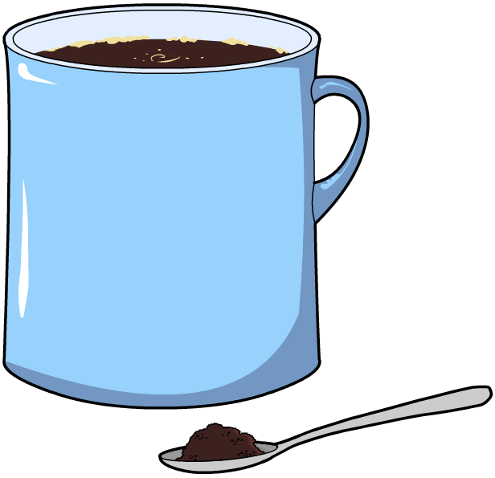
Mixtures and solutions
A mixture is two or more substances that are mixed together but not chemically joined.
A solution is a special type of mixture that is made when a solid dissolves and mixes with a liquid.
For example, a cup of instant coffee is a solution.
The solid that dissolves (e.g. coffee granules) is called the solute.
The liquid that does the dissolving (e.g. hot water) is called the solvent.
How many other examples of solutions can you think of?
Notes:
Teacher notes
Examples of other solutions could include: salt water (salt dissolved in water), bleach (sodium hypochlorite dissolved in water) and carbonated sodas (carbon dioxide dissolved in water).

Slide 4
Solubility experiment

Slide 5
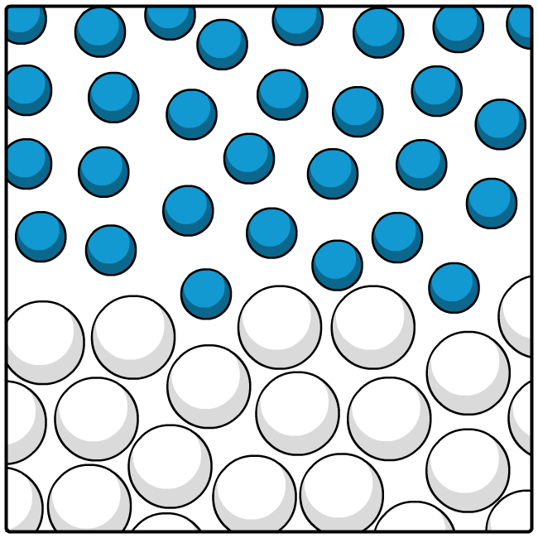
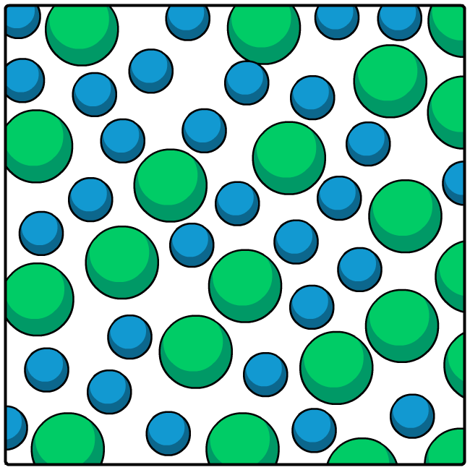
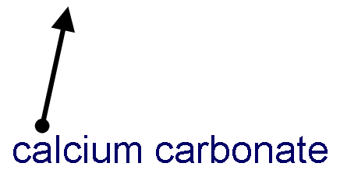
What is solubility?
Calcium carbonate is not soluble in water because the calcium carbonate and water particles are not able to mix.
Copper sulfate is soluble in water because the copper sulfate and water particles are able to mix.

Slide 6
Conservation of mass experiment

Slide 7
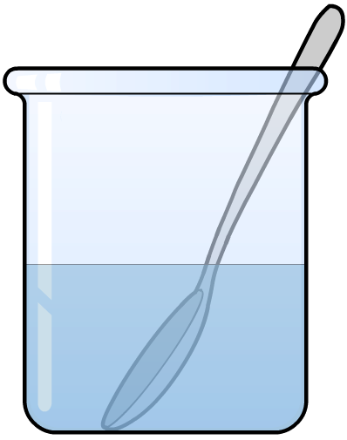
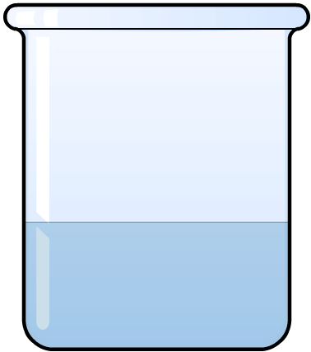
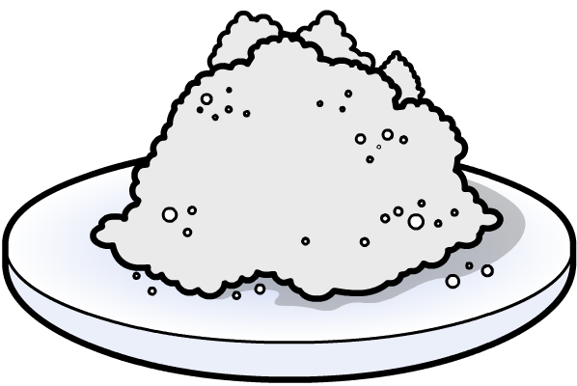
Conservation of mass
If 10 g of salt is added to 50 g of water, what is the mass of the solution?
+
50 g
+
10 g
60 g
?
After evaporating the mixture, would there be exactly 10 g, more than 10 g, or less than 10 g of salt left over?
Notes:
Teacher notes
Due to the conservation of mass, exactly 10 g of salt would be recovered if the mixture is separated by evaporation.

Slide 8
Conservation of mass – extension
If 10 g of salt is added to 50 g of sea water, what is the mass of the solution?
+
50 g
+
10 g
60 g
?
After evaporating the mixture, would there be exactly 10 g, more than 10 g, or less than 10 g of salt left over?
Notes:
Teacher notes
With the sea water already containing salt, it is important that students understand that there will be more than the original 10 g of salt once the mixture is evaporated.

Slide 9
Does a solid keep dissolving?

Slide 10
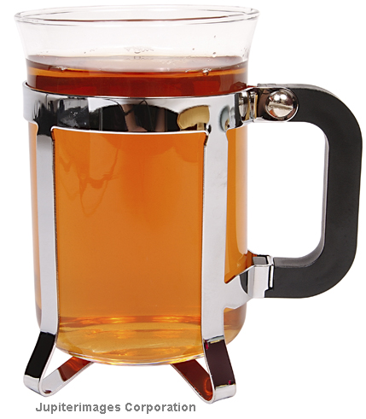
How does temperature affect solubility?
Does sugar dissolve in cold tea?
The sugar does dissolve, but not as much as in a cup of hot tea.
The sugar is more soluble at higher temperatures.
The amount of a solute that can dissolve at a given temperature is called its solubility.
How does temperature affect the solubility of a substance?
The solubility of a substance usually increases as the temperature increases.
Notes:
This slide covers the Science and Engineering Practice:
Constructing Explanations and Designing Solutions: Apply scientific ideas, principles, and/or evidence to provide an explanation of phenomena and solve design problems, taking into account possible unanticipated effects.
Photo credit: © 2018 Jupiterimages Corporation

