Slide 1
The Reactivity Series

Slide 2
Information
Developing and Using Models
Planning and Carrying Out Investigations
Constructing Explanations and Designing Solutions
1. Patterns
7. Stability and Change

Slide 3
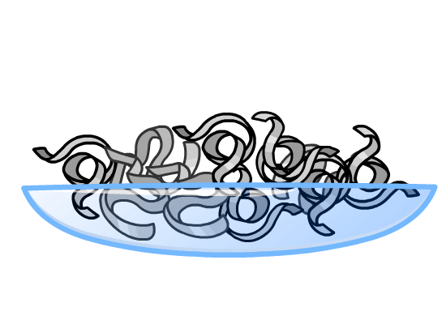
What is the reactivity series
It is possible to arrange a group of elements based on their reactivity. This is how reactive each element is.
Different metal elements have different reactivities.
For example, potassium reacts aggressively with water, whereas gold will not react with water.
The metal elements are arranged in the reactivity series. The most reactive metal is at the top and the least reactive metal is at the bottom.
Notes:
Teacher notes
Reactivity is the extent to which a substance is able to take part in chemical reactions.
This presentation is accompanied by the worksheet The Reactivity Series.

Slide 4
The reactivity series
You can remember the order with this silly sentence:
Please
increasing reactivity
potassium
Carbon and hydrogen are also in the reactivity series, even though they are non-metals.
send
sodium
Charlie’s
calcium
monkeys
magnesium
and
aluminum
carbon
zebras
zinc
in
iron
large
hydrogen
lead
cages
copper
securely
silver
guarded!
gold
Notes:
Teacher notes
Make sure students understand where carbon fits in the reactivity series. Although carbon and hydrogen are not metals, they are included in the reactivity series. This is because the reactivity of metals in some reactions can be predicted by comparison with carbon and hydrogen. All metals above carbon are more reactive than it and all metals below carbon are less reactive.

Slide 5
Reactivity ordering activity
Notes:
Teacher notes
This ordering activity can be related to the different methods of protecting iron from corrosion. In a displacement reaction, the more reactive metal will take the place of the other in the salt. This shows that zinc and magnesium are suitable for use as protection against corrosion of iron. This is because they will displace iron in iron oxide. On the other hand, tin will make iron corrode more rapidly as iron will displace the tin in tin oxide.

Slide 6
Building the reactivity series
During a reaction, metals lose electrons to form positive ions.
Therefore, the reactivity of a metal is related to its ability to form positive ions.
Reactions of metals with water and acids can be used to arrange metal elements in order of reactivity.
We can use the reactivity series to make predictions about the reactions of metals.
Notes:
This slide covers the Science and Engineering Practices:
Developing and Using Models: Develop, revise, and/or use a model based on evidence to illustrate and/or predict the relationships between systems or between components of a system.
Constructing Explanations and Designing Solutions: Apply scientific ideas, principles, and/or evidence to provide an explanation of phenomena and solve design problems, taking into account possible unanticipated effects.

Slide 7
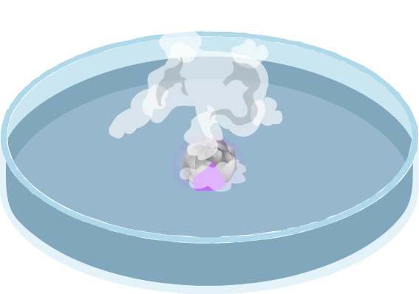
Reacting metals with water
When any metal reacts with water, the products are a metal hydroxide and hydrogen gas.
The general equation for the reaction of a metal with water is:
metal
+
water
metal hydroxide
+
hydrogen
Different metals react with water to a different extent.
What test could you do to show hydrogen is produced?
Notes:
Teacher notes
The squeaky pop test could be carried out to test for hydrogen. A lighted splint is inserted into the test tube, and the hydrogen present burns rapidly. A characteristic squeaky pop can be heard.

Slide 8
Investigating reactivity with water
Notes:
This slide covers the Science and Engineering Practice:
Planning and Carrying Out Investigations: Plan and conduct an investigation or test a design solution in a safe and ethical manner including considerations of environmental, social, and personal impacts.

Slide 9
Which element is more reactive?
From the experiments with water at room temperature, the order of metals in the reactivity series can be determined.
From their reactions with water, what is the order of reactivity for potassium, lithium and rubidium?
metal
reaction with water
lithium
fizzes and slowly disappears
explosive reaction, lilac flame produced immediately
potassium
rubidium
explodes with sparks
Why can magnesium only react with water in the form of steam?
Notes:
Teacher notes
The order of reactivity for potassium, lithium and rubidium is: rubidium>potassium>lithium, where rubidium is the most reactive and lithium is the least reactive.
Magnesium is less reactive than other elements above carbon in the reactivity series. It requires more energy to react with water, and so will only react with water in the form of steam.

Slide 10
Reacting metals with acid
Notes:
This slide covers the Science and Engineering Practices:
Developing and Using Models: Develop, revise, and/or use a model based on evidence to illustrate and/or predict the relationships between systems or between components of a system.
Planning and Carrying Out Investigations: Plan and conduct an investigation individually and collaboratively to produce data to serve as the basis for evidence, and in the design: decide on types, how much, and accuracy of data needed to produce reliable measurements and consider limitations on the precision of the data (e.g., number of trials, cost, risk, time), and refine the design accordingly.

Slide 11
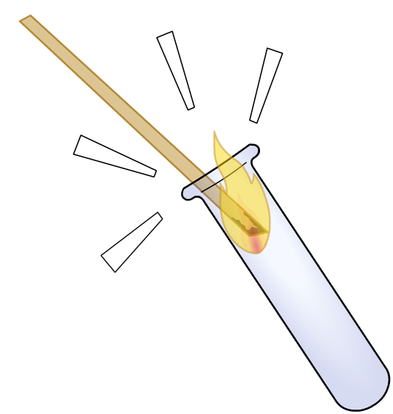
Products of metals reacting with acid
When metals react with acid, a salt and bubbles of gas are produced.
The “squeaky pop” test shows that this gas is hydrogen.
What is the general equation for the reaction of a metal with acid?
The salt produced depends on the metal and type of acid used in the reaction.
Notes:
Teacher notes
The squeaky pop test is a method of testing for hydrogen in a chemical reaction. A lighted splint is inserted into the test tube. If hydrogen is present, a squeaky “pop” sound can be heard. Sometimes the flame is also extinguished.

Slide 12
Metals and hydrochloric acid
What are the balanced equations for these reactions?
hydrochloric
acid
magnesium
chloride
magnesium
+
+
hydrogen
Mg
+
2
HCl
MgCl₂
+
H₂
hydrochloric
acid
zinc
chloride
zinc
+
+
hydrogen
Zn
+
2
HCl
ZnCl₂
+
H₂
hydrochloric
acid
aluminum
chloride
aluminum
+
+
hydrogen
2
Al
+
6
HCl
2
AlCl₃
+
H₂
3
Notes:
Teacher notes
The metal atom is replacing hydrogen in the acid to form metal salts. All metals below hydrogen in the reactivity series are unable to react with acids.

Slide 13
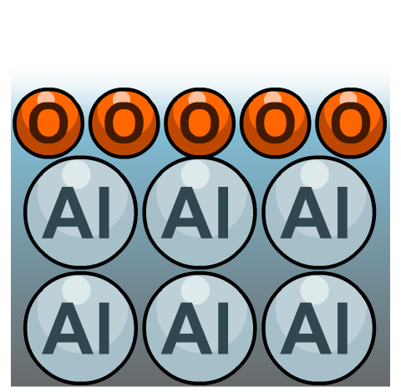
Aluminum – the exception
According to the reactivity series, aluminum should be a fairly reactive metal, but in reality it often appears unreactive. Why?
A protective layer of aluminum oxide quickly forms on its surface. The layer stops aluminum reacting with other substances, such as water in the air. This is why aluminum can be used to build airplanes and saucepans.
oxygen in the atmosphere
If the protective layer is removed, the aluminum reacts more quickly.
coating of oxygen atoms
aluminum atoms
Notes:
This slide covers the Science and Engineering Practice:
Constructing Explanations and Designing Solutions: Apply scientific ideas, principles, and/or evidence to provide an explanation of phenomena and solve design problems, taking into account possible unanticipated effects.

Slide 14
Predicting simple reactions
Use the reactivity series to predict if a reaction will take place and how intense the reaction will be:
increasing reactivity
potassium
metal
reacts with
prediction
sodium
gold
acid
no reaction
calcium
magnesium
calcium
water
fizzing
aluminum
zinc
sodium
oxygen
burns vigorously
iron
very slow reaction
lead
silver
oxygen
copper
silver
zinc
oxygen
burns moderately
gold
Notes:
This slide covers the Science and Engineering Practice:
Developing and Using Models: Develop, revise, and/or use a model based on evidence to illustrate and/or predict the relationships between systems or between components of a system.

Slide 15
What is the order of reactivity?

Slide 16
Reacting metals with oxygen
Most metals react with oxygen.
Some metals react quickly and some only react very slowly. For example, magnesium burns in oxygen with a bright flame.
When a metal reacts with oxygen, the product is a metal oxide.
metal
+
oxygen
metal oxide
The metal gains oxygen, it is an oxidation reaction.
Notes:
Teacher notes
Magnesium reacts with oxygen to produce magnesium oxide.
Metals such as magnesium and iron are used to make sparklers. The metals react with oxygen to produce their respective metal oxides.

Slide 17
What is oxidation?
Oxidation is the addition of oxygen to a substance, or the loss of electrons from a substance.
When iron or steel rusts, it is actually being oxidized.
The iron atoms gain oxygen in the reaction, and so are oxidized. Oxygen is the oxidizing agent.
The oxygen is reduced in the reaction, why?
Notes:
Teacher notes
The oxygen molecules are reduced as they gain electrons from the iron atoms. Iron is the reducing agent.

Slide 18
What is reduction?
To obtain a metal from a metal oxide, the oxygen must be removed.
Reduction is the removal of oxygen from a substance,
or the addition of electrons to the substance.
Carbon can be used to extract some metals by reduction.
In this reaction, the carbon removes oxygen from lead oxide. The lead loses oxygen, and so is reduced by carbon.
Notes:
Teacher notes
This reaction is called a “redox” reaction because both reduction and oxidation are taking place. Lead oxide loses oxygen to form lead, and is therefore reduced. Carbon gains oxygen to form carbon monoxide, and so is oxidized. Students may need to be reminded that only metals that are less reactive than carbon (i.e. below carbon in the reactivity series) can be extracted by reduction.

Slide 19
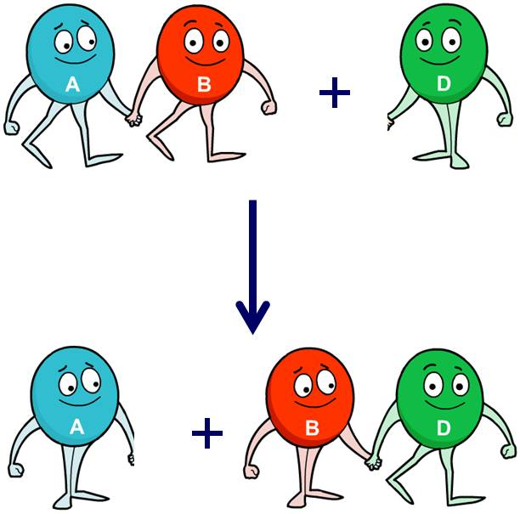
What are displacement reactions?
The reactivity series can be used to predict the products of reactions involving metals.
If two metal compounds react, the more reactive metal pushes out, or displaces, the less reactive metal from its compound.
These are called displacement reactions.
The two metals are competing with each other, and the more reactive metal wins!
Notes:
This slide covers the Science and Engineering Practice:
Developing and Using Models: Develop, revise, and/or use a model based on evidence to illustrate and/or predict the relationships between systems or between components of a system.

Slide 20
Displacement reactions
Notes:
Teacher notes
The displaced copper forms a pink layer on the surface of magnesium.
Students could be asked what would happen if the aqueous metal is more reactive than the solid metal.
A more reactive metal can displace a less reactive metal from a compound. This means that if the metal in solution is more reactive, then the solid metal added will be unable to displace the metal in solution.
This slide covers the Science and Engineering Practice:
Planning and Carrying Out Investigations: Plan and conduct an investigation individually and collaboratively to produce data to serve as the basis for evidence, and in the design: decide on types, how much, and accuracy of data needed to produce reliable measurements and consider limitations on the precision of the data (e.g., number of trials, cost, risk, time), and refine the design accordingly.

Slide 21
Displacement of copper by magnesium
During the reaction of solid magnesium and aqueous copper sulfate, the copper is displaced by magnesium.
Mg(s) + CuSO₄  Cu(s) + MgSO₄(aq)
What is the ionic equation for this reaction?
Mg(s) + Cu²⁺(aq) + SO₄^{2–}(aq)  Cu(s) + Mg²⁺(aq) + SO₄^{2–}(aq)
The sulfate ions (SO₄^{2–}) are unchanged in the reaction, they are therefore not included in the final ionic equation:
Mg(s) + Cu²⁺(aq)  Cu(s) + Mg²⁺(aq)
Notes:
Teacher notes
For more information about writing ionic equations, please refer to the Formulae and Equations presentation.

Slide 22
What happens to the electrons?
What happens to the electrons when magnesium reacts with copper sulfate?
Mg(s) + Cu²⁺(aq)  Cu(s) + Mg²⁺(aq)
Half equations show what happens to the electrons during oxidation and reduction:
oxidation:
Mg  Mg²⁺ + 2e–
reduction:
Cu²⁺ + 2e–  Cu
The magnesium atom loses electrons. It is oxidized.
The copper ion gains electrons. It is reduced.

Slide 23
Predicting the order of reactivity
Displacement reactions can be used to predict the order of reactivity.
Look at the reactions of iron (Fe), copper (Cu) and silver (Ag) below.
reactants
products
Fe (s) + CuSO₄ (aq)
Cu (s) + FeSO₄ (aq)
Cu (s) + 2AgNO₃ (aq)
2Ag (s) + Cu(NO₃)₂ (aq)
What is the order of reactivity?
Fe
Cu
Ag
most reactive
least reactive
Notes:
Teacher notes
Students could discuss the order of reactivity: copper is more reactive than silver as copper displaced silver in the reaction with silver nitrate. As iron displaced copper to form iron sulfate, iron is more reactive than both copper and silver.

Slide 24
Will displacement take place?
Notes:
This slide covers the Science and Engineering Practice:
Developing and Using Models: Develop, revise, and/or use a model based on evidence to illustrate and/or predict the relationships between systems or between components of a system.

Slide 25
Displacement reactions – metal oxides
Metal oxides are involved in displacement reactions.
When a metal is added to a metal oxide, competition occurs for the oxygen atom.
The more reactive metal will displace the less reactive metal to form a new metal oxide.
Look at the displacement reaction between magnesium (Mg) and zinc oxide (ZnO):
As magnesium is more reactive, it displaces zinc. This results in the formation of magnesium oxide (MgO) and zinc (Zn).

Slide 26
Predicting displacement reactions
What happens if silver (Ag) reacts with zinc oxide (ZnO)?
potassium
sodium
calcium
magnesium
aluminum
carbon
zinc
Silver cannot be oxidized as it is below zinc in the reactivity series.
iron
lead
hydrogen
This means it is less reactive than zinc, and no reaction will occur.
copper
silver
gold
platinum
Notes:
This slide covers the Science and Engineering Practice:
Developing and Using Models: Develop, revise, and/or use a model based on evidence to illustrate and/or predict the relationships between systems or between components of a system.

Slide 27
Working out reactivity using metal oxides
Look at the table below. Based on the reactions given, what is the order of reactivity of the metals?
reactants
products
Mg + ZnO
MgO + Zn
Na
increasing reactivity
Mg
Na + MgO
Na₂O + Mg
Zn
Cu
Zn + CuO
ZnO + Cu
What is oxidized and what is reduced in each of these reactions?
Notes:
Teacher notes
Mg + ZnO→MgO + Zn Mg is oxidized and Zn is reduced
Na + MgO→Na₂O + Mg Na is oxidized and Mg is reduced
Zn + CuO→ZnO + Cu Zn is oxidized and Cu is reduced

