Slide 1
Transition Metals

Slide 2
Information
Analyzing and Interpreting Data
Constructing Explanations and Designing Solutions
1. Patterns
6. Structure and Function

Slide 3
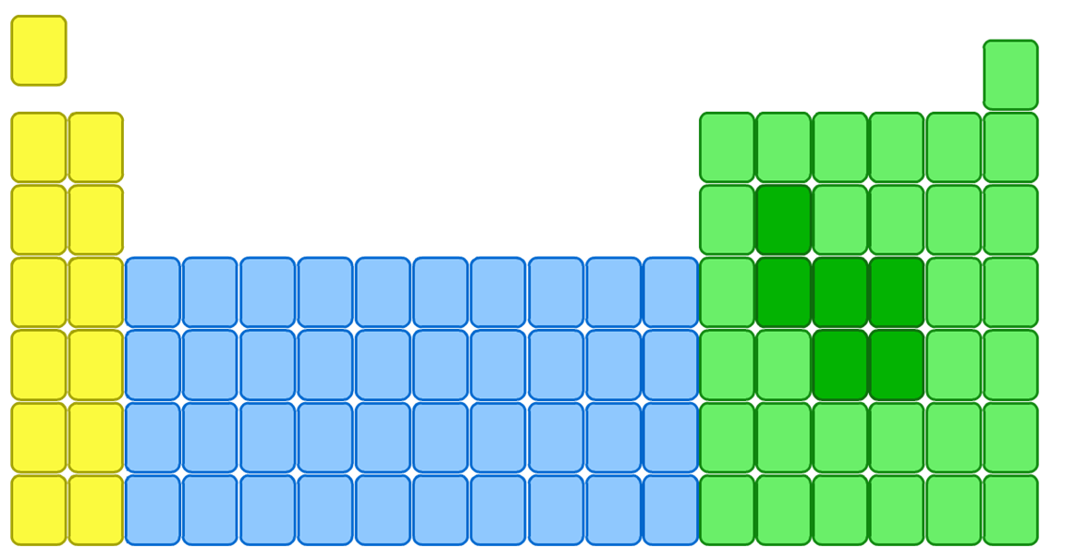
Where are the transition metals?
The transition metals are the block of elements found between group 2 and group 3 of the periodic table.
group 2
group 3
transition metals

Slide 4
Comparing properties of different metals
How do the properties of transition metals compare with those of alkali metals?
Compared to the alkali metals, the transition metals:
are harder and stronger. They cannot be cut with a knife.
are more dense. This means that in a fixed volume of metal, there are more atoms of a transition metal than there are of an alkali metal.
have higher melting and boiling points – except mercury.
Notes:
Teacher notes
The alkali metals are group 1 in the periodic table. For more information about alkali metals, please refer to the Group 1: Alkali Metals presentation.

Slide 5
Comparing densities of metals
Notes:
Teacher notes
This animated graph could be used as a stimulus for either small-group or whole-class discussion on the trends in densities among the transition metals, and as a comparison between the transition metals and some examples of other metals. Potassium (K) and rubidium (Rb) are alkali metals. Their density is much lower than that of the transition metals.
This slide covers the Science and Engineering Practice:
Analyzing and Interpreting Data: Analyze data using tools, technologies, and/or models (e.g., computational, mathematical) in order to make valid and reliable scientific claims or determine an optimal design solution.

Slide 6
Comparing melting points of metals
Notes:
Teacher notes
This animated graph could be used as a stimulus for either small-group or whole-class discussion on the trends in melting points among the transition metals, and as a comparison between the transition metals and some examples of other metals. Potassium (K) and rubidium (Rb) are alkali metals. Their melting point is significantly lower than that of the transition metals.
This slide covers the Science and Engineering Practice:
Analyzing and Interpreting Data: Analyze data using tools, technologies, and/or models (e.g., computational, mathematical) in order to make valid and reliable scientific claims or determine an optimal design solution.

Slide 7
Transition metals: true or false?
Notes:
Teacher notes
This true-or-false activity could be used as an introductory or summary activity on the properties of transition metals, or at the start of the lesson to gauge students’ existing knowledge of the subject matter. Colored traffic light cards (red = false, yellow = don’t know, green = true) could be used to make this a whole-class exercise.

Slide 8
How reactive are the transition metals?
The general trend is for a decrease in reactivity from left to right across a given period in the periodic table.
However, there are exceptions to this rule. For example, zinc is more reactive than expected and iron reacts quite readily with oxygen and water.
Zinc is more reactive than expected.
decrease in reactivity
Where in the transition element block of the periodic table do you think silver and gold are found?

Slide 9
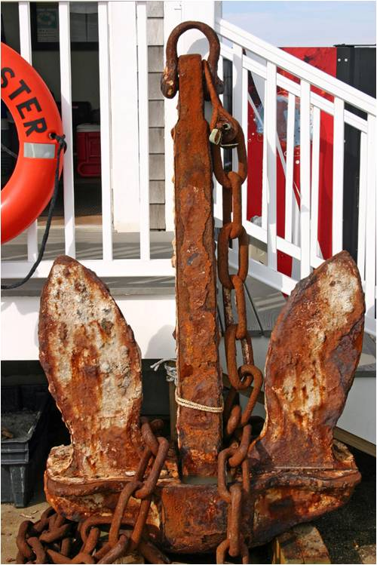
The reactions of metals with water
Unlike alkali metals, transition metals do not react strongly with water.
Many transition metals, including copper, titanium and nickel, do not react with water at all.
Most transition metals are resistant to corrosion. This makes them suitable for structural uses, for example, in cars, buildings and bridges.
One exception is iron, which reacts with water and oxygen to form rust.
Notes:
Teacher notes
Corrosion is the gradual destruction of metals by chemical reactions with substances in the environment.
Photo credit: © Chris Bradshaw, shutterstock.com 2018

Slide 10
How do metals react with air?
Notes:
Teacher notes
Sodium is an alkali metal. Titanium, iron and copper are transition metals.
In stage 1, students should be able to see that the color of the sodium block darkens when it is exposed to air. This is because the sodium is quickly oxidized when it is exposed to the oxygen in air, causing the surface to tarnish. Over a much longer period of time, iron and copper will also react and tarnish.
The reactivity of transition metals tends to increase across a period. However, iron is more reactive than expected.
For more information about stage 2 of this animation, please refer to the Flame Tests and Emission Spectroscopy presentation.

Slide 11
Transition metal ions
When transition metals react, they lose electrons. As a result, they form positive ions.
Some transition metals only make one type of ion. For example:
silver only forms Ag⁺ ions
zinc only forms Zn²⁺ ions.
However, most transition metals can form more than one type of positive ion. This is because they can lose different numbers of electrons. For example:
iron can form both Fe²⁺ and Fe³⁺ ions.

Slide 12
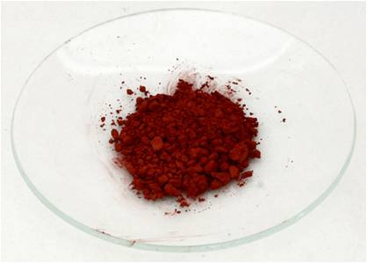
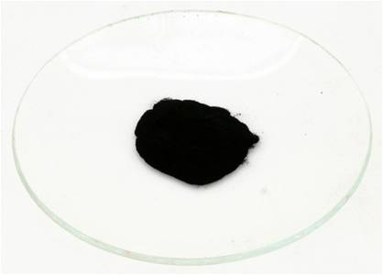
Transition metal compounds
Most transition metals can form different positive ions. This means they can form many compounds.
Copper can form Cu⁺, which can make the red compound copper (I) oxide – Cu₂O.
Copper can also form Cu²⁺, which can make the black compound copper (II) oxide – CuO.
The number in brackets indicates how many electrons have been lost from the neutral copper atom.
Notes:
Photo credit: copper compounds, all © Dr John Mileham, 2018

Slide 13
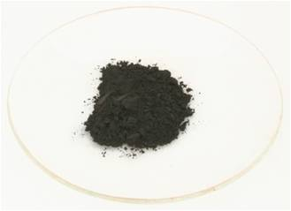
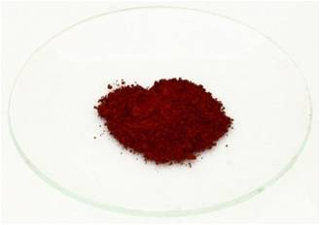
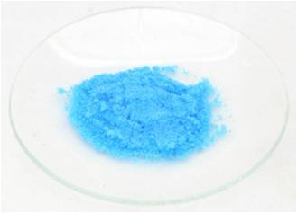
Transition metal compounds and color
Most transition metals form colored compounds.
Iron (II) oxide (FeO₂) is black.
Iron (III) oxide (Fe₂O₃) is red/brown. When combined with water (hydrated) this is rust.
Copper (II) sulfate crystals (CuSO₄.5H₂O) are blue. These can be turned white by heating the crystals to remove the water.
Notes:
Photo credit: colored compounds, all © Dr John Mileham, 2018

Slide 14
Uses of transition metals
Due to their wide range of properties, transition metals have many applications, including:
building materials: they are often strong and hard
jewelry: gold, silver and platinum are shiny and do not react readily with oxygen or water
medicine: titanium is used in artificial joints
paints: colored transition metal compounds are used to color paints and pottery glazes
alloys: transition metal alloys are used in coins, musical instruments and food packaging
catalysts: different transition metals are used as catalysts to speed up reactions in industrial processes.
Notes:
This slide covers the Science and Engineering Practice:
Constructing Explanations and Designing Solutions: Apply scientific ideas, principles, and/or evidence to provide an explanation of phenomena and solve design problems, taking into account possible unanticipated effects.

Slide 15
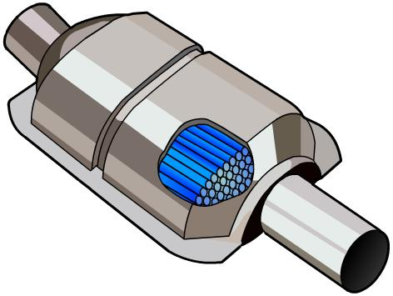
Uses of transition metals: catalysts
A catalyst is a substance that increases the rate of a chemical reaction without being used up. Catalysts improve the efficiency of many industrial processes.
Transition metals are used as catalysts in different industrial processes:
platinum: used in catalytic converters
nickel: a catalyst in the production of margarine
iron: used as a catalyst in the Haber process
vanadium: vanadium oxide is the catalyst in the Contact Process.
Notes:
Teacher notes
The Haber process is used to produce ammonia by reacting nitrogen and hydrogen. For more information about the Haber process, please refer to The Haber Process presentation.
For more information about catalysts and catalytic converters, please refer to the Catalysts presentation.

Slide 16
What are transition metals used for?
Notes:
Teacher notes
Copper is also used as a building material because it is anti-microbial. This property means that bacteria are unable to grow on the surface of copper. Therefore, copper is often used for hospital surfaces that are regularly touched, such as doors and bed rails, to help reduce the spread of disease-causing microbes in hospitals.
Photo credits: bridge, building, ring, toothbrush, Eiffel Tower © Jupiterimages Corporation 2018, bracelet © Matthew Bowden, X-ray © Wellcome Photo Library, thermometer © Tomasz A. Poszwa, pottery © Michel Meynsbrughen, nickel © B Brown, shutterstock.com 2018

