Slide 1
Acceleration

Slide 2
Information
Developing and Using Models
Analyzing and Interpreting Data
Using Mathematics and Computational Thinking
1. Patterns
3. Scale, Proportion, and Quantity
7. Stability and Change

Slide 3
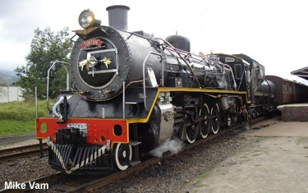
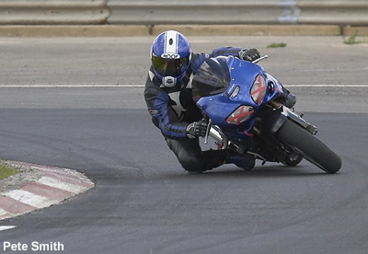
What is acceleration?
The acceleration of an object is a measure of how quickly its velocity changes.
A train accelerates in a straight line from rest. As it does, its velocity increases.
The brakes on this motorcycle are causing it to slow down. This is negative acceleration. Negative acceleration is often called deceleration.
Notes:
Photo credits: train © Mike Vam 2018, motorbike © Pete Smith 2018

Slide 4
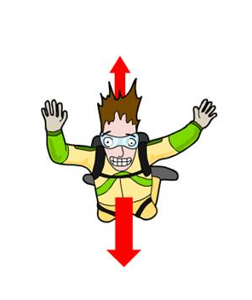
Acceleration and direction
Acceleration is a vector quantity. Vector quantities have a direction as well as a magnitude (size). Scalar quantities only have magnitude.
This means that acceleration must involve either a change in speed, a change in direction, or both.
scalar quantities
vector quantities
mass
velocity
time
acceleration
speed
displacement

Slide 5
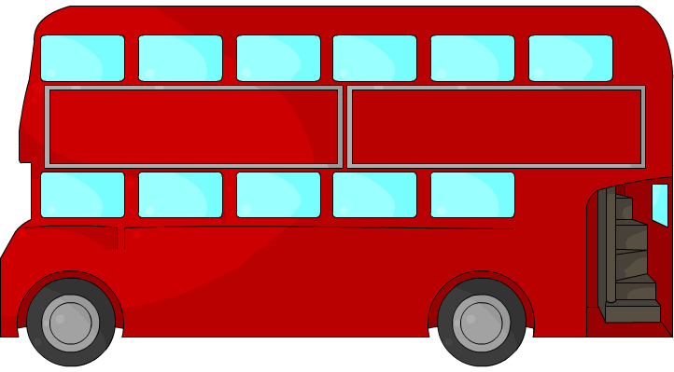
Estimating acceleration
Estimate the acceleration of…
… a speeding roller coaster
roughly 50 m/s²
…a sprinter
around 5 m/s²
…a bus.
about 1 m/s²
Notes:
Teacher notes
Ask students to suggest guesses for these objects. An Olympic athlete, like Usain Bolt, might be capable of accelerations in excess of 9 m/s². A roller coaster would typically provide riders with accelerations between 30 and 60 m/s².

Slide 6
How is acceleration calculated?
The acceleration of an object can be calculated using this equation:
acceleration =
change in velocity
time taken
Like velocity, change in velocity is also measured in meters per second (m/s). It can be positive or negative.
Time taken is measured in seconds (s).
Acceleration is measured in meters per second per second (m/s²). It can be positive or negative.

Slide 7
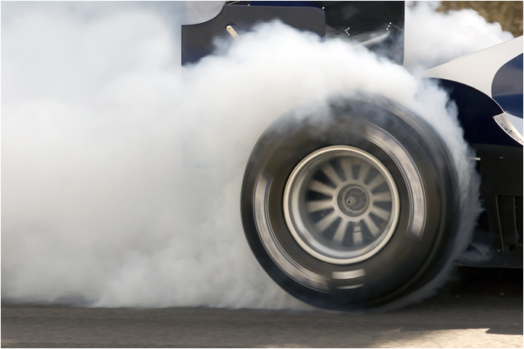
Simple acceleration problem
A racing car accelerates from rest to a velocity of 27 m/s in 2 seconds.
What is its acceleration?
change in velocity
acceleration =
time taken
27 – 0
=
2
= 13.5 m/s²
Notes:
This slide covers the Science and Engineering Practices:
Developing and Using Models: Develop and/or use a model (including mathematical and computational) to generate data to support explanations, predict phenomena, analyze systems, and/or solve problems.
Using Mathematics and Computational Thinking: Apply techniques of algebra and functions to represent and solve scientific and engineering problems.
Photo credit: © Jaywarren79, Shutterstock.com 2018

Slide 8
Developing the formula
The formula to calculate acceleration can also be written like this:
v – u
a =
t
a is acceleration, measured in meters per second squared (m/s²).
v is the final velocity, measured in meters per second (m/s).
u is the initial velocity, measured in meters per second (m/s).
t is the time taken, measured in seconds (s).

Slide 9
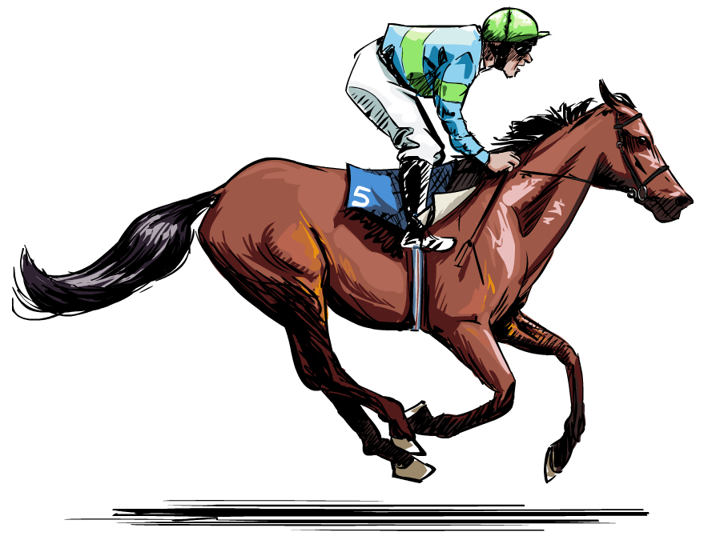
Acceleration problem
A race horse accelerates from 6 m/s to a speed of 12 m/s in a time of 4 seconds. What is the horse’s acceleration?
a =
v – u
t
=
12 – 6
4
= 1.5 m/s²
Notes:
This slide covers the Science and Engineering Practices:
Developing and Using Models: Develop and/or use a model (including mathematical and computational) to generate data to support explanations, predict phenomena, analyze systems, and/or solve problems.
Using Mathematics and Computational Thinking: Apply techniques of algebra and functions to represent and solve scientific and engineering problems.

Slide 10
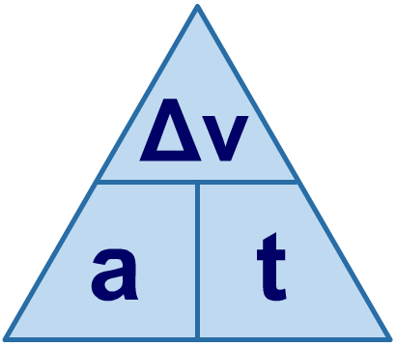
Using a formula triangle
A formula triangle helps you to rearrange a formula. The formula triangle for acceleration (a), change in velocity (Δv) and time (t) is shown below.
Cover the quantity that you are trying to work out. This gives the rearranged formula needed for the calculation.
So to find acceleration (a), cover up a…
…which gives the formula…
÷
÷
Δv
a =
t
×
Notes:
Teacher notes
Students may need reminding that the symbol “Δ” represents “change in.”

Slide 11
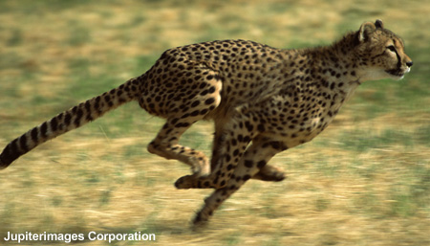
Acceleration problem
A hungry cheetah spots a gazelle and decides to chase it. The cheetah accelerates at 10 m/s² from rest until it reaches 20 m/s. How long did this take?
change in velocity
acceleration =
time taken
change in velocity
time taken =
acceleration
20
=
10
= 2 s
Notes:
This slide covers the Science and Engineering Practices:
Developing and Using Models: Develop and/or use a model (including mathematical and computational) to generate data to support explanations, predict phenomena, analyze systems, and/or solve problems.
Using Mathematics and Computational Thinking: Apply techniques of algebra and functions to represent and solve scientific and engineering problems.
Photo credit: © Jupiterimages Corporation, 2018

Slide 12
Acceleration calculations
Notes:
Teacher notes
There are five questions included in this flash activity. They involve rearranging the acceleration equation and substituting the values given in the question.
This slide covers the Science and Engineering Practices:
Developing and Using Models: Develop and/or use a model (including mathematical and computational) to generate data to support explanations, predict phenomena, analyze systems, and/or solve problems.
Using Mathematics and Computational Thinking: Apply techniques of algebra and functions to represent and solve scientific and engineering problems.

Slide 13
Uniform acceleration
If an object’s acceleration is constant, and it is traveling in a straight line, then this equation applies:
v² – u² = 2 a s
a is acceleration, measured in meters per second squared (m/s²).
v is the final velocity, measured in meters per second (m/s).
u is the initial velocity, measured in meters per second (m/s).
s is the displacement, measured in meters (m).
Acceleration that is not changing is often referred to as uniform acceleration.

Slide 14
Acceleration problem
A cruise ship accelerates from rest at a constant rate and travels in a straight line out of the harbor. If its final velocity is 10 m/s and the distance from the port to the sea is 150 m, what was its acceleration?
v² – u² = 2 a s
divide both sides by 2s
v² – u²
2s
= a
Notes:
This slide covers the Science and Engineering Practices:
Developing and Using Models: Develop and/or use a model (including mathematical and computational) to generate data to support explanations, predict phenomena, analyze systems, and/or solve problems.
Using Mathematics and Computational Thinking: Apply techniques of algebra and functions to represent and solve scientific and engineering problems.
Photo credit: © Ruth Peterkin, shutterstock.com 2018

Slide 15
Acceleration problem
A cruise ship accelerates from rest at a constant rate and travels in a straight line out of the harbor. If its final velocity is 10 m/s and the distance from the port to the sea is 150 m, what was its acceleration?
a =
v² – u²
2s
=
10² – 0²
2 × 150
=
100
300
= 0.33 m/s²
Notes:
This slide is accompanied by the worksheet Acceleration.
This slide covers the Science and Engineering Practices:
Developing and Using Models: Develop and/or use a model (including mathematical and computational) to generate data to support explanations, predict phenomena, analyze systems, and/or solve problems.
Using Mathematics and Computational Thinking: Apply techniques of algebra and functions to represent and solve scientific and engineering problems.
Photo credit: © Ruth Peterkin, shutterstock.com 2018

Slide 16
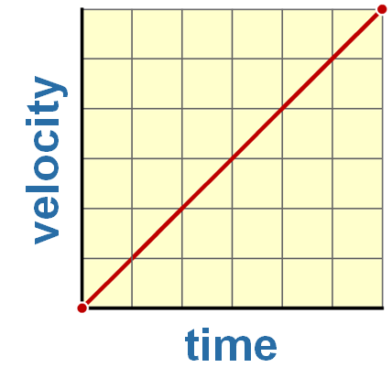
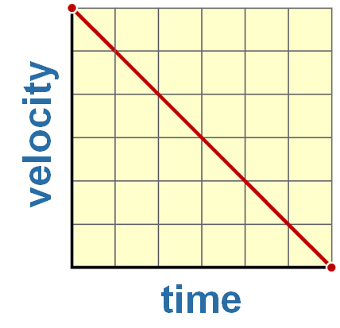
Calculating acceleration from the gradient
A graph of velocity over time can be used to work out the acceleration of an object. Acceleration is represented by the slope of the line: the gradient.
If the gradient goes up, the object has a positive acceleration.
If the gradient goes down, the object has a negative acceleration, or deceleration.
Notes:
16

Slide 17
Analyzing velocity–time graphs
Notes:
Teacher notes
This animated velocity–time graph introduces the idea that the gradient of velocity–time graphs can provide qualitative information about the acceleration of an object. Students should be made aware that deceleration is essentially negative acceleration.
Students could also be made aware that a curved gradient indicates that the object is accelerating or decelerating at a non-uniform (variable) rate.
This slide covers the Science and Engineering Practice:
Developing and Using Models: Develop and/or use a model (including mathematical and computational) to generate data to support explanations, predict phenomena, analyze systems, and/or solve problems.

Slide 18
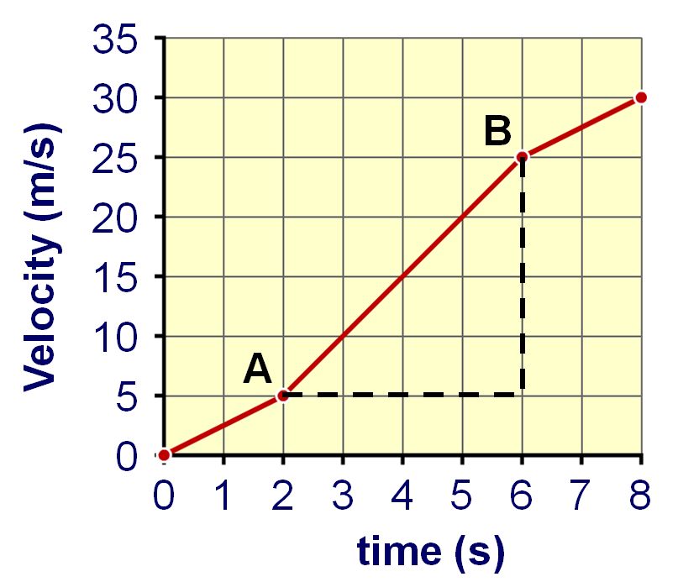
What’s the acceleration?
What is the acceleration of the object between points A and B?
The object’s velocity has increased by 20 m/s (25 – 5 = 20).
It took 4 s to change speed (6 – 2 = 4).
velocity
time
acceleration =
20
=
4
= 5 m/s²
Notes:
This slide is accompanied by the worksheet Acceleration.
This slide covers the Science and Engineering Practices:
Analyzing and Interpreting Data: Apply concepts of statistics and probability (including determining function fits to data, slope, intercept, and correlation coefficient for linear fits) to scientific and engineering questions and problems, using digital tools when feasible.
Using Mathematics and Computational Thinking: Apply techniques of algebra and functions to represent and solve scientific and engineering problems.

Slide 19
Calculating acceleration from a graph
Notes:
This slide covers the Science and Engineering Practices:
Analyzing and Interpreting Data: Apply concepts of statistics and probability (including determining function fits to data, slope, intercept, and correlation coefficient for linear fits) to scientific and engineering questions and problems, using digital tools when feasible.
Using Mathematics and Computational Thinking: Apply techniques of algebra and functions to represent and solve scientific and engineering problems.

Slide 20
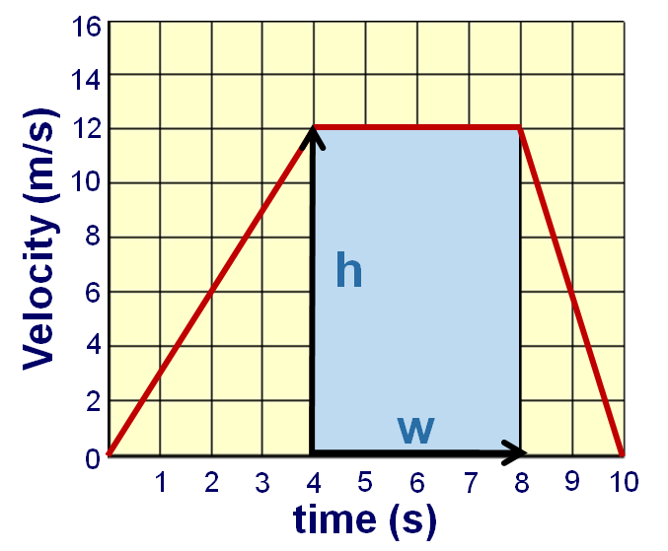
The area under a velocity–time graph
What does the area underneath a velocity–time graph represent?
area = height × width
In a velocity–time graph, the distance along the y axis (i.e. the height of the rectangle) represents the velocity of the object.
The distance along the x axis (i.e. the width of the rectangle) represents the time taken.
Therefore, the area of the rectangle is equivalent to the velocity multiplied by the time:
area = velocity × time
Notes:
Teacher notes
On slides 20 to 22, it is shown that the area underneath a velocity–time graph is equivalent to the displacement. Slide 20 and 21 discuss this mathematically and slide 22 is a flash activity that performs a step-by-step calculation.
This slide covers the Science and Engineering Practice:
Developing and Using Models: Develop and/or use a model (including mathematical and computational) to generate data to support explanations, predict phenomena, analyze systems, and/or solve problems.

Slide 21
The area under a velocity–time graph
What does the area underneath a velocity–time graph represent?
area = velocity × time
Remember that:
distance
velocity =
time
…which rearranges to give…
distance = velocity × time
Therefore:
area under graph = velocity × time = displacement
Notes:
Teacher notes
You could extend this slide by asking students to calculate the total displacement of the object in the graph above (84 m).
This slide is accompanied by the worksheet Acceleration.
This slide covers the Science and Engineering Practice:
Developing and Using Models: Develop and/or use a model (including mathematical and computational) to generate data to support explanations, predict phenomena, analyze systems, and/or solve problems.

Slide 22
The area under a velocity–time graph
Notes:
Teacher notes
This six-part animated sequence provides a step-by-step guide to how the displacement of an object can be calculated from the area underneath its velocity–time graph.
This slide covers the Science and Engineering Practices:
Analyzing and Interpreting Data: Apply concepts of statistics and probability (including determining function fits to data, slope, intercept, and correlation coefficient for linear fits) to scientific and engineering questions and problems, using digital tools when feasible.
Using Mathematics and Computational Thinking: Apply techniques of algebra and functions to represent and solve scientific and engineering problems.

Slide 23
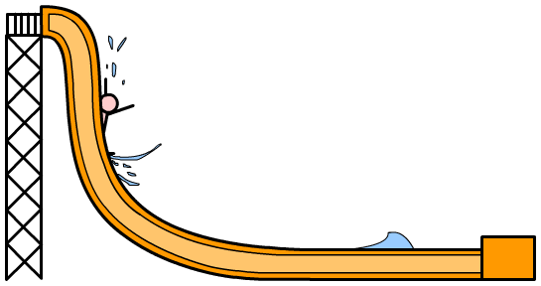
Acceleration and direction
Remember: both velocity and acceleration are vector quantities. Therefore, in order to graph how velocity changes over time, the direction the object is moving in needs to be taken into account.
One way of doing this is to specify the direction first, and only think about how the velocity changes in that particular direction.
As a person goes down this water slide, how does their acceleration affect their velocity in the direction of the arrow?

Slide 24
Velocity–time graphs
Notes:
Teacher notes
These two slides could be extended by asking students to draw other graphs of motion where the object is not traveling in a straight line, such as a golf ball hit from a golf tee.

