Slide 1
Changing Momentum

Slide 2
Information
Asking Questions and Defining Problems
Developing and Using Models
Planning and Carrying Out Investigations
Analyzing and Interpreting Data
Using Mathematics and Computational Thinking
Constructing Explanations and Designing Solutions
2. Cause and Effect
3. Scale, Proportion, and Quantity
4. Systems and System Models
6. Structure and Function
7. Stability and Change

Slide 3
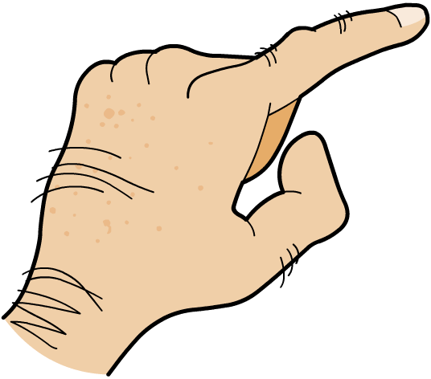
What is a change in momentum?
All moving objects have momentum.
momentum = mass × velocity
The heavier an object is and the faster it moves, the more momentum it will have and the harder it will be to stop.
When a force acts on an object that is moving, or able to move, a change in momentum occurs.
​The cube is stationary and has no momentum.
​Force is applied.
​The cube’s momentum changes; it gains momentum.
Notes:
Teacher notes
It may be helpful to explain to students that the example does not violate the principle of the conservation of energy. Any change in the momentum of a system is balanced by changes in momentum outside the system.
For more information about momentum, please refer to the Momentum presentation.

Slide 4
Force and change in momentum
The change in momentum depends on the size of the force and the time for which it is applied. The relationship between these values is shown by this equation:
change in momentum
force =
time
Momentum, p, is measured in kilogram meters per second (kg m/s).
Time, t, is measured in seconds (s).
Force, F, is measured in newtons (N).

Slide 5
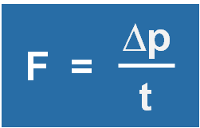
Finding the formula part 1
Where does the formula for change in momentum come from?
change in momentum
time
force =
First, remember that Newton’s second law of motion states:
force = mass × acceleration
F = ma
The formula for acceleration is:
change in velocity
time
∆v
acceleration =
a =
t
Notes:
Teacher notes
Students may need reminding that the delta symbol here is mathematical shorthand for change.
For more information about Newton’s second law, please refer to the Newton’s Second Law of Motion presentation.
This slide covers the Science and Engineering Practice:
Developing and Using Models: Develop and/or use a model (including mathematical and computational) to generate data to support explanations, predict phenomena, analyze systems, and/or solve problems.

Slide 6
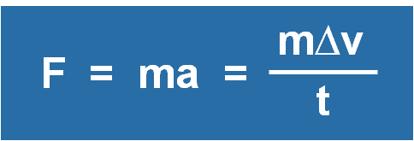
Finding the formula part 2
Substituting the formula for acceleration into Newton’s second law:
Remember the formula for momentum:
momentum = mass × velocity
p = mv
Substitute it into the equation:
m∆v
∆p
F =
=
t
t
Success! Again, we find that the force is equal to the rate of change in momentum.
Notes:
Teacher notes
More mathematically interested students might want to consider the difference (or lack of difference) between:
F = m (Δv/t) and F = m ((v – u)/t), multiplying out both to find
F = mΔv/t and F = (mv – mu) / t
as a method of understanding that mass is considered unchanged between the initial momentum and final momentum.
This slide covers the Science and Engineering Practice:
Developing and Using Models: Develop and/or use a model (including mathematical and computational) to generate data to support explanations, predict phenomena, analyze systems, and/or solve problems.

Slide 7
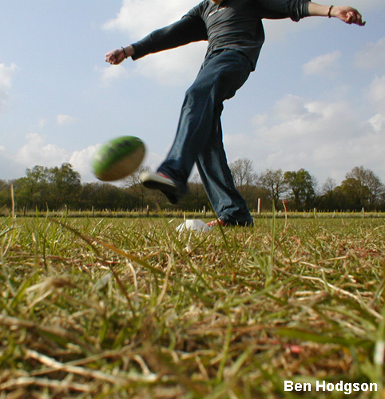
Change in momentum question 1
A football of mass 0.5 kg is kicked from stationary to a velocity of 8 m/s. The kicker’s foot is in contact with ball for 0.1 seconds.
What force does the kicker use?
=
change in momentum
time
force
(0.5 × 8) – (0.5 × 0)
=
0.1
=
4
0.1
=
40 N
Notes:
This slide covers the Science and Engineering Practice:
Using Mathematics and Computational Thinking: Apply techniques of algebra and functions to represent and solve scientific and engineering problems.
Photo credit: © Ben Hodgson, 2018

Slide 8
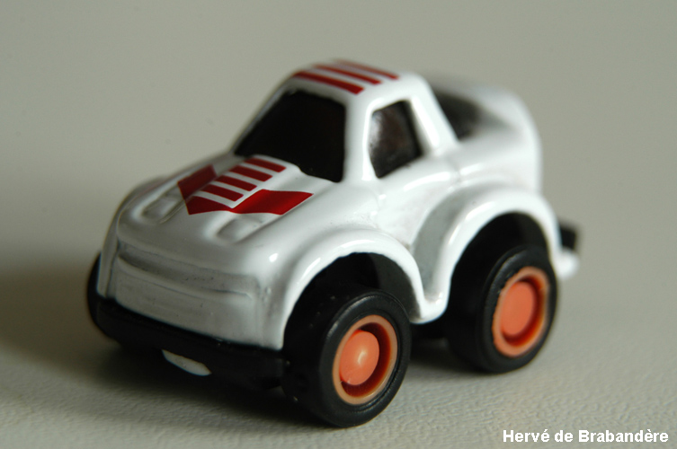
Change in momentum question 2
A tennis ball is rolled at a stationary toy car of mass 0.1 kg. After the collision, the car then moves with a velocity of 0.5 m/s. The ball and car are in contact for 0.05 seconds.
With what force does the tennis ball hit the toy car?
=
change in momentum
time
force
(0.1 × 0.5) – (0.1 × 0)
=
0.05
=
0.05
0.05
=
1 N
Notes:
This slide covers the Science and Engineering Practice:
Using Mathematics and Computational Thinking: Apply techniques of algebra and functions to represent and solve scientific and engineering problems.
Photo credit: © Hervé de Brabandère, 2018

Slide 9
Change in momentum calculations
Notes:
Teacher notes
This flash activity contains five multiple choice calculation questions about changes in momentum. If a wrong answer is selected, a cross will appear, and there will be the opportunity to select another.
This slide is accompanied by the worksheet Changing Momentum.
This slide covers the Science and Engineering Practice:
Using Mathematics and Computational Thinking: Apply techniques of algebra and functions to represent and solve scientific and engineering problems.

Slide 10
Relating force, acceleration and velocity
Sam is a tennis player practising her serve. If she increases the force she uses, what will happen to the acceleration of the ball?
Sam’s coach shows her a new technique that increases the amount of time her racket is in contact with the tennis ball. If she still hits the ball with the same force, what will happen to the velocity of the tennis ball?
Sam buys new tennis balls that are heavier than before. Assuming that she still hits them in the same way with the same force, what will happen to the speed of her serve?
Notes:
Teacher notes
An increase in force will result in an increased acceleration. By extending the time for which the force is applied, the tennis ball gains additional momentum in the form of increased velocity. Increasing the mass of the tennis ball, without changing the force or the time for which it is applied, will decrease the velocity.
This slide covers the Science and Engineering Practice:
Asking Questions and Defining Problems: Ask questions that arise from examining models or a theory, to clarify and/or seek additional information and relationships.

Slide 11
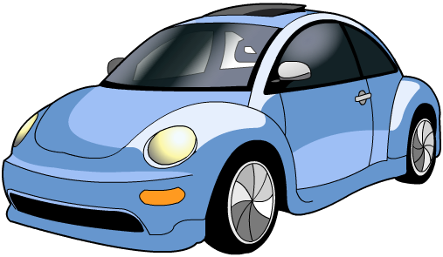
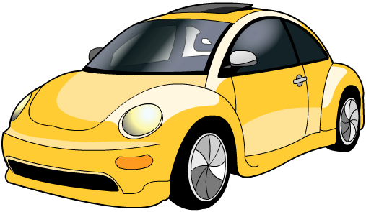
Relating force and momentum
These two cars have the same mass.
If the blue car is traveling at 50 mph, and the yellow car is traveling at 75 mph, which has the most momentum?
Both cars brake at the same time and both travel 10 m before stopping.
Which driver experiences the most force? Why?
Notes:
Teacher notes
The yellow car has more momentum.
The driver in the yellow car experiences a greater force. For students who are more comfortable with algebra, there are many ways to show this mathematically; the following suggested example uses F = ma, a = v/t and v = s/t.
v_{blue}*t_{blue} = v_{yellow}*t_{yellow} because the distance traveled by both is constant. Since the yellow car is traveling faster (i.e. v_{yellow} > v_{blue}), the time taken to stop must be shorter (i.e. t_{blue} > t_{yellow}). Therefore a_{yellow} > a_{blue}, and since the mass is the same, the force must also be larger by F = ma. As an extension, discuss with students whether the force is negative or positive.

Slide 12
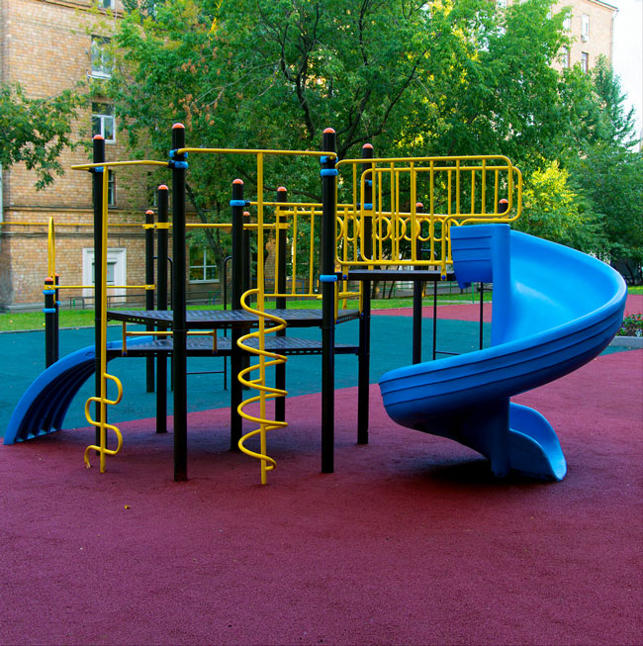
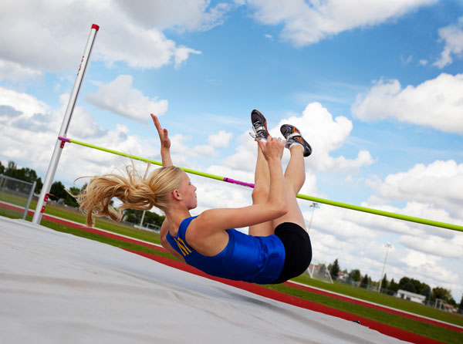
Falling over safely
Increasing the time it takes for a change in momentum to occur is a very useful way of making collisions safer. Many different safety features use this principle.
For instance:
cushioned surfaces in children’s playgrounds
crash mats for athletes
Can you think of any other examples?
Notes:
Photo credits: children’s playground © alex2004, high jumper © Brenda Carson, both at shutterstock.com 2018

Slide 13
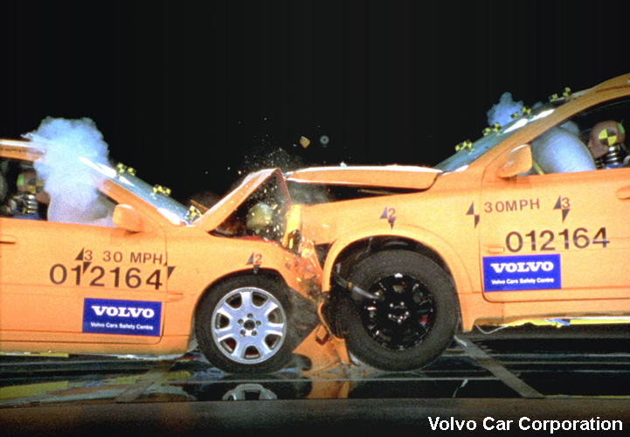
Car crashes and momentum
What happens if two cars traveling very quickly collide?
Both cars come to a stop in a short space of time. This means that the cars and their occupants experience a large change of momentum very quickly.
How can changes in momentum cause a serious injury?
A very large change of momentum in a short space of time means that the car occupants will experience a large force.
How could you use this principle to make cars safer?
Notes:
Photo credit: © Volvo Car Corporation, Public Affairs, SE-405 31 Gothenburg, 2018

Slide 14
Reducing force in car crashes
One way to reduce the forces acting on a person in a collision is to increase the time it takes for the person to decelerate.
A longer deceleration means that the same change in momentum occurs over a longer time. There is therefore a smaller force acting on the person.
Explain how rate of change of momentum is relevant for:
seatbelts
airbags
crumple zones.
Notes:
Teacher notes
You could ask students to suggest explanations, before clicking to the next slide where a flash activity explains the principles behind seatbelts, airbags and crumple zones.
Photo credit: © Volvo Car Corporation, Public Affairs, SE-405 31 Gothenburg

Slide 15
How do car safety features work?
Notes:
Teacher notes
This guide to car safety features explains how seatbelts, airbags and crumple zones reduce the rate of change of momentum in order to minimize the forces acting on passengers or drivers.
This slide is accompanied by the worksheet Changing Momentum.
The worksheet accompanying this slide covers the Science and Engineering Practices:
Planning and Carrying Out Investigations: Plan an investigation or test a design individually and collaboratively to produce data to serve as the basis for evidence as part of building and revising models, supporting explanations for phenomena, or testing solutions to problems. Consider possible variables or effects and evaluate the confounding investigation’s design to ensure variables are controlled.
Planning and Carrying Out Investigations: Select appropriate tools to collect, record, analyze, and evaluate data.
Constructing Explanations and Designing Solutions: Apply scientific ideas, principles, and/or evidence to provide an explanation of phenomena and solve design problems, taking into account possible unanticipated effects.
Constructing Explanations and Designing Solutions: Design, evaluate, and/or refine a solution to a complex real-world problem, based on scientific knowledge, student-generated sources of evidence, prioritized criteria, and trade-off considerations.
Photo credit: Volvo Car Corporation, Public Affairs, SE-405 31 Gothenburg

Slide 16
Seat belts
Seat belts prevent car occupants from being thrown forwards into the steering wheel, windscreen or front seats.
They are also designed to slow the person down gradually. This is why they are made of materials that are able to stretch slightly.
Equal lengths of four materials were stretched and the results recorded. Which is the most suitable for making seat belts?
material
extension caused by 10 N
extension caused by 20 N
weight at which snapped
polythene
3 cm
9 cm
150 N
nylon
1 cm
2 cm
300 N
cotton
1.2 cm
2.4 cm
50 N
steel wool
0.25 cm
0.5 cm
350 N
Notes:
Teacher notes
Nylon is the best material to use, because it stretches, but not too much, and can take a lot of weight without breaking.
Polythene is too stretchy and could allow the person to move too much in a crash.
Cotton breaks too easily for use in seat belts.
Steel wool does not stretch enough to slow the person gradually.
This table could be linked to work on Hooke’s law. Samples of these materials and others could be tested in class to assess their properties. For more information about Hooke’s law, please refer to the Elasticity presentation.
This slide covers the Science and Engineering Practices:
Analyzing and Interpreting Data: Analyze data to identify design features or characteristics of the components of a proposed process or system to optimize it relative to criteria for success.
Constructing Explanations and Designing Solutions: Design, evaluate, and/or refine a solution to a complex real-world problem, based on scientific knowledge, student-generated sources of evidence, prioritized criteria, and trade-off considerations.

Slide 17
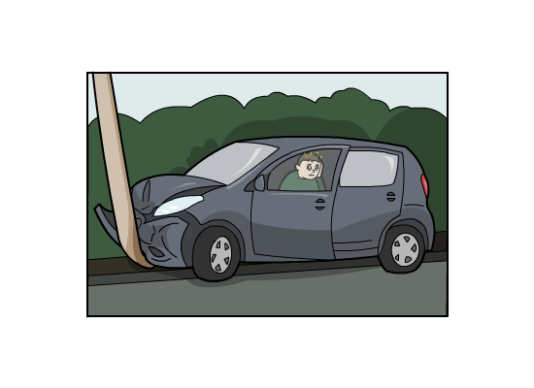
Increasing collision time calculation
A 90 kg driver with no seatbelt crashes at 12.5 m/s, impacting against the steering column in 0.04 seconds. What is the force on the driver?
momentum = mass × velocity
= 90 × 12.5
= 1,125 kg m/s
change in momentum
force =
time
With a seatbelt, the driver would have stopped in 0.2 s.
1,125
=
0.04
What would the force on the driver have been if they had worn a seatbelt?
= 28,125 N
Notes:
Teacher notes
With a seatbelt, the force on the driver would have been:
1,125/0.2 = 5,625 N
This is around a fifth of the force in the original impact.
This slide covers the Science and Engineering Practice:
Using Mathematics and Computational Thinking: Apply techniques of algebra and functions to represent and solve scientific and engineering problems.

Slide 18
Why do we have to wear seatbelts?

Slide 19
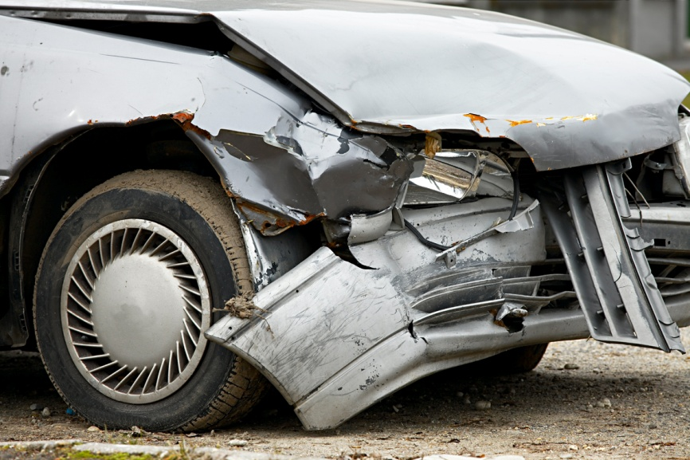
Crumple zones
Crumple zones are areas of cars that are designed to buckle and collapse in a collision.
They help to prevent injuries in two ways:
They increase the duration of the collision so that the occupants decelerate slower.
They absorb some of the energy of the collision by changing shape.
Crumple zones are added to the front, rear and sides of most cars. Why do you think they are biggest at the front?
Notes:
This slide covers the Science and Engineering Practice:
Constructing Explanations and Designing Solutions: Design, evaluate, and/or refine a solution to a complex real-world problem, based on scientific knowledge, student-generated sources of evidence, prioritized criteria, and trade-off considerations.
Photo credit: © (Péter Gudella), Shutterstock 2018

Slide 20
Crumple zone in a crash
Watch this video of a simulated crash test.
How does the crumple zone affect the time it takes for the passenger compartment to slow down?
Notes:
This slide covers the Science and Engineering Practice:
Constructing Explanations and Designing Solutions: Design, evaluate, and/or refine a solution to a complex real-world problem, based on scientific knowledge, student-generated sources of evidence, prioritized criteria, and trade-off considerations.
Video credit: © (saginbay), Shutterstock 2018

Slide 21
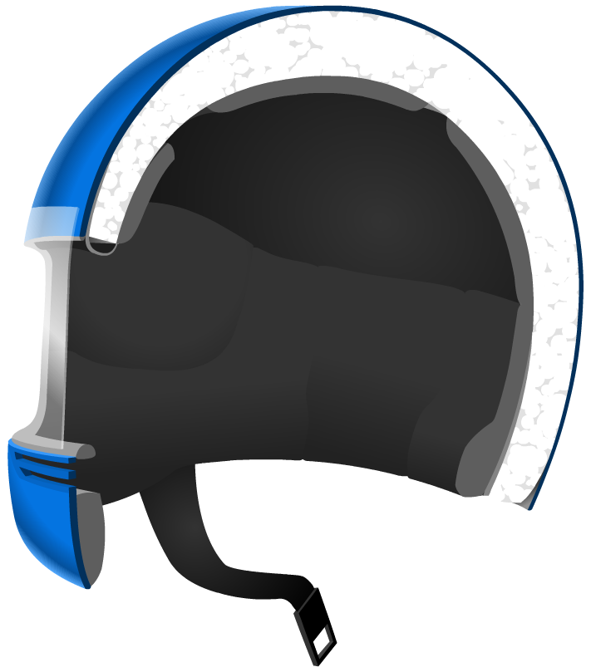
Motorcycle helmets
Motorcycle helmets are designed to prevent injury to the head and brain.
hard casing
They generally contain a layer of crushable foam.
crushable foam
In a collision, the foam part of the helmet crushes, extending the head's stopping time by about six thousandths of a second. This reduces the peak force on the brain.
The hard outer casing holds the foam in place and prevents objects piercing the helmet.
Notes:
This slide covers the Science and Engineering Practice:
Constructing Explanations and Designing Solutions: Design, evaluate, and/or refine a solution to a complex real-world problem, based on scientific knowledge, student-generated sources of evidence, prioritized criteria, and trade-off considerations.

Slide 22
Evaluating different safety measures
Read the information in the table below. Which are the most beneficial safety features?
estimated lives saved in the US per year
safety feature
seat belts
15,000
motorcycle helmets
2,000
airbags
3,000
How accurate do you think these figures are? What problems might researchers face in calculating them?
Notes:
Teacher notes
Data from www.nhtsa.gov.
This slide covers the Science and Engineering Practices:
Analyzing and Interpreting Data: Analyze data to identify design features or characteristics of the components of a proposed process or system to optimize it relative to criteria for success.
Analyzing and Interpreting Data: Consider limitations of data analysis (e.g., measurement error, sample selection) when analyzing and interpreting data.

