Slide 1
Circular Motion

Slide 2
Information
Constructing Explanations and Designing Solutions
2. Cause and Effect

Slide 3
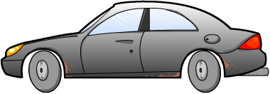
Forces and acceleration
An object will remain stationary or will move in the same direction at a constant speed, unless the forces acting on it are not balanced.
This will cause an acceleration in the direction of the stronger force. This can make an object slow down or speed up, or it can cause it to change direction.
Notes:
This presentation is accompanied by the worksheet Circular Motion.

Slide 4
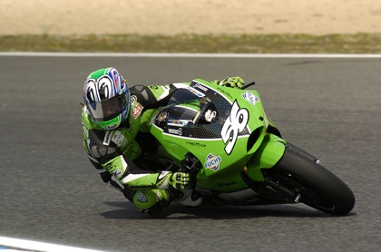
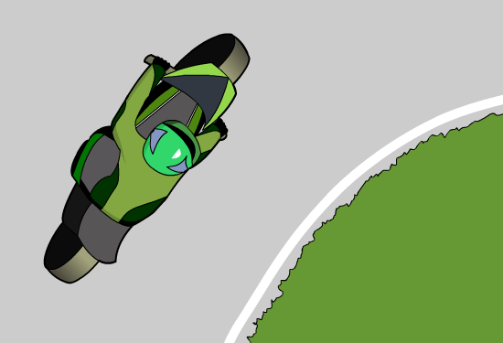
Acceleration in a circle
A motorcycle drives around a corner at a constant speed. Its direction changes as it goes around the corner, so even though its speed is constant, it must be accelerating.
This acceleration must be at right angles (perpendicular) to the direction of movement as it turns the corner, otherwise its speed could not be constant.
Which way do you think the motorcycle is accelerating, towards the inside of the turn, or away from it?
Notes:
This slide covers the Science and Engineering Practice:
Constructing Explanations and Designing Solutions: Apply scientific ideas, principles, and/or evidence to provide an explanation of phenomena and solve design problems, taking into account possible unanticipated effects.
Photo credit: © Luis Louro, Shutterstock 2018

Slide 5
Forces causing circular motion
Any object that moves in a circle must be accelerating towards the center of that circle. What causes this?
What equation do you know that links force and acceleration?
F
=
m × a
Force and acceleration are both vector quantities, unlike mass, so according to this equation, their directions must be equal.
All circular motion must therefore be caused by a force acting towards the center of the circle.
This force is known as the centripetal force.
Notes:
This slide covers the Science and Engineering Practice:
Constructing Explanations and Designing Solutions: Apply scientific ideas, principles, and/or evidence to provide an explanation of phenomena and solve design problems, taking into account possible unanticipated effects.

Slide 6
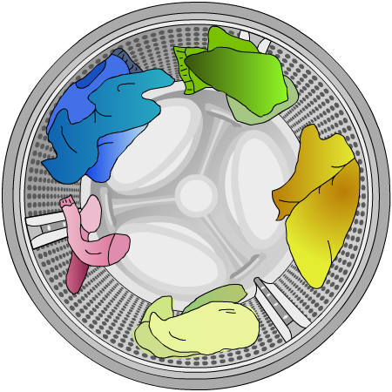
Thinking about circular motion
The centripetal force is not a type of force, like gravity or friction; it is just the name given to the net force on an object if that net force causes the object to continuously change direction.
So an object moves in a circle when a force continuously prevents it from moving in a straight line.
Think about a washing machine. The contact force from the sides of the drum provides the centripetal force that keeps the clothes moving in a circle. The water is free to escape through the holes in the sides, so does not experience the centripetal force and travels in straight lines.
Notes:
This slide covers the Science and Engineering Practice:
Constructing Explanations and Designing Solutions: Apply scientific ideas, principles, and/or evidence to provide an explanation of phenomena and solve design problems, taking into account possible unanticipated effects.

Slide 7
Centrifugal force or centripetal force?
Swing a mass around in a circle on the end of a string. Do you feel a force pulling your hand outwards? This is often called a “centrifugal force.” You might have heard that centrifugal forces cause circular motion, but this is not correct.
The mass on the end of the string is the object that is performing circular motion, so it is the forces on this object that are important. The tension in the string causes the mass to move in a circle: tension is the centripetal force here.
centripetal force
reaction force
The force on your hand is a reaction force.

Slide 8
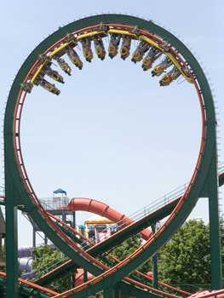
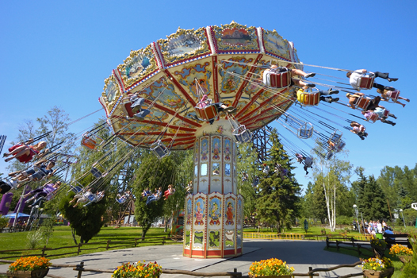
Examples of centripetal forces
Here are two more examples of circular motion caused by centripetal forces:
Can you figure out the direction of the force in each case, and describe the type of force involved?
Notes:
Teacher notes
It might be worth discussing both of these examples with students in some detail, as they are both situations in which the riders might feel as if they are experiencing a “centrifugal force.”
The rollercoaster is kept on the loop-the-loop by a reaction force from the surface of the track. The seats on the carousel are pulled round by the tension in the cables, and the riders are held there by the reaction forces from the surfaces of their seats.
Photo credits: rollercoaster © David C Rehner, carousel © Sergey I, both at Shutterstock.com 2018

Slide 9
What factors affect the centripetal force?

Slide 10
Factors affecting centripetal forces
How does the centripetal force depend on mass?
F = ma, so force is proportional to mass.
The greater the mass, the larger the centripetal force needed to maintain circular motion.
How does the centripetal force depend on speed and radius?
F = ma, so force is proportional to acceleration. If the truck is going faster, or if its radius is smaller, then it is changing direction more quickly, so its acceleration is greater.
The greater the speed, and the smaller the radius, the larger the centripetal force needed to maintain circular motion.
Notes:
This slide covers the Science and Engineering Practice:
Constructing Explanations and Designing Solutions: Make a quantitative and/or qualitative claim regarding the relationship between dependent and independent variables.

Slide 11
Understanding centripetal forces

