Slide 1
Current, Resistance and Potential Difference

Slide 2
Information
Asking Questions and Defining Problems
Developing and Using Models
Planning and Carrying Out Investigations
Analyzing and Interpreting Data
Using Mathematics and Computational Thinking
Constructing Explanations and Designing Solutions
2. Cause and Effect
3. Scale, Proportion, and Quantity
5. Energy and Matter

Slide 3
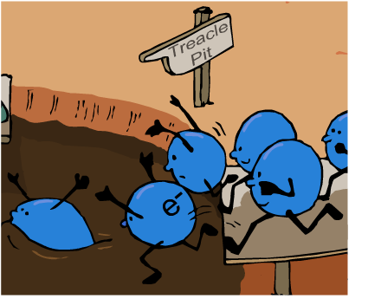
What affects the size of the current?
Current is a measure of the rate of flow of electric charge through a circuit. A larger current means a faster rate of flow.
Current can be changed by increasing or decreasing the potential difference (also known as the voltage) of the circuit.
Components in a circuit may reduce the size of the current. This is called resistance.
All the elements in a circuit, including wires, resist current.
Resistance is a measure of how hard it is for charge to flow round an electrical circuit.
Notes:
This presentation is accompanied by the worksheet Current, Resistance and Potential Difference.

Slide 4
Resistance simulation
Notes:
Teacher notes
This animated activity illustrates why resistance occurs in conductors and why some resistors have a higher degree of resistance than others. While using this activity it should be highlighted that energy is neither created nor destroyed, but transferred from electrical energy to heat and light energy.
This slide covers the Science and Engineering Practices:
Developing and Using Models: Develop, revise, and/or use a model based on evidence to illustrate and/or predict the relationships between systems or between components of a system.
Constructing Explanations and Designing Solutions: Apply scientific ideas, principles, and/or evidence to provide an explanation of phenomena and solve design problems, taking into account possible unanticipated effects.

Slide 5
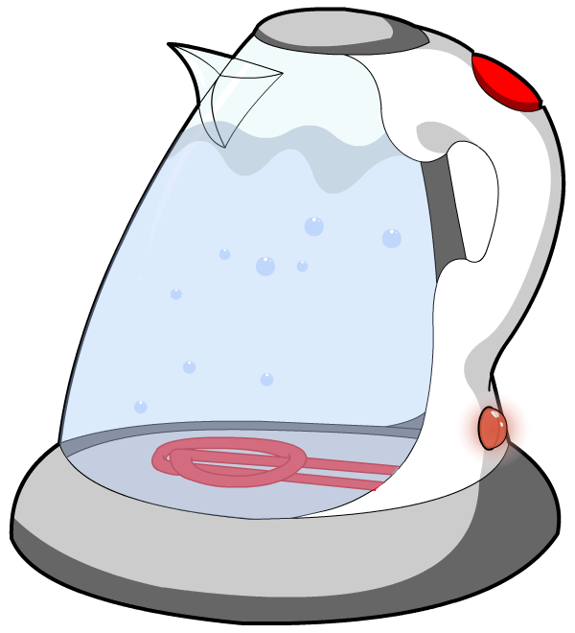
What is a resistor?
A resistor is a component designed to reduce the current.
A variable resistor has a resistance that can be changed.
A fixed resistor has a resistance that remains the same.
Many domestic appliances use resistance to transfer electrical energy to heat and light energy.
As current is passed through the metal element in this kettle, resistance causes the metal to get hot and so boils the water.
Resistors are also used to control the current in electric circuits.
Notes:
Teacher notes
To extend this slide, students could be asked to identify other household items that use resistance in this way, such as a toaster or an electric fire.
For more information about resistors and resistance, please refer to the Resistors presentation.

Slide 6
Current–potential difference graphs
Notes:
Teacher notes
This animated graph could be used to introduce the topic of current-potential difference graphs and Ohm’s law.
Suitable prompts include:
Stage 1: What is the shape of the line?
Stage 2: What will happen to the size of the current if potential difference is multiplied by a factor of four?
Stage 3: This stage introduces Ohm’s law, which states that potential difference = current x resistance (V = I × R). Students could be asked to consider which factors control the size of the current.
This slide covers the Science and Engineering Practice:
Analyzing and Interpreting Data: Analyze data using tools, technologies, and/or models (e.g., computational, mathematical) in order to make valid and reliable scientific claims or determine an optimal design solution.

Slide 7
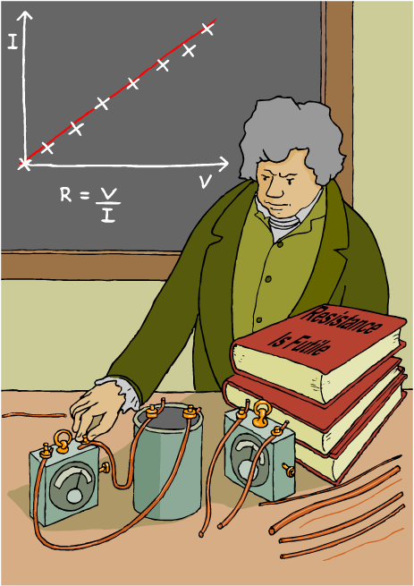
The irresistible Georg Ohm
Resistance is a measure of the amount of opposition to the current.
For any given potential difference, the greater the resistance across a component, the smaller the current.
The connection between current, voltage and resistance was discovered in 1827 by Georg Ohm.
The formula V = I × R is known as Ohm’s Law and the unit of resistance is called the ohm. It is represented by the symbol Ω.
Notes:
Teacher notes
The illustration shows Georg Ohm carrying out an electrical experiment with a simple circuit based on examples of early 19th century electrical equipment (cell and galvanometers). There are wires of different lengths and thicknesses on the right-hand side of the image.

Slide 8
What is Ohm’s law?
Ohm’s law is usually written as:
potential difference = current × resistance
or
V = I × R
What are the units of potential difference, current and resistance?
Resistance (R) is measured in ohms (Ω).
Current (I) is measured in amps (A).
Potential difference (V) is measured in volts (V).
Notes:
This slide covers the Science and Engineering Practices:
Developing and Using Models: Develop and/or use a model (including mathematical and computational) to generate data to support explanations, predict phenomena, analyze systems, and/or solve problems.
Using Mathematics and Computational Thinking: Use mathematical, computational, and/or algorithmic representations of phenomena or design solutions to describe and/or support claims and/or explanations.

Slide 9
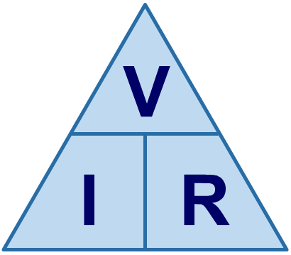
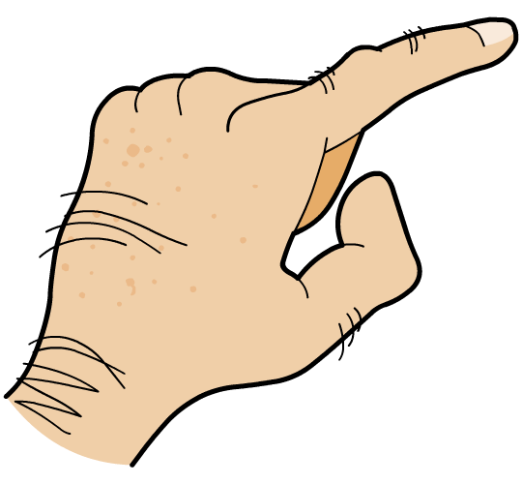
Ohm’s law formula triangle
A formula triangle helps you to rearrange a formula. The formula triangle for V = I R is shown below.
Cover up the quantity that you have to work out. This gives the formula needed.
So to find current (I), cover up I…
…which gives the formula…
÷
÷
I =
×

Slide 10
What does Ohm’s law show?
What do the different arrangements of Ohm’s law show about the relationships between current, potential difference (p.d.) and resistance?
As p.d. increases, the current increases. If the resistance is constant, then doubling p.d. will double the current and vice versa.
V = I × R
This means that p.d. and current are directly proportional.
If voltage is constant, then current decreases as resistance increases. If resistance is doubled, the current will halve.
I = V ÷ R
Current and resistance are inversely proportional.
Notes:
Teacher notes
This slide could be used with higher ability students to help improve their understanding of the subject matter.
This slide covers the Science and Engineering Practice:
Asking Questions and Defining Problems: Ask questions that arise from examining models or a theory, to clarify and/or seek additional information and relationships.

Slide 11
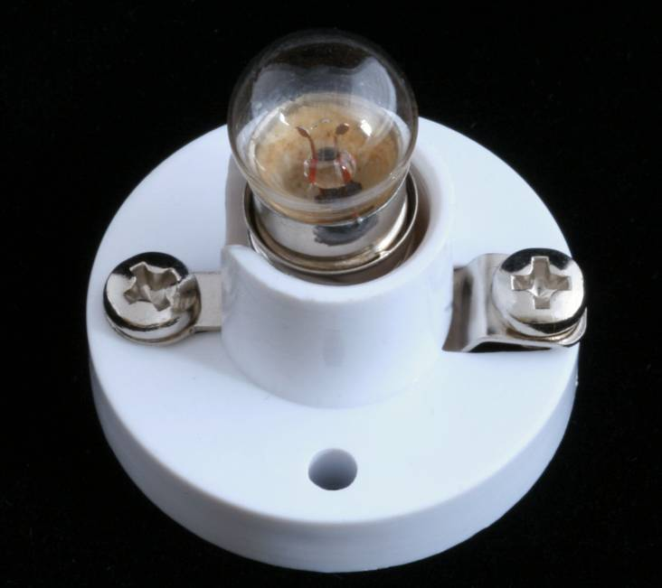
Calculating the resistance of a bulb
A filament bulb has a current of 0.2 A running through it, with a potential difference of 5 V across it.
What is the resistance of the filament in the bulb?
V = I R
V
R =
I
In calculations like this one, the resistance of the connecting wires is usually small enough to be ignored.
5 V
=
0.2 A
= 25 Ω
Notes:
This slide covers the Science and Engineering Practice:
Using Mathematics and Computational Thinking: Apply techniques of algebra and functions to represent and solve scientific and engineering problems.

Slide 12
Resistance calculations
Notes:
Teacher notes
This calculations activity could be used as a summary exercise to check students’ ability to use V = I R.
This slide covers the Science and Engineering Practice:
Using Mathematics and Computational Thinking: Apply techniques of algebra and functions to represent and solve scientific and engineering problems.

Slide 13
Finding the resistance of a component
Notes:
Teacher notes
This flash activity has four statements to complete, with eight drop down boxes.
For more information about connecting components in a circuit, please refer to the Series and Parallel Circuits presentation.

Slide 14
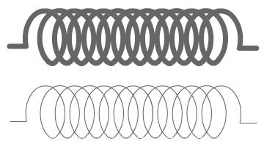
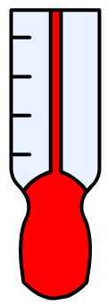
What affects resistance?
The resistance of a wire depends on several factors:
material
thickness
length
temperature
What experiments could be used to test how length and thickness affect resistance?
Notes:
Teacher notes
This slide could be used as an introduction to the investigations covered on the next slides.
This slide covers the Science and Engineering Practice:
Planning and Carrying Out Investigations: Plan and conduct an investigation individually and collaboratively to produce data to serve as the basis for evidence, and in the design: decide on types, how much, and accuracy of data needed to produce reliable measurements and consider limitations on the precision of the data (e.g., number of trials, cost, risk, time), and refine the design accordingly.

Slide 15
Resistance and length
Notes:
Teacher notes
To extend the activity, students could be asked to calculate what the resistance will be before the answer is revealed.
This slide covers the Science and Engineering Practice:
Planning and Carrying Out Investigations: Plan and conduct an investigation individually and collaboratively to produce data to serve as the basis for evidence, and in the design: decide on types, how much, and accuracy of data needed to produce reliable measurements and consider limitations on the precision of the data (e.g., number of trials, cost, risk, time), and refine the design accordingly.

Slide 16
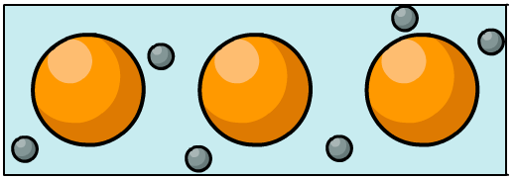
How does length affect resistance?
The table shows the resistance of different lengths of wire.
What general pattern do these results show?
When the length of the wire increases, resistance increases.
Resistance is the result of electrons colliding with metal ions. When the length of the wire is increased, the electrons have to travel further, so more collisions will occur.
Notes:
Teacher notes
The table provides a summary of the results from the virtual experiment on length and resistance on the previous slide.
This slide covers the Science and Engineering Practices:
Analyzing and Interpreting Data: Analyze data using tools, technologies, and/or models (e.g., computational, mathematical) in order to make valid and reliable scientific claims or determine an optimal design solution.
Constructing Explanations and Designing Solutions: Apply scientific ideas, principles, and/or evidence to provide an explanation of phenomena and solve design problems, taking into account possible unanticipated effects.

Slide 17
Resistance and thickness
Notes:
Teacher notes
This simulation activity could be used to investigate the effect of the thickness of a coil on its resistance. It could be used as a precursor to running the practical in the lab, or as a revision exercise. To extend the activity, students could be asked to calculate the resistance in ohms independently before the answer is revealed.
This slide covers the Science and Engineering Practice:
Planning and Carrying Out Investigations: Plan and conduct an investigation individually and collaboratively to produce data to serve as the basis for evidence, and in the design: decide on types, how much, and accuracy of data needed to produce reliable measurements and consider limitations on the precision of the data (e.g., number of trials, cost, risk, time), and refine the design accordingly.

Slide 18
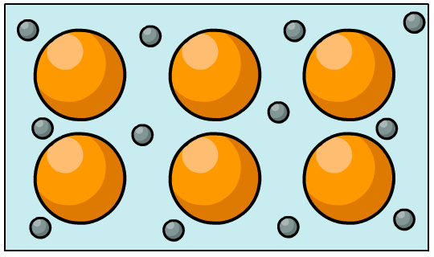
How does thickness affect resistance?
The table shows the resistance of different thicknesses of wire. What general pattern do these results show?
When the thickness of wire increases, resistance decreases.
Increasing the thickness of a wire increases the surface area that the electrons can flow through. This decreases the chance of collisions with metal ions.
Notes:
Teacher notes
The table provides a summary of the results from the virtual experiment on thickness and resistance on the previous slide.
This slide covers the Science and Engineering Practices:
Analyzing and Interpreting Data: Analyze data using tools, technologies, and/or models (e.g., computational, mathematical) in order to make valid and reliable scientific claims or determine an optimal design solution.
Constructing Explanations and Designing Solutions: Apply scientific ideas, principles, and/or evidence to provide an explanation of phenomena and solve design problems, taking into account possible unanticipated effects.

Slide 19
Resistance: an analogy
As the length of the wire increases, the resistance also increases. As the thickness of the wire increases, the resistance decreases.
One way to remember this is to imagine charge carriers as people trying to move through a crowd.
The wider the sidewalk (i.e. the thicker the wire) the easier it is to move through.
The longer the street, the more difficult it is to get to the end without knocking into anyone.
Notes:
Photo credit: © blvdone, shutterstock.com 2018

Slide 20
Factors affecting resistance
Notes:
This slide covers the Science and Engineering Practices:
Developing and Using Models: Develop, revise, and/or use a model based on evidence to illustrate and/or predict the relationships between systems or between components of a system.
Constructing Explanations and Designing Solutions: Apply scientific ideas, principles, and/or evidence to provide an explanation of phenomena and solve design problems, taking into account possible unanticipated effects.

Slide 21
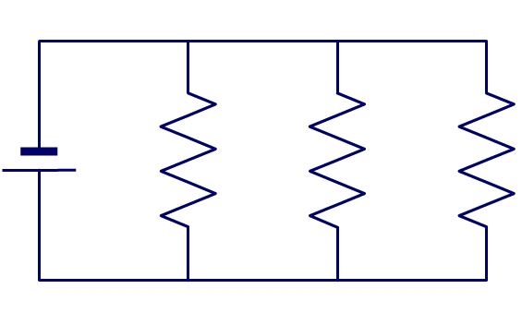
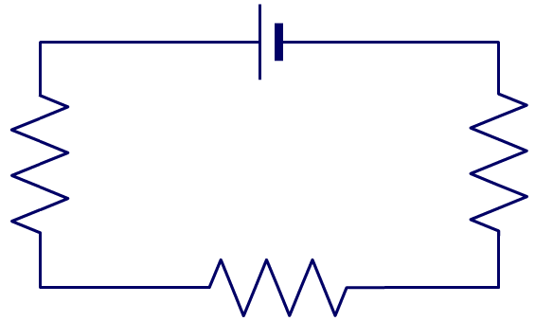
Combining resistances
What happens when a circuit has multiple resistors?
It depends on how the resistors are connected to each other.
in parallel
in series
If resistors are connected in parallel, the total resistance of the circuit is reduced.
If resistors are connected in series, the total resistance of the circuit is increased.
Notes:
Teacher notes
For more information about resistors in series and parallel circuits, please refer to the Series and Parallel Circuits presentation.

