Slide 1
Distance–time Graphs

Slide 2
Information
Developing and Using Models
Analyzing and Interpreting Data
Using Mathematics and Computational Thinking
1. Patterns
3. Scale, Proportion, and Quantity
7. Stability and Change

Slide 3
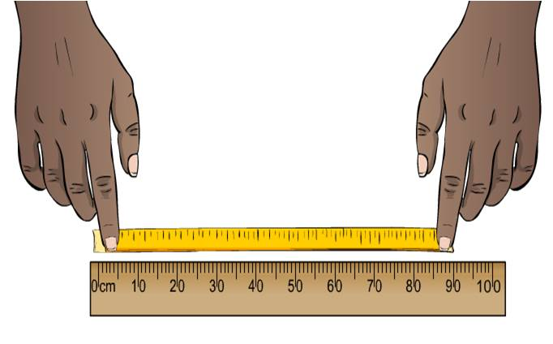
Measuring distance and time
The distance an object has traveled can be measured in lots of different ways.
Simple instruments like rulers and tape measures are useful over short distances. More sophisticated techniques are needed for larger or more accurate measurements.

Slide 4
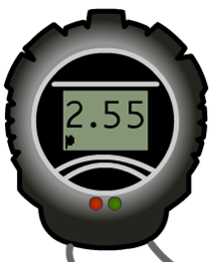
Measuring time
Time is usually measured using some form of clock.
For example, a stopwatch is used to measure how fast someone runs 100 m. This can be automated by a computer to improve accuracy.
The distance an object has traveled over time can be graphed to create a distance–time graph.
Distance-time graphs can help us visualize the motion of the object.

Slide 5
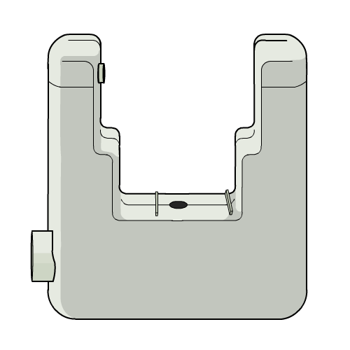
Measuring accurately
Distance
Cars can keep track of distance by measuring the number of rotations a wheel has made and multiplying this by the wheel’s circumference. GPS satellites can also be used to measure large distances.
Time
Time can be measured accurately using light gates. They contain a light source and a sensor. When an object passes through the light gate, the sensor cannot detect light from the source, so the time taken for the object to pass through the light gate can be measured.

Slide 6
Representing speed
Notes:
Teacher notes
This activity can be used as an introduction to speed as a function of distance and time, and could lead on to a discussion about different ways to collect and represent scientific data.
This slide covers the Science and Engineering Practice:
Developing and Using Models: Develop and/or use a model (including mathematical and computational) to generate data to support explanations, predict phenomena, analyze systems, and/or solve problems.

Slide 7
Analysing distance–time graphs
Notes:
Teacher notes
This animated graph is the same as the one shown at the end of the activity on the previous slide, and introduces the idea that the gradient of distance–time graphs can provide qualitative information about the speed of an object. Students should be made aware that non-uniform (variable) speed indicates the object is accelerating or decelerating.
This slide covers the Science and Engineering Practice:
Analyzing and Interpreting Data: Apply concepts of statistics and probability (including determining function fits to data, slope, intercept, and correlation coefficient for linear fits) to scientific and engineering questions and problems, using digital tools when feasible.

Slide 8
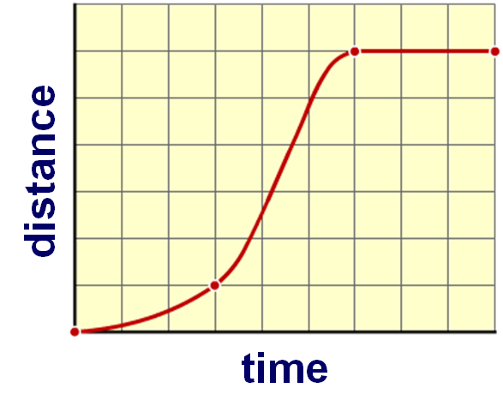
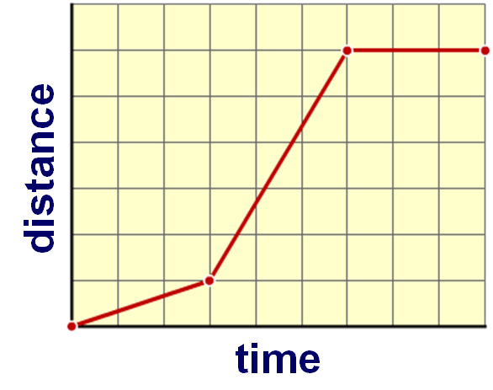
Calculating speed from the gradient
The slope of a graph is called the gradient.
The gradient of the line in a distance–time graph equals the speed.
It is difficult to calculate the gradient of “realistic” graphs because the line is curved.
Simple graphs use straight lines only, making it easy to calculate the gradient.

Slide 9
Calculating speed from graphs
Notes:
Teacher notes
This multiple-choice quiz could be used as an introductory activity to assess students’ understanding how to calculate the speed from the gradient of a distance–time graph.
This slide is accompanied by the worksheet Distance–time Graphs.
This slide covers the Science and Engineering Practices:
Analyzing and Interpreting Data: Apply concepts of statistics and probability (including determining function fits to data, slope, intercept, and correlation coefficient for linear fits) to scientific and engineering questions and problems, using digital tools when feasible.
Using Mathematics and Computational Thinking: Apply techniques of algebra and functions to represent and solve scientific and engineering problems.

Slide 10
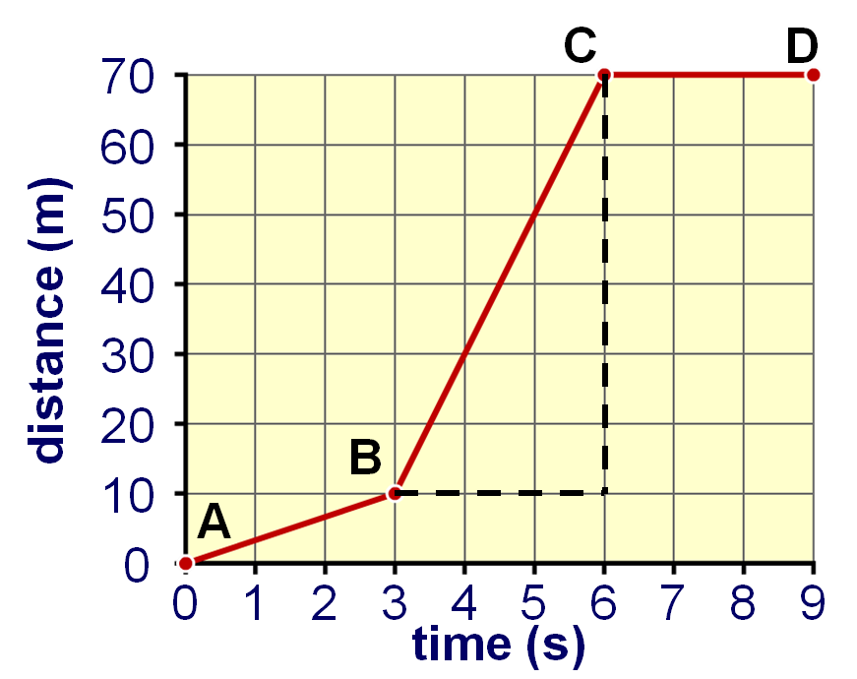
What’s the speed?
What is the speed of the object between points B and C?
the object has moved 60 m (70 – 10 )
it took 3 s to move this distance (6 – 3)
speed = distance/time
= 60/3
= 20 m/s
If you calculate the object’s speed between points A and D, will the answer be the same?
Notes:
This slide covers the Science and Engineering Practices:
Analyzing and Interpreting Data: Apply concepts of statistics and probability (including determining function fits to data, slope, intercept, and correlation coefficient for linear fits) to scientific and engineering questions and problems, using digital tools when feasible.
Using Mathematics and Computational Thinking: Apply techniques of algebra and functions to represent and solve scientific and engineering problems.

Slide 11
Average speed vs. instantaneous speed
Objects often travel at non-uniform velocity: for example, the speed of a race car around a track will vary. The speed at a given point is called the instantaneous speed.
Average speed for one lap will be different to the instantaneous speeds recorded at different points around the circuit.
Instantaneous speed is the gradient of a distance–time graph at one point.
Average speed is total distance divided by total time.
Notes:
This slide covers the Science and Engineering Practice:
Analyzing and Interpreting Data: Apply concepts of statistics and probability (including determining function fits to data, slope, intercept, and correlation coefficient for linear fits) to scientific and engineering questions and problems, using digital tools when feasible.

Slide 12
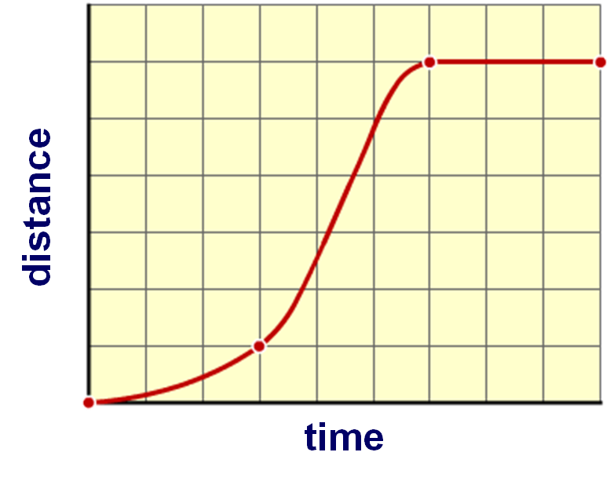
Gradient of a distance-time graph
The instantaneous speed of an object can be calculated from its distance–time graph.
The steepness of the graph tells us how much distance is covered in a small amount of time. This is the speed of the object.
The steepness of the graph is technically called the gradient. We can calculate this value at any point to find the object’s speed.
Notes:
Teacher notes
The blue lines are tangents to the graph. A tangent shows how steep a graph is at any particular point and can be used to calculate an object’s instantaneous speed.
This slide covers the Science and Engineering Practice:
Analyzing and Interpreting Data: Apply concepts of statistics and probability (including determining function fits to data, slope, intercept, and correlation coefficient for linear fits) to scientific and engineering questions and problems, using digital tools when feasible.

Slide 13
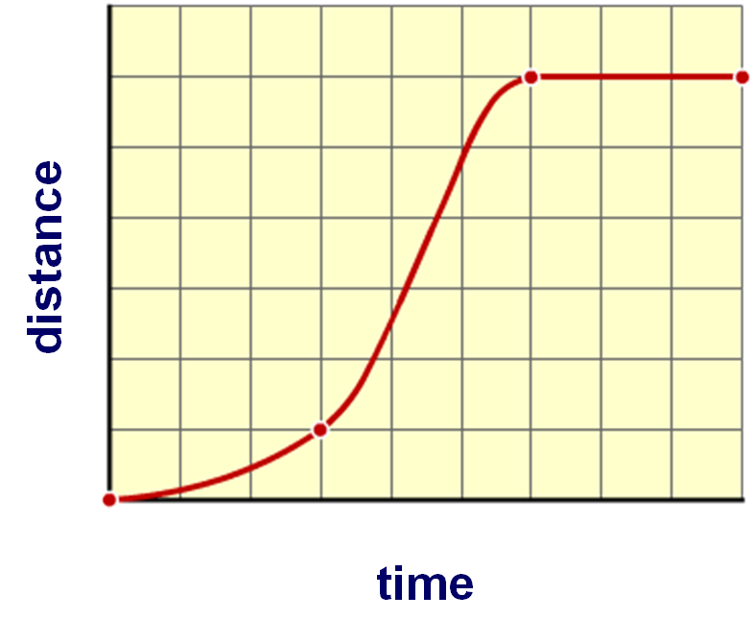
Calculating gradients
To find the gradient of a distance–time graph, first pick the point you are interested in.
Draw a line tangent to this point. The tangent should touch the graph at this point only. This line represents the steepness, or the gradient, at that point.
By then drawing a triangle with this line, the calculation is very similar to calculating average speed.
change in distance
change in time
Notes:
This slide covers the Science and Engineering Practice:
Analyzing and Interpreting Data: Apply concepts of statistics and probability (including determining function fits to data, slope, intercept, and correlation coefficient for linear fits) to scientific and engineering questions and problems, using digital tools when feasible.

Slide 14
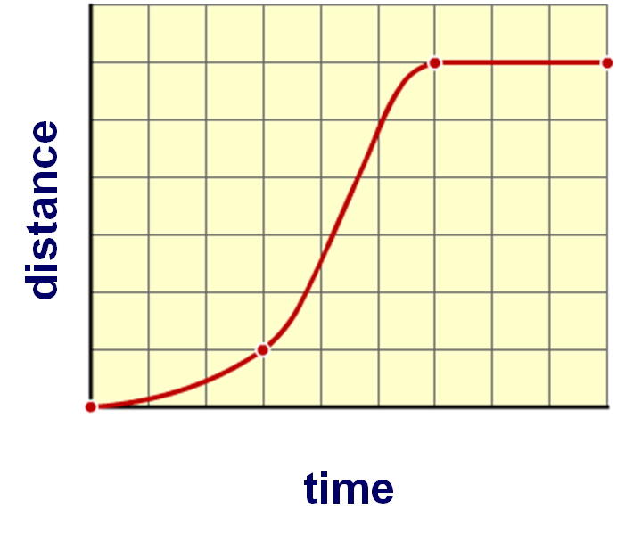
Gradient of a distance-time graph
Speed is always calculated by dividing the distance traveled by the time taken. By dividing the change in distance by the change in time at a particular point, the instantaneous speed is given.
We can find the change in distance and time by subtracting the values on the triangle.
d₂ – d₁
speed = gradient =
d₂
t₂ – t₁
d₁
t₁
t₂
Notes:
This slide covers the Science and Engineering Practice:
Analyzing and Interpreting Data: Apply concepts of statistics and probability (including determining function fits to data, slope, intercept, and correlation coefficient for linear fits) to scientific and engineering questions and problems, using digital tools when feasible.

Slide 15
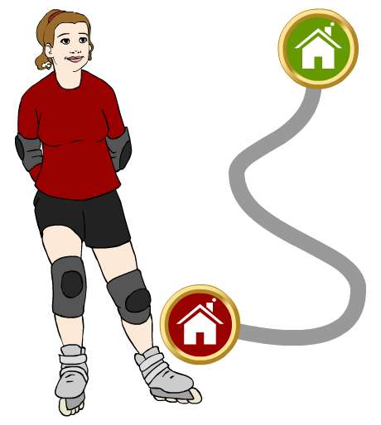
Displacement
Displacement is the net distance from the starting point. It is not the same as the distance an object has traveled.
For example, Jody roller skates 2.1 km to her friend Selma’s house.
displacement = 1.1 km
Her displacement however, is only 1.1 km north east. This is the “straight line” distance she is from her starting point.
Like velocity, displacement measurements must include an indication of direction.
distance
traveled
= 2.1 km

Slide 16
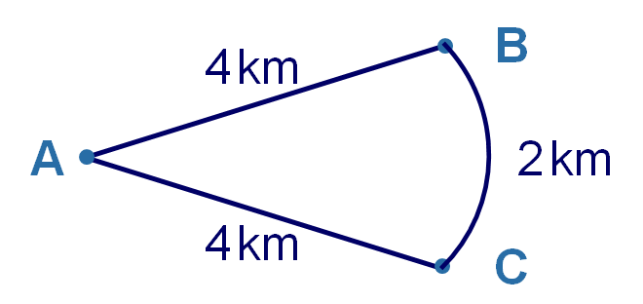
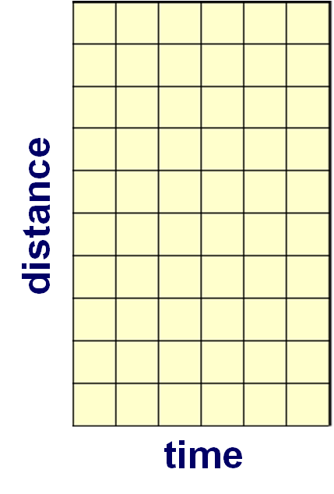
Displacement–time graphs
A displacement–time graph shows how the “straight line” distance from an object’s starting point varies with time.
Mark runs a distance of 10 km at a constant speed. His route is shown below.
Since Mark’s speed was constant, a distance–time graph of his journey is a straight line.
Notes:
This slide covers the Science and Engineering Practice:
Developing and Using Models: Develop and/or use a model (including mathematical and computational) to generate data to support explanations, predict phenomena, analyze systems, and/or solve problems.

Slide 17
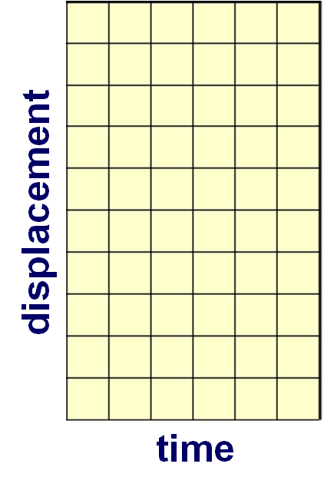
Displacement–time graphs
A displacement–time graph shows how the “straight line” distance from an object’s starting point varies with time.
Mark runs a distance of 10 km at a constant speed. His route is shown below.
As Mark runs from point A to point B, his displacement from his starting point increases.
Notes:
This slide covers the Science and Engineering Practice:
Developing and Using Models: Develop and/or use a model (including mathematical and computational) to generate data to support explanations, predict phenomena, analyze systems, and/or solve problems.

Slide 18
Displacement–time graphs
A displacement–time graph shows how the “straight line” distance from an object’s starting point varies with time.
Mark runs a distance of 10 km at a constant speed. His route is shown below.
As Mark runs from point B to point C, the “straight line” distance from him to the starting point does not change. His displacement stays the same.
Notes:
This slide covers the Science and Engineering Practice:
Developing and Using Models: Develop and/or use a model (including mathematical and computational) to generate data to support explanations, predict phenomena, analyze systems, and/or solve problems.

Slide 19
Displacement–time graphs
A displacement–time graph shows how the “straight line” distance from an object’s starting point varies with time.
Mark runs a distance of 10 km at a constant speed. His route is shown below.
As Mark runs from point C back to point A, he runs towards his starting point. His displacement from his starting point decreases.
Notes:
This slide covers the Science and Engineering Practice:
Developing and Using Models: Develop and/or use a model (including mathematical and computational) to generate data to support explanations, predict phenomena, analyze systems, and/or solve problems.

