Slide 1
Efficiency of Energy Transfers

Slide 2
Information
Asking Questions and Defining Problems
Developing and Using Models
Planning and Carrying Out Investigations
Analyzing and Interpreting Data
Using Mathematics and Computational Thinking
Constructing Explanations and Designing Solutions
2. Cause and Effect
3. Scale, Proportion, and Quantity
4. Systems and System Models
5. Energy and Matter

Slide 3
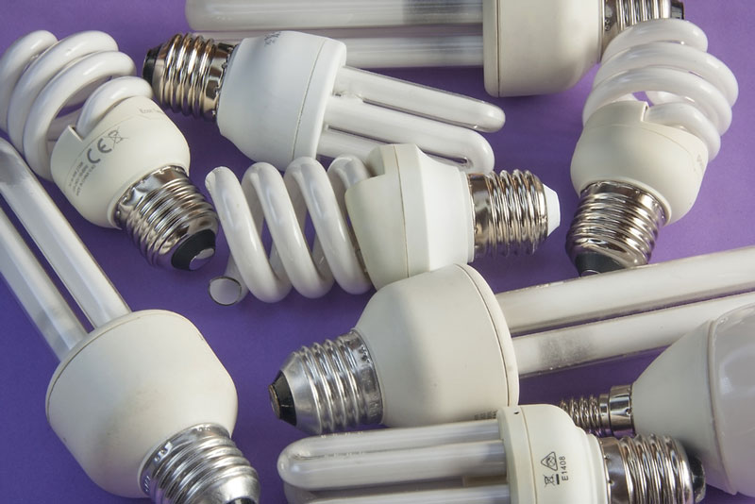
What is energy efficiency?
Efficiency is a measure of how good a device is at changing energy from one form to another.
All devices waste energy, so no device is perfectly efficient.
The more efficient a device is, the less energy is wasted.
An energy-efficient light bulb is more efficient than a filament bulb because it wastes less energy.
It converts a greater proportion of
the energy that it is supplied with
into light energy and not heat.
Notes:
Photo credit: © Carmen Lac, shutterstock.com 2018

Slide 4
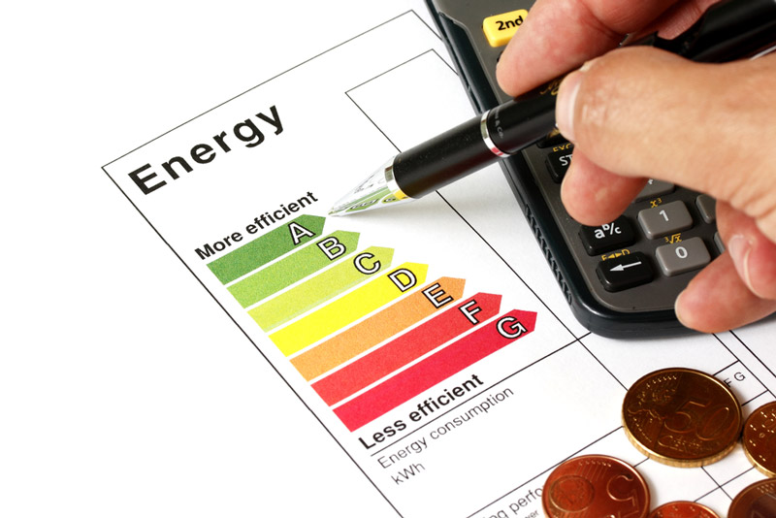
Why is energy efficiency important?
Appliances that are more efficient need less electricity to run.
New electrical appliances display information about how energy efficient they are.
This helps consumers to identify which appliance will use the least energy and cost the least to run.
Energy efficiency is not just about saving money. It is also about reducing pollution and conserving finite energy resources.
Notes:
Photo credit: © MPanchenko, shutterstock.com 2018

Slide 5
How is energy efficiency calculated?
The energy efficiency of a device can be calculated using this formula:
useful output energy
total input energy
energy efficiency =
Useful output energy is measured in joules (J).
Total input energy is measured in joules (J).
Energy efficiency does not have any units. It is a number between 0 and 1 which can be converted into a percentage by multiplying by 100.
Notes:
This slide covers the Science and Engineering Practice:
Developing and Using Models: Develop and/or use a model (including mathematical and computational) to generate data to support explanations, predict phenomena, analyze systems, and/or solve problems.

Slide 6
Efficiency, input energy and output energy
Notes:
This slide covers the Science and Engineering Practices:
Developing and Using Models: Develop and/or use a model (including mathematical and computational) to generate data to support explanations, predict phenomena, analyze systems, and/or solve problems.
Using Mathematics and Computational Thinking: Apply techniques of algebra and functions to represent and solve scientific and engineering problems.

Slide 7
Efficiency and power
The efficiency of a device can be calculated using power instead of energy. Power and energy are closely related. Power is the rate at which energy is transferred.
useful output power
efficiency =
total input power
Useful power is measured in watts (W).
Total power is measured in watts (W).
Efficiency calculations using power are carried out in exactly the same way as calculations using energy. Efficiency can be expressed as a decimal or a %.
Notes:
Teacher notes
Students may need reminding that efficiency has no associated units.
This slide covers the Science and Engineering Practice:
Developing and Using Models: Develop and/or use a model (including mathematical and computational) to generate data to support explanations, predict phenomena, analyze systems, and/or solve problems.

Slide 8
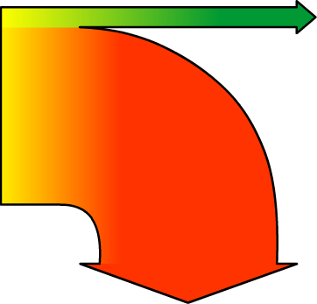
Representing energy transfers
All the energy transfers (useful and wasted) that are associated with a device can be represented by a Sankey diagram. This makes it easy to compare the efficiencies of devices.
A Sankey diagram uses arrows to represent all output energies. The thickness of each arrow is proportional to the output.
filament light bulb
energy efficient light bulb
100 J
electrical
energy
(input)
10 J
light
energy
(output)
20 J
electrical
energy
(input)
10 J
light
energy
(output)
10 J heat energy
(wasted)
90 J heat energy (wasted)
How do these light bulbs compare?
Notes:
Teacher notes
Students should note that the green arrows are the same size; both light bulbs have the same amount of useful energy output of 10 J. However, the amount of energy wasted is drastically different. To extend this slide, ask students to calculate the efficiency of each light bulb from the stated values (10% in the case of the filament light bulb, 50% in the case of the energy efficient light bulb).
This slide covers the Science and Engineering Practice:
Developing and Using Models: Develop and/or use a model (including mathematical and computational) to generate data to support explanations, predict phenomena, analyze systems, and/or solve problems.

Slide 9
Drawing Sankey diagrams
We can draw accurate Sankey diagrams to represent the amount of energy input, the amount of useful energy output and the amount of energy wasted.
Graph paper makes this easy for us to do. The width of each line can be measured in squares. If we look at the energy efficient light bulb:
input energy
= 20 J
= 10 squares
useful output energy
= 10 J
= 5 squares
wasted heat energy
= 10 J
= 5 squares
Notes:
This slide is accompanied by the worksheet Efficiency of Energy Transfers.
This slide covers the Science and Engineering Practice:
Developing and Using Models: Develop and/or use a model (including mathematical and computational) to generate data to support explanations, predict phenomena, analyze systems, and/or solve problems.

Slide 10
The bounce of a ball
Notes:
Teacher notes
This virtual experiment and the following slide can be used to explore the factors that affect efficiency in energy transfers. Students could be asked to interpret the data and come to conclusions. For example:
Why is bounce height always less than drop height?
Why is bounce height a measure of efficiency?
In what form(s) is energy wasted?
If squash courts were carpeted, what difference would that make to the game? Would players have to work harder?
Why would a tennis player be interested in the efficiency of their serve?
This slide covers the Science and Engineering Practices:
Asking Questions and Defining Problems: Ask questions to determine relationships, including quantitative relationships, between independent and dependent variables.
Planning and Carrying Out Investigations: Plan and conduct an investigation individually and collaboratively to produce data to serve as the basis for evidence, and in the design: decide on types, how much, and accuracy of data needed to produce reliable measurements and consider limitations on the precision of the data (e.g., number of trials, cost, risk, time), and refine the design accordingly.
Analyzing and Interpreting Data: Analyze data using tools, technologies, and/or models (e.g., computational, mathematical) in order to make valid and reliable scientific claims or determine an optimal design solution.

Slide 11
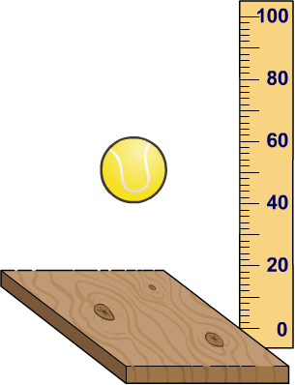
Interpreting bouncing ball data
For each of the three independent variables, analyze the results by answering the following questions:
1. How did the change in variable affect the bounce height?
2. How efficient was the transfer of energy?
For example:
useful output energy
efficiency =
total input energy
=
40 cm
= 40%
100 cm
Therefore, 60% of the energy has been wasted.
Notes:
This slide covers the Science and Engineering Practices:
Analyzing and Interpreting Data: Analyze data using tools, technologies, and/or models (e.g., computational, mathematical) in order to make valid and reliable scientific claims or determine an optimal design solution.
Using Mathematics and Computational Thinking: Apply techniques of algebra and functions to represent and solve scientific and engineering problems.

Slide 12
Experimental conclusions
Did increasing the drop height affect the efficiency?
No. Increasing the drop height increases the amount of energy input. It does increase the bounce height, but does not affect the efficiency of the energy transfer.
Which variables did affect the efficiency?
changing the type of ball
changing the bounce surface
Notes:
This slide covers the Science and Engineering Practices:
Analyzing and Interpreting Data: Analyze data using tools, technologies, and/or models (e.g., computational, mathematical) in order to make valid and reliable scientific claims or determine an optimal design solution.
Constructing Explanations and Designing Solutions: Make a quantitative and/or qualitative claim regarding the relationship between dependent and independent variables.

