Slide 1
Elasticity

Slide 2
Information
Developing and Using Models
Planning and Carrying Out Investigations
Analyzing and Interpreting Data
Using Mathematics and Computational Thinking
Constructing Explanations and Designing Solutions
1. Patterns
3. Scale, Proportion, and Quantity
5. Energy and Matter
6. Structure and Function

Slide 3
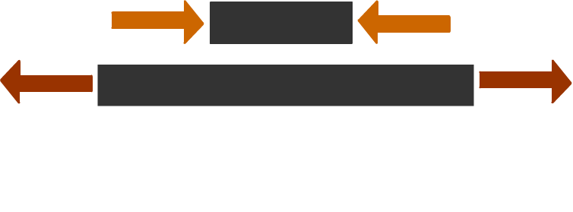
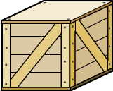
Deforming objects
Forces can make objects change their speed or their direction when they are in motion. They can also make objects change shape, or deform.
compression
tension
Objects in compression are being squashed. Objects in tension are being stretched.
This beam is bending under a weight. The top edge is being compressed, whilst the bottom edge is being stretched.
Notes:
Teacher notes
Ask students to come up with scenarios involving compression, tension or both. Shelves, bridges, springs and rubber bands are all common examples.

Slide 4
Stretching an elastic band
Imagine holding an elastic band between your hands and slowly moving your hands apart.
The elastic band stretches.
Now imagine holding the elastic band in just one place and trying to stretch it.
It does not work. Why is this?
Notes:
Teacher notes
You can demonstrate this to the class using a large elastic band. You could demonstrate a similar phenomenon involving compressive forces by using a peg or clip.

Slide 5
Changing the shape of an object
If just one force is applied to a stationary object, the object will move in the direction of the force.
The shape of the object will not change.
To change the shape of an object, applying one force alone is not enough. At least two forces acting in different directions are needed.
Whether the object is stretched, compressed or bent depends on the direction of the forces.
Notes:
This slide covers the Science and Engineering Practice:
Constructing Explanations and Designing Solutions: Apply scientific ideas, principles, and/or evidence to provide an explanation of phenomena and solve design problems, taking into account possible unanticipated effects.

Slide 6
Elastic or plastic?
Materials can undergo elastic or inelastic deformation. Most materials do both, depending on how much force is applied and how they are deformed.
Materials that have been deformed elastically return to their original shape once the external force is removed.
Materials that have been deformed inelastically do not return to their original shape once the external force is removed; the change in shape is permanent. This is also called plastic deformation.
Notes:
Photo credits: elastic bands © Irina Nartova, clay © mares, both shutterstock.com 2018

Slide 7
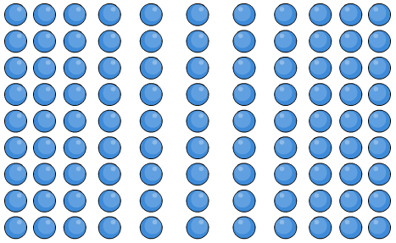
Stretching forces and the particle model
The deformation of materials can be explained using the particle model.
When a force changes the shape of a material, it changes the forces between particles, stretching or compressing the bonds between the particles. This changes the separation between particles.
When a material is elastically deformed, the bonds return to their original shape once the force is removed.
When a material is plastically deformed, the structure of the particles is permanently changed.
Notes:
This slide covers the Science and Engineering Practices:
Developing and Using Models: Use a model to provide mechanistic accounts of phenomena.
Constructing Explanations and Designing Solutions: Apply scientific ideas, principles, and/or evidence to provide an explanation of phenomena and solve design problems, taking into account possible unanticipated effects.

Slide 8
Hooke’s law
Hooke’s law states that;
The extension of an elastic object is directly proportional to the force applied, provided its limit of proportionality is not exceeded.
Mathematically, this can be written as;
F ∝ e
or
F = k e
F is the force, measured in newtons (N).
original
length
e
e is the extension, measured in meters (m).
F
k is the spring constant, measured in newtons per meter (N/m).
Notes:
Teacher notes
The stiffer a spring is, the greater its spring constant (k).
This slide covers the Science and Engineering Practices:
Developing and Using Models: Develop and/or use a model (including mathematical and computational) to generate data to support explanations, predict phenomena, analyze systems, and/or solve problems.
Using Mathematics and Computational Thinking: Use mathematical, computational, and/or algorithmic representations of phenomena or design solutions to describe and/or support claims and/or explanations.

Slide 9
Investigating springs
Notes:
Teacher notes
Students could design and carry out an experiment to find out k based on this and the next slide. A spring can be suspended from the edge of a desk and its length measured. Weights can be added to it to increase the force on it, and its new length measured for each weight added. Extension for each weight can be calculated by subtracting the original length from these values. A graph of weight (force) against extension can be plotted. The gradient of the linear region of this graph is k.
Other materials such as a rubber band or a polythene strip could also be tested to see if they obey Hooke’s law, i.e. if they initially have a constant gradient for their force–extension graphs.
Possible issues to discuss include:
Accuracy in measuring the length of the spring. Students should measure from the same point each time (the end of the coils as shown above, or the last coil).
Safety – the spring could snap if overloaded, so safety goggles should be worn and a box should be placed underneath the weights to catch them if they fall.
Have enough points been plotted on the graph to ensure as accurate as possible a line of best fit and therefore gradient?
This slide covers the Science and Engineering Practice:
Analyzing and Interpreting Data: Analyze data using tools, technologies, and/or models (e.g., computational, mathematical) in order to make valid and reliable scientific claims or determine an optimal design solution.

Slide 10
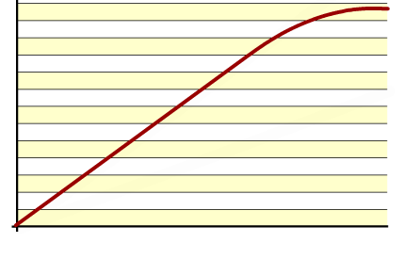
Results
If the spring is stretched far enough, it reaches the limit of proportionality and then the elastic limit before finally breaking.
break point
limit of proportionality
Up until this point, the spring is obeying Hooke’s law, and the graph is a straight line with gradient k.
elastic limit Separates the elastic region and the
plastic region.
The elastic limit is the point beyond which the spring will no longer return to its original shape when the force is removed.
Notes:
Teacher notes
You could ask students to highlight the linear and non-linear regions of the graph, or alternatively, the elastic and plastic regions of the graph. The link between the definitions of elasticity and elastic limit could be highlighted – the elastic limit is the extent to which a material displays the property of elasticity.
This slide covers the Science and Engineering Practice:
Analyzing and Interpreting Data: Analyze data using tools, technologies, and/or models (e.g., computational, mathematical) in order to make valid and reliable scientific claims or determine an optimal design solution.

Slide 11
Hooke’s law and compression
Hooke’s law also applies to the elastic compression of objects.
The compression of an elastic object is directly proportional to the force applied, provided its limit of proportionality is not exceeded.
F ∝ e
or
F = k e
original length
F is the force, measured in newtons (N).
e
e is the compression, measured in meters (m).
k is the spring constant, measured in newtons per meter (N/m).
F
Notes:
Teacher notes
The stiffer a spring is, the greater its spring constant (k).
This slide covers the Science and Engineering Practices:
Developing and Using Models: Develop and/or use a model (including mathematical and computational) to generate data to support explanations, predict phenomena, analyze systems, and/or solve problems.
Using Mathematics and Computational Thinking: Use mathematical, computational, and/or algorithmic representations of phenomena or design solutions to describe and/or support claims and/or explanations.

Slide 12
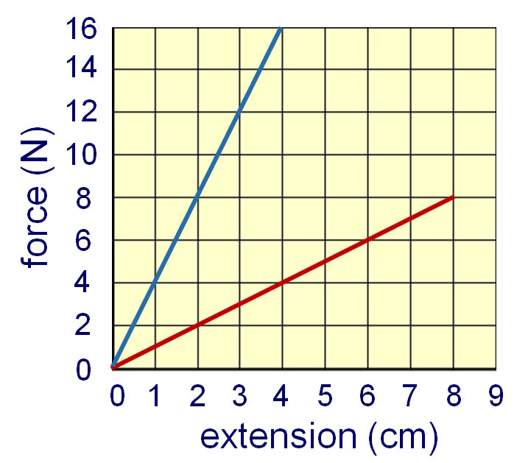
Calculating a spring constant
A force–extension graph is plotted for two different springs.
Calculate the spring constant of the spring represented by the red line.
force = k × extension
F
k =
e
8
k =
0.08
k = 100 N/m
Which spring has the bigger spring constant?
Notes:
Teacher notes
You could ask students to judge which spring has the bigger spring constant by comparing the gradients, and then calculate the blue spring constant to check (k_{blue} = 400 N/m).
This slide covers the Science and Engineering Practices:
Analyzing and Interpreting Data: Apply concepts of statistics and probability (including determining function fits to data, slope, intercept, and correlation coefficient for linear fits) to scientific and engineering questions and problems, using digital tools when feasible.
Using Mathematics and Computational Thinking: Apply techniques of algebra and functions to represent and solve scientific and engineering problems.

Slide 13
Elasticity calculations
Notes:
Teacher notes
This calculation activity contains three questions to test students understanding of Hooke’s law and how to use it. Questions can be skipped using the arrows; each step of working out can be revealed by pressing the “equals” button.
This slide covers the Science and Engineering Practice:
Using Mathematics and Computational Thinking: Apply techniques of algebra and functions to represent and solve scientific and engineering problems.

Slide 14
Jack-in-a-box example
When a force acts to compress or stretch an object, that force does work.
For example, when the lid is closed on a jack-in-the-box, the spring inside is compressed. Energy is stored in the spring in the form of elastic potential energy.
When the lid is lifted, removing the compressive force, the elastic potential energy stored in the spring is changed into kinetic energy and the jack jumps out.
Notes:
Teacher notes
Students may need to be introduced to or reminded about the concept of forces doing work. For more information about the work done by forces, please refer to the Work Done presentation.
This slide covers the Science and Engineering Practice:
Constructing Explanations and Designing Solutions: Apply scientific ideas, principles, and/or evidence to provide an explanation of phenomena and solve design problems, taking into account possible unanticipated effects.
Photo credit: © ZTS, shutterstock.com 2018

Slide 15
Work done by forces
The work done by a force is equivalent to:
work done = force × distance
According to the law of conservation of energy, energy is never created or destroyed. Instead, energy is transferred from one form to another.
work done = amount of energy transferred
However, most energy transfers are not as simple as one form of energy changing into another form of energy. For example, the resistive force in a light bulb changes electrical energy into both heat energy and light energy.
Notes:
Teacher notes
Students may need to be reminded that the law of conservation of energy states that energy is not created or destroyed but merely changed in form. This means that:
energy never just “disappears”
the total amount of energy always stays the same, i.e. total input energy = total output energy
in most energy transfers, the energy is transferred to several different forms that may or may not be useful.
For more information about the conservation of energy, please refer to the Potential and Kinetic Energy presentation.

Slide 16
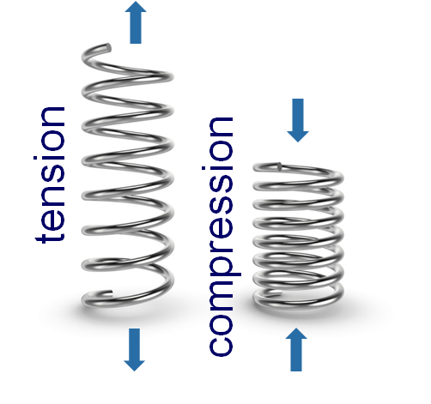
Work done and energy stored
When a spring is squashed or stretched, work is done by forces of compression or tension.
work done = energy transferred
Assuming that the spring is not extended or compressed past the limit of proportionality, this means that:
work done = elastic potential energy stored
Notes:
Photo credit: © Gearstd, shutterstock.com 2018

Slide 17
Elastic potential energy
The formula for elastic potential energy is:
elastic potential energy = ½ × spring constant × (extension)²
or
E_{e} = ½ k e²
Like other forms of energy, elastic potential energy, E_{e}, is measured in joules (J).
Extension or compression, e, is measured in meters (m).
The spring constant, k, is measured in newtons per meter (N/m).
Notes:
This slide covers the Science and Engineering Practice:
Developing and Using Models: Develop and/or use a model (including mathematical and computational) to generate data to support explanations, predict phenomena, analyze systems, and/or solve problems.

Slide 18
Calculating elastic potential energy
A spring with a spring constant of 25 N/m is originally 50 cm in length.
After a force is applied, it is compressed to 30 cm in length. Calculate the elastic potential energy stored.
Choose the right formula:
step 1
E_{e} = ½ k e²
Work out the compression:
step 2
e = 0.5 – 0.3 = 0.2 m
Input the values:
step 3
E_{e} = ½ × 25 × 0.2²
E_{e} = 0.5 J
Notes:
This slide covers the Science and Engineering Practice:
Using Mathematics and Computational Thinking: Apply techniques of algebra and functions to represent and solve scientific and engineering problems.

Slide 19
Extended calculation question part 1
A force does 1 J of work extending a spring with a spring constant of 50 N/m.
If the original length of the spring was 20 cm, how long is it now?
Choose the right formula:
step 1
W = E_{e} = ½ k e²
Rearrange the formula to find e:
2 W k
step 2
e² =
2 W k
√
e²=
Notes:
This slide covers the Science and Engineering Practice:
Using Mathematics and Computational Thinking: Apply techniques of algebra and functions to represent and solve scientific and engineering problems.

Slide 20
Extended calculation question part 2
A force does 1 J of work extending a spring with a spring constant of 50 N/m.
If the original length of the spring was 20 cm, how long is it now?
Input the values:
2 × 1
1
√
√
e²=
=
step 3
50
25
1
=
= 0.2 m
5
Add the extension to the original length to find the new length:
step 4
length = 0.2 + 0.2
= 0.4 m
Notes:
This slide covers the Science and Engineering Practice:
Using Mathematics and Computational Thinking: Apply techniques of algebra and functions to represent and solve scientific and engineering problems.

Slide 21
Slingshot science
Notes:
Teacher notes
This virtual experiment illustrates the relationship between EPE and KE. It could be used as a precursor to running the practical in the lab, or as a summary exercise. To extend this activity, ask students to explain why KE is a little bit less than EPE.
This slide covers the Science and Engineering Practice:
Planning and Carrying Out Investigations: Plan an investigation or test a design individually and collaboratively to produce data to serve as the basis for evidence as part of building and revising models, supporting explanations for phenomena, or testing solutions to problems. Consider possible variables or effects and evaluate the confounding investigation’s design to ensure variables are controlled.

