Slide 1
Electrical Power

Slide 2
Information
Developing and Using Models
Using Mathematics and Computational Thinking
5. Energy and Matter

Slide 3
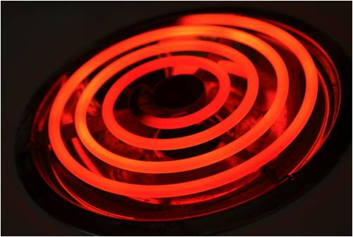
What is electrical power?
Electrical power is the rate at which energy is transferred in a circuit. All electrical appliances have a power rating. This tells you the rate at which the appliance uses energy.
Power is measured in watts (W): 1 watt means 1 joule of energy is used every second. 1,000 watts = 1 kilowatt (kW).
Appliances that need to create heat, such as washing machines, cookers and hairdryers, usually use the most power.
TVs, radios and computers usually use the least amount of power.
Notes:
Teacher notes
For more information about power, please refer to the Work and Power presentation.
This presentation is accompanied by the worksheet Electrical Power.
Photo credit: © Morgan Lane Photography, shutterstock.com 2018

Slide 4
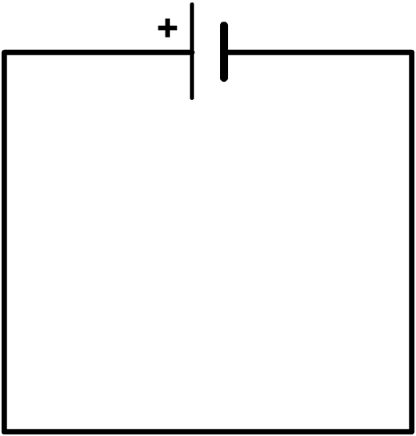
Electrical power and work
Work is done whenever a force acts to move an object. When work is done, energy is transferred from one form to another.
Work is done when charge flows around a circuit.
The battery does work in order to push the charge through the wires.
Energy is being transferred from chemical energy to electrical energy.
Notes:
Teacher notes
Note that the arrows are showing the direction of conventional current, rather than electron flow. Students may need reminding that energy is only ever transferred from one form to another, and cannot be created or destroyed. For more information about the conservation of energy and work, please refer to the Energy Transfers and Work and Power presentations respectively.

Slide 5
Calculating power
Power is a measure of the rate of energy transfer. It is calculated using the formula:
energy
power =
time
Power, P, is measured in watts (W).
Energy, E, is measured in joules (J).
Time, t, is measured in seconds (s).
The higher the power rating of a device, the more energy transferred every second by the device.
Notes:
This slide covers the Science and Engineering Practice:
Developing and Using Models: Develop and/or use a model (including mathematical and computational) to generate data to support explanations, predict phenomena, analyze systems, and/or solve problems.

Slide 6
Energy transferred and charge
The amount of energy transferred can also be related to the potential difference and charge:
energy transferred = potential difference × charge flow
Energy, E, is measured in joules (J).
Potential difference, V, is measured in volts (V).
Charge flow, Q, is measured in coulombs (C).
A cell with a potential difference of 1 volt transfers 1 joule of energy to each coulomb of charge.
Notes:
This slide covers the Science and Engineering Practice:
Developing and Using Models: Develop and/or use a model (including mathematical and computational) to generate data to support explanations, predict phenomena, analyze systems, and/or solve problems.

Slide 7
What is the formula for electrical power?
The power of an electrical device is related to the current and the potential difference by the formula:
power = potential difference × current
What are the units of power, current and potential difference?
Power, P, is measured in watts (W).
Current, I, is measured in amps (A).
Potential difference, V, is measured in volts (V).
Notes:
Teacher notes
For more information about current and potential difference, please refer to the Current, Resistance and Potential Difference presentation.
This slide covers the Science and Engineering Practice:
Developing and Using Models: Develop and/or use a model (including mathematical and computational) to generate data to support explanations, predict phenomena, analyze systems, and/or solve problems.

Slide 8
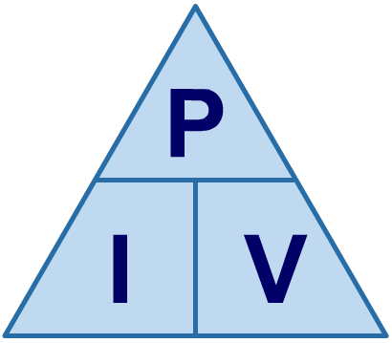
Using a formula triangle
A formula triangle helps you to rearrange a formula. The formula triangle for P = V I is shown below.
Cover up whatever quantity you are trying to find to leave the calculation required.
So, to find current (I), cover up I…
…which gives the formula…
÷
÷
P
I =
V
×

Slide 9
Electrical power calculations
Notes:
Teacher notes
This activity consists of three calculation questions, which can be answered by using or rearranging the formula P = VI. Questions can be skipped by pressing the forward arrow.
This slide covers the Science and Engineering Practice:
Using Mathematics and Computational Thinking: Apply techniques of algebra and functions to represent and solve scientific and engineering problems.

Slide 10
Power, current and voltage
Notes:
Teacher notes
This virtual experiment consists of a circuit, with a battery, voltmeter and ammeter. The three components to choose from are a motor, a light bulb and a resistor. You could ask students to check the power calculated is accurate, using the values given and the formula P = VI, or to rank the components from least to most power consuming.

Slide 11
An alternative formula for electrical power
Remember that:
potential difference = current × resistance
V = I R
Substituting this equation into the equation for power, we find:
P = V I P = (I R) I = I² R
Power, P, is measured in watts (W).
Current, I, is measured in amperes (A).
Resistance, R, is measured in ohms (Ω).
Notes:
This slide covers the Science and Engineering Practice:
Developing and Using Models: Develop and/or use a model (including mathematical and computational) to generate data to support explanations, predict phenomena, analyze systems, and/or solve problems.

Slide 12
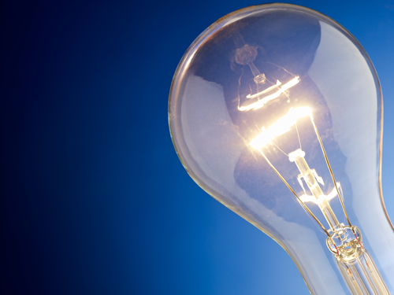
Electrical power: example calculation
A filament bulb has a resistance of 150 Ω and a current of 0.6 A running through it. At what power is the filament bulb operating?
P = I² R
= 0.6² × 150
= 54 W
If a different bulb with a resistance of 300 Ω was used instead, what would happen to the power consumption?
Notes:
Teacher notes
If a higher resistance bulb was used, assuming that the current did not change, the power consumption would increase. In this case, the power consumption would increase to 108 W. Students should be able to recognize that doubling the resistance has doubled the amount of energy transferred.
This slide covers the Science and Engineering Practice:
Using Mathematics and Computational Thinking: Apply techniques of algebra and functions to represent and solve scientific and engineering problems.
Photo credit: © Diego Cervo, shutterstock.com 2018

Slide 13
Energy transfer in the home
Electricity is an essential source of energy for many household appliances.
Electrical appliances are designed to convert electrical energy into other forms of energy.
For example:
A fan converts electrical energy from the mains into kinetic energy using an electric motor.
A laptop converts electrical energy from its rechargeable battery into light energy.
A speaker converts electrical energy from the mains into sound energy.
Notes:
Teacher notes
For more information about motors and speakers, please refer to the Motors and the The Generator Effect presentations respectively.

Slide 14
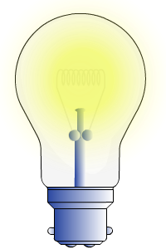
Resistance in electrical appliances
A resistor is a circuit component designed to reduce the current and make it more difficult for charge to move around a circuit. For a higher resistance, the power source has to do more work to overcome it.
When an electric current flows through a resistor, it produces heat. Many domestic appliances use resistance to transfer electrical energy to heat energy.
As current is passed through the heating element in a toaster, resistance causes the wires in the element to get hot.
If a metal becomes very hot, it may glow. A filament bulb transfers electrical energy into light energy in this way.
Notes:
Teacher notes
To extend this slide, students could be asked to identify other household items that use resistance in this way.
For more information about resistors, please refer to the Resistors presentation.

Slide 15
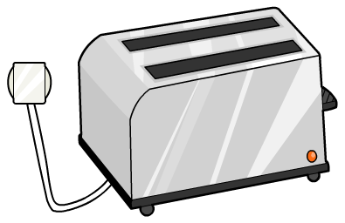
Amount of energy transferred
The amount of energy transferred depends on how long the appliance is turned on for and the power of the appliance.
For example, a toaster has a lot of power, but is only switched on for a short amount of time. A light bulb has less power, but is often left on for a long time.
A toaster with a power rating of 2,000 W that is turned on for 3 minutes uses 360 kJ of energy.
A 60 W light bulb that is left on for 3 hours will use 648 kJ of energy.

Slide 16
Amount of energy transferred
An appliance with a high power rating will transfer more energy than one with a low power rating in the same time period.
This is why a 100 W light bulb is brighter than a 40 W light bulb: more electrical energy is transferred into light energy every second.
Think about the appliances you use. What has the highest power rating? What does it convert electrical energy into?
Notes:
Teacher notes
Students could be encouraged to make comparisons between their appliances.
This may be a good opportunity to remind students that most appliances transfer electrical energy into multiple different forms of energy, some of which are useful, and some of which are not.
Photo credit: © haveseen, shutterstock.com 2018

Slide 17
Joules: a useful unit of energy?
Joules are the standard unit for energy in science. However, in terms of energy used by electrical appliances, a joule is a very small unit.
Consider a TV that is left on continuously for a week. It uses 120 V and 4 A. Calculate how much energy is used.
time = 60 × 60 × 24 × 7
= 604,800 s
energy = power × time
= current × voltage × time
= 4 × 120 × 604,800
= 290,304,000 J = 290 MJ
Notes:
Teacher notes
Students may not be aware or may need to be reminded that “M” represents mega, i.e. million.
This slide covers the Science and Engineering Practice:
Using Mathematics and Computational Thinking: Apply techniques of algebra and functions to represent and solve scientific and engineering problems.

Slide 18
Kilowatt-hours
Because joules are relatively small, a different unit called a kilowatt-hour (kWh) is often used instead.
energy = power × time
Energy is measured in kilowatt-hours (kWh), not joules.
Power is measured in kilowatts (kW), not watts.
Time is measured in hours (h), not seconds.
So, for the TV on the previous slide:
power = 4 A × 120 V = 480 W = 0.48 kW
time = 604,800 s = 168 hours
energy = 0.48 × 168 = 80.6 kWh
Notes:
This slide covers the Science and Engineering Practice:
Using Mathematics and Computational Thinking: Apply techniques of algebra and functions to represent and solve scientific and engineering problems.

