Slide 1
Friction

Slide 2
Information
Constructing Explanations and Designing Solutions
2. Cause and Effect

Slide 3
What is friction?
Friction is a resistive force that slows things down and tries to stop objects from sliding past each other.
friction
pulling force
Friction always acts in the opposite direction to which an object is moving or trying to move.
What would happen if friction didn’t exist?

Slide 4
Friction – useful or a problem?
Notes:
Teacher notes
This drag and drop activity provides the opportunity for informal assessment of students’ understanding of friction.

Slide 5
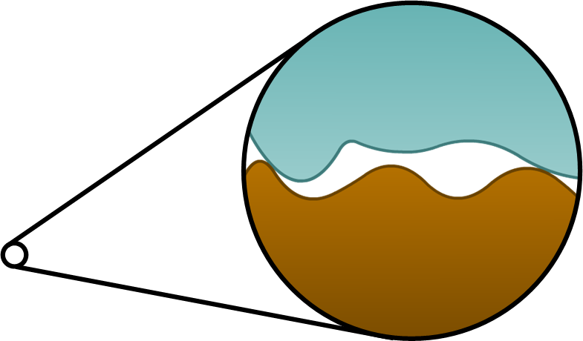
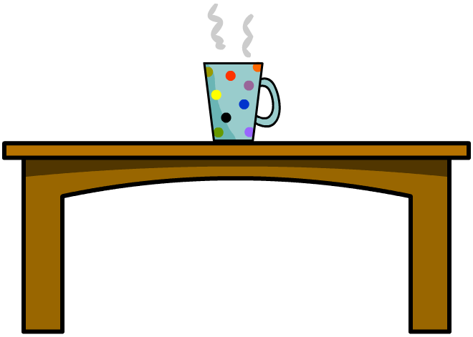
What causes friction?
Friction occurs between two objects because the surfaces of those objects are rough and contain bumps and hollows.
This roughness means that a force is needed to move the two objects over each other.
Even objects that appear very smooth, such as polished metal or ice, have a rough surface if viewed under a microscope.
Notes:
This slide covers the Science and Engineering Practice:
Constructing Explanations and Designing Solutions: Apply scientific ideas, principles, and/or evidence to provide an explanation of phenomena and solve design problems, taking into account possible unanticipated effects.

Slide 6
How does friction change?

Slide 7
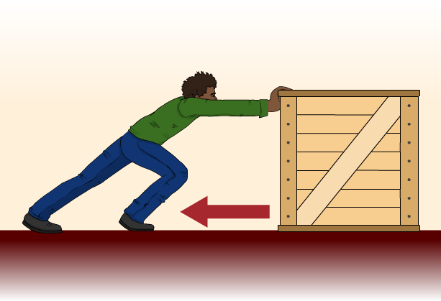
Static and kinetic friction
There are two types of friction between solids.
Static friction is the force that prevents a solid object from moving. The maximum static friction depends on both the object and the surface it is on.
If a force smaller than this maximum tries to slide the surfaces past each other, the static friction will equal the force applied.
If the force applied is greater than this maximum, the surfaces will move and the friction between them will be kinetic. Kinetic friction opposes the motion of moving objects.

Slide 8
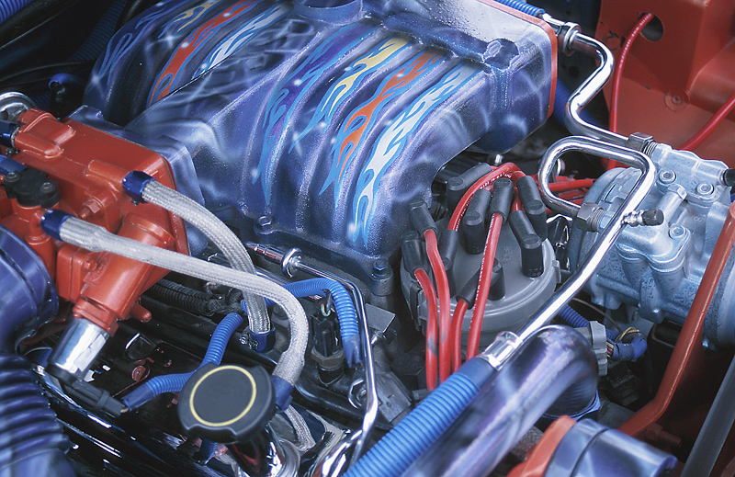
Reducing the effects of friction
Friction always tries to stop things from moving or slow things down. What effect does this have?
Friction creates heat and eventually wears down surfaces, which can be very damaging.
Lubricants are used to reduce friction in machinery and so help protect surfaces. In car engines, oil is used as a lubricant.
Bearings and rollers can also be used to reduce friction, for example, in wheels.
Notes:
Photo credit: © 2018 Jupiterimages Corporation

Slide 9
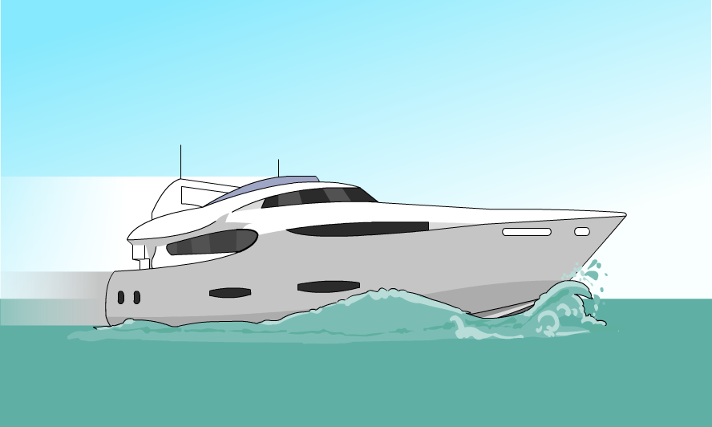
Friction in a fluid
Friction is most obvious when it acts between two solid objects, but it also acts on an object moving through a fluid (liquid or gas).
Friction in a fluid is caused by the particles in the fluid. As an object pushes against the particles, the particles push back against the object, resulting in a resistive force.
Friction caused by an object moving through air is called air resistance.
Friction caused by an object moving through a liquid, such as water, is called drag.

Slide 10
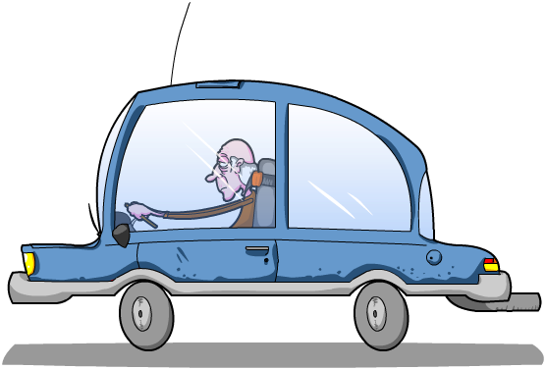
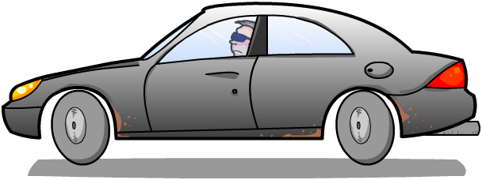
Reducing the impact of air resistance
Friction caused by air resistance affects the speed and fuel consumption of vehicles such as cars and airplanes.
Vehicles are specially shaped, or streamlined, to enable air to flow past them as easily as possible, therefore reducing air resistance.
Which of these cars is the more streamlined?
In a similar way, ships and boats have streamlined hulls to reduce the drag effects of water.

