Slide 1
Gravity

Slide 2
Information
Asking Questions and Defining Problems
Developing and Using Models
Using Mathematics and Computational Thinking
Constructing Explanations and Designing Solutions
1. Patterns
2. Cause and Effect
3. Scale, Proportion, and Quantity
5. Energy and Matter

Slide 3
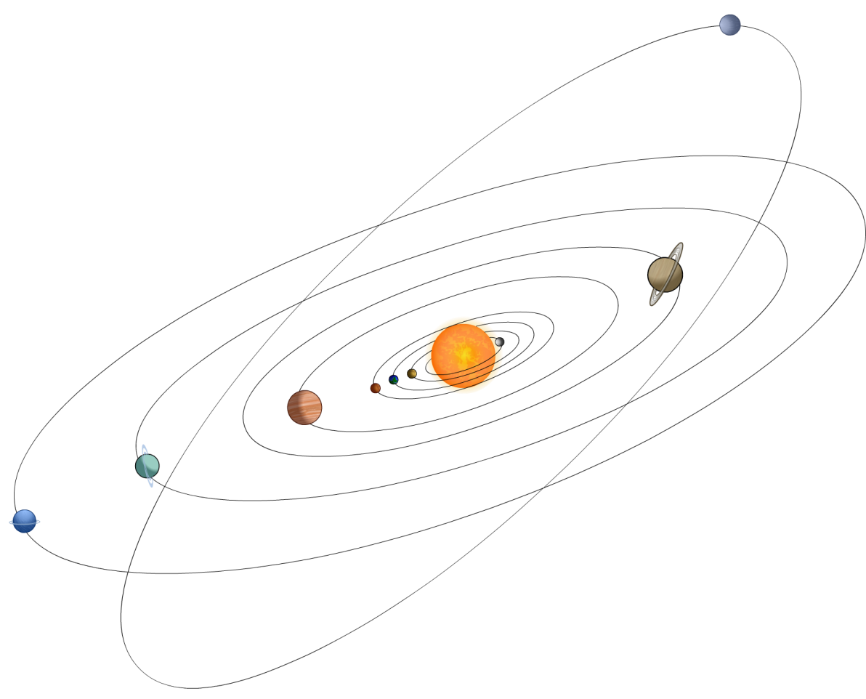
Forces and fields
Some forces, such as gravity, magnetism and the electric force, can act on objects that are not touching.
How do these forces act when objects are at a distance from each other?
Forces that act at a distance can be explained by fields that surround objects and can transfer energy through space.
For example, objects that have mass are surrounded by gravitational fields.
Notes:
Teacher notes
For more information about magnetism and the electric force, please refer to the Magnetism and Electric Fields presentations respectively.
This slide covers the Science and Engineering Practice:
Asking Questions and Defining Problems: Ask questions to clarify and refine a model, an explanation, or an engineering problem.
Constructing Explanations and Designing Solutions: Apply scientific ideas, principles, and/or evidence to provide an explanation of phenomena and solve design problems, taking into account possible unanticipated effects.

Slide 4
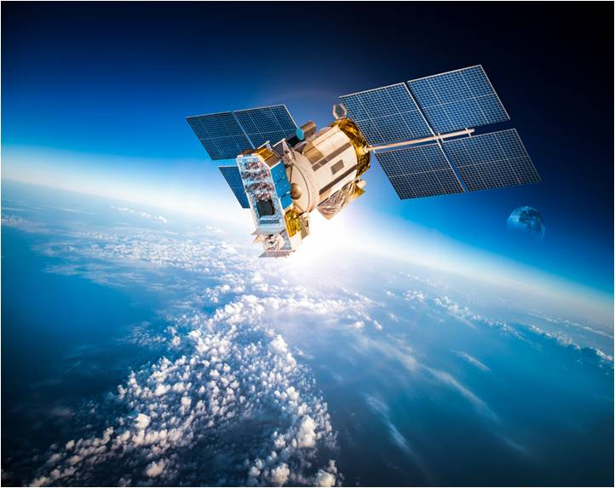
What is gravity?
Gravity is a force that exists between masses.
The size of the force due to gravity depends on:
the amount of mass each object has
the distance between the objects.
The direction of the force is always attractive. Gravity always acts to bring masses together; it never repels them.
Gravity is a relatively weak force, so we only tend to notice it when one of the masses is very large, like the Earth or a star.
Notes:
Photo credit: © Andrey Armyagov, shutterstock.com 2018

Slide 5
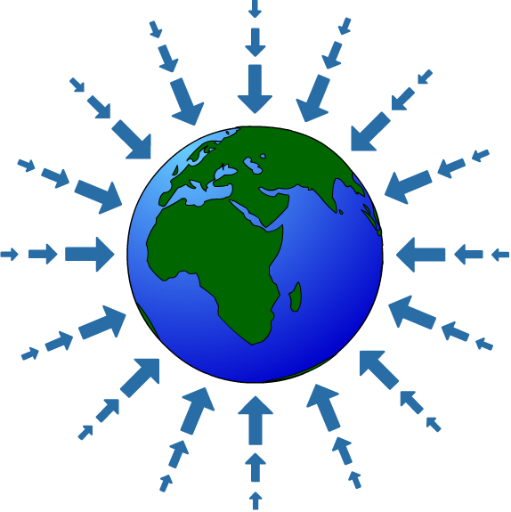
Gravitational fields
The Earth, like all other objects, has mass. This means it has a gravitational field that attracts other objects.
We can show this using arrows.
The arrows show the magnitude and direction of the force due to gravity at that point.
The closer to the Earth’s surface, the stronger the gravitational field.
Notes:
Teacher notes
Diagram is not to scale and assumes that the Earth is a point mass with a perfectly uniform gravitational field.
This slide covers the Science and Engineering Practice:
Developing and Using Models: Use a model to provide mechanistic accounts of phenomena.

Slide 6
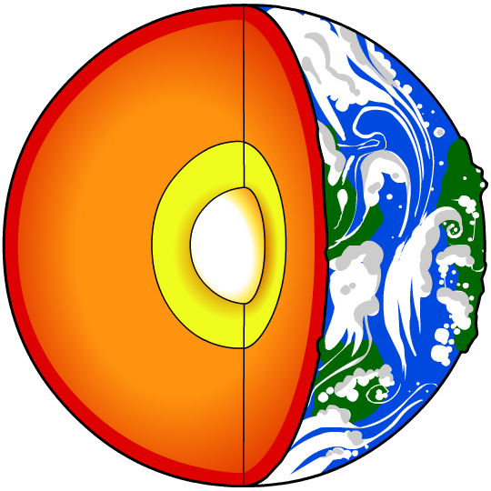
Variations in gravity
The gravitational force on an object on Earth depends on where it is in the Earth’s gravitational field, and what the gravitational field strength is at that point.
For example, at the edge of the atmosphere, the gravitational field strength is about three quarters of the value at sea-level.
In reality, the Earth’s gravitational field is not completely uniform. Gravity also varies because of:
geology – gravity is affected very slightly by the density of local rocks
latitude – the Earth is not a perfect sphere and has a bulge around the equator.
Notes:
Teacher notes
The edge of the atmosphere is taken to be the Karman line; value is approximate.
For more information about calculating the gravitational force acting on an object on Earth’s surface, please refer to the Mass and Weight presentation.

Slide 7
Gravitational force between two masses
Notes:
This slide covers the Science and Engineering Practice:
Developing and Using Models: Use a model to provide mechanistic accounts of phenomena.

Slide 8
Newton’s third law
Newton reasoned that the gravitational pull exerted by a body should be proportional to its mass.
F₁
F₂
F₁ ∝ m₁
F₂ ∝ m₂
But Newton’s third law states that these forces are equal:
F₁ = F₂
So the force between the masses must be proportional to both.
F_{grav}
F_{grav}
F_{grav} ∝ m₁m₂
Notes:
This slide covers the Science and Engineering Practice:
Developing and Using Models: Develop and/or use a model (including mathematical and computational) to generate data to support explanations, predict phenomena, analyze systems, and/or solve problems.

Slide 9
Inverse square law of gravitation
Newton realized that the gravitational pull of the Earth on the Moon must be the force that kept the Moon in orbit.
He compared the force that would be necessary to cause the Moon’s approximately circular motion to the force of gravity at the Earth’s surface.
He concluded that the gravitational force between two bodies must fall off with the square of the distance between their centers, r.
m₁ m₂
F_{grav} ∝
r²
Notes:
This slide covers the Science and Engineering Practice:
Developing and Using Models: Develop and/or use a model (including mathematical and computational) to generate data to support explanations, predict phenomena, analyze systems, and/or solve problems.

Slide 10
Newton’s law of gravitation
The full mathematical expression of Newton’s law of universal gravitation is:
G m₁ m₂
F_{grav} = –
r²
where the G is the gravitational constant:
G = 6.67 × 10^{–11} N m² kg^{–2}
The force is conventionally understood to be negative because it is an attractive force.
F_{grav}
F_{grav}
r
Notes:
This slide covers the Science and Engineering Practices:
Developing and Using Models: Develop and/or use a model (including mathematical and computational) to generate data to support explanations, predict phenomena, analyze systems, and/or solve problems.
Using Mathematics and Computational Thinking: Use mathematical, computational, and/or algorithmic representations of phenomena or design solutions to describe and/or support claims and/or explanations.

Slide 11
Calculating gravitational forces
Notes:
This slide covers the Science and Engineering Practices:
Using Mathematics and Computational Thinking: Use mathematical, computational, and/or algorithmic representations of phenomena or design solutions to describe and/or support claims and/or explanations.
Using Mathematics and Computational Thinking: Apply techniques of algebra and functions to represent and solve scientific and engineering problems.

Slide 12
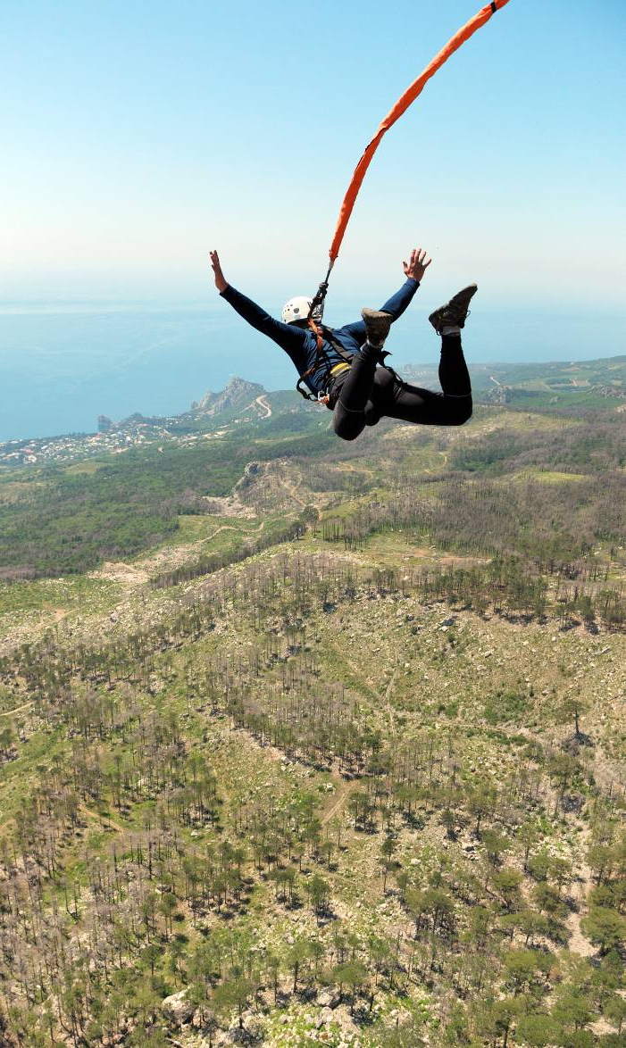
Energy stored in gravitational fields
When two objects interact through a gravitational field, energy is stored in the field. Energy is transferred when an object’s position in the field changes.
Imagine a bungee jumper in Earth’s gravitational field:
When the bungee jumper starts to fall, energy is transferred from the field into kinetic energy in the bungee jumper and elastic energy in the cord.
As the elastic cord pulls the bungee jumper back up, energy is transferred from the bungee jumper and cord back into the Earth’s gravitational field.
Notes:
This slide covers the Science and Engineering Practice:
Constructing Explanations and Designing Solutions: Apply scientific ideas, principles, and/or evidence to provide an explanation of phenomena and solve design problems, taking into account possible unanticipated effects.
Photo credit: © Vitalii Nesterchuk, shutterstock.com 2018

Slide 13
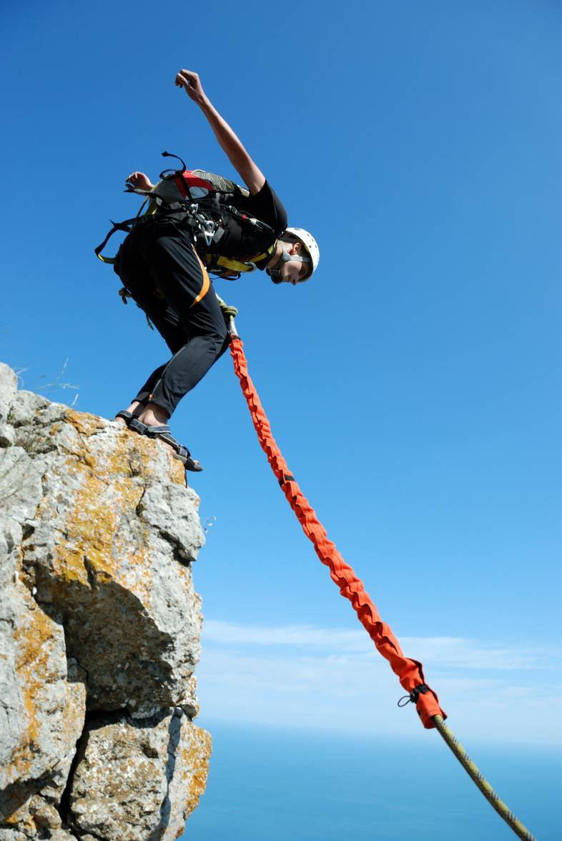
Gravitational potential energy
It is often helpful to think of the energy transferred to and from an object as a form of potential energy stored in the object. We call this gravitational potential energy (GPE).
As the bungee jumper falls, GPE is converted into kinetic and elastic energy.
When the bungee jumper bounces back up, this energy is converted back into GPE.
GPE is the amount of energy an object has because of its position in a gravitational field, i.e. its height.
Notes:
Teacher notes
There are many types of potential energy, of which gravitational potential energy is just one. Others include:
elastic potential energy – e.g. in a spring or a rubber band
chemical potential energy – e.g. in food, fuels and batteries
nuclear potential energy – e.g. the nucleus in a uranium atom.
For more information about forms of energy and transferring energy between forms, please refer to the Energy Transfers presentation.
This slide covers the Science and Engineering Practice:
Constructing Explanations and Designing Solutions: Apply scientific ideas, principles, and/or evidence to provide an explanation of phenomena and solve design problems, taking into account possible unanticipated effects.
Photo credit: © Vitalii Nesterchuk, shutterstock.com 2018

Slide 14
Calculating gravitational potential energy
The energy stored in the the gravitational field between two objects depends on the distance between the objects. For an object close to the Earth’s surface, GPE can be calculated using the equation:
GPE = mass × gravitational field strength × height
Mass, m, is measured in kilograms (kg).
Gravitational field strength, g, is measured in newtons per kilogram (N/kg). It is approximately 10 N/kg close to the surface of Earth.
Height, h, is measured in meters (m).
Gravitational potential energy (GPE), E_{p}, is measured in joules (J).
Notes:
Teacher notes
An alternate version of this equation would be “GPE = weight × height,” as “weight = mass × gravitational field strength.”
This slide covers the Science and Engineering Practice:
Developing and Using Models: Develop and/or use a model (including mathematical and computational) to generate data to support explanations, predict phenomena, analyze systems, and/or solve problems.

Slide 15
Factors affecting GPE
Notes:
Teacher notes
This activity could be used to introduce the factors affecting the GPE of objects, and/or the “GPE = mgh” equation.

Slide 16
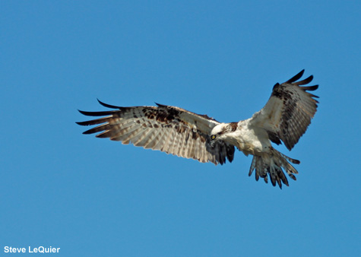
Calculating GPE question 1
An osprey with a mass of 2 kg flies at a height of 200 m above the ground.
How much gravitational potential energy does the osprey have?
Assume g = 10 N/kg.
GPE = mass × gravitational field strength × height
= 2 × 10 × 200
= 4,000 J
Notes:
This slide covers the Science and Engineering Practice:
Using Mathematics and Computational Thinking: Apply techniques of algebra and functions to represent and solve scientific and engineering problems.
Photo credit: © Steve LeQuier, 2018

Slide 17
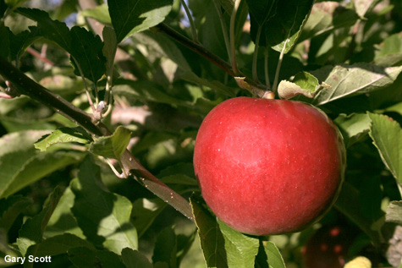
Calculating GPE question 2
An apple with a mass of 200 g falls 3 m from its branch to the ground.
How much GPE will the apple have lost when it hits the ground?
Assume g = 10 N/kg.
GPE lost
change in height
= mass × gravitational field strength ×
= 0.2 × 10 × 3
= 6 J
Notes:
This slide covers the Science and Engineering Practice:
Using Mathematics and Computational Thinking: Apply techniques of algebra and functions to represent and solve scientific and engineering problems.
Photo credit: © Gary Scott, 2018

Slide 18
GPE, mass and height calculations
Notes:
Teacher notes
This multiple-choice activity has four questions and provides an opportunity for students to practice using the “GPE = mgh” equation.
This slide covers the Science and Engineering Practice:
Using Mathematics and Computational Thinking: Apply techniques of algebra and functions to represent and solve scientific and engineering problems.

