Slide 1
Hazards of Electromagnetic Waves

Slide 2
Information
Planning and Carrying Out Investigations
Using Mathematics and Computational Thinking
Constructing Explanations and Designing Solutions
Obtaining, Evaluating and Communicating Information
1. Patterns
2. Cause and Effect
5. Energy and Matter

Slide 3
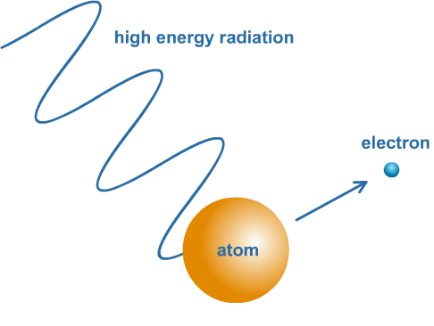
How do EM waves interact with matter?
Changes in atoms or the nuclei of atoms can result in the emission of electromagnetic radiation over a wide range of frequencies. Changes in the nuclei of atoms cause the emission of high frequency gamma rays.
The reverse of this also happens: if an atom absorbs EM radiation, it can result in a change in the atom or nucleus.
This means that electromagnetic waves can have hazardous effects on body cells. EM waves with high frequencies have high energies, so are able to cause the most damage. If a wave has enough energy, it can remove the outer electrons from atoms. This is called ionization.

Slide 4
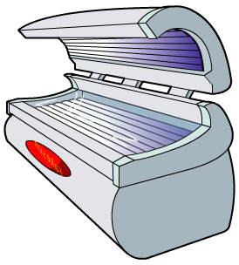
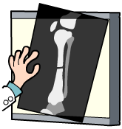
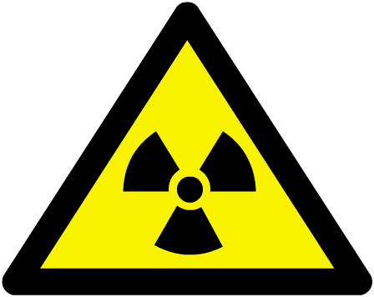
How do ionizing waves affect humans?
Ionizing waves have enough energy to ionize the atoms in materials. These waves can have a severe effect on living tissue by killing cells or damaging DNA.
Ultraviolet (UV) rays are absorbed by the body. Skin tissues can be ionized and damaged by the shortest-wavelength ultraviolet radiation causing skin cancer.
X-rays pass through soft body tissue, such as skin and muscle, without being absorbed. Denser tissue, such as bone, absorbs some X-rays and can be ionized.
Gamma rays pass through the body but very high energy waves can ionize atoms in living tissue.

Slide 5
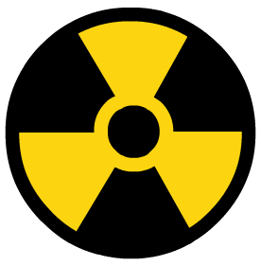
Measuring the effect of radiation
Ionizing waves, such as gamma rays, can damage the DNA in cells and even kill cells. The risk that exposure to radiation presents can be measured using the radiation dose.
Radiation dose is measured in sieverts (Sv) or millisieverts (mSv). 1,000 mSv = 1 Sv.
A very high dose of gamma rays in a short time can be fatal. A low dose over a long period of time will increase the risk of a person developing cancer.
The average person in the US receives an annual dose of about 6.2 mSv from background radiation. The International Commission on Radiological Protection sets a limit of 20 mSv per year for workers in the nuclear industry.

Slide 6
Hazards of X-rays and gamma rays
Notes:
Teacher notes
This three-part animated sequence illustrates the effects of X-­rays and gamma rays on living tissues. While viewing the animation, it should be highlighted that exposure to high levels of X-­rays/gamma rays can be harmful.

Slide 7
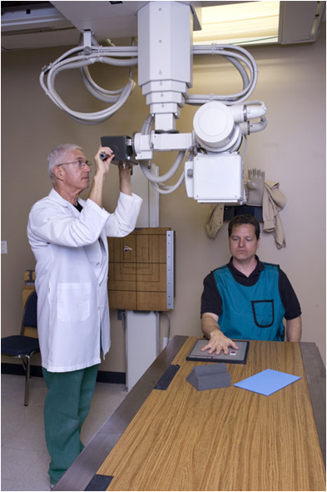
How are X-ray images taken safely?
Precautions must be used when X-ray images are taken.
Only the area of the body being examined is targeted with X-rays. Other areas are protected with a lead shield, which is too dense for X-rays to pass through.
One-off X-rays do not pose much risk to health. Radiographers take several X-rays each day and their potential dose is much higher.
To minimize their exposure when an X-ray image is being taken, radiographers must wear a lead apron, stand behind a screen that absorbs X-rays or even leave the room.
Notes:
Teacher notes
The photograph shows a radiographer setting up an X-­ray of a patient’s hand. Once set up, the radiographer will leave the room to take the X­-ray. The patient is wearing a lead apron to protect his organs from the X-­rays.
This slide is accompanied by the worksheet Hazards of Electromagnetic Waves.
Photo credit: © James Steidl, shutterstock.com 2018

Slide 8
X-ray risks
Notes:
This slide is accompanied by the worksheet Hazards of Electromagnetic Waves.
The worksheet accompanying this slide covers the Science and Engineering Practices:
Using Mathematics and Computational Thinking: Apply techniques of algebra and functions to represent and solve scientific and engineering problems.
Using Mathematics and Computational Thinking: Apply ratios, rates, percentages, and unit conversions in the context of complicated measurement problems involving quantities with derived or compound units (such as mg/mL, kg/m3, acre-feet, etc.).

Slide 9
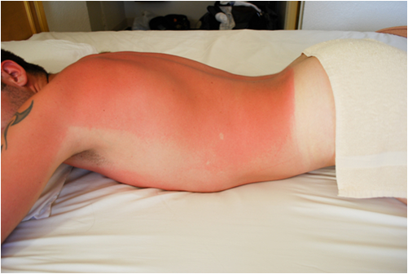
How does UV radiation affect skin?
The skin uses UV radiation from the Sun to make vitamin D, which is needed for strong bones. Some exposure to UV radiation is beneficial but overexposure is generally harmful.
Sunburn occurs when the skin is exposed to high-intensity UV radiation, which damages skin cells. Repeated exposure leads to premature ageing of the skin and increases the risk of skin cancer.
Intense UV radiation can inflame the eyes and long-term exposure may cause cataracts.
Notes:
Photo credit: © comosaydice, shutterstock.com 2018

Slide 10
Dark or fair skin?
Dark skin contains more melanin than light skin. Melanin is the body’s natural defence against UV radiation.
Melanin absorbs some of the UV before it can penetrate the top layers of the skin and damage cells underneath.
Melanoma is a dangerous form of skin cancer that forms in the melanin-producing cells of the skin.
Notes:
Teacher notes
The skin cells producing melanin are called melanocytes. Melanin absorbs UV and prevents damage to DNA.
Factors that increase the risk for melanoma relating to UV exposure include having moles (more moles = higher risk), very fair skin (especially with fair/red hair and freckles) and being easily sunburnt.
Photo credit: © Martin Allinger, shutterstock.com 2018

Slide 11
Is a suntan safe?
Some people think that a suntan is safe and makes them look healthy. In fact, a suntan is a sign of UV damage. It is the skin’s attempt to protect cells from further damage by creating its own sunscreen.
Not all skin types can tan: skin that is easily sunburnt is most at risk from UV damage. A suntan only provides some protection, and naturally dark or tanned skin can still suffer sunburn.
Everyone, regardless of skin type, is at risk from eye damage caused by UV radiation.
Notes:
Teacher notes
A suntan is the result of skins cells producing extra melanin.
Photo credit: © photos.com 2018

Slide 12
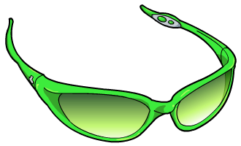
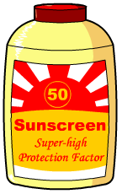
Limiting exposure to UV radiation
Prolonged exposure to UV radiation carries serious health risks and so protection is important.
A combination of measures can protect skin and eyes from UV radiation:
cover up, wear a wide-brimmed hat and sunglasses, and stay in the shade.
apply sunblock or sunscreen. They should be applied to the skin generously and often when out in the sun.
Protection is essential for workers who are routinely exposed to UV radiation. Welders must use a head shield to protect their eyes and wear thick clothing to protect their skin.
Notes:
Teacher notes
Sunscreen absorbs UV radiation whereas sunblock physically blocks it, usually with the ingredients titanium dioxide or zinc oxide.

Slide 13
Investigating sunscreens
Notes:
This slide covers the Science and Engineering Practice:
Planning and Carrying Out Investigations: Plan and conduct an investigation individually and collaboratively to produce data to serve as the basis for evidence, and in the design: decide on types, how much, and accuracy of data needed to produce reliable measurements and consider limitations on the precision of the data (e.g., number of trials, cost, risk, time), and refine the design accordingly.

Slide 14
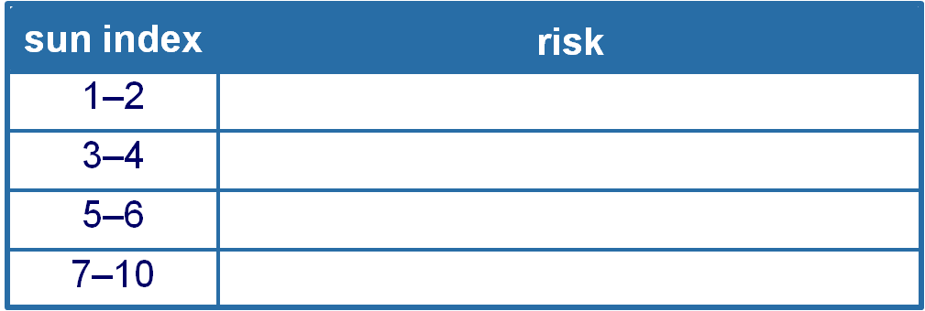
SPF and safe time in the Sun
Sun Protection Factor (SPF) is a number used by sunscreen manufacturers to indicate how much longer you can stay out in the sun before getting burnt.
safe time in sun = SPF × burn time with no sunscreen
The sun index appears on weather reports, and gives a rough idea of the intensity of UV from the sun on a given day.
low
avoid being out for more than 1–2 hours
burns in 30–60 mins
severe burns in 20–30 mins
Notes:
Teacher notes
Students could be asked to think about what factors might affect how accurate in reality the value “safe time in the sun” is. These might include the amount of sunscreen applied, how well it is rubbed in, whether it is wiped off through physical contact with clothes, etc.
This slide is accompanied by the worksheet Hazards of Electromagnetic Waves.
The worksheet accompanying this slide covers the Science and Engineering Practice:
Constructing Explanations and Designing Solutions: Apply scientific ideas, principles, and/or evidence to provide an explanation of phenomena and solve design problems, taking into account possible unanticipated effects.

Slide 15
Voluntary exposure to UV radiation
Notes:
Teacher notes
This voting activity enables the individual opinions of the class to be represented graphically. It could be used at a start of a topic, then repeated as a summary activity to see if students’ opinions have changed after learning the relevant material.

Slide 16
UV radiation: fact or opinion?
Notes:
Teacher notes
This fact-or-opinion activity could be used as an introductory or summary activity on ultraviolet waves, or at the start of the lesson to gauge students’ existing knowledge of the subject matter. Colored traffic light cards (red = false, yellow = don’t know, green = true) could be used to make this a whole-class exercise.

Slide 17
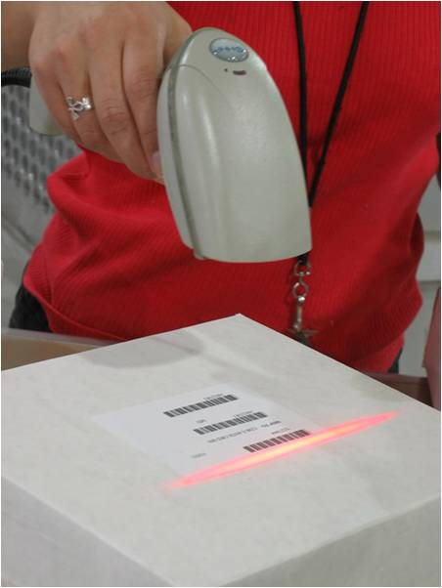
How does visible light affect humans?
Visible light and longer wavelengths of electromagnetic waves do not have enough energy to ionize atoms in cells. When these waves are absorbed by matter, the energy that they carry is converted into thermal energy.
Very bright visible light can damage your eyes and may even cause blindness. This is why you should not look at the Sun through a telescope or binoculars.
Lasers are very intense sources of visible light. Some very powerful lasers can cut through materials such as metal. These would also be able to burn through living tissue.
Notes:
Photo credit: © Grant Blakeman, shutterstock.com 2018

Slide 18
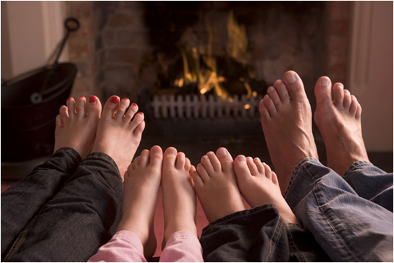
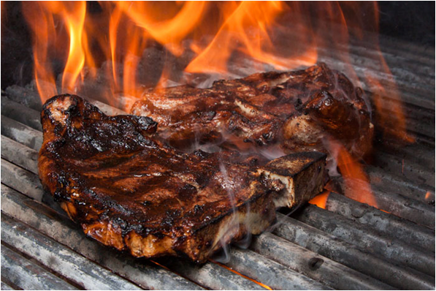
How do infrared waves affect humans?
Infrared (IR) waves are absorbed by skin to a limited depth. They transfer their energy to the skin tissue warming it up.
This heating effect is detected by temperature-sensitive nerve endings in the skin.
Infrared waves from this grill heat the surface of the meat.
If the meat absorbs too much energy, it will become burnt.
If skin is exposed to too many high-energy infrared waves, it will become burnt.
Notes:
Photo credits: feet © Monkey Business Images, grill © BKingFoto, both at shutterstock.com 2018

Slide 19
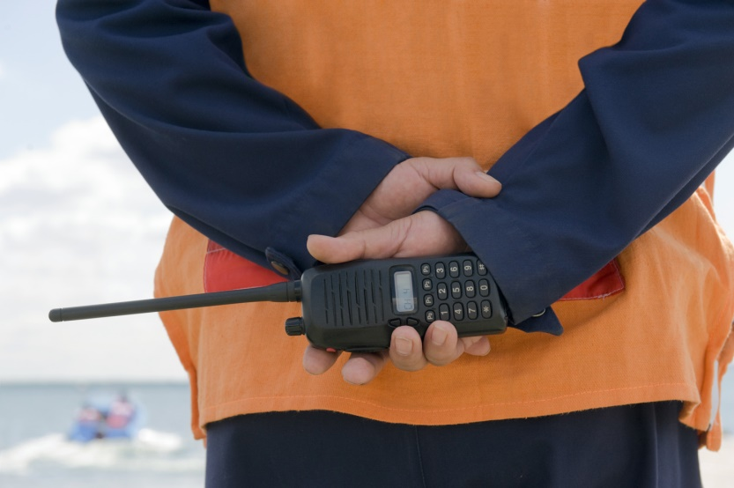
Are microwaves and radio waves harmful?
Microwaves are very slightly absorbed by the body and can cause a minor heating effect.
However, the microwaves produced by mobile phones have not yet been proved to cause health problems.
Radio waves are the longest-wavelength electromagnetic waves and mostly pass through the body.
They are not strongly absorbed by the body and are not thought to have a harmful effect on living tissue. Radio waves that are absorbed by the body will have a very slight heating effect.
Notes:
Photo credit: © Bork, shutterstock.com 2018

Slide 20
Researching the effect of EM waves
Conduct research into the effect one type of electromagnetic wave has on matter.
You should:
Take information from a range of published materials.
Consider the reliability of each source. Who is the author? What is their motive in publishing the information? Might they be biased?
Identify any errors in the claims made or flaws in the arguments presented.
Decide whether a statement is a scientific observation, an opinion or an interpretation of a scientific observation.
Notes:
Teacher notes
Some students will need support in order to access this activity. It may be helpful to provide a pack of published materials for students to use in which scientific and technical texts have been adapted for student use.
This slide covers the Science and Engineering Practices:
Obtaining, Evaluating, and Communicating Information: Gather, read, and evaluate scientific and/or technical information from multiple authoritative sources, assessing the evidence and usefulness of each source.
Obtaining, Evaluating, and Communicating Information: Evaluate the validity and reliability of and/or synthesize multiple claims, methods, and/or designs that appear in scientific and technical texts or media reports, verifying the data when possible.

Slide 21
Effect of electromagnetic waves
Notes:
Teacher notes
This matching activity could be used as an introductory or summary activity on electromagnetic waves and how they affect living tissues.

