Slide 1
Infrared Radiation

Slide 2
Information
Asking Questions and Defining Problems
Planning and Carrying Out Investigations
Constructing Explanations and Designing Solutions
4. Systems and System Models
5. Energy and Matter

Slide 3
What is infrared radiation?
All objects absorb and emit thermal radiation, also known as infrared radiation. Infrared radiation is made up of infrared waves.
Infrared waves are part of the electromagnetic spectrum. They can be reflected, transmitted or absorbed.
Notes:
Teacher notes
For more information about electromagnetic waves, please refer to the The Electromagnetic Spectrum, Reflection and Refraction of Waves, Hazards of Electromagnetic Waves and Uses of Electromagnetic Waves presentations.

Slide 4
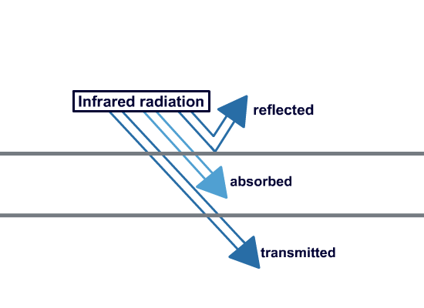
How is heat transferred?
When radiation hits an object, what happens depends on:
the material the object is made of
the wavelength of the radiation.
For example, glass is very good at transmitting waves that have the same wavelength as visible light, so it appears transparent to human eyes.
Infrared waves heat objects that absorb them.
Objects transfer heat to their surroundings by emitting infrared radiation.

Slide 5
Infrared radiation
Notes:
Teacher notes
It may be helpful to remind students that absolute zero is the temperature where particles have minimum kinetic energy, and it occurs at –273.15 °C or 0 K. It is important to emphasize that all objects with a temperature above absolute zero, even those ordinarily thought of as quite cold, emit thermal radiation. The flash activity on the next slide can be used to reinforce this concept. It may also be helpful to explicitly state the relation; the hotter the body, the more infrared radiation it radiates in a given time.
This slide covers the Science and Engineering Practice:
Asking Questions and Defining Problems: Ask questions that arise from careful observation of phenomena, or unexpected results, to clarify and/or seek additional information.

Slide 6
Investigating thermal emission
Notes:
Teacher notes
This virtual experiment uses a Leslie’s cube to investigate the emissions of heat radiation from different surfaces. It could be used as a precursor to running the practical in the lab or as a summary exercise. When using this activity, it should be made clear that the water inside the cube and the initial temperature of each side is the same in each experiment. The thermopile measures the amount of heat radiation emitted by the surface, which is then recorded in the table.
This slide covers the Science and Engineering Practice:
Planning and Carrying Out Investigations: Plan and conduct an investigation individually and collaboratively to produce data to serve as the basis for evidence, and in the design: decide on types, how much, and accuracy of data needed to produce reliable measurements and consider limitations on the precision of the data (e.g., number of trials, cost, risk, time), and refine the design accordingly.

Slide 7
Emitting thermal radiation
All objects, no matter what their temperature, emit some thermal radiation.
Certain surfaces are better at emitting thermal radiation than others.
best emitter
worst emitter
matte black
white
silver
Matte black surfaces are the best emitters of radiation.
Shiny surfaces are the worst emitters of radiation.
Which type of kettle would cool down faster: a black kettle or a shiny metallic kettle?

Slide 8
Investigating thermal absorption
Notes:
Teacher notes
This virtual experiment investigates the ability of different surfaces to absorb heat. It could be used as a precursor to running the practical in the lab or as a summary exercise. To extend the activity, students could be asked to consider which variables need to be controlled to make this experiment fair and accurate.
See the help text in the activity to get started.
This slide is accompanied by the worksheet Infrared Radiation.
This slide covers the Science and Engineering Practice:
Planning and Carrying Out Investigations: Plan and conduct an investigation individually and collaboratively to produce data to serve as the basis for evidence, and in the design: decide on types, how much, and accuracy of data needed to produce reliable measurements and consider limitations on the precision of the data (e.g., number of trials, cost, risk, time), and refine the design accordingly.

Slide 9
Absorbing thermal radiation
Infrared waves heat objects that absorb them.
Certain surfaces are better at absorbing thermal radiation than others. Good emitters are also good absorbers.
best emitter
worst emitter
matte black
white
silver
best absorber
worst absorber
Matte black surfaces are the best absorbers of radiation.
Shiny surfaces are the worst absorbers of radiation.

Slide 10
Absorbing and emitting radiation
Remember: surfaces that are good at absorbing radiation are also good at emitting radiation.
A perfect black body is an object that absorbs all of the radiation that impacts it; no radiation is reflected or transmitted. A perfect black body would be the best possible emitter of radiation.
All radiation is absorbed…
Black bodies are called black because they do not reflect any visible light.
… and emitted.
Notes:
Teacher notes
A perfect black body is an idealized construct. However, stars behave like perfect black bodies to a good approximation.

Slide 11
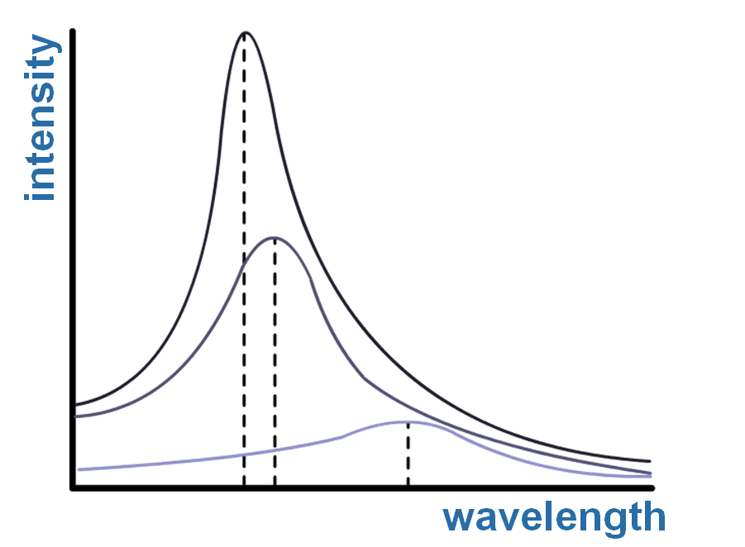
Emitting black body radiation
The temperature of an object affects the type and amount of radiation it emits.
This graph shows black body radiation for objects with different temperatures.
This object is very hot. The total intensity of radiation is high and the peak wavelength is short.
This object is cold. The total intensity of radiation is low and the peak wavelength is long.
Notes:
Teacher notes
Students could be reminded that these lines are continuous for black body radiation, since all wavelengths are absorbed and emitted.

Slide 12
Emitting radiation
Bodies that are hot emit higher intensity radiation because they have more thermal energy.
Imagine a hot cup of tea in a cold kitchen. Initially, the tea has a lot of thermal energy, and it radiates quickly. This process transfers energy from the tea to the room.
As the tea loses energy, it radiates slower and slower. Eventually, the rate of absorption and the rate of emission will be equal.
The tea does not stop emitting or absorbing radiation. But its temperature will remain constant, because the tea absorbs energy as quickly as it radiates it.
Notes:
This slide covers the Science and Engineering Practice:
Constructing Explanations and Designing Solutions: Apply scientific ideas, principles, and/or evidence to provide an explanation of phenomena and solve design problems, taking into account possible unanticipated effects.

Slide 13
Equilibrium
What is happening to this cube’s temperature?
The cube is getting warmer.
rate of absorption > the rate of emission.
The cube is getting cooler.
rate of absorption < the rate of emission.
The cube’s temperature does not change.
rate of absorption = the rate of emission.
Notes:
Teacher notes
It should be emphasized that the final cube is in a dynamic equilibrium; it has not stopped emitting and absorbing radiation, but its temperature remains constant because the rates of absorption and emission are equal. If students are not familiar with the concept, a useful simile is to imagine running the “wrong” way on an escalator; both the person and the escalator are moving, but if the motion is exactly equal and in opposite directions, the net displacement is zero.

Slide 14
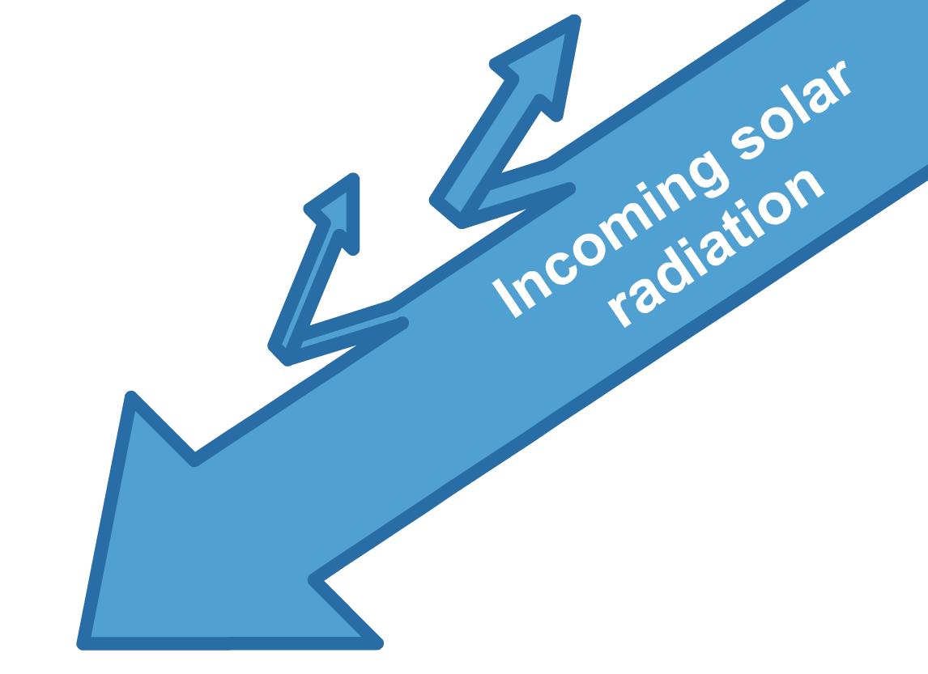
Incoming solar radiation
Some is reflected by clouds or absorbed by the atmosphere
Some is reflected by the Earth’s surface.
Most is absorbed by the Earth — around 70%.
The temperature of the Earth is affected by the balance between how much radiation is reflected and how much is absorbed.
Not all of the radiation from the Sun is absorbed by the Earth. What happens to it?
Notes:
Teacher notes
Incoming solar radiation is measured in watts per meter squared, W/m².
The total amount of solar radiation the Earth receives, and can therefore absorb, varies for many reasons:
the Earth has an elliptical orbit
the Earth is tilted on its axis.
Different places on Earth experience different amounts of solar radiation at different times, because the Earth is a spinning sphere, and not a flat stationary plane.

Slide 15
The temperature of the Earth
Like all other bodies, the temperature of the Earth changes according to how quickly radiation is absorbed compared to how quickly radiation is emitted.
When facing the Sun, that side of the Earth is absorbing radiation and heating up.
As it gets hotter, it emits more radiation.
The Earth is a lot cooler than the Sun, so the radiation emitted has a much longer wavelength.
Notes:
This slide covers the Science and Engineering Practice:
Constructing Explanations and Designing Solutions: Apply scientific ideas, principles, and/or evidence to provide an explanation of phenomena and solve design problems, taking into account possible unanticipated effects.

Slide 16
Radiation emitted by the Earth
The atmosphere absorbs the longer wavelength radiation emitted from the Earth and heats up.
As the atmosphere gets hotter, it too emits more radiation. Some of it is emitted in the direction of the Earth’s surface, and is reabsorbed by the Earth.
Without the warming effect of the atmosphere, the Earth would be much colder.
Notes:
Teacher notes
The amount of radiation emitted from the Earth that is absorbed and emitted by the atmosphere also depends on the chemical composition of the atmosphere.
This slide covers the Science and Engineering Practice:
Constructing Explanations and Designing Solutions: Apply scientific ideas, principles, and/or evidence to provide an explanation of phenomena and solve design problems, taking into account possible unanticipated effects.

