Slide 1
Lenses

Slide 2
Information
Developing and Using Models
Using Mathematics and Computational Thinking
2. Cause and Effect
4. Systems and System Models
6. Structure and Function

Slide 3
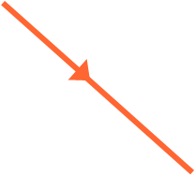
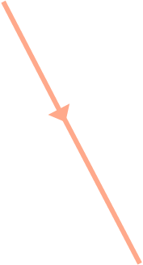
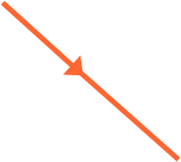
What is refraction?
What happens when a ray of light strikes a block of glass at an angle?
It bends and changes direction. This is known as refraction.
normal
incident ray
air
glass
When the light enters the glass, it bends toward the normal.
When the light leaves the glass, the opposite happens: it bends away from the normal.
refracted ray
normal
Notes:
Teacher notes
The light ray refracts because light waves travel slower in glass than in air. For more information about refraction, please refer to the Reflection and Refraction of Waves presentation.
This presentation is accompanied by the worksheet Lenses.

Slide 4
What are lenses?
Lenses use the principle of refraction to change the direction of light and form images.
They can be categorized by their shape:
convex
concave
Thicker in the middle than at their edges.
Thinner in the middle than at their edges.

Slide 5
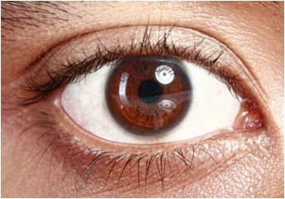
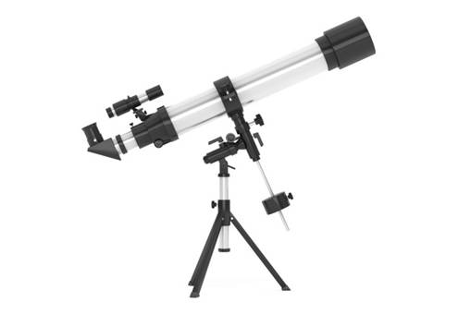
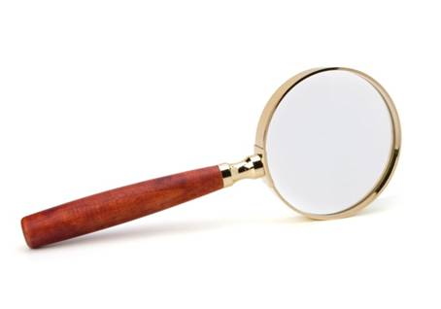
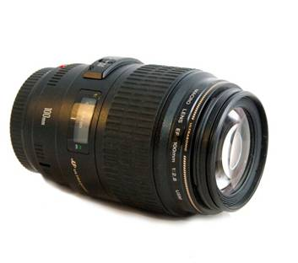
Convex lenses
Convex lenses are also called converging lenses. They are designed to make light rays converge (come together) at a single focus.
Convex lenses occur naturally in the eye.
They are also found in:
camera
lenses
magnifying
glasses
refracting telescopes
Notes:
Photo credits: eye © Odua Images, telescope © doomu, camera lens © Tepikina Nastya, magnifying glass © Nattika, all at shutterstock.com 2018

Slide 6
How do convex lenses work?
Notes:
Teacher notes
This animation explains the function of a convex lens in terms of refraction. Between each stage, students could be asked to predict what will happen next.
This slide covers the Science and Engineering Practice:
Developing and Using Models: Use a model to provide mechanistic accounts of phenomena.

Slide 7
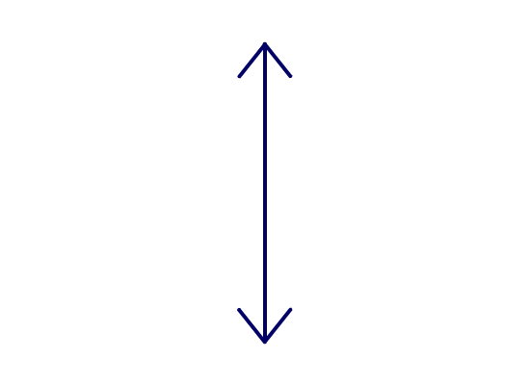
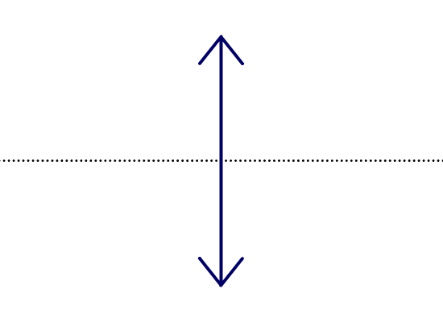
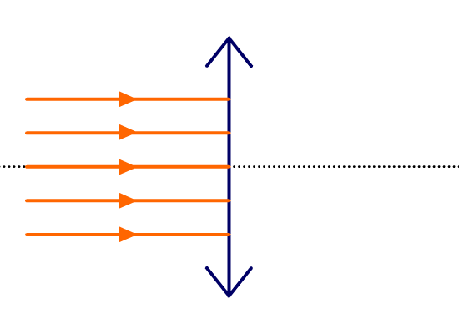
What are ray diagrams? (1)
Physicists use ray diagrams to model how convex and concave lenses refract light to form images.
convex lens
This is the symbol for a convex lens.
principal axis
A line is drawn going through the center of the lens. This is called the principal axis.
What would you expect the other side of this ray diagram to look like?
Notes:
This slide covers the Science and Engineering Practice:
Developing and Using Models: Develop, revise, and/or use a model based on evidence to illustrate and/or predict the relationships between systems or between components of a system.

Slide 8
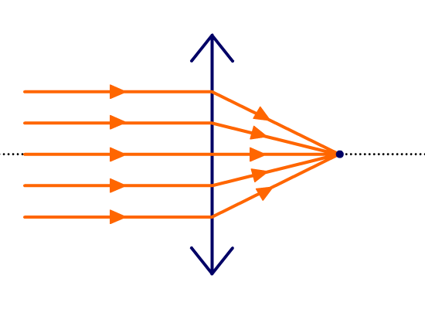
What are ray diagrams? (2)
Physicists use ray diagrams to model how convex and concave lenses refract light to form images.
Convex lenses make rays of light converge.
focal length
The rays of light come together and are focused on a single point on the principal axis.
principal focus
This point is called the focal point or principal focus. The distance from the lens to the principal focus is the focal length of the lens.
Notes:
Teacher notes
The terms principal focus and focal point are used interchangeably.
This slide covers the Science and Engineering Practice:
Developing and Using Models: Develop, revise, and/or use a model based on evidence to illustrate and/or predict the relationships between systems or between components of a system.

Slide 9
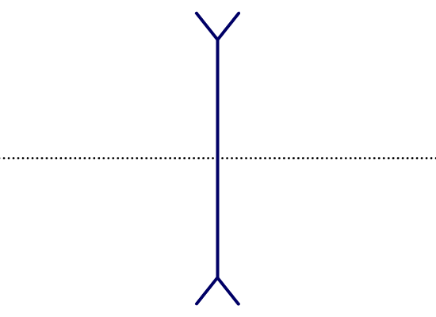
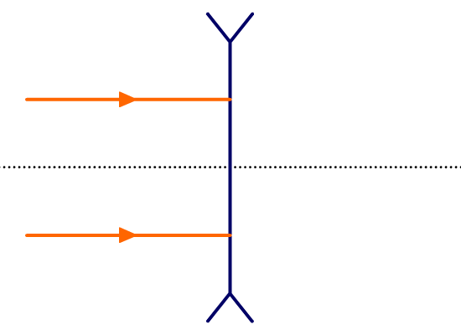
Focus of a concave lens (1)
We can also use ray diagrams to model concave lenses.
This is the symbol for a concave lens.
What would you expect the other side of this ray diagram to look like?
Notes:
This slide covers the Science and Engineering Practice:
Developing and Using Models: Develop, revise, and/or use a model based on evidence to illustrate and/or predict the relationships between systems or between components of a system.

Slide 10
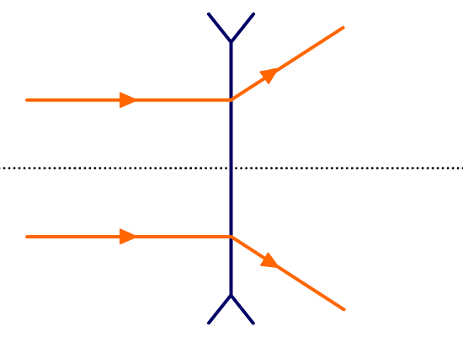
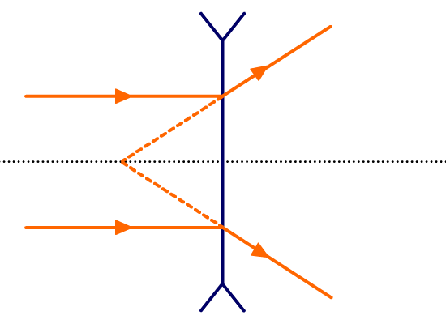
Focus of a concave lens (2)
We can also use ray diagrams to model concave lenses.
Concave lenses make rays of light diverge.
focal length
The focal point of a concave lens is in front of the lens.
focal point, F
To find it, we can trace the refracted rays backwards to the point where they intersect.
Notes:
Teacher notes
Conventionally, the focal length for a concave lens is described as negative.
This slide covers the Science and Engineering Practice:
Developing and Using Models: Develop, revise, and/or use a model based on evidence to illustrate and/or predict the relationships between systems or between components of a system.

Slide 11
Rules for refracting light
How a light is refracted by a lens depends on the direction it is traveling in before it impacts.
The focal points are one focal length from the center of the lens.
F
F
before it hits the lens
after refraction
parallel to principal axis
through focal point
through focal point
parallel to principal axis
incident on center of lens
not refracted
Notes:
This slide covers the Science and Engineering Practice:
Developing and Using Models: Develop, revise, and/or use a model based on evidence to illustrate and/or predict the relationships between systems or between components of a system.

Slide 12
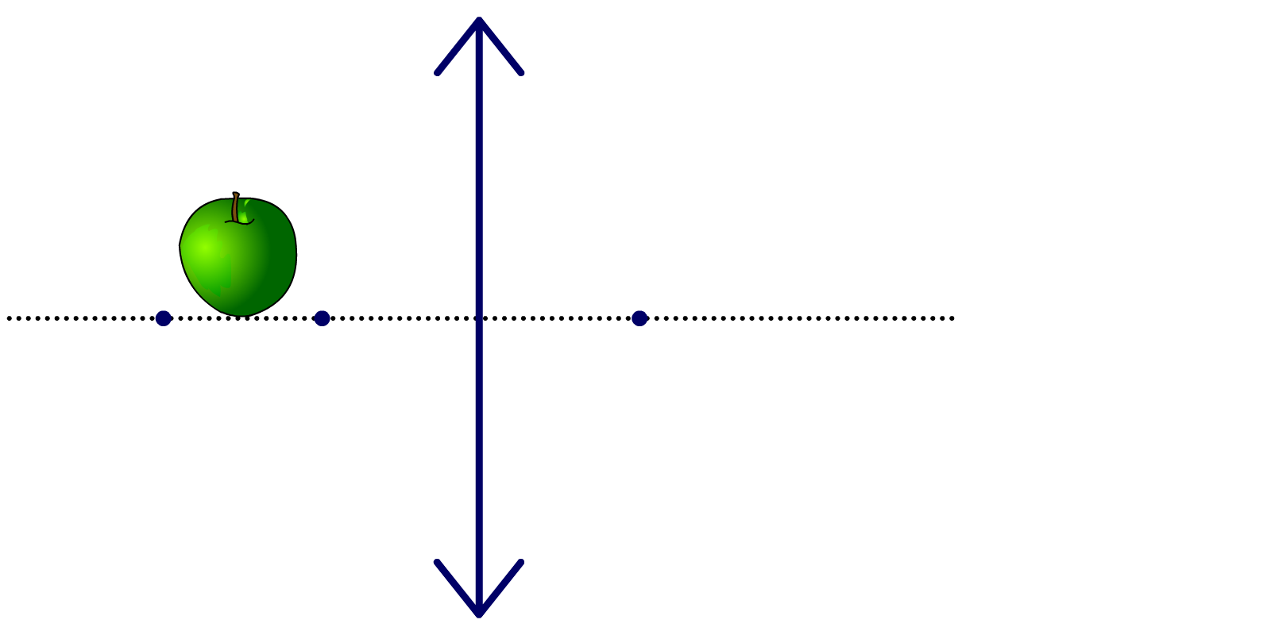
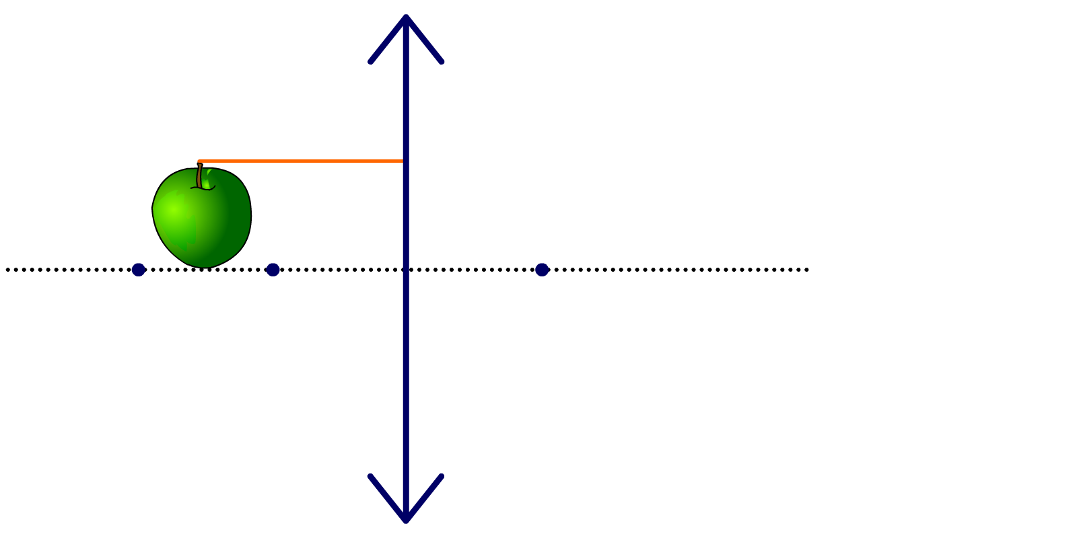
Constructing ray diagrams (1)
Complete this ray diagram for light passing from an object through a convex lens.
Start by drawing a ray that is parallel to the principal axis from the top of the object.
2F
F
F
Any ray that impacts the lens parallel to its principal axis must be refracted through the focal point of the lens.
Notes:
This slide covers the Science and Engineering Practice:
Developing and Using Models: Develop, revise, and/or use a model based on evidence to illustrate and/or predict the relationships between systems or between components of a system.

Slide 13
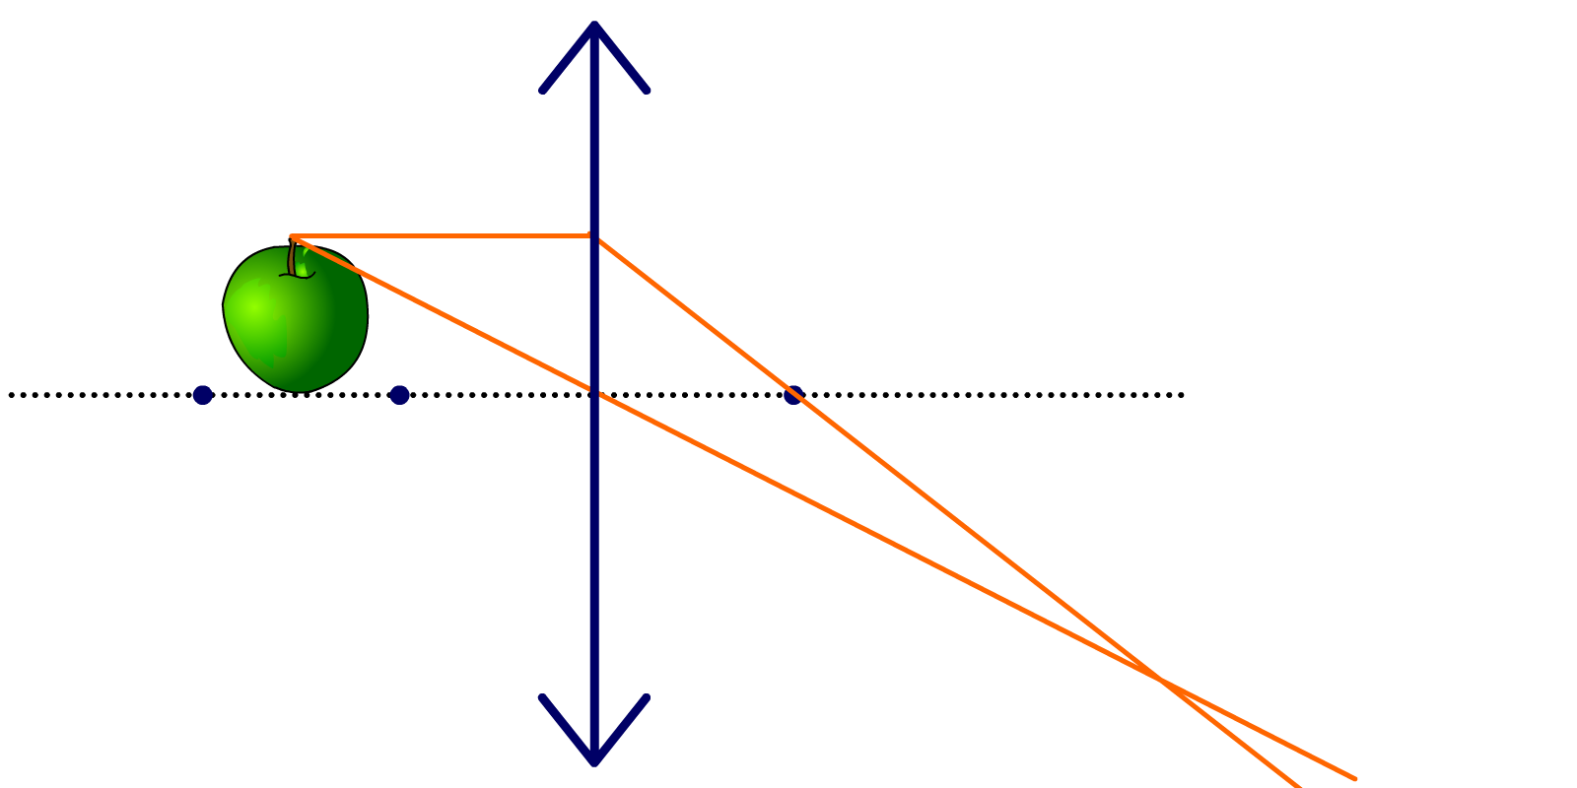
Constructing ray diagrams (2)
Complete this ray diagram for light passing from an object through a convex lens.
Secondly, draw a ray from the top of the object through the center of the lens.
2F
F
F
Any ray that passes through the exact center of the lens will not be refracted; its direction will not change.
Notes:
This slide covers the Science and Engineering Practice:
Developing and Using Models: Develop, revise, and/or use a model based on evidence to illustrate and/or predict the relationships between systems or between components of a system.

Slide 14
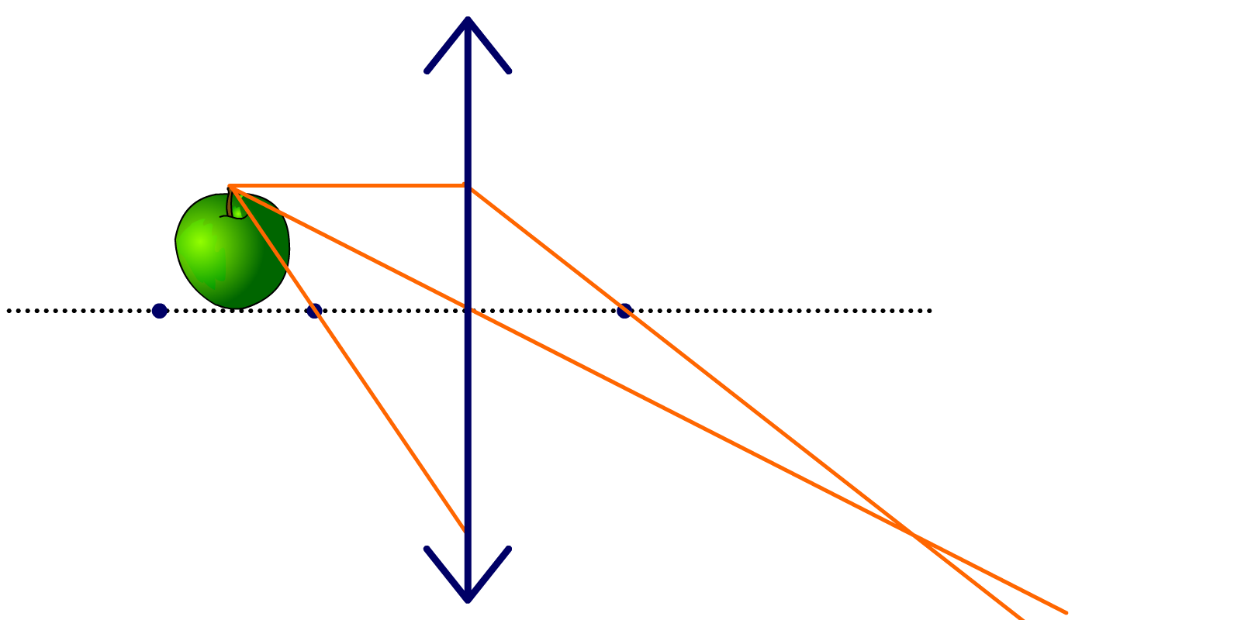
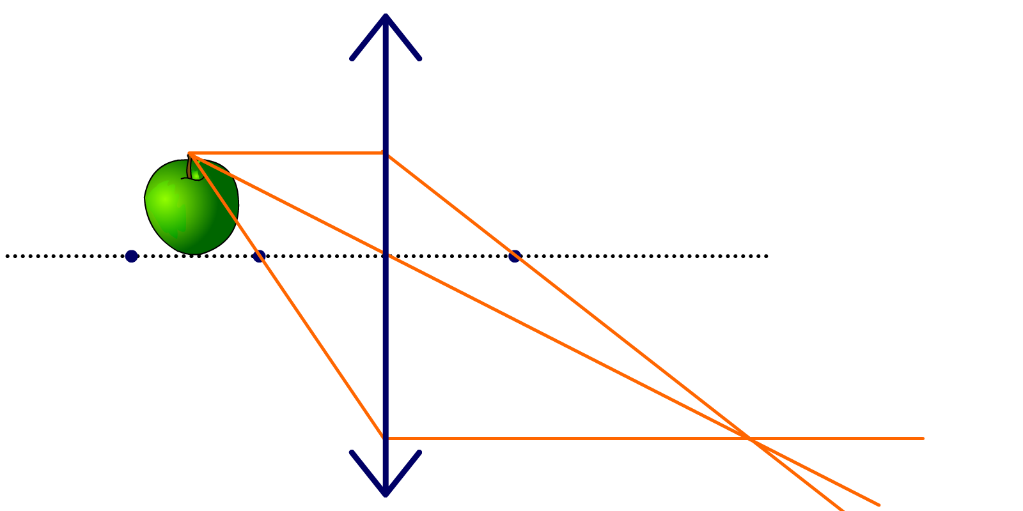
Constructing ray diagrams (3)
Complete this ray diagram for light passing from an object through a convex lens.
Finally, there is one more ray that we can draw.
What will happen to this ray after it impacts the lens?
2F
F
F
It will be refracted so that it exits the lens parallel to the principal axis.
Notes:
This slide covers the Science and Engineering Practice:
Developing and Using Models: Develop, revise, and/or use a model based on evidence to illustrate and/or predict the relationships between systems or between components of a system.

Slide 15
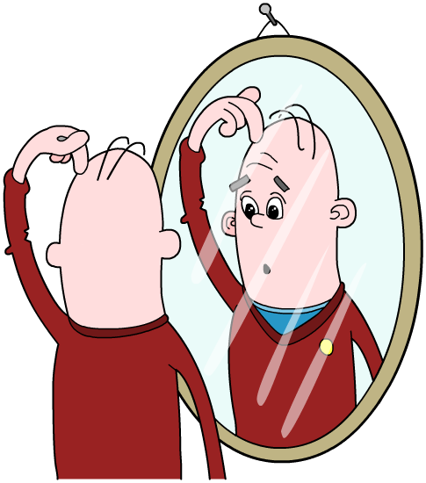
Real or virtual?
When someone looks into a mirror, they see an image. The image appears to be behind the mirror.
If you look behind the mirror, the image is obviously not there, so we say it is a virtual image. Virtual images cannot be formed on a screen.
A real image is one that can be formed on a screen, such as
a real image from a projector.
Concave lenses only produce virtual images. Convex lenses can produce images that are real or virtual.

Slide 16
Real and virtual images

Slide 17
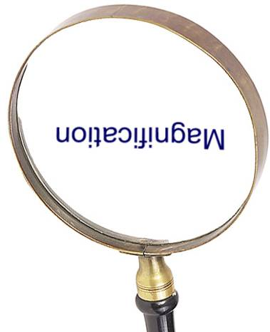
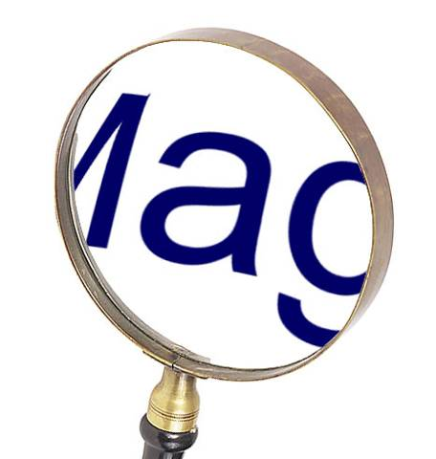
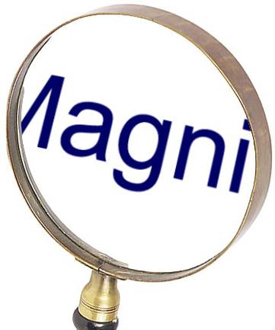
Images produced by convex lenses
Convex lenses produce different types of image depending on how far away the object is from the lens. This can be demonstrated with a magnifying glass.
How does the image change when a magnifying glass is gradually moved closer to some writing?
Magnification
Magnification
Magnification
45 cm away
5 cm away
10 cm away
Notes:
Photo credit: © Photos.com 2018

Slide 18
Forming images with ray diagrams
Notes:
Teacher notes
The first half of this animation shows the construction of a ray diagram for a convex lens. The second half shows the construction of a ray diagram for a concave lens.
The animation could be paused at the end of the third stage and students could use the method shown to produce a series of ray diagrams for a convex lens. Encourage them to use a ruler when drawing these diagrams.
To help students understand why the image formed is inverted, they should repeat the process for a point at the top and a point at the bottom of the object. They will see that the image of the point at the bottom of the object forms above the image of the point at the top. This shows that the image is inverted. In the example on the slide, the jelly baby’s foot is on the principal axis, showing that the foot must also be on the axis in the image.
After watching the second half of the animation, students could draw ray diagrams using both types of lenses and with the object positioned at 2F, beyond 2F, at F and in front of F. What do they find? The next section of the presentation will discuss the types of images formed by lenses in more detail.
This slide covers the Science and Engineering Practice:
Developing and Using Models: Develop, revise, and/or use a model based on evidence to illustrate and/or predict the relationships between systems or between components of a system.

Slide 19
Images created by convex lenses
Notes:
Teacher notes
This flash animation allows students to investigate the type of image formed by a convex lens with the object in any position. Ask students whether the image is:
real or virtual?
upright or inverted?
magnified, diminished or the same size as the object?
Pressing the “show” button will reveal the answers to these questions.

Slide 20
Images created by concave lenses
Notes:
Teacher notes
This flash animation allows students to investigate the type of image formed by a concave lens with the object in any position. Ask students whether the image is:
real or virtual?
upright or inverted?
magnified, diminished or the same size as the object?
Pressing the “show” button will reveal the answers to these questions.

Slide 21
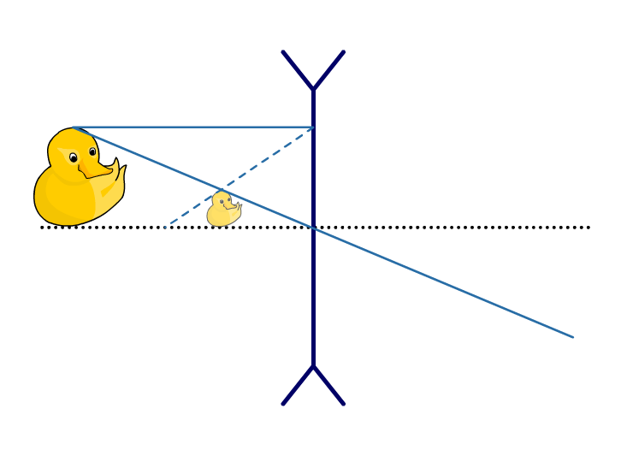
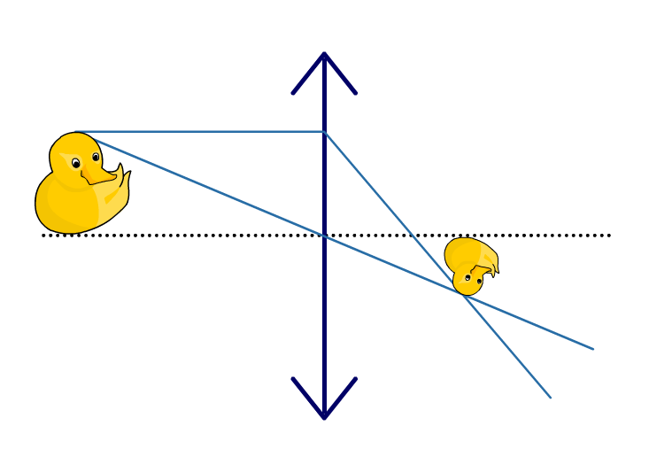
Comparing concave and convex lenses
Look at these ray diagrams. Which shows a convex lens and which shows a concave lens?
?
?
concave
convex
Concave lenses produce images that are always:
Convex lenses produce images that can be either:
virtual
real or virtual
upright
inverted or upright
smaller.
bigger or smaller.
Notes:
Teacher notes
This slide summarizes the information included in the previous two flash animations. Students may find it helpful to be reminded that if an image appears on the same side of the lens as the object, it will be upright and virtual. To extend this slide, ask students what type of lens would be needed to make an image of the duck that was upright, virtual and magnified? Relative to the focal length of that lens, where would the duck need to be placed on the principal axis?

Slide 22
Magnification formula
To calculate the magnification of a mirror or a lens, use the formula below:
image height
magnification
=
object height
If magnification is greater than 1, then the image is…
…bigger than the object.
If magnification is equal to 1, then the image is
…the same size as the object.
If magnification is less than 1, then the image is
…smaller than the object.
Notes:
This slide covers the Science and Engineering Practice:
Using Mathematics and Computational Thinking: Use mathematical, computational, and/or algorithmic representations of phenomena or design solutions to describe and/or support claims and/or explanations.

Slide 23
Calculating magnification
A beetle is 1.5 cm high. Its image is 4.5 cm high when viewed through a lens. Calculate the magnification of the lens.
image height
magnification
=
object height
4.5 cm
magnification
=
1.5 cm
= 3
Remember that magnification is a ratio and therefore does not have any units.
Notes:
Teacher notes
Students should be reminded that both image height and object height should be measured in the same units (typically either millimeters or centimeters).
This slide covers the Science and Engineering Practices:
Using Mathematics and Computational Thinking: Use mathematical, computational, and/or algorithmic representations of phenomena or design solutions to describe and/or support claims and/or explanations.
Using Mathematics and Computational Thinking: Apply techniques of algebra and functions to represent and solve scientific and engineering problems.
Using Mathematics and Computational Thinking: Apply ratios, rates, percentages, and unit conversions in the context of complicated measurement problems involving quantities with derived or compound units (such as mg/mL, kg/m3, acre-feet, etc.).

Slide 24
Calculating image size
When viewed through a magnifying glass, this ant appears 16 cm tall. If the magnification of the glass is 8, what is the actual size of the ant?
image height
magnification
=
object height
image height
object height
=
magnification
16 cm
object height
=
8
=
2 cm
Notes:
This slide covers the Science and Engineering Practices:
Using Mathematics and Computational Thinking: Use mathematical, computational, and/or algorithmic representations of phenomena or design solutions to describe and/or support claims and/or explanations.
Using Mathematics and Computational Thinking: Apply techniques of algebra and functions to represent and solve scientific and engineering problems.
Using Mathematics and Computational Thinking: Apply ratios, rates, percentages, and unit conversions in the context of complicated measurement problems involving quantities with derived or compound units (such as mg/mL, kg/m3, acre-feet, etc.).

