Slide 1
Light as Waves and Particles

Slide 2
Information
Developing and Using Models
Constructing Explanations and Designing Solutions
Engaging in Argument from Evidence
2. Cause and Effect
4. Systems and System Models
5. Energy and Matter

Slide 3
What is light?
Scientists have debated the nature of light for centuries.
In the 17th century, Sir Isaac Newton proposed that light was made up of tiny particles, which he called corpuscles.
At about the same time, the Dutch scientist Christiaan Huygens published his own theory of light. Huygens thought that light was a wave. Newton’s reputation as a scientist meant that the particle theory of light was more popular than Huygens’ wave model.
List what you know about how light behaves. Does its behavior suggest it is a wave or a particle?
Notes:
Teacher notes
Newton and Huygens were not the only scientists to develop theories of the nature of light in the 17th century; the information on this slide is limited to them in the interests of simplicity.
Photo credit: © pixbox77, shutterstock.com 2018

Slide 4
Light moves in straight lines
What do shadows tell us about light?
Shadows show that light cannot pass through or bend around opaque objects. Light moves in straight lines.
This is different from sound, which can be heard around corners. Sound is a wave, so does this mean that light must be a particle?
Notes:
Teacher notes
Sound can be heard around corners because it is diffracted by large obstacles. We now know that light can also diffract, but its wavelength is much too short to be diffracted by doorways and other large gaps.
Students could be encouraged to relate the observation that light travels in straight lines to Newton’s first law of motion: a moving object will continue to move at the same speed in a straight line unless acted upon by a force. What does this tell us about light? (In fact, Newton believed that corpuscles had mass and undergo projectile motion near the Earth, but appear to travel in a straight line because their velocity is so great.)
This slide covers the Science and Engineering Practice:
Constructing Explanations and Designing Solutions: Apply scientific ideas, principles, and/or evidence to provide an explanation of phenomena and solve design problems, taking into account possible unanticipated effects.

Slide 5
Light can be reflected
When a smooth ball collides elastically with a frictionless surface, it bounces at an angle equal to the incident angle.
normal
incident ray
i
r
reflected ray
point of incidence
plane mirror
This is precisely what happens when light is reflected.
The angle of reflection (r) is always exactly equal to the angle of incidence (i). Light behaves like a smooth sphere colliding elastically with a surface.
Could the reflection of light also be explained by a wave model of light?
Notes:
Teacher notes
Students could be encouraged to consider what is the logical implication of this experimental result in order to get a better understanding of the relationship between experiment and theory. The reflection of light is compatible with the theory that light is a particle; it is also compatible with the theory that light is a wave.
For more information about the reflection of light, please refer to the Reflection and Refraction of Waves presentation.
This slide covers the Science and Engineering Practice:
Constructing Explanations and Designing Solutions: Apply scientific ideas, principles, and/or evidence to provide an explanation of phenomena and solve design problems, taking into account possible unanticipated effects.

Slide 6
Light can be refracted
A ray of light changes direction when it changes medium (for example, when it moves from air to water or glass).
This change of direction, called refraction, is due to the change in the speed of light as it changes medium.
Newton explained refraction by suggesting that particles of light are attracted to matter, so speed up near the surface of a denser medium.
In the wave model of light, refraction is explained by stating that light slows down when it moves into a denser medium.
Notes:
Teacher notes
For more information about the refraction of light, please refer to the Reflection and Refraction of Waves presentation.
This slide covers the Science and Engineering Practice:
Constructing Explanations and Designing Solutions: Apply scientific ideas, principles, and/or evidence to provide an explanation of phenomena and solve design problems, taking into account possible unanticipated effects.
Photo credit: © MilanB, shutterstock.com 2018

Slide 7
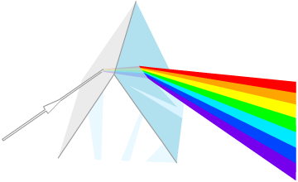
Light can be dispersed
When white light is passed through a prism, it is split into a spectrum of colors. This is known as dispersion.
Dispersion occurs because white light is a mixture of different wavelengths, which we see as different colors.
These wavelengths are refracted by different amounts, so they are separated out when light passes through a prism.
Can dispersion be explained by a particle model of light?
Notes:
Teacher notes
Newton explained dispersion in terms of particles by suggesting that different color light particles had different masses.
For more information about the dispersion of light, please refer to the Visible Light presentation.
This slide covers the Science and Engineering Practice:
Constructing Explanations and Designing Solutions: Apply scientific ideas, principles, and/or evidence to provide an explanation of phenomena and solve design problems, taking into account possible unanticipated effects.

Slide 8
Is light a wave?
Notes:
Teacher notes
Monochromatic light is light of a single wavelength. The interference pattern that results from shining monochromatic light through a double slit depends on the wavelength of the light. Students could be asked what they would see if white light were used instead of red light.
For more information about diffraction and interference, please refer to the Diffraction and Interference presentations respectively.
Photo credit (Sun): © garloon, Shutterstock.com 2018

Slide 9
Light as a wave
Before Young’s double split experiment, most experiments with light could be explained by both waves and particles.
The pattern that Young observed could not be explained if light was made of particles. Light from each slit diffracted and interfered with light from the other slit. This could only happen if light is a wave.
In 1850, Léon Foucault demonstrated that light travelled slower in water than air. Newton’s corpuscular theory had predicted that light would travel faster in water.
These two experiments caused scientists to accept the theory that light is a wave.
Notes:
Teacher notes
The wave theory of light developed in the 19th century was not Huygens’ theory of light, although Huygens’ principle of wave propagation was adopted as a model to explain the propagation of light. Huygens had proposed that light was a longitudinal wave that traveled through the “ether.”
This slide covers the Science and Engineering Practice:
Engaging in Argument from Evidence: Evaluate the claims, evidence, and/or reasoning behind currently accepted explanations or solutions to determine the merits of arguments.

Slide 10
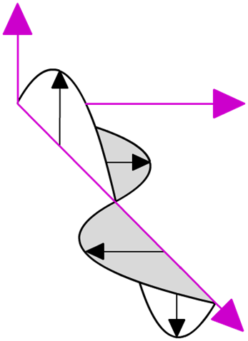
Electromagnetic waves
In the 1860s, the physicist James Clerk Maxwell developed his theory of electromagnetism. He predicted the existence of a wave made up of oscillating electric and magnetic fields.
Maxwell calculated the speed of his predicted wave and found that it was equal to the measured speed of light. He concluded that light is an electromagnetic wave.
Maxwell also suggested that infrared and ultraviolet light are electromagnetic (EM) waves. In the years following the publication of Maxwell’s theory, other types of EM waves, such as radio waves and X-rays, were discovered.
magnetic field
electric field
wave direction
Notes:
Teacher notes
For more information about electromagnetism and electromagnetic waves, please refer to the Electromagnetism and The Electromagnetic Spectrum presentations respectively.

Slide 11
The photoelectric effect
Towards the end of the 19th century, scientists discovered that shining ultraviolet light on a metal released electrons from the metal. This is known as the photoelectric effect.
Philipp Lenard made some observations of this effect that could not be explained by the accepted wave model of light:
The maximum kinetic energy of the electrons emitted depended on the frequency of the light, not its intensity. Intensity is the energy transferred per unit area per unit time, so it was expected to affect the electron’s energy.
If the light used was below a certain frequency, no electrons were emitted. A high intensity, low frequency wave was thought to transfer more energy than a low intensity, high frequency wave.
Notes:
Teacher notes
For more information about the photoelectric effect, please refer to the The Photoelectric Effect presentation.

Slide 12
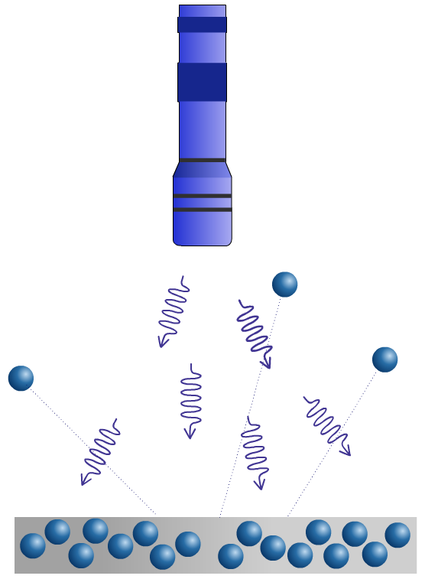
Photons
In 1905, Albert Einstein published a paper that described his explanation of the photoelectric effect.
Einstein proposed that light comes in discrete “packets”, called quanta, which means that it sometimes behaves like a particle. Today, quanta of light are called photons.
The energy of an individual photon depends on the frequency of the light.
This explains the unexpected results of the photoelectric effect: each photon with a high enough energy releases a single electron. Low frequency photons do not have enough energy and so do not release electrons.
Notes:
Teacher notes
The idea that energy is quantized was first introduced by Max Planck in 1900 to solve the “ultraviolet catastrophe.” Planck proposed that atoms could only have discrete energy values: the energy emitted by atoms as they lost energy could only take values that corresponded to the differences in atoms’ energy levels.
This slide covers the Science and Engineering Practice:
Engaging in Argument from Evidence: Evaluate the claims, evidence, and/or reasoning behind currently accepted explanations or solutions to determine the merits of arguments.

Slide 13
Light: wave, particle or both?
Light and other electromagnetic radiation can be described as waves made up of oscillating electric and magnetic fields or as particle-like “packets” of energy called photons.
Which model is more useful depends on the situation. Some behaviors of light can be described using either waves or particles; other behaviors can only be explained using one of these models.
In which situations is it more helpful to think of light as a wave? When is it more useful to model light as a particle?
Notes:
This slide covers the Science and Engineering Practice:
Developing and Using Models: Develop and/or use multiple types of models to provide mechanistic accounts and/or predict phenomena, and move flexibly between model types based on merits and limitations.

Slide 14
Wave–particle duality

Slide 15
Changing opinions on light: summary
Notes:
Teacher notes
This animation could be used as an introductory or summary activity on the nature of light.
This slide is accompanied by the worksheet Light as Waves and Particles.
This slide covers the Science and Engineering Practice:
Engaging in Argument from Evidence: Evaluate the claims, evidence, and/or reasoning behind currently accepted explanations or solutions to determine the merits of arguments.

