Slide 1
Moments

Slide 2
Information
Developing and Using Models
Planning and Carrying Out Investigations
Using Mathematics and Computational Thinking
Constructing Explanations and Designing Solutions
2. Cause and Effect
3. Scale, Proportion, and Quantity
6. Structure and Function

Slide 3
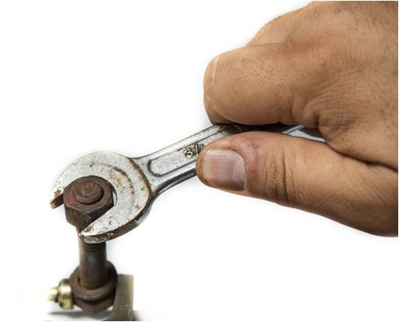
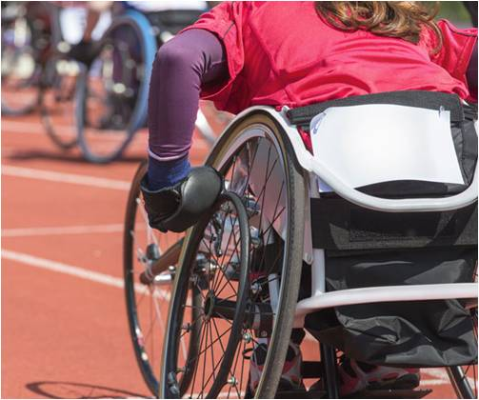
Rotational forces
A force, or a system of forces, can be used to make objects rotate around a pivot.
For example:
Applying a clockwise force to the wrench tightens the bolt.
Wheelchair athletes spin their wheels by pushing downwards.
Notes:
Teacher notes
For more information about forces, please refer to the Introduction to Forces presentation.
Photo credits: wrench © PhotoMagicWorld, athlete © mezzotint, both at shutterstock.com 2018

Slide 4
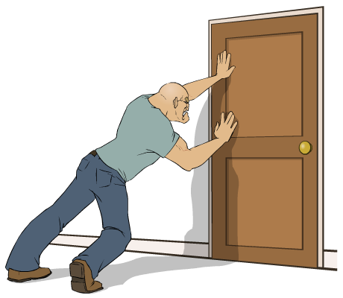
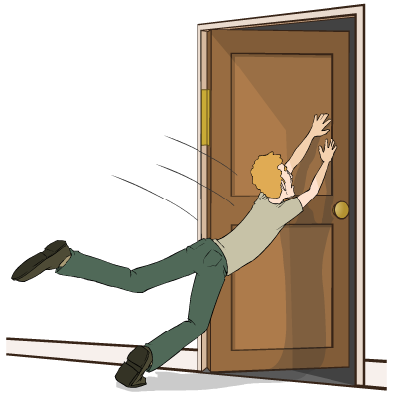
What is a moment?
When a force applied to an object makes it rotate around a pivot, the turning effect is called a moment.
The size of the moment depends on two factors.
The bigger the force, the larger the turning effect.
The greater the distance from the pivot to the point where the force is applied, the larger the turning effect.
Why does the door open more easily for the second person?
Notes:
Teacher notes
The door opens more readily for the second person because the second person is applying a force further from the hinges of the door, which act as a pivot.
This slide covers the Science and Engineering Practice:
Developing and Using Models: Develop, revise, and/or use a model based on evidence to illustrate and/or predict the relationships between systems or between components of a system.

Slide 5
Understanding moments
Notes:
Teacher notes
This multiple choice quiz tests students’ understanding of the relationship between distance from pivot and moment of the force for five different examples, including; an Allen key, a door, a wrench, a screwdriver and a wheelbarrow.
This slide covers the Science and Engineering Practice:
Developing and Using Models: Develop, revise, and/or use a model based on evidence to illustrate and/or predict the relationships between systems or between components of a system.

Slide 6
Calculating moments
The size of a moment can be calculated using the equation:
moment of a force = force × distance
M = F × d
The moment of a force (M) is measured in newton meters (Nm).
Force (F) is measured in newtons (N).
Distance (d) is the perpendicular distance from the pivot to the line of action of the force. It is measured in meters (m).
Notes:
This slide covers the Science and Engineering Practice:
Using Mathematics and Computational Thinking: Use mathematical, computational, and/or algorithmic representations of phenomena or design solutions to describe and/or support claims and/or explanations.

Slide 7
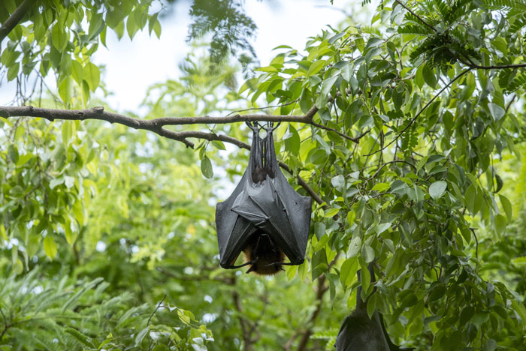
Calculating moments example (1)
A sleeping bat hangs from a branch. If the force of its weight is 8 N downwards and its perpendicular distance from the tree trunk is 20 cm, what is the moment of the force?
moment of a force
= force × distance
moment
= 8 × 0.2
= 1.6 Nm
Notes:
This slide covers the Science and Engineering Practices:
Using Mathematics and Computational Thinking: Use mathematical, computational, and/or algorithmic representations of phenomena or design solutions to describe and/or support claims and/or explanations.
Using Mathematics and Computational Thinking: Apply techniques of algebra and functions to represent and solve scientific and engineering problems.
Photo credit: © Bird Hunter, shutterstock.com 2018

Slide 8
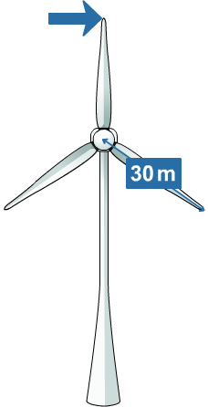
Calculating moments example (2)
A wind turbine has blades that are 30 m long. The wind pushes against the tip of the top blade to create a moment of 150,000 Nm. What is the force of the wind?
moment of a force
= force × distance
moment
force
=
distance
150,000
force
=
30
force
= 5,000 N
Notes:
This slide covers the Science and Engineering Practices:
Using Mathematics and Computational Thinking: Use mathematical, computational, and/or algorithmic representations of phenomena or design solutions to describe and/or support claims and/or explanations.
Using Mathematics and Computational Thinking: Apply techniques of algebra and functions to represent and solve scientific and engineering problems.

Slide 9
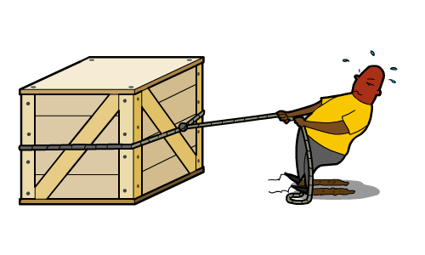
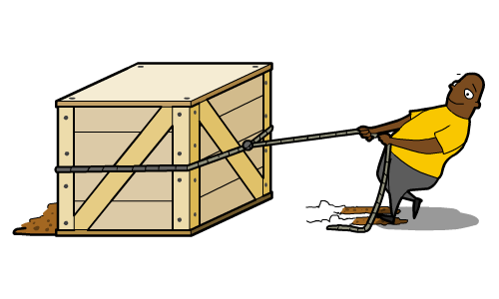
Balanced and unbalanced forces
When forces in opposite directions have the same value, they cancel each other out. We say that the forces are balanced.
The object either remains stationary or continues to move at a constant speed.
If the forces on an object are not balanced, there is a resultant force, and the object accelerates.
Notes:
Teacher notes
For more information about balanced and unbalanced forces, please refer to the Acceleration, Newton’s First Law of Motion, Newton’s Second Law of Motion and Resultant Forces presentations.

Slide 10
Clockwise and counterclockwise moments (1)
When Johannes and Victor lift their feet off the ground, what will happen to the seesaw?
Johannes
Victor
pivot point
The force of gravity acting on each person creates a turning effect on the seesaw. It creates an clockwise moment on Victor. On Johannes, it creates a counterclockwise moment.
Notes:
This slide covers the Science and Engineering Practice:
Constructing Explanations and Designing Solutions: Apply scientific ideas, principles, and/or evidence to provide an explanation of phenomena and solve design problems, taking into account possible unanticipated effects.

Slide 11
Clockwise and counterclockwise moments (2)
When Johannes and Victor lift their feet off the ground, what will happen to the seesaw?
Victor
Johannes
The clockwise moment is larger than the counterclockwise moment, so the seesaw will turn in a clockwise direction. The seesaw tips and Victor is lifted into the air.
Notes:
This slide covers the Science and Engineering Practice:
Constructing Explanations and Designing Solutions: Apply scientific ideas, principles, and/or evidence to provide an explanation of phenomena and solve design problems, taking into account possible unanticipated effects.

Slide 12
Balancing moments
What would happen if Victor sat on the seesaw with someone the same weight as him?
They would each exert the same downward force. Since they are sitting the same distance away from the pivot, their moments are equal and the seesaw is balanced.
If an object is balanced about a pivot, then we can say that:
sum of counter- clockwise moments
sum of clockwise moments
=
Notes:
This slide covers the Science and Engineering Practice:
Constructing Explanations and Designing Solutions: Apply scientific ideas, principles, and/or evidence to provide an explanation of phenomena and solve design problems, taking into account possible unanticipated effects.

Slide 13
Balancing scales
Notes:
Teacher notes
This activity tests pupils’ understanding of both the moment equation and how to balance moments. Set up a combination of weights on the left-hand side of the scales and ask pupils to work out what to add to the right-hand side to balance the scales. Pupils could also be asked to think of as many different solutions as possible to each problem.
Arrangements of weights on the left (and some possible answers) might include:
400 g at 10 cm (400 g at 10 cm; 200 g at 20 cm; 800 g at 5 cm)
100 g at 17 cm (100 g at 17 cm is the only solution)
700 g at 20 cm (using all four hooks: 600 g at 10 cm with 400 g at 20 cm; 1000 g at 12 cm with 100 g at 20 cm)
100 g at 20 cm, 12 cm and 6 cm (200 g at 19 cm is the only solution)
This slide covers the Science and Engineering Practice:
Planning and Carrying Out Investigations: Make directional hypotheses that specify what happens to a dependent variable when an independent variable is manipulated.

Slide 14
Calculating forces and distances

Slide 15
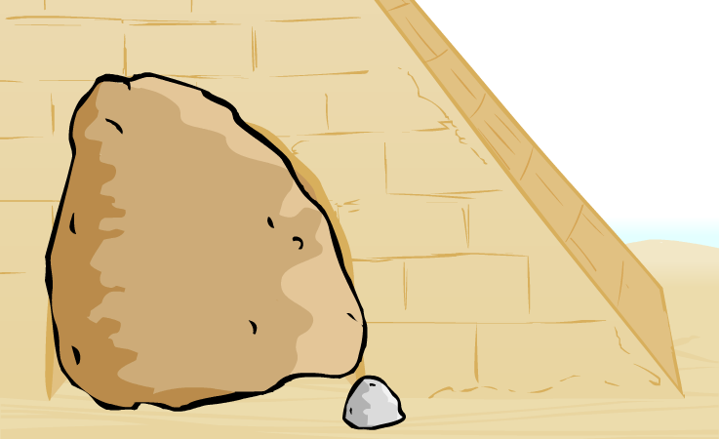
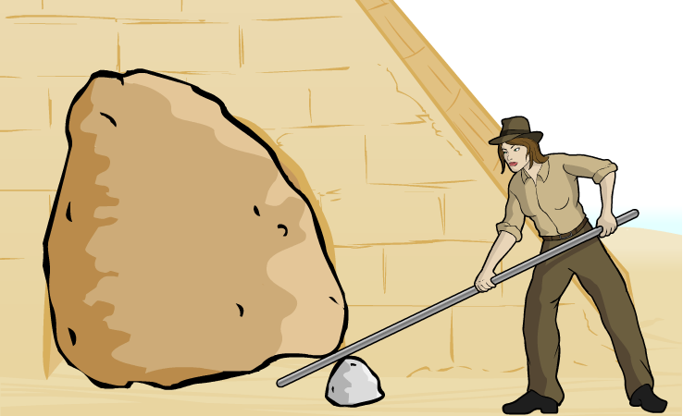
Lifting heavy objects (1)
The explorer Jane Wolf needs to move a 1,000 N boulder that is blocking an entrance. She can only apply a 20 N force, but she also has a 6 m metal pole.
How can Jane use moments to move the boulder?
Jane uses the smaller stone as a fulcrum, or a pivot point, and the metal pole as a lever.
To see why this works, we need to calculate the clockwise and counterclockwise moments around the stone.
1,000 N
6 m

Slide 16
Lifting heavy objects (2)
How can Jane use moments to move the boulder?
The smaller stone is 0.1m from the boulder, which exerts a 1,000 N force downwards.
Calculate the counterclockwise moment the boulder creates.
moment of a force = force × distance
= 1,000 × 0.1
= 100 Nm
100 Nm
Notes:
Teacher notes
For simplicity, it is assumed that the weight of the boulder acts as a single downwards force at the end of the pole, with a perpendicular distance of 0.1 m from the pivot point.
This slide covers the Science and Engineering Practice:
Using Mathematics and Computational Thinking: Apply techniques of algebra and functions to represent and solve scientific and engineering problems.

Slide 17
Lifting heavy objects (3)
How can Jane use moments to move the boulder?
Jane applies a downwards force of 20 N to her end of the lever, at a perpendicular distance of 5.9 m from the stone.
Calculate the clockwise moment created by Jane.
moment of a force = force × distance
118 Nm
= 20 × 5.9
= 118 Nm
100 Nm
Notes:
Teacher notes
Again, for simplicity, it is assumed that Jane applies a single downwards force at her end of the pole, with a perpendicular distance of 5.9 m from the pivot point.
This slide covers the Science and Engineering Practice:
Using Mathematics and Computational Thinking: Apply techniques of algebra and functions to represent and solve scientific and engineering problems.

Slide 18
Lifting heavy objects (4)
How can Jane use moments to move the boulder?
The clockwise moment on the lever is greater than the counterclockwise moment on the lever.
The forces are unbalanced, and the lever rotates around the pivot, lifting the boulder.
118 Nm
100 Nm

Slide 19
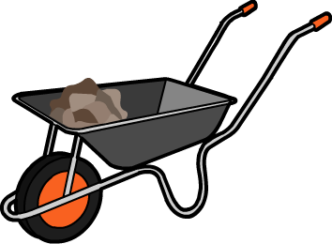
Levers
Jane was able to move the boulder because she used a lever. Levers are designed to transmit the rotational effects of forces in order to make it easier to lift objects.
Another example of a mechanical system that uses a lever is a wheelbarrow.
On a wheelbarrow, the center of the wheel is the fulcrum. The object to be lifted is called the load.
load
fulcrum
To lift the load, an upwards force is applied.

Slide 20
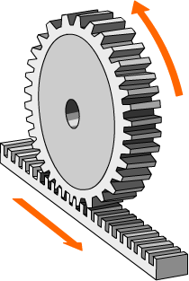
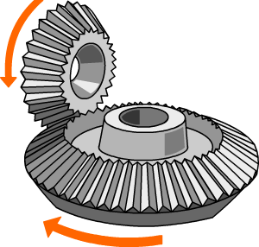
Gears
Gears, like levers, are also used to transmit the rotational effects of forces.
Gears can be used to:
change the direction of rotation
convert from rotational to linear motion
Notes:
Teacher notes
The image on the left is a bevel gear mechanism in which a clockwise motion in the vertical plane is transformed into an counterclockwise motion in the horizontal plane. The image on the right is a rack and pin system. To extend this slide, ask students to come up with their own gear configurations and to describe the transformation of movement they create.
Gears can also be used to change the speed and power of a movement.

Slide 21
How do bicycle gears work?
Notes:
This slide covers the Science and Engineering Practice:
Constructing Explanations and Designing Solutions: Apply scientific ideas, principles, and/or evidence to provide an explanation of phenomena and solve design problems, taking into account possible unanticipated effects.

