Slide 1
Newton’s Third Law of Motion

Slide 2
Information
Constructing Explanations and Designing Solutions
2. Cause and Effect

Slide 3
What is Newton’s third law?
Forces arise from interactions between two objects.
A force cannot exist on its own – a force always causes a reaction in the form of a second force.
This forms the basis of Newton’s third law of motion, which states:
If object A exerts a force on object B, then object B exerts an equal but opposite force on object A.
These pairs of forces that act between two objects are sometimes called action–reaction pairs or interaction pairs.
Notes:
Teacher notes
Students should understand that action–reaction pairs are not the same as balanced forces – while the latter act on just one object, the former act on two separate but interacting objects.
Newton’s third law is sometimes written as: “For every action, there is an equal and opposite reaction.”
This presentation is accompanied by the worksheet Newton’s Third Law of Motion.

Slide 4
Action–reaction pairs
Notes:
Teacher notes
This activity provides the opportunity for informal assessment of students’ understanding of the action–reaction pairs.
This slide covers the Science and Engineering Practice:
Constructing Explanations and Designing Solutions: Apply scientific ideas, principles, and/or evidence to provide an explanation of phenomena and solve design problems, taking into account possible unanticipated effects.

Slide 5
What forces support objects?
What forces are acting between Mel’s computer and the table it is resting on?
The computer pushes down on the table because it is attracted by the Earth’s gravity.
contact force
The table exerts an equal and opposite force pushing upwards on the computer. This is called the reaction of the surface.
reaction force

Slide 6
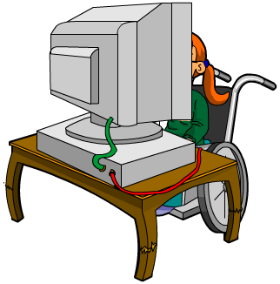
Reaction of the surface
If the downward force exerted by a stationary object increases (for example, if it gets heavier), the reaction of the surface will also increase to match it.
This remains true up to a certain limit, when the downward force overcomes the reaction of the surface.
At this point, the object will move downwards through the surface.

Slide 7
Reaction forces and thrust
Notes:
This slide covers the Science and Engineering Practice:
Constructing Explanations and Designing Solutions: Apply scientific ideas, principles, and/or evidence to provide an explanation of phenomena and solve design problems, taking into account possible unanticipated effects.

