Slide 1
Nuclear Fission

Slide 2
Information
Developing and Using Models
Constructing Explanations and Designing Solutions
2. Cause and Effect
4. Systems and System Models
5. Energy and Matter
7. Stability and Change

Slide 3
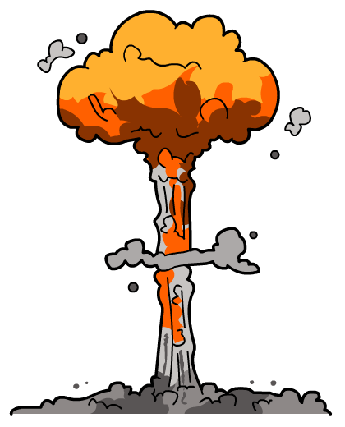
What is nuclear fission?
Nuclear fission is when a large and unstable nucleus splits into two smaller nuclei, releasing large amounts of energy.
Unlike radioactive decay, fission rarely occurs naturally. Fission usually occurs when a heavy nucleus absorbs a neutron.
Isotopes that undergo fission include uranium-235 and plutonium-239. Most nuclear reactors use uranium-235.
The fission of 1 kilogram of uranium-235 releases more energy than burning
2 million kilograms of coal!
Notes:
This presentation is accompanied by the worksheet Nuclear Fission.

Slide 4
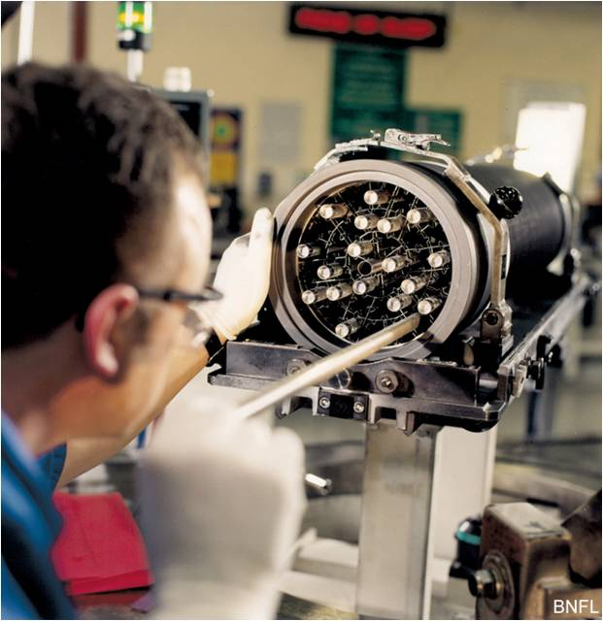
How is uranium used in nuclear reactors?
There are two major isotopes of uranium – 238 and 235. Uranium-238 is more common, but it does not undergo nuclear fission.
Only 0.7% of naturally-occurring uranium is uranium-235, which does undergo nuclear fission.
Before it can be used as the fuel in nuclear power stations, uranium needs to be enriched until it has 3% uranium-235.
The enriched fuel is made into rods which are used in the reactor.
Notes:
Teacher notes
The image shows fuel rods being inserted into an assembly which will then be put into the nuclear reactor.
These fuel rods are for use in an Advanced Gas-cooled Reactor (AGR). AGR fuel is made from uranium dioxide powder. An AGR fuel element is made up of uranium oxide pellets stacked inside stainless steel tubes. These tubes are then grouped together in a graphite “sleeve” to form a “fuel assembly.” An AGR assembly is made up of 36 steel tubes, each containing 64 pellets.
Photo credit: © BNFL, 2018

Slide 5
What happens in nuclear fission?
Notes:
Teacher notes
This three-stage animated sequence explains nuclear fission.
This slide covers the Science and Engineering Practices:
Developing and Using Models: Develop, revise, and/or use a model based on evidence to illustrate and/or predict the relationships between systems or between components of a system.
Developing and Using Models: Use a model to provide mechanistic accounts of phenomena.

Slide 6
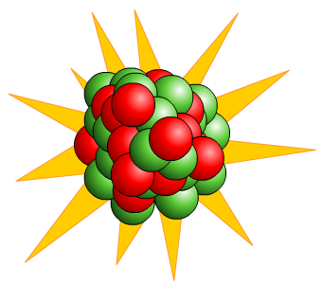
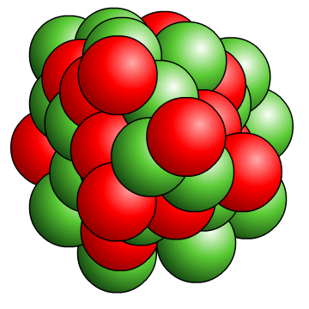
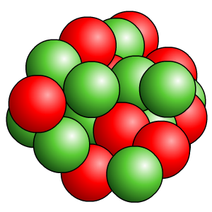
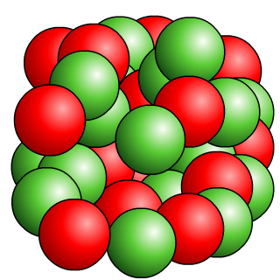
What are the products of fission?
When fission of uranium-235 occurs, it splits into two smaller nuclei, roughly equal in size, known as daughter nuclei, and emits a couple of neutrons and gamma rays.
Many possible daughter nuclei may be formed in a fission process. One example is shown below.
fission
+
+
+
uranium235
+
neutron
uranium
236
strontium90
+
xenon144
+
neutrons

Slide 7
Where does the energy come from?
Barium and krypton are often the daughter nuclei formed by the fission of uranium-235. The decay equation for this is:
235
1
90
143
1
U
+
n
Kr
+
Ba
+
3
n
92
0
36
56
0
In this decay equation, the number of protons and the mass numbers on both sides of the equation balance.
However, the particles after decay have slightly less mass than the particles before decay.
The mass that has been lost has turned into energy.
Some of this energy is transformed into the kinetic energy of the fission products and some energy is released in the form of gamma rays.
Notes:
This slide covers the Science and Engineering Practices:
Developing and Using Models: Develop, revise, and/or use a model based on evidence to illustrate and/or predict the relationships between systems or between components of a system.
Constructing Explanations and Designing Solutions: Apply scientific ideas, principles, and/or evidence to provide an explanation of phenomena and solve design problems, taking into account possible unanticipated effects.

Slide 8
How does nuclear power work?
Notes:
Teacher notes
This sequence explains how nuclear fission is used to create electricity in a nuclear power station.
This slide covers the Science and Engineering Practice:
Developing and Using Models: Develop, revise, and/or use a model based on evidence to illustrate and/or predict the relationships between systems or between components of a system.

Slide 9
Nuclear fission – true or false?
Notes:
Teacher notes
This true-or-false activity could be used as an introductory or summary activity on nuclear fission, or at the start of the lesson to gauge students’ existing knowledge of the subject matter. Colored traffic light cards (red = false, yellow = don’t know, green = true) could be used to make this a whole-class exercise.

Slide 10
What happens in a chain reaction?
Notes:
Teacher notes
This three-stage animated sequence explains how a chain reaction occurs.
This slide covers the Science and Engineering Practices:
Developing and Using Models: Develop, revise, and/or use a model based on evidence to illustrate and/or predict the relationships between systems or between components of a system.
Developing and Using Models: Use a model to provide mechanistic accounts of phenomena.

Slide 11
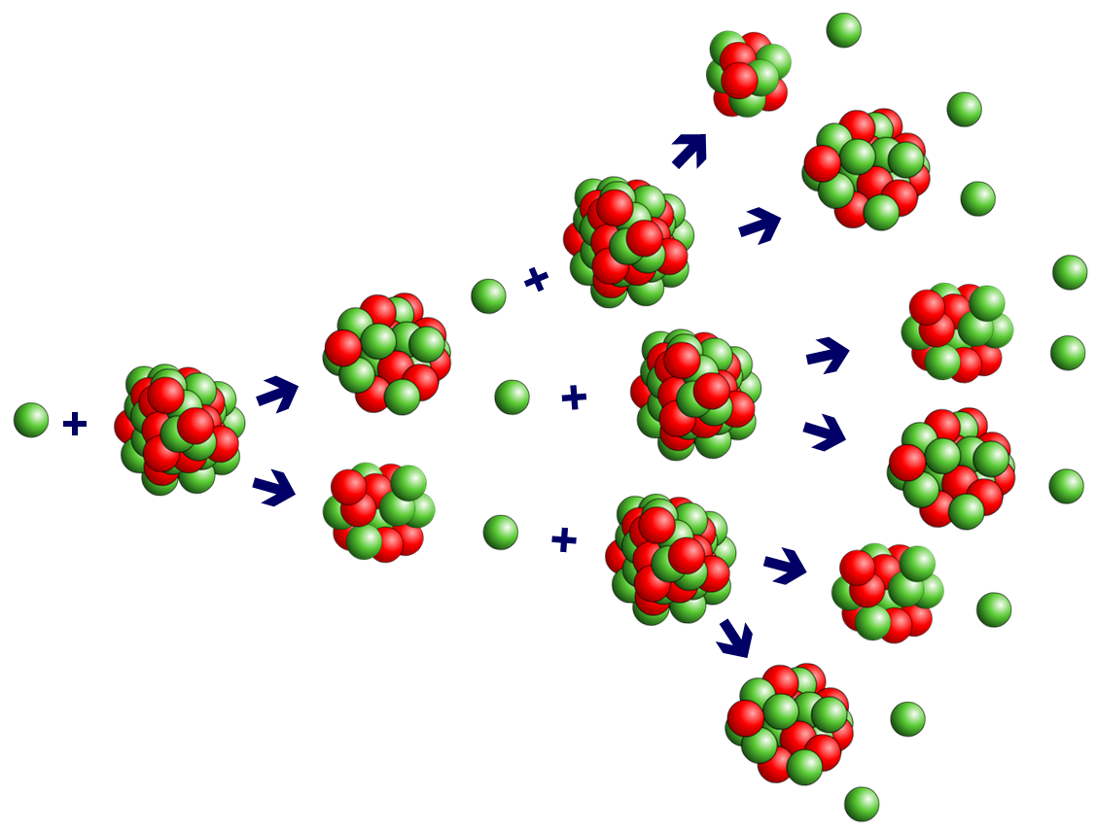
What is a chain reaction?
Nuclear fission results in a chain reaction because each time a nucleus splits it releases more neutrons, which can
go on and cause more fission
reactions to occur,
and so on.
This is why a chain reaction releases a lot of energy so rapidly.
If a chain reaction is uncontrolled, heat
builds up very quickly. A chain reaction must
be controlled to maintain a steady output of heat.

Slide 12
How are neutrons controlled?
Notes:
This slide covers the Science and Engineering Practice:
Constructing Explanations and Designing Solutions: Design, evaluate, and/or refine a solution to a complex real-world problem, based on scientific knowledge, student-generated sources of evidence, prioritized criteria, and trade-off considerations.

Slide 13
Chain reactions – key words
Notes:
Teacher notes
This matching activity could be used as an introductory or summary activity on chain reactions.
This slide covers the Science and Engineering Practice:
Constructing Explanations and Designing Solutions: Design, evaluate, and/or refine a solution to a complex real-world problem, based on scientific knowledge, student-generated sources of evidence, prioritized criteria, and trade-off considerations.

Slide 14
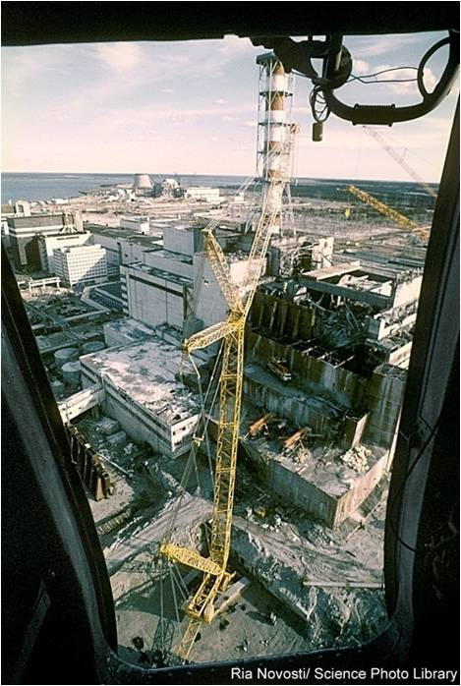
Why must we control chain reactions?
Chain reactions can generate a lot of heat and can be extremely dangerous if they are not properly controlled.
This is what happened at Chernobyl in Ukraine in 1986 in one of the most serious nuclear power accidents.
Most of the control rods had been removed from a reactor during a test.
The chain reactions were uncontrolled and generated too much heat.
The reactor overheated and caused a steam explosion, which blew the building apart and released a lot of radiation into the environment.
Notes:
Teacher notes
The image shows an aerial view of the remains of the Chernobyl nuclear power station in the Ukraine (formerly part of the USSR) after the accident which occurred on April 25th, 1986. It happened during a low-power experiment with the No.4 RBMK- type reactor. The core overheated and caused a steam explosion which breached its containment building. The RBMK design did not include a secondary containment structure which would have prevented release of the core's contents. Over a billion billion becquerels of radioactive nuclides were released into the atmosphere, contaminating much of northern Europe. The 3 other RBMK units at Chernobyl were returned to power within the year.
This slide covers the Science and Engineering Practice:
Constructing Explanations and Designing Solutions: Apply scientific ideas, principles, and/or evidence to provide an explanation of phenomena and solve design problems, taking into account possible unanticipated effects.
Photo credit: © Ria Novosti/ Science Photo Library 2018

Slide 15
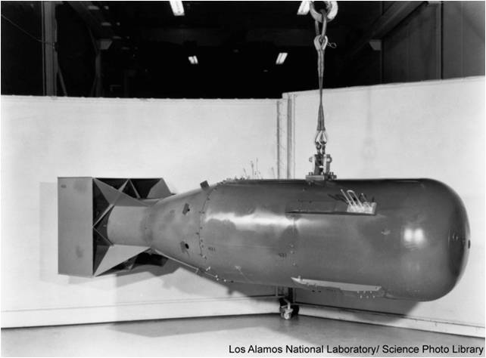
How do nuclear weapons work?
Nuclear bombs use uncontrolled chain reactions.
For such a chain reaction to occur, there must be a certain amount of uranium atoms. This is called the critical mass.
A nuclear weapon works by forcing together two masses of uranium-235 to create a critical mass.
This results in uncontrolled chain reactions releasing huge amounts of energy.
This four ton uranium bomb is similar to one used during the Second World War in Hiroshima, Japan. It has the same power as 22,000 tons of high explosive.
Notes:
Teacher notes
The image shows the bomb called "Little Boy", an atomic fission bomb of the type dropped over Hiroshima, Japan on August 6th, 1945. The bomb was triggered using a “gun” method whereby a subcritical mass of uranium is fired, using an explosive charge, at a target consisting of another similar subcritical mass. The assembly of this supercritical mass of fissionable material initiated a nuclear chain reaction which produced vast quantities of energy. It weighed only 4 tons, but had a yield equivalent to nearly 20,000 tons of high explosive.
This slide covers the Science and Engineering Practice:
Constructing Explanations and Designing Solutions: Apply scientific ideas, principles, and/or evidence to provide an explanation of phenomena and solve design problems, taking into account possible unanticipated effects.
Photo credit: © Los Alamos National Laboratory/ Science Photo Library 2018

