Slide 1
Potential and Kinetic Energy

Slide 2
Information
Developing and Using Models
Using Mathematics and Computational Thinking
4. Systems and System Models
5. Energy and Matter

Slide 3
What is a system?
A system is an object or a group of objects. It is a useful way of thinking about some physics problems.
Energy can take many different forms. For example:
moving objects have kinetic energy
stretched or compressed objects have elastic potential energy
objects in a gravitational field have gravitational potential energy.
When something about a system changes, the way that energy is stored in it can also change from one form to another.
Notes:
Teacher notes
For more information about forms of energy and the principle of conservation of energy, please refer to the Energy Transfers presentation.

Slide 4
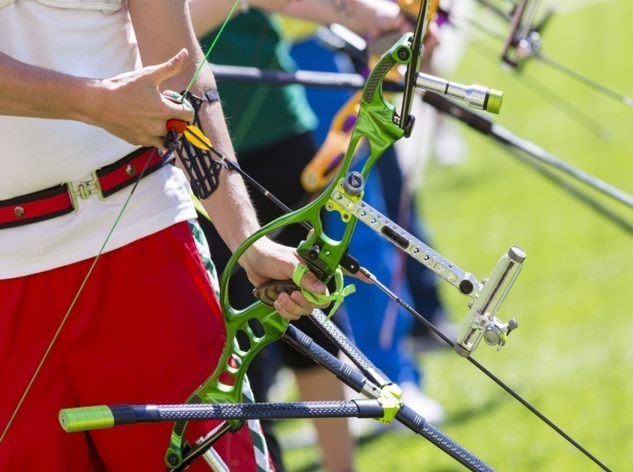
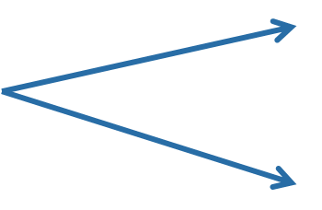
Changes in energy
Can you describe the way that energy is changing in these systems?
An arrow fired from a bow:
An archer draws back the bow string, storing elastic potential energy. When they release it, the arrow flies forwards and upwards.
kinetic energy
elastic potential energy
gravitational potential energy
Notes:
This slide covers the Science and Engineering Practice:
Developing and Using Models: Develop, revise, and/or use a model based on evidence to illustrate and/or predict the relationships between systems or between components of a system.
Photo credit: © Cylonphoto, shutterstock.com 2018

Slide 5
Changes in energy
Can you describe the way that energy is changing in these systems?
A basketball hitting the floor:
An athlete scores a basket. As the basketball falls, its gravitational potential energy is converted to kinetic energy. It compresses (squashes) when it hits the floor, and the kinetic energy is stored as elastic potential energy.
gravitational potential energy
kinetic energy
elastic potential energy
Notes:
Teacher notes
To extend this slide, students could be asked to continue describing what happens to the energy in the system after the ball has hit the floor.
This slide covers the Science and Engineering Practice:
Developing and Using Models: Develop, revise, and/or use a model based on evidence to illustrate and/or predict the relationships between systems or between components of a system.
Photo credit: © Brocreative, shutterstock.com 2018

Slide 6
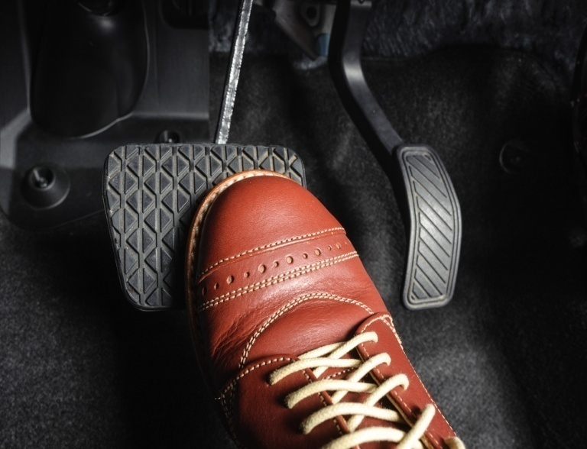
Changes in energy
Can you describe the way that energy is changing in these systems?
A car braking at a traffic light:
When the brakes are applied, friction increases. The kinetic energy of the wheels is transferred into sound energy and heat (thermal) energy.
sound energy
kinetic energy
heat (thermal) energy
Notes:
This slide covers the Science and Engineering Practice:
Developing and Using Models: Develop, revise, and/or use a model based on evidence to illustrate and/or predict the relationships between systems or between components of a system.
Photo credit: © NorGal, shutterstock.com 2018

Slide 7
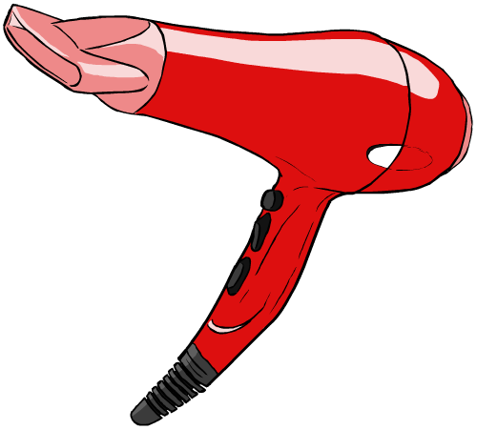
Changes in energy
Can you describe the way that energy is changing in these systems?
A hair dryer producing hot air:
When the hair dryer is switched on, a motor starts turning the fan inside and current flows through the heating element. Electrical energy is converted into sound energy and heat (thermal) energy.
sound energy
electrical energy
heat (thermal) energy
Notes:
Teacher notes
To extend this section, students could be asked to come up with their own examples of systems in which the way energy is stored is changing. This section could also be easily connected to other taught material, such as pendulums, springs, circuits or falling objects.
This slide covers the Science and Engineering Practice:
Developing and Using Models: Develop, revise, and/or use a model based on evidence to illustrate and/or predict the relationships between systems or between components of a system.

Slide 8
What is gravitational potential energy?
When an object is lifted upwards, the force doing the lifting does work against the force of gravity.
For example, this crane does work lifting this box.
The work done is stored as gravitational potential energy (E_{p}). It is called potential energy because it has the potential to be transferred into other forms of energy later.
For example, if the hook broke and the box fell, the stored gravitational potential energy would be converted to kinetic energy.
Notes:
Teacher notes
For more information about gravity, please refer to the Gravity presentation.

Slide 9
How is GPE calculated?
The GPE of an object can be calculated using this equation:
GPE = mass × gravitational field strength × height
or
E_{p} = m g h
Mass (m) is measured in kilograms (kg).
Gravitational field strength (g) is measured in newtons per kilogram (N/kg), and is usually assumed to be 10 N/kg close to the surface of Earth.
Height (h) is measured in meters (m).
Gravitational potential energy (E_{p}) is measured in joules (J).
Notes:
Teacher notes
An alternate version of this equation would be “GPE = weight × height,” as “weight = mass × gravitational field strength.”
This slide is accompanied by the worksheet Potential and Kinetic Energy.
This slide covers the Science and Engineering Practice:
Using Mathematics and Computational Thinking: Create and/or revise a computational model or simulation of a phenomenon, designed device, process, or system.

Slide 10
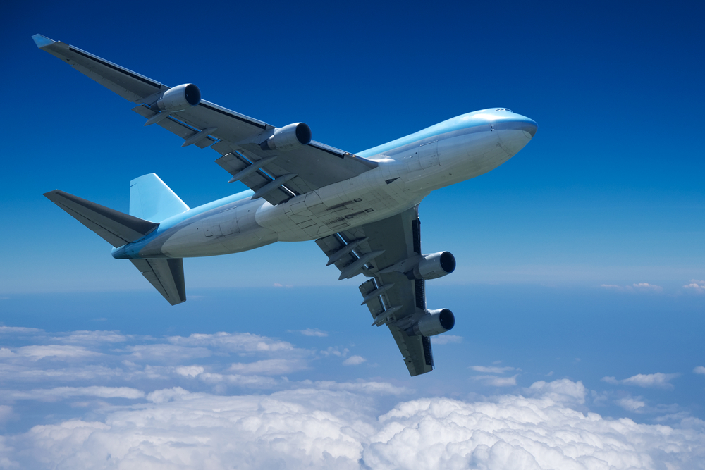
Calculating GPE question 1
A plane with a mass of 5,000 kg travels at a height of 10 km above the ground.
How much gravitational potential energy does the plane have?
Assume a value of 10 N/kg for gravitational field strength.
GPE = mass × gravitational field strength × height
= 5,000 × 10 × 10,000
= 500,000,000 J
= 500 MJ
Notes:
This slide covers the Science and Engineering Practice:
Using Mathematics and Computational Thinking: Apply techniques of algebra and functions to represent and solve scientific and engineering problems.
Photo credit: © Muellek Josef, shutterstock.com 2018

Slide 11
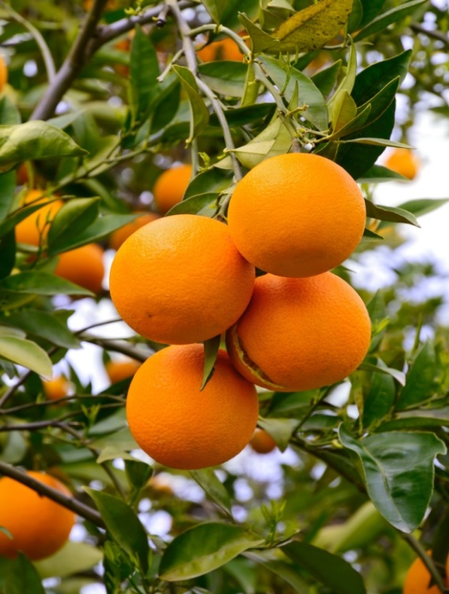
Calculating GPE question 2
An orange with a mass of 250 g falls 2.5 m from its branch to the ground.
How much GPE will the orange have lost when it hits the ground?
Assume a value of 10 N/kg for g.
GPE lost
change in height
= mass × gravitational field strength ×
= 0.25 × 10 × 2.5
= 6.25 J
Notes:
This slide covers the Science and Engineering Practice:
Using Mathematics and Computational Thinking: Apply techniques of algebra and functions to represent and solve scientific and engineering problems.
Photo credit: © eAlisa, shutterstock.com 2018

Slide 12
GPE, mass and height calculations
Notes:
Teacher notes
This multiple-choice activity has four questions and provides an opportunity for students to practice using the equation for gravitational potential energy.
This slide covers the Science and Engineering Practice:
Using Mathematics and Computational Thinking: Apply techniques of algebra and functions to represent and solve scientific and engineering problems.

Slide 13
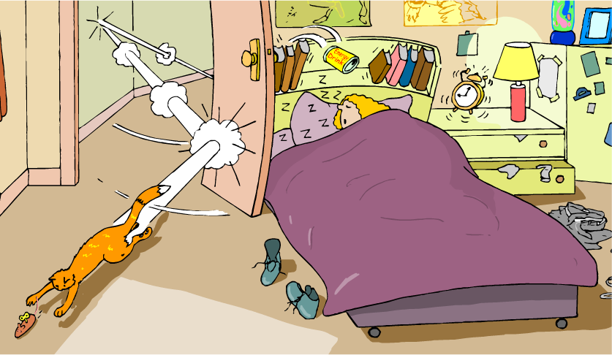
What is kinetic energy?
The word “kinetic” comes from the Greek word “kinesis,” meaning motion.
Kinetic energy is the energy an object has because it is moving.
All moving things have kinetic energy, but the amount of energy they have is not just dependent on how fast they are moving.
What other factors might affect the kinetic energy of a moving object?

Slide 14
How is kinetic energy calculated?
The kinetic energy (E_{k}) of an object can be calculated using this equation:
E_{k} = ½ × mass × velocity²
or
E_{k} = ½ m v²
Mass, m, is measured in kilograms (kg).
Velocity, v, is measured in meters per second (m/s).
Kinetic energy, E_{k}, is measured in joules (J).
Notes:
This slide is accompanied by the worksheet Potential and Kinetic Energy.
This slide covers the Science and Engineering Practice:
Using Mathematics and Computational Thinking: Create and/or revise a computational model or simulation of a phenomenon, designed device, process, or system.

Slide 15
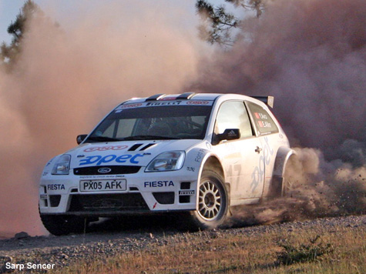
Calculating kinetic energy question
A car with a mass of 1,000 kg travels at a velocity of 20 m/s.
What is the kinetic energy of the car?
kinetic energy = ½ × mass × velocity²
= ½ × 1,000 × 20²
= 200,000 J = 200 kJ
Notes:
This slide covers the Science and Engineering Practice:
Using Mathematics and Computational Thinking: Apply techniques of algebra and functions to represent and solve scientific and engineering problems.
Photo credit: © Sarp Sencer, 2018

Slide 16
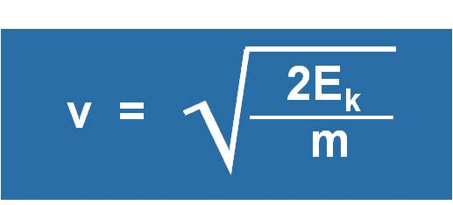
Rearranging the kinetic energy equation
If you know the kinetic energy of an object, you can rearrange the equation in order to calculate its mass or velocity.
E_{k} = ½mv²
Rearranged to calculate mass:
Rearranged to calculate velocity:
2E_{k}
m =
v²

Slide 17
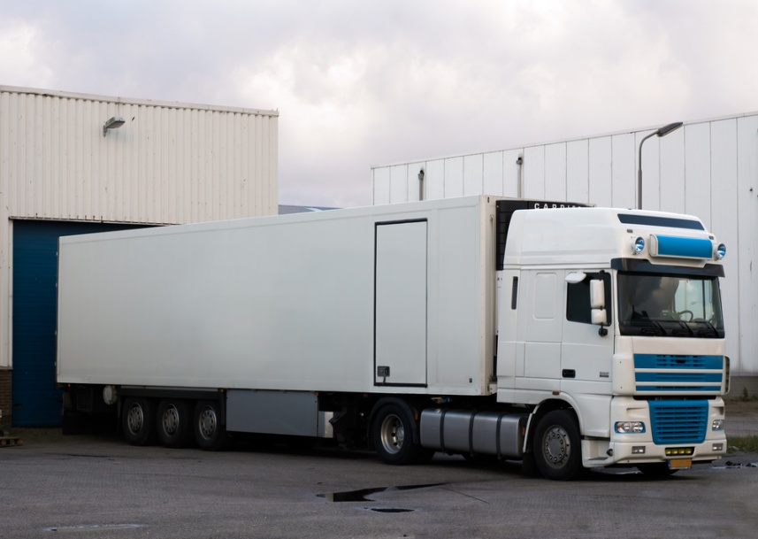
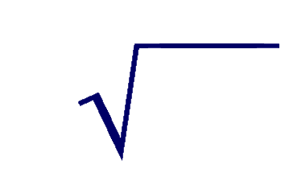
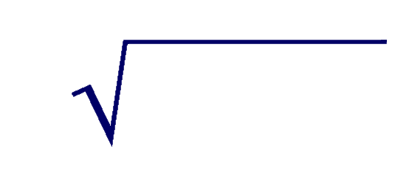
Calculating velocity question
A truck has a mass of 20,000 kg. If its kinetic energy is 2.25 MJ, at what velocity is it traveling?
E_{k} = ½ m v²
2E_{k}
velocity =
m
=
2 × 2,250,000
20,000
= 15 m/s
Notes:
This slide covers the Science and Engineering Practice:
Using Mathematics and Computational Thinking: Apply techniques of algebra and functions to represent and solve scientific and engineering problems.
Photo credit: © Eric Gevaert, shutterstock.com 2018

Slide 18
Using the kinetic energy equation
Notes:
Teacher notes
This multiple-choice activity has three questions and provides an opportunity for students to practice using the equation E_{k} = ½mv².
This slide covers the Science and Engineering Practice:
Using Mathematics and Computational Thinking: Apply techniques of algebra and functions to represent and solve scientific and engineering problems.

Slide 19
Energy transfers within a system
Imagine a tennis ball with a mass of 60 g dropped from a height of 50 cm.
Initially, the tennis ball has some gravitational potential energy (E_{p}):
m = 0.06 kg
E_{p} = m g h
= 0.06 × 10 × 0.5
h = 0.5 m
= 0.3 J
And no kinetic energy (E_{k}), because it is not moving.
The total energy in the system is 0.3 J.
Notes:
This slide covers the Science and Engineering Practices:
Using Mathematics and Computational Thinking: Create and/or revise a computational model or simulation of a phenomenon, designed device, process, or system.
Using Mathematics and Computational Thinking: Apply techniques of algebra and functions to represent and solve scientific and engineering problems.

Slide 20
Energy transfers within a system
Imagine a tennis ball with a mass of 60 g dropped from a height of 50 cm.
E_{p} = 0.3 J
When it is dropped, E_{p} is converted to E_{k}.
E_{k} = 0 J
E_{p} = 0.2 J
As it falls, E_{p} decreases and E_{k} increases, but the total energy of the system stays the same.
total energy = 0.3 J
E_{k} = 0.1 J
total energy = 0.3 J
E_{p} = 0.1 J
E_{k} = 0.2 J
When it hits the ground, E_{p} is reduced to zero. All of the gravitational potential energy has been transferred to kinetic energy.
E_{p} = 0 J
total energy = 0.3 J
E_{k} = 0.3 J
total energy = 0.3 J
Notes:
Teacher notes
This slide ignores the effects of air resistance.
This slide covers the Science and Engineering Practices:
Using Mathematics and Computational Thinking: Create and/or revise a computational model or simulation of a phenomenon, designed device, process, or system.
Using Mathematics and Computational Thinking: Apply techniques of algebra and functions to represent and solve scientific and engineering problems.

Slide 21
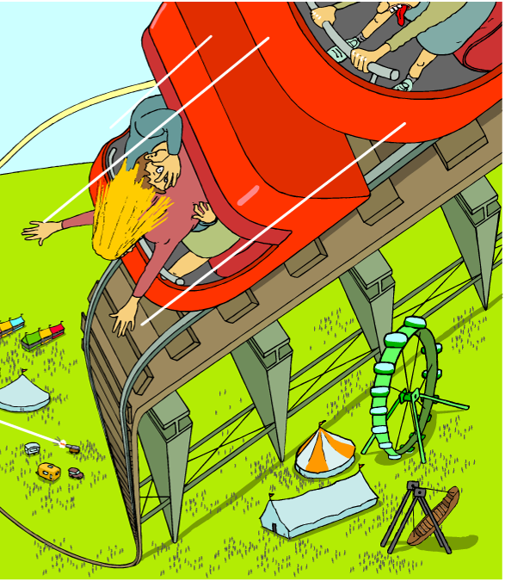
The relationship between GPE and KE
As the roller coaster loses height, the stored gravitational potential energy is transferred into kinetic energy.
E_{p} lost = E_{k} gained
This equation is only true if air resistance and friction are ignored.
In reality, E_{p} would also be transferred into heat and sound energy, so the E_{k} of the roller coaster would be a bit less than the E_{p} lost.
Notes:
This slide is accompanied by the worksheet Potential and Kinetic Energy.
This slide covers the Science and Engineering Practice:
Using Mathematics and Computational Thinking: Create and/or revise a computational model or simulation of a phenomenon, designed device, process, or system.

Slide 22
Energy transfer of roller coasters
Notes:
Teacher notes
This simulation of a roller coaster illustrates the link between GPE and KE; that as one increases, the other decreases. It should be noted that the GPE and KE always add up to the same value (251kJ) and the simulation assumes no loss of energy to friction or air resistance. Students could simply observe the relationship between GPE and KE by seeing how the bars change during the simulation, or one value could be revealed to enable the students to calculate the other value.
Students could be asked to calculate the GPE and KE of the roller coaster at various different points in the simulation, using the two equations they have learned. By hiding the height or velocity and revealing the GPE or KE, students could also be asked to find the missing value to practice using the rearranged GPE and KE equations.
This slide covers the Science and Engineering Practices:
Using Mathematics and Computational Thinking: Create and/or revise a computational model or simulation of a phenomenon, designed device, process, or system.
Using Mathematics and Computational Thinking: Apply techniques of algebra and functions to represent and solve scientific and engineering problems.

Slide 23
Terminal velocity

Slide 24
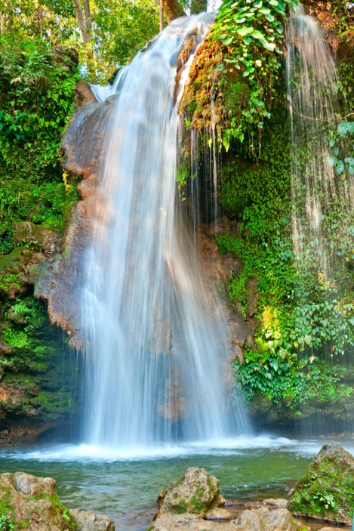
Dissipated energy
A spontaneous process is one that can happen without an outside source of energy. In a spontaneous process, potential energy stored in a system is dissipated (or “lost”).
Water flowing down a waterfall is a spontaneous process. At the top of a waterfall, the water has gravitational potential energy. This is converted to kinetic energy as the water falls.
A short distance from the bottom of the waterfall, the water is flowing at the same rate as at the top. It has the same amount of kinetic energy as at the top of the waterfall, but less gravitational potential energy.
The gravitational potential energy has been dissipated as sound and thermal energy.
Notes:
Teacher notes
For more information about dissipated energy and thermal energy, please refer to the Energy Transfers and Thermal Energy presentations.
Photo credit: © Dchauy, shutterstock.com 2018

