Slide 1
Pressure in a Fluid

Slide 2
Information
Developing and Using Models
Using Mathematics and Computational Thinking
Constructing Explanations and Designing Solutions
2. Cause and Effect
3. Scale, Proportion, and Quantity

Slide 3
What is a fluid?
A fluid is a substance that can flow. Liquids and gases are fluids.
Liquids and gases can flow because the particles in a liquid or gas are not fixed in place, but constantly move about randomly.
As the particles in a fluid move around, they collide with each other and with the walls of the fluid’s container.

Slide 4
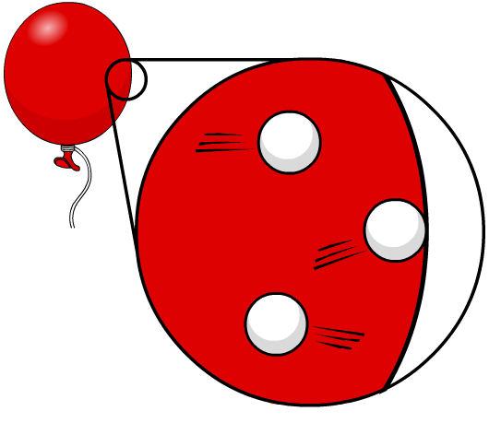
What causes pressure in a fluid?
The pressure in a fluid is caused by the particles in the fluid.
As the particles in a fluid move, they collide with any surface that is in contact with the fluid. Each particle exerts a small force on the surface it collides with.
The pressure the fluid exerts on the surface is the total force caused by all these collisions over the area of the surface.
Since the particles in a fluid move randomly, the pressure in a fluid acts equally in all directions.
Notes:
This slide covers the Science and Engineering Practices:
Developing and Using Models: Use a model to provide mechanistic accounts of phenomena.
Constructing Explanations and Designing Solutions: Apply scientific ideas, principles, and/or evidence to provide an explanation of phenomena and solve design problems, taking into account possible unanticipated effects.

Slide 5
Pressure at the surface of a fluid
The pressure in a fluid causes a force normal (at right angles) to any surface.
The pressure at the surface of a fluid is given by the formula:
F
P =
A
P is pressure, in pascals (Pa).
F is force, in newtons (N).
A is cross-sectional area, in meters squared (m²).
Notes:
This slide covers the Science and Engineering Practice:
Using Mathematics and Computational Thinking: Use mathematical, computational, and/or algorithmic representations of phenomena or design solutions to describe and/or support claims and/or explanations.

Slide 6
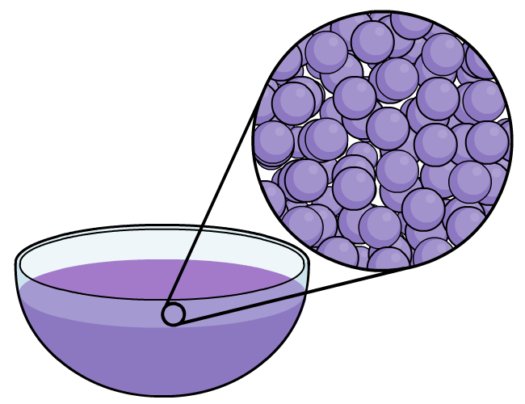
Compressing a liquid
The particles in a liquid are not in a regular arrangement, but they are tightly packed with no gaps.
Because they are tightly packed, the volume of a liquid cannot decrease under pressure
– it is incompressible.
Since a liquid cannot be compressed, pressure on a liquid in one place will be transmitted to other points in the liquid.
Hydraulic systems use this property of liquids to transfer movement from one part of a machine to another.
Notes:
Teacher notes
Liquids can in fact be compressed very slightly, when under extremely high pressure. This effect is small enough that it can be ignored.
This slide covers the Science and Engineering Practices:
Developing and Using Models: Use a model to provide mechanistic accounts of phenomena.
Constructing Explanations and Designing Solutions: Apply scientific ideas, principles, and/or evidence to provide an explanation of phenomena and solve design problems, taking into account possible unanticipated effects.

Slide 7
Hydraulic systems
Notes:
This slide covers the Science and Engineering Practice:
Constructing Explanations and Designing Solutions: Apply scientific ideas, principles, and/or evidence to provide an explanation of phenomena and solve design problems, taking into account possible unanticipated effects.

Slide 8
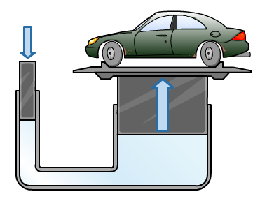
Calculating the pressure on a surface
Very heavy objects can be lifted using a hydraulic jack.
A mechanic pushes with a force of 12 N on a piston with an area of 0.01 m². The car-lifting piston has an area of 10 m².
What force lifts the car?
12 N
Find the pressure on the small piston.
F
12 N
P =
=
= 1,200 Pa
A
0.01 m²
0.01 m²
The pressure on the large piston is the same, so use this to find the force.
10 m²
P on large piston = 1,200 Pa
F = P × A
= 1,200 Pa × 10 m²
= 12,000 N
Notes:
Teacher notes
The pressure in a liquid acts equally in all directions, so the pressure applied to the liquid by the mechanic (through the small piston) is then exerted by the liquid on the large piston. This means that the pressure on the small piston and the pressure on the large piston are the same. Students could be encouraged to predict the next step of the workings at each stage.
This slide covers the Science and Engineering Practices:
Using Mathematics and Computational Thinking: Use mathematical, computational, and/or algorithmic representations of phenomena or design solutions to describe and/or support claims and/or explanations.
Using Mathematics and Computational Thinking: Apply techniques of algebra and functions to represent and solve scientific and engineering problems.

Slide 9
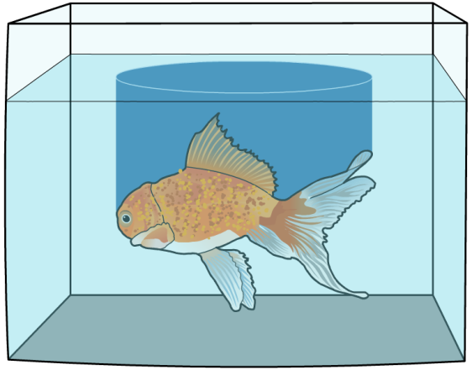
Factors affecting pressure in a liquid
When an object is submerged in a liquid, the liquid will exert a pressure on the object.
The pressure will depend on the force the liquid applies to the object. This force is the weight of the liquid above the object.
The darker blue column shows the water above the fish. The pressure on the fish depends on the weight of this column.
The column of liquid above an object weighs more when the height of the column is greater. So, the pressure on an object is greater when the object is deeper in the liquid.
The column of liquid also weighs more when the density of the liquid is greater.

Slide 10
Pressure in a column of liquid
The pressure exerted on an object submerged in a liquid depends on the density of the liquid and the amount of liquid above the object.
The pressure due to the column of liquid above an object in the liquid is given by the formula:
P = ρ g h
P is pressure, in pascals (Pa).
ρ is density, in kilograms per meter cubed (kg/m³).
g is gravitational field strength, in kilogram meters per second squared (kg m/s²).
h is height of the column of liquid in meters (m).
Notes:
This slide covers the Science and Engineering Practice:
Using Mathematics and Computational Thinking: Use mathematical, computational, and/or algorithmic representations of phenomena or design solutions to describe and/or support claims and/or explanations.

Slide 11
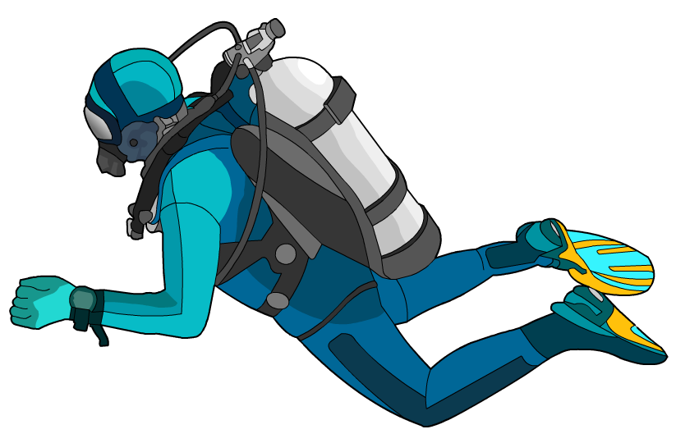
Calculating pressure - example
Scuba divers deep below the surface of the sea experience a high pressure from the water around them.
In order to prevent their lungs collapsing under this pressure, scuba divers need to breathe in compressed air. The air must have the same pressure as the water around them.
The density of water is 1 kg/m³. The gravitational field strength on Earth is 10 kg m/s². What air pressure would a diver need when 20 m below the surface?
air pressure needed = water pressure at 20 m
pressure = ρ g h
= 1 kg/m³ × 10 kg m/s² × 20 m
= 200 Pa
Notes:
This slide covers the Science and Engineering Practice:
Using Mathematics and Computational Thinking: Apply techniques of algebra and functions to represent and solve scientific and engineering problems.

Slide 12
Upthrust
Notes:
This slide covers the Science and Engineering Practice:
Constructing Explanations and Designing Solutions: Apply scientific ideas, principles, and/or evidence to provide an explanation of phenomena and solve design problems, taking into account possible unanticipated effects.

Slide 13
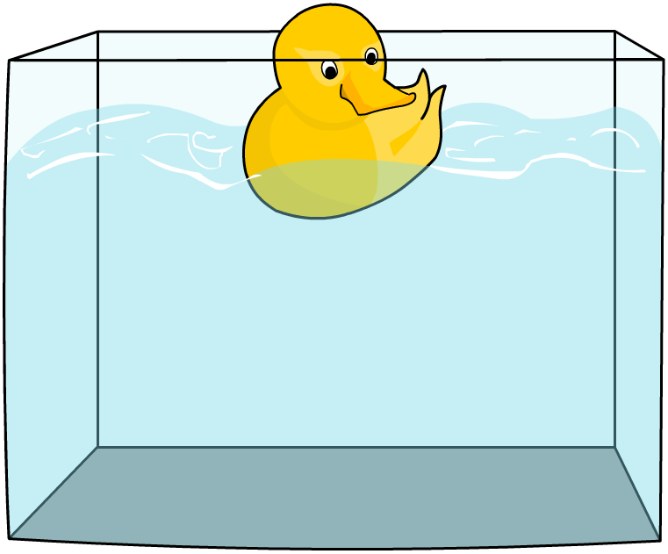
Floating and sinking
If an object’s weight is greater than the upthrust, the object will experience a net force acting downwards and sink.
If the upthrust is greater than the weight pushing the object down, there will be a net force acting upwards and the object will float.
Once the top of a floating object moves above the surface of the fluid, the upthrust will begin to decrease. Once the upthrust is equal to the weight, the net force on the object will become zero. The object will stop moving and stay partly submerged.
Notes:
This slide covers the Science and Engineering Practice:
Constructing Explanations and Designing Solutions: Apply scientific ideas, principles, and/or evidence to provide an explanation of phenomena and solve design problems, taking into account possible unanticipated effects.

Slide 14
Density and floating
The upthrust on an object submerged in a fluid is the force exerted by the fluid due to the difference in pressure on different parts of the object.
ΔP = ρ g Δh
The difference in pressure depends on the distance between the top and bottom of the object, but it also depends on the density of the fluid. So an object experiences a greater upthrust when it is submerged in a denser fluid.
This means that a greater weight is required to overcome upthrust and cause an object to sink in a dense fluid. So an object that sinks in one fluid can float in a denser fluid.
Notes:
This slide covers the Science and Engineering Practice:
Constructing Explanations and Designing Solutions: Apply scientific ideas, principles, and/or evidence to provide an explanation of phenomena and solve design problems, taking into account possible unanticipated effects.

Slide 15
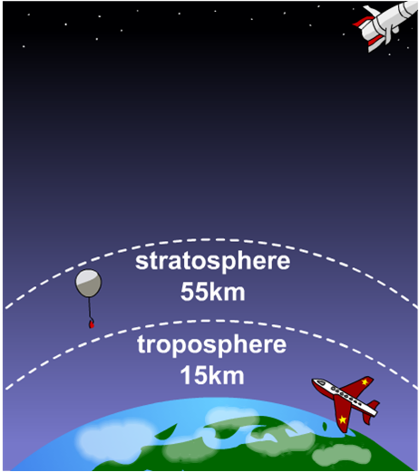
What is the atmosphere?
The Earth is different to the other planets in our solar system because it has an atmosphere that can support life.
The atmosphere is an envelope of different gases surrounding the Earth. The density of the atmosphere decreases as height above the Earth’s surface increases.
80% of atmospheric gases are in the 15 km closest to Earth. This is a very thin layer compared to the Earth’s diameter, which is approximately 12,756 km.

Slide 16
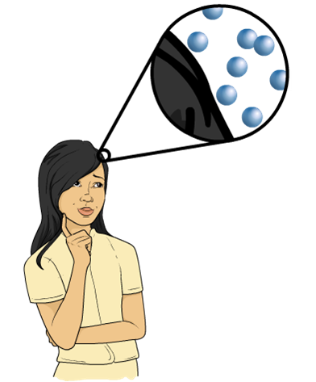
Atmospheric pressure
The air around you exerts pressure on you. This is called atmospheric pressure.
Atmospheric pressure is caused by air molecules colliding with a surface.
The pressure exerted by the air is greater when there are more collisions between the air molecules and the surface.
Why doesn’t the pressure from the air squash you?
Notes:
Teacher notes
Allow students to discuss this question in small groups and contribute their ideas to a class discussion. Remind students that their bodies contain air and liquids that exert pressure on them from the inside out. This pressure balances out the pressure from the air.
This slide covers the Science and Engineering Practice:
Developing and Using Models: Use a model to provide mechanistic accounts of phenomena.

Slide 17
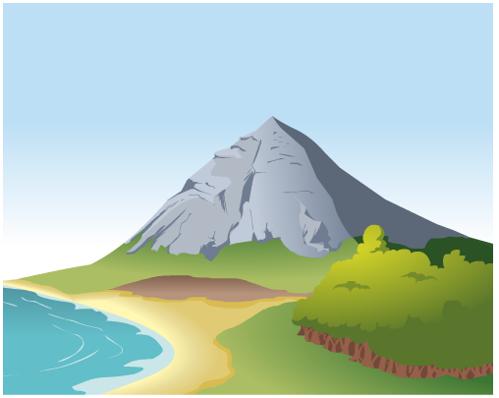
Altitude and atmospheric pressure
The air pressure acting on you depends on your altitude, or how high up you are.
At sea level the atmospheric pressure is about 10.13 N/cm² or 101,325 Pa.
When you climb a mountain, the weight of the air above you is less.
There are fewer air molecules above you to collide with you, so the atmospheric pressure is less.

