Slide 1
Resultant Forces

Slide 2
Information
Using Mathematics and Computational Thinking
2. Cause and Effect
4. Systems and System Models

Slide 3
How can forces be represented?
The forces acting on any object can be shown using a vector diagram.
A vector diagram uses labeled arrows to show all the forces acting on an object.
air resistance
The direction of each arrow shows the direction of each force.
The length of each arrow is proportional to the size of the force.
What is the vector diagram for the forces on this ball when it first starts to fall?
weight

Slide 4
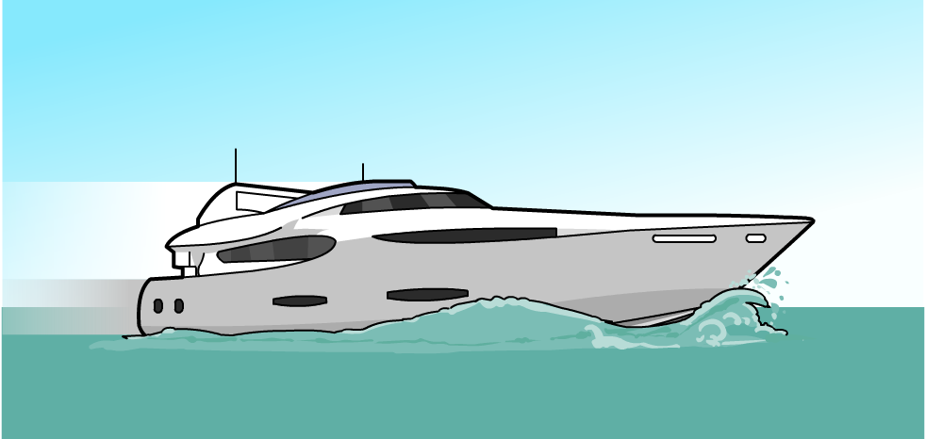
What forces act on an object?
There are usually several different forces acting on an object.
What forces are acting on this accelerating boat?
air resistance
upthrust
thrust
drag
weight

Slide 5
Identifying forces
Notes:
Teacher notes
This activity provides the opportunity for informal assessment of students’ ability to identify different forces. It should be pointed out to students that only selected forces are shown in each case.

Slide 6
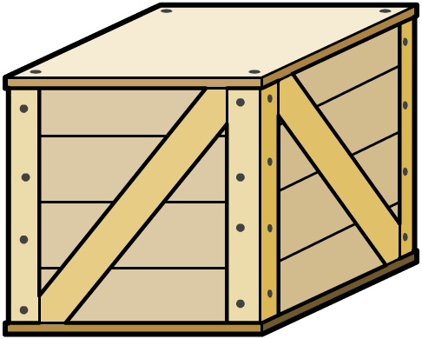
What are resultant forces?
There are usually several different forces acting on an object. The overall motion of the object will depend on the size and direction of all the forces.
The motion of the object will depend on the resultant force. This is a single force that has the same effect as all the original forces acting together.
The resultant force is calculated by adding all the forces together, taking their direction into account.
resultant force on the crate
50 N
30 N
= 50 N – 30 N
= 20 N to the left
Notes:
This slide covers the Science and Engineering Practice:
Using Mathematics and Computational Thinking: Apply techniques of algebra and functions to represent and solve scientific and engineering problems.

Slide 7
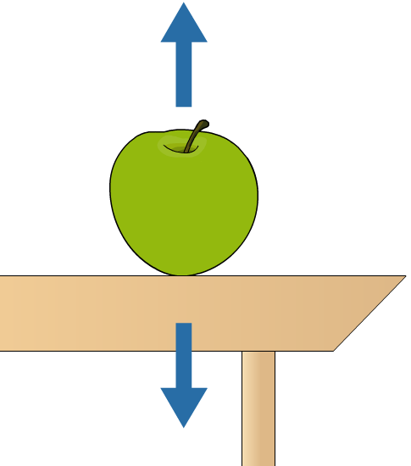
Balanced forces
What is the resultant force acting on this apple?
1 N
resultant force = 1 N – 1 N
= 0 N
1 N
When the resultant force on an object is zero, the forces acting on the object are balanced and the object is said to be in equilibrium.
Notes:
This slide covers the Science and Engineering Practice:
Using Mathematics and Computational Thinking: Apply techniques of algebra and functions to represent and solve scientific and engineering problems.

Slide 8
Calculating resultant forces
Notes:
This slide covers the Science and Engineering Practice:
Using Mathematics and Computational Thinking: Apply techniques of algebra and functions to represent and solve scientific and engineering problems.

Slide 9
Using vector diagrams
The resultant force on objects that have forces acting on them in different directions can be found using vector diagrams.
To find the resultant of these two forces, we need to place the arrows head to tail.
12 N
9 N
The resultant force is represented by an arrow drawn from the tail of the first vector to the head of the second vector.
scale: 1 cm = 1 N
15 cm
= 15 N
9 N
The size of the resultant force can be found by drawing the diagram to scale and measuring the length of the resultant force arrow.
= 9 cm
12 N
= 12 cm
Notes:
This slide covers the Science and Engineering Practice:
Using Mathematics and Computational Thinking: Use mathematical, computational, and/or algorithmic representations of phenomena or design solutions to describe and/or support claims and/or explanations.

Slide 10
Resultant force example
Draw this pair of forces to scale and find the magnitude and direction of the resultant force.
1. Choose a scale: for example, 1 cm = 1 N.
12 N
2. Draw the two forces to scale, placed head to tail.
16 N
3. Draw an arrow from the tail of the first vector to the head of the second. This arrow represents the resultant force.
20 cm
= 20 N
4. Measure the length of the resultant force arrow. Use the scale to convert from cm to N.
16 cm
12 cm
Notes:
This slide covers the Science and Engineering Practice:
Using Mathematics and Computational Thinking: Use mathematical, computational, and/or algorithmic representations of phenomena or design solutions to describe and/or support claims and/or explanations.

Slide 11
Vector diagrams of balanced forces
When an object is in equilibrium, the forces acting on the object are balanced and the resultant force is zero.
This means that, when the arrows representing these forces are placed head to tail, the tail of the first arrow is in the same place as the head of the last arrow.
When adding vectors together head to tail, the order in which they are placed does not matter. You will get the same result whichever order you use!
Notes:
This slide covers the Science and Engineering Practice:
Using Mathematics and Computational Thinking: Use mathematical, computational, and/or algorithmic representations of phenomena or design solutions to describe and/or support claims and/or explanations.

Slide 12
Resolving forces
Just as several forces can be represented by a single resultant force, a single force can be represented by two forces that have the same effect as the single force.
These two forces are components of the single force and act at right angles to one another.
5 N
Replacing a single force with two component forces is known as resolving the force. This can be useful if we want to know the amount of a force that acts in a particular direction.
4 N
3 N
Notes:
This slide covers the Science and Engineering Practice:
Using Mathematics and Computational Thinking: Use mathematical, computational, and/or algorithmic representations of phenomena or design solutions to describe and/or support claims and/or explanations.

Slide 13
How can forces be resolved?
A force can be resolved into two components using a scale vector diagram. This shows the size and direction of the forces, with the size of the forces drawn to scale.
Suppose we want to resolve the force acting on the crate into vertical and horizontal components.
The force on the crate has been drawn to a scale of 1 cm = 1 N.
10 cm
8 cm
= 8 N
To find the size of the component forces, we need to measure the length of the arrows in the diagram and use the scale to calculate the size of the force.
10 N
6 cm = 6 N
Notes:
This slide covers the Science and Engineering Practice:
Using Mathematics and Computational Thinking: Use mathematical, computational, and/or algorithmic representations of phenomena or design solutions to describe and/or support claims and/or explanations.

