Slide 1
Sound Waves

Slide 2
Information
Developing and Using Models
Analyzing and Interpreting Data
Using Mathematics and Computational Thinking
Constructing Explanations and Designing Solutions
1. Patterns

Slide 3
What causes sound?
Take a tuning fork and strike it against a block of wood.
What do you observe?
The tuning fork vibrates and you hear a sound.
Sounds are made when an object vibrates.
Sound travels because the vibrating object makes nearby particles vibrate.
Sound needs a medium to travel through – it cannot pass through a vacuum.

Slide 4
How does sound travel through the air?
Notes:
Teacher notes
You should point out to your class that, in fact, the air particles would be constantly moving around in a random motion. In the animation, they are only moving a little so that the change in density as the wave moves is more obvious.
This slide covers the Science and Engineering Practice:
Developing and Using Models: Use a model to provide mechanistic accounts of phenomena.

Slide 5
“Looking” at sound waves
Notes:
Teacher notes
This activity includes sound clips.
Photo credit: © Matthew Cole, shutterstock.com 2018
Audio credits: pure tone © Soundbible.com. This sound is in the public domain. Bell © Mike Koenig, Soundbible.com. This sound is reproduced under the terms of the Creative Commons License. A copy of the license can be read at this address: http://creativecommons.org/licenses/by/3.0/

Slide 6
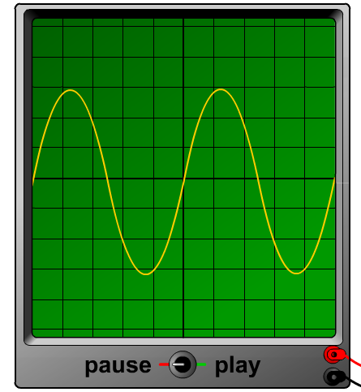
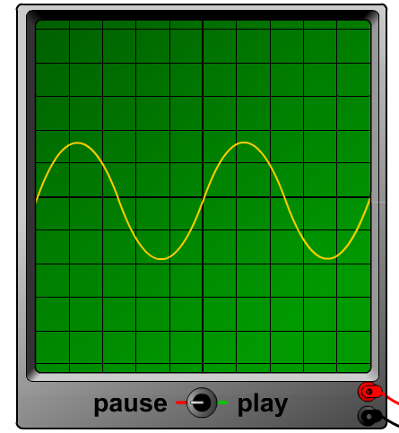
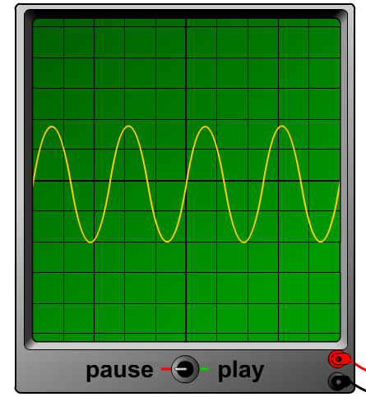
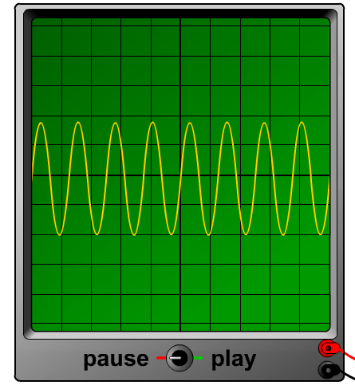
Which wave is the loudest and highest?
Which trace represents the louder sound?
A
B
Sound A has the larger amplitude (i.e. the taller waves), so it is the louder of these two sounds.
Which trace represents the sound with the higher pitch?
A
B
Sound B has the greater number of waves across the oscilloscope – it has the higher frequency and so has the higher pitch.

Slide 7
Amplitude and wavelength

Slide 8
Describing sound waves

Slide 9
Sound waves in different materials
Notes:
This slide covers the Science and Engineering Practice:
Developing and Using Models: Use a model to provide mechanistic accounts of phenomena.

Slide 10
Speed of sound in different materials
Notes:
This slide covers the Science and Engineering Practice:
Analyzing and Interpreting Data: Analyze data using tools, technologies, and/or models (e.g., computational, mathematical) in order to make valid and reliable scientific claims or determine an optimal design solution.

Slide 11
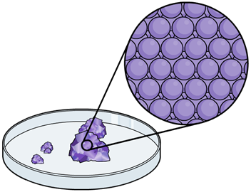
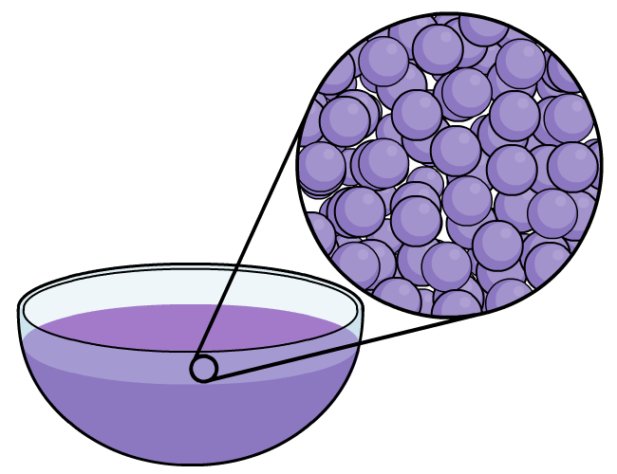
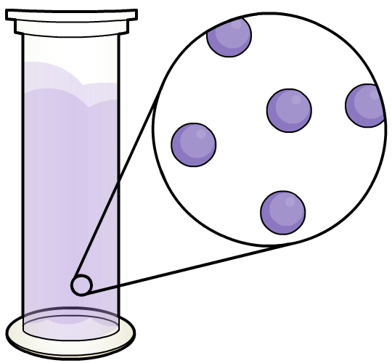
Sound in different materials
Sound needs a substance through which to move because it travels by making particles vibrate.
Which state of matter does sound travel fastest through?
Sound waves travel fastest through solids.
The particles in a solid are closer together than in a gas, and more tightly bound than in a liquid. This means that vibrations are passed from particle to particle more easily in a solid, enabling sound to travel faster.
Notes:
This slide covers the Science and Engineering Practice:
Constructing Explanations and Designing Solutions: Apply scientific ideas, principles, and/or evidence to provide an explanation of phenomena and solve design problems, taking into account possible unanticipated effects.

Slide 12
Changing medium
Notes:
This slide covers the Science and Engineering Practices:
Developing and Using Models: Use a model to provide mechanistic accounts of phenomena.
Constructing Explanations and Designing Solutions: Apply scientific ideas, principles, and/or evidence to provide an explanation of phenomena and solve design problems, taking into account possible unanticipated effects.

Slide 13
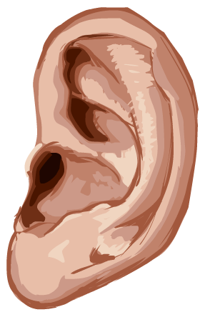
Transmission of sound
The transmission of sound from one medium to another is extremely important to human life.
Our vocal chords transmit sound from soft tissue to the air.
Sound waves in the air produce vibrations in different parts of our ears so we can hear.
Microphones and loudspeakers also involve the transmission of sound between air and other media.

Slide 14
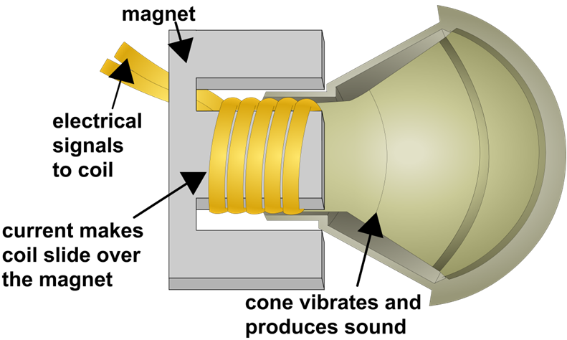
Sound produced in loudspeakers
Loudspeakers turn electricity into sound.
The loudspeaker uses a coil that can slide over a permanent magnet. A paper cone is attached to the coil.
As electricity flows back and forth in the cables, the coil and the attached cone move back and forth at the same frequency. This vibrates the air in front of the speaker, creating sound waves.
The greater the vibration of the cone, the louder the sound.
Notes:
Teacher notes
For more information about how electromagnetism is used in loudspeakers, please refer to the The Generator Effect presentation.
This slide covers the Science and Engineering Practice:
Constructing Explanations and Designing Solutions: Apply scientific ideas, principles, and/or evidence to provide an explanation of phenomena and solve design problems, taking into account possible unanticipated effects.

Slide 15
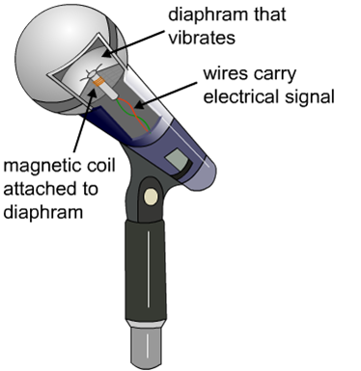
Detecting sound using microphones
Microphones convert sound waves into electricity.
A microphone works in a similar way to a loudspeaker, but in reverse. A microphone contains a diaphragm. This is a thin piece of material (paper, plastic or aluminum) that vibrates when sound waves hit it.
When sound waves reach the microphone, the diaphragm vibrates at the same frequency, moving a coil back and forth.
This movement induces an alternating electrical current that becomes the audio signal.
Notes:
Teacher notes
For more information about how electromagnetism is used in microphones, please refer to the The Generator Effect presentation.
This slide covers the Science and Engineering Practice:
Constructing Explanations and Designing Solutions: Apply scientific ideas, principles, and/or evidence to provide an explanation of phenomena and solve design problems, taking into account possible unanticipated effects.

Slide 16
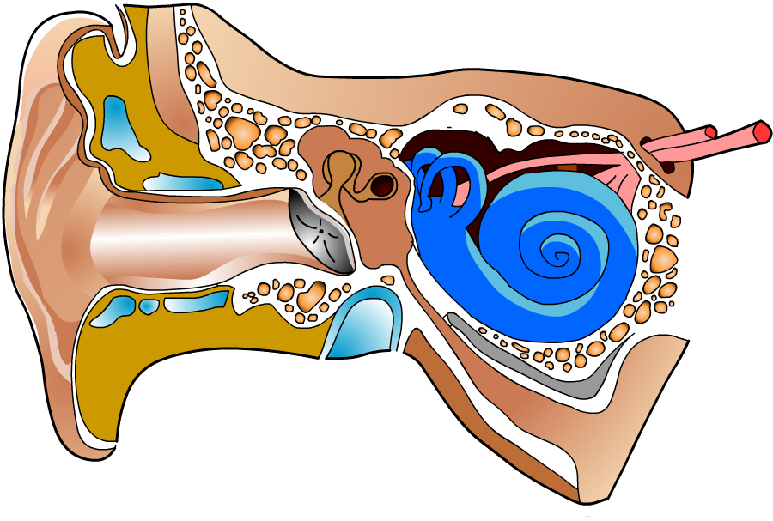
Electrical ears
Ears are actually very similar to microphones.
The ear contains a diaphragm called the eardrum. The ear detects sound when sound waves from the air hit the eardrum, causing it to vibrate.
The sound is passed onto the cochlea by small bones in the ear, where the sound wave is converted into an electrical signal.
This is then carried to the brain by nerve cells.

Slide 17
How does the ear work?
1. Sound waves are collected by the outer ear (or pinna).
6. The auditory nerve takes the signals to the brain.
2. The sound waves travel along the ear canal.
3. The waves reach the eardrum and make it vibrate.
4. The small bones (ossicles) amplify the vibrations.
5. The cochlea turns these into electrical signals.

Slide 18
How do we hear?
Notes:
Teacher notes
Stage 1: sound waves travel along the ear canal to the eardrum.
Stage 2: the sound waves cause the eardrum to vibrate. The ossicles amplify these vibrations.
Stage 3: the vibrations are turned into electrical signals in the cochlea. These signals travel along the auditory nerve to the brain.
This slide covers the Science and Engineering Practice:
Developing and Using Models: Use a model to provide mechanistic accounts of phenomena.

Slide 19
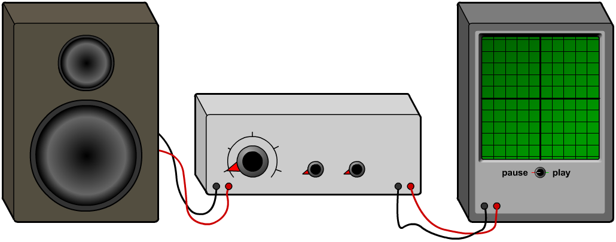
What range of frequencies can you hear?
Humans can only hear sounds of certain frequencies. The range of frequencies a person can hear is called their hearing range.
Hearing range can be tested using a pitch sweep, in which the frequency of a sound wave is gradually increased. This can be created using a signal generator and loudspeaker.
What is the normal hearing range of a human ear?
20 Hz to 20,000 Hz

Slide 20
Why can’t we hear all frequencies of sound?
Processes that convert sound waves in air into vibrations in solids only work over a limited frequency range. This limits the hearing range of humans.
High frequency sound waves are not easily transmitted through the solid bones (ossicles) of the inner ear. This prevents the signals from being passed to the cochlea and reaching the brain.
This is why humans cannot hear frequencies higher than 20 kHz.

Slide 21
The ear and hearing summary

Slide 22
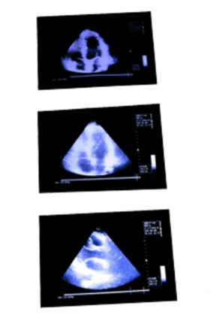
Waves at boundaries
When a wave reaches the surface of a different material, it can be absorbed, reflected or transmitted. Which of these occurs, and by how much, depends on both the type of wave and the type of material.
If the wave is transmitted to the
new material, it may change speed, causing refraction. The speed of a wave in a material depends on both the wave and the material.
These properties of waves can be used to detect and explore structures that cannot be observed directly.
Notes:
Teacher notes
For more information on how waves behave at boundaries between media, please refer to the Reflection and Refraction of Waves presentation.
Photo credit: © dusan 96, shutterstock.com 2018

Slide 23
Ultrasound
Sounds are made when an object vibrates. Most human ears can detect vibrations of 20–20,000 Hz.
Sounds with frequencies higher than 20,000 Hz are known as ultrasound and cannot be heard by humans.
Sounds with frequencies lower than 20 Hz are known as infrasound. These sounds cannot be heard by humans either.
Many animals, including bats and dolphins, use ultrasound to communicate or to find prey. Some animals, including the hippopotamus, use infrasound for communication.
Notes:
Photo credits: vampire bat © Pichugin Dmitry, hippopotamus © kentoh, both at shutterstock.com 2018

Slide 24
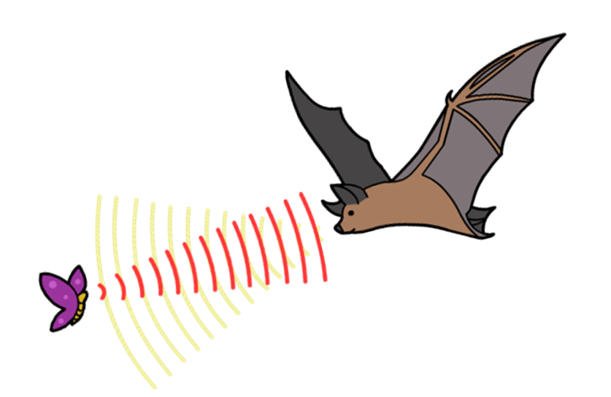
Batnav
As well as using ultrasound to communicate, animals can also use it to find prey in the dark or simply to navigate. This is known as echolocation.
Bats are nocturnal, but they are able to locate prey in the dark (and distinguish between different types of prey) by emitting clicks and pulses of ultrasound.
By working out the time taken for the ultrasound waves to be reflected off an obstacle, the bat is able to calculate the size and shape of the obstacle, and where it is.

Slide 25
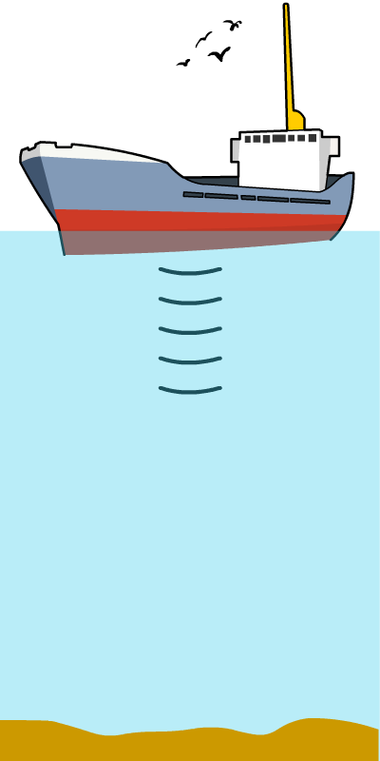
Sonar
One practical application of ultrasound is sonar.
Originally an acronym for ‘SOund Navigation And Ranging’, sonar uses the same principle as echolocation in animals. A signal is sent out, and the time taken for it to return to its source after reflecting from a surface, such as a lakebed, is measured.
Knowing the speed of sound in water, it is then possible to calculate the distance the sound has traveled using this equation:
distance = speed × time

Slide 26
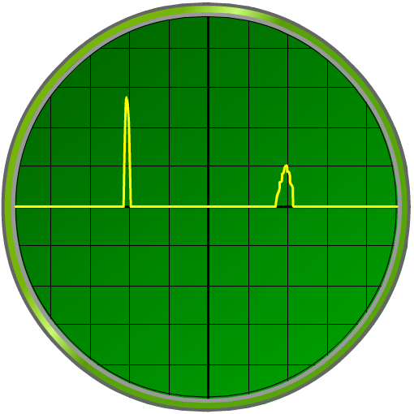
Depth evaluation using ultrasound
A ship has recorded the following trace while using sonar to map the bottom of a lake. The traces are 0.01 s apart, and sound travels at 1,500 m/s in water. How deep is the lake?
distance
= speed × time
transmitted signal
reflected signal
= 1,500 × 0.01
= 15 m
However, this is not the depth of the lake. It is the distance the sound has traveled, down to the lakebed and back up again.
depth of the lake
= 15 ÷ 2
= 7.5 m
Notes:
This slide covers the Science and Engineering Practice:
Using Mathematics and Computational Thinking: Apply techniques of algebra and functions to represent and solve scientific and engineering problems.

Slide 27
Ultrasound calculations
Notes:
This slide covers the Science and Engineering Practice:
Using Mathematics and Computational Thinking: Apply techniques of algebra and functions to represent and solve scientific and engineering problems.

Slide 28
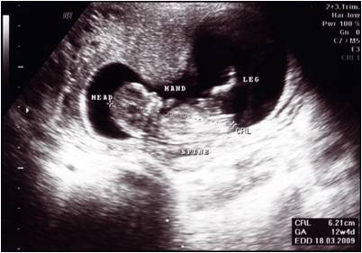
How does ultrasound imaging work?
We have seen how to calculate a simple distance to a boundary using sonar. How can ultrasound be used to create more complex images, such as that of a fetus?
Waves are not only reflected by solid surfaces: they are reflected from any boundary between different media. When transmitted into the body, ultrasound is reflected to varying strengths by all the different tissue boundaries present.
The reflected waves are
detected by a receiver.
A computer turns the positions and intensities of these echoes into a
2-dimensional image.
Notes:
Teacher notes
Ultrasound can be used to scan unborn children because it is non-ionizing and so will not cause cell damage that would harm the fetus. X‑‍rays would be too dangerous to use in this context.
Photo credit: © Ngo Thye Aun, shutterstock.com 2018

Slide 29
How does ultrasound work?
Notes:
Photo credit: © Mikael Damkier, shutterstock.com 2018

Slide 30
Other uses of ultrasound
Notes:
Photo credits: ultrasound scan © Jiri Hera, porthole © Yurchyks, antique watch © Carlos Yudica, medical equipment © Guy Shapira, ultrasound heart scans © dusan 96, all at shutterstock.com 2018

