Slide 1
Specific Latent Heat

Slide 2
Information
Developing and Using Models
Planning and Carrying Out Investigations
Analyzing and Interpreting Data
Using Mathematics and Computational Thinking
Constructing Explanations and Designing Solutions
4. Systems and System Models
5. Energy and Matter
7. Stability and Change

Slide 3
Heating substances
Heating a system gives energy to the particles in the system, so increases the internal energy of the system.
Increasing the energy stored in a system will either increase the temperature of the system or change its state.
The amount of energy needed to raise the temperature of a substance depends on the specific heat capacity of the substance.
The amount of energy needed to change the state of a substance depends on the specific latent heat of the substance.
Notes:
Teacher notes
For more information about the internal energy of a system and specific heat capacity, please refer to the Internal Energy and Specific Heat Capacity presentation.

Slide 4
Specific latent heat

Slide 5
Specific latent heat example
A bath is filled with 60 kg of ice. Calculate the energy needed to melt all of the ice in the bath. The specific latent heat of fusion of water = 334,000 J/kg.
energy absorbed = mass × specific latent heat
E = m L
E = 60 kg × 334,000 J/kg
E = 20,040,000 J = 20.0 MJ
How much energy is needed to boil all the water in the bath and change its state to water vapor? The specific latent heat of vaporization of water is 2,260,000 J/kg.
E = m L
E = 60 kg × 2,260,000 J/kg
E = 135,600,000 J = 135.6 MJ
Notes:
This slide covers the Science and Engineering Practices:
Using Mathematics and Computational Thinking: Use mathematical, computational, and/or algorithmic representations of phenomena or design solutions to describe and/or support claims and/or explanations.
Using Mathematics and Computational Thinking: Apply techniques of algebra and functions to represent and solve scientific and engineering problems.

Slide 6
Calculating specific latent heat
Notes:
Teacher notes
Remind students to make sure they are using the correct units, e.g., J or MJ. 1 MJ = 1,000,000 J.
This slide is accompanied by the worksheet Specific Latent Heat.
This slide covers the Science and Engineering Practice:
Using Mathematics and Computational Thinking: Apply techniques of algebra and functions to represent and solve scientific and engineering problems.

Slide 7
Specific latent heat examples
Notes:
This slide covers the Science and Engineering Practice:
Using Mathematics and Computational Thinking: Apply techniques of algebra and functions to represent and solve scientific and engineering problems.

Slide 8
What happens when a solid melts?
Notes:
This slide covers the Science and Engineering Practices:
Developing and Using Models: Use a model to provide mechanistic accounts of phenomena.
Constructing Explanations and Designing Solutions: Apply scientific ideas, principles, and/or evidence to provide an explanation of phenomena and solve design problems, taking into account possible unanticipated effects.

Slide 9
What happens when a liquid boils?
Notes:
This slide covers the Science and Engineering Practices:
Developing and Using Models: Use a model to provide mechanistic accounts of phenomena.
Constructing Explanations and Designing Solutions: Apply scientific ideas, principles, and/or evidence to provide an explanation of phenomena and solve design problems, taking into account possible unanticipated effects.

Slide 10
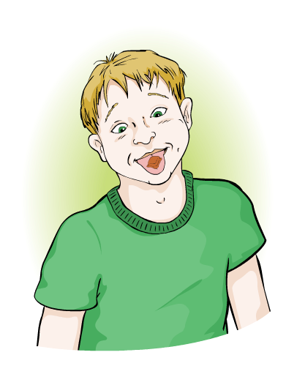
Melting chocolate
When you place a piece of chocolate on your tongue, what happens to it? Can you explain why, using the following key words?
vibrate, bonds, temperature, heat
1. Energy is transferred as heat from high to low temperatures.
2. The heat transfers from your tongue to the chocolate.
3. This makes the particles in the chocolate vibrate more quickly, until the chocolate reaches its melting point.
4. If the chocolate is at its melting point, then the energy breaks the bonds between the particles in the chocolate.
5. The chocolate then melts.
Notes:
This slide covers the Science and Engineering Practice:
Constructing Explanations and Designing Solutions: Apply scientific ideas, principles, and/or evidence to provide an explanation of phenomena and solve design problems, taking into account possible unanticipated effects.

Slide 11
The cooling of stearic acid
Notes:
Teacher notes
It may be helpful to remind pupils to watch both the thermometer and the test tube when the stearic acid is cooling.
This slide covers the Science and Engineering Practices:
Planning and Carrying Out Investigations: Plan an investigation or test a design individually and collaboratively to produce data to serve as the basis for evidence as part of building and revising models, supporting explanations for phenomena, or testing solutions to problems. Consider possible variables or effects and evaluate the confounding investigation’s design to ensure variables are controlled.
Analyzing and Interpreting Data: Analyze data using tools, technologies, and/or models (e.g., computational, mathematical) in order to make valid and reliable scientific claims or determine an optimal design solution.

Slide 12
What happens to ice as it is heated?
Notes:
This slide covers the Science and Engineering Practices:
Planning and Carrying Out Investigations: Plan an investigation or test a design individually and collaboratively to produce data to serve as the basis for evidence as part of building and revising models, supporting explanations for phenomena, or testing solutions to problems. Consider possible variables or effects and evaluate the confounding investigation’s design to ensure variables are controlled.
Analyzing and Interpreting Data: Analyze data using tools, technologies, and/or models (e.g., computational, mathematical) in order to make valid and reliable scientific claims or determine an optimal design solution.

Slide 13
Changing state summary

