Slide 1
Terminal Velocity

Slide 2
Information
Analyzing and Interpreting Data
Constructing Explanations and Designing Solutions
4. Systems and System Models

Slide 3
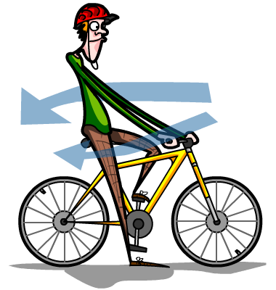
Acceleration through a fluid
When objects accelerate through a medium (like air or water) they displace the molecules already present. This produces a resistive force.
Liquids tend to have a higher resistive force than gases. Imagine trying to run underwater compared to running on land.
The faster an object is moving, the greater the resistive force becomes.

Slide 4
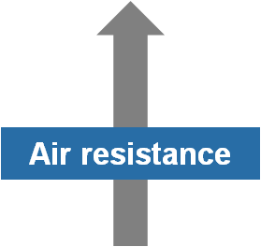
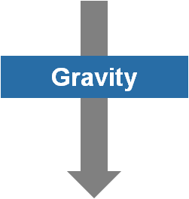
Acceleration due to gravity
Gravity is a force that acts to attract masses to one another. Close to the Earth’s surface, gravitational forces create an acceleration of about 9.8 m/s².
Consider an object dropped from a plane. The force of gravity accelerates the object downwards.
As its speed increases, so does the air resistance. Eventually, the two forces balance, and the object has reached terminal velocity.
Notes:
Teacher notes
The effect of air resistance on a falling object depends on its shape and its mass. Objects that are heavier or more streamlined will be slowed less by air resistance.
This slide covers the Science and Engineering Practice:
Constructing Explanations and Designing Solutions: Apply scientific ideas, principles, and/or evidence to provide an explanation of phenomena and solve design problems, taking into account possible unanticipated effects.

Slide 5
Terminal velocity of a skydiver
Notes:
Teacher notes
The terminal velocity for a skydiver is around 60 m/s, but varies with factors such as the weight and the shape of person. A heavier person in a more streamlined position will have a higher terminal velocity.
To extend this activity, ask students to draw or comment on the force arrows on the right of the image:
Shortly after the skydiver deploys his parachute (point C on the following graph)
When the skydiver is close to the ground (point D on the following graph)
When the skydiver is on the ground (point E on the following graph).
This slide covers the Science and Engineering Practice:
Constructing Explanations and Designing Solutions: Apply scientific ideas, principles, and/or evidence to provide an explanation of phenomena and solve design problems, taking into account possible unanticipated effects.

Slide 6
Velocity–time graph of skydiver
Notes:
Teacher notes
This animated and interactive graph provides an opportunity for students to apply their knowledge of velocity–time / speed–time graphs to explain the descent of a skydiver. While it continues the theme of balanced forces, the graph could also introduce the idea of unbalanced forces leading to acceleration and deceleration.
This slide covers the Science and Engineering Practice:
Analyzing and Interpreting Data: Analyze data using tools, technologies, and/or models (e.g., computational, mathematical) in order to make valid and reliable scientific claims or determine an optimal design solution.

Slide 7
How does a parachute work?

