Slide 1
The Electromagnetic Spectrum

Slide 2
Information
Asking Questions and Defining Problems
Developing and Using Models
Engaging in Argument from Evidence
1. Patterns
2. Cause and Effect
3. Scale, Proportion, and Quantity
4. Systems and System Models

Slide 3
Detecting waves beyond the visible spectrum
Notes:
This slide covers the Science and Engineering Practice:
Asking Questions and Defining Problems: Ask questions that arise from careful observation of phenomena, or unexpected results, to clarify and/or seek additional information.

Slide 4
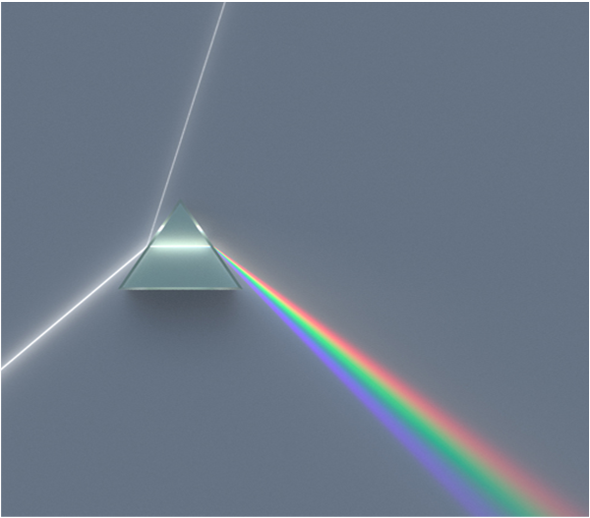
Invisible “light”
It has long been known that when sunlight passes through a prism it is split into its component colors. This effect is called dispersion.
In 1800, Sir Frederick William Herschel placed a thermometer next to the red light refracted through a prism. To his surprise the thermometer read a higher temperature than the rest of
the spectrum.
sunlight
visible light
infrared
This led to the idea of an invisible form of light beyond red in the spectrum. This was to be called infrared.
Notes:
Teacher notes
Herschel had other famous discoveries. He discovered Uranus (and two of its moons), the fact the coral was an animal not a plant, and two moons of Saturn, among other diverse discoveries. He was a German-born British scientist and composer.
This slide covers the Science and Engineering Practice:
Engaging in Argument from Evidence: Evaluate the claims, evidence, and/or reasoning behind currently accepted explanations or solutions to determine the merits of arguments.
Photo credit: © Spigget
This image is reproduced under the terms of the GNU Free Documentation License. A copy of the license can be read at this address: http://commons.wikimedia.org/wiki/Commons:GNU_Free_Documentation_License

Slide 5
Looking for “cooling rays”
In 1801, a German scientist called Johann Wilhelm Ritter heard about Herschel’s discovery of infrared heating rays. He thought there must be an opposite cooling ray and set out to find it.
Silver chloride is a chemical which decomposes when exposed to light. Ritter confirmed the common belief that violet was more effective than red in this. He then went on to show another “invisible” kind of radiation was even faster.
sunlight
visible light
infrared
He called this radiation “chemical rays.” This was changed to the term we use today – ultraviolet.
ultraviolet
Notes:
Teacher notes
Ritter wrote his experimental results in insufficient detail and in a poor writing style. This, combined with an interest in the occult, caused him not to be taken seriously by his peers. He died young leaving four children in poverty.
This slide covers the Science and Engineering Practice:
Engaging in Argument from Evidence: Evaluate the claims, evidence, and/or reasoning behind currently accepted explanations or solutions to determine the merits of arguments.
Photo credit: © Spigget
This image is reproduced under the terms of the GNU Free Documentation License. A copy of the license can be read at this address: http://commons.wikimedia.org/wiki/Commons:GNU_Free_Documentation_License

Slide 6
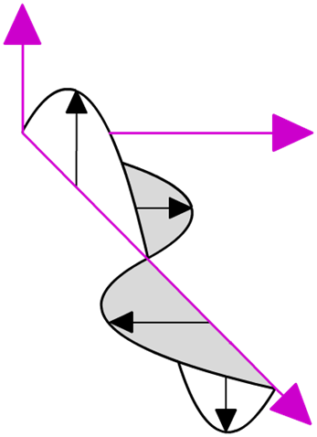
What are electromagnetic waves?
What is the connection between light, microwaves and X-rays?
They are all different types of electromagnetic radiation that travel as waves and transfer energy from the source of the waves to an absorber. For example, energy from the Sun is transferred by electromagnetic waves to the Earth.
Electromagnetic waves are transverse waves made up of oscillating electric and magnetic fields.
magnetic field
electric field
All electromagnetic waves travel at the same speed in a vacuum (such as space): the speed of light (300,000,000 m/s).
wave direction
Notes:
This slide covers the Science and Engineering Practice:
Developing and Using Models: Use a model to provide mechanistic accounts of phenomena.

Slide 7
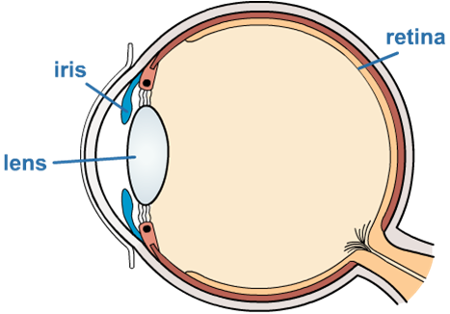
Properties of waves
The properties of waves are basically determined by their reflection, transmission and absorption by different materials.
When absorbed, waves can interact in very interesting ways which make them suitable for different applications.
For example, visible light waves interact with special receptor cells at the back of human eyes which go onto produce electrical signals that can be interpreted by the brain.

Slide 8
Changing frequency
The frequency/wavelength of the electromagnetic wave will affect its properties.
The waves can be categorized according to these properties.
radio waves
microwaves
infrared
visible light
UV
X-rays
gamma rays
10 m
10 cm
1 mm
0.01 mm
100 nm
1 nm
0.01 nm

Slide 9
Are electromagnetic waves dangerous?
The shorter the wavelength (and higher the frequency) of electromagnetic waves, the more energy that they carry.
radio waves
microwaves
infrared
visible light
UV
X-rays
gamma rays
10 m
10 cm
1 mm
0.01 mm
100 nm
1 nm
0.01 nm
energy increases
hazard increases
High-frequency electromagnetic waves, such as gamma rays, are potentially more harmful because they have more energy.
Notes:
Teacher notes
Even within the categories, the properties can change, but naming the different bands of the EM spectrum is helpful when talking about their uses.
For more information about the hazards of electromagnetic waves, please refer to the Hazards of Electromagnetic Waves presentation.

Slide 10
Frequency matters
The frequency of an EM wave will determine whether it can be:
transmitted through glass (for example, visible light can be transmitted through glass but ultraviolet cannot)
reflected by objects (green light is reflected by leaves, but no other light is reflected)
absorbed by water (microwaves are absorbed by water, but radio waves are not).

Slide 11
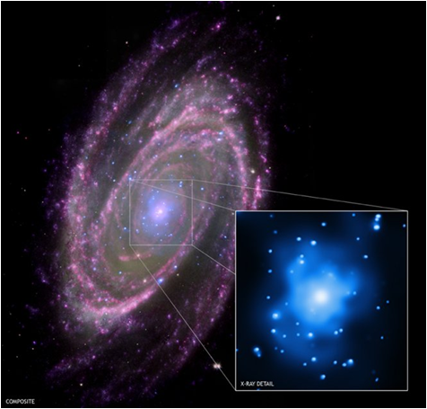
How do electromagnetic waves differ?
Different electromagnetic waves carry different amounts of energy.
For example, X-rays carry more energy than visible light, ultraviolet or infrared rays.
The amount of energy carried
by an electromagnetic wave
depends on the wavelength:
the shorter the wavelength, the higher its energy.
Wavelength and frequency are linked properties of a wave: the shorter the wavelength, the higher its frequency.
So, frequency also tells you about the energy of a wave:
the higher its frequency, the higher the energy.
Notes:
Teacher notes
The image on this slide is a composite NASA image of the spiral galaxy M81, located about 12 million light years away. The image includes X-ray data from the Chandra X-ray Observatory (blue), optical data from the Hubble Space Telescope (green), infrared data from the Spitzer Space Telescope (pink) and ultraviolet data from GALEX (purple). The inset shows a close-up of the Chandra X-ray image. At the centre of M81 is a supermassive black hole that is about 70 million times more massive than the Sun.
Photo credit: © NASA, 2018

Slide 12
The electromagnetic spectrum
Notes:
Teacher notes
This sequence, summarizing the electromagnetic spectrum and the uses of the different types of electromagnetic waves, could be used as an introduction to the electromagnetic spectrum or as an introductory or summary activity on the electromagnetic spectrum.
For more information about the uses of electromagnetic waves, please refer to the Uses of Electromagnetic Waves presentation.
This slide is accompanied by the worksheet The Electromagnetic Spectrum.

