Slide 1
The Photoelectric Effect

Slide 2
Information
Developing and Using Models
Planning and Carrying Out Investigations
Using Mathematics and Computational Thinking
Constructing Explanations and Designing Solutions
Obtaining, Evaluating and Communicating Information
1. Patterns
2. Cause and Effect
3. Scale, Proportion, and Quantity
5. Energy and Matter

Slide 3
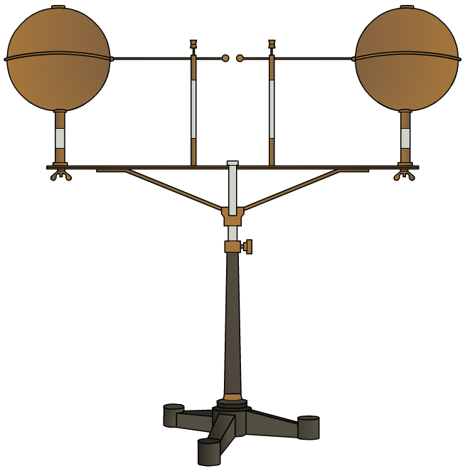
The discovery of photoelectricity
Photoelectricity was first discovered in 1887 by Heinrich Hertz during investigations into radio waves using a “spark gap.”
Radio waves are produced when a high voltage is supplied across two electrodes causing a spark in the gap.
Hertz found that if ultraviolet light was shone on the electrodes, the sparks were much stronger and thicker.

Slide 4
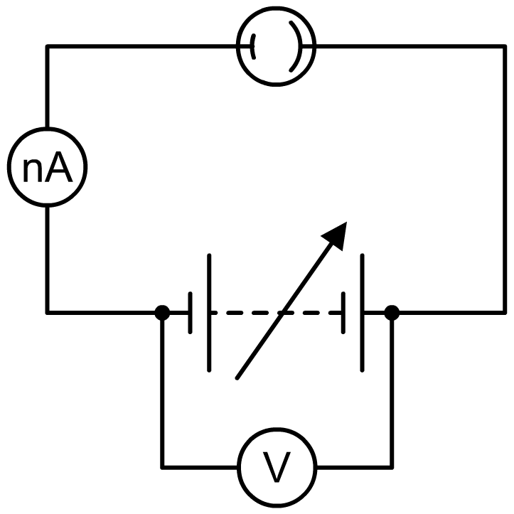
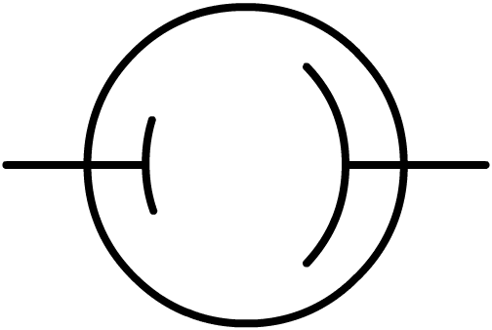
Measuring photoelectricity
In the late 19th century, scientists used apparatus like this photocell to analyze and measure photoelectricity.
photocell
When light is shone on the cathode of the photocell, electrons are released. They are attracted to the anode, causing a current to flow.
cathode
anode
vacuum
Notes:
Teacher notes
The “nA” symbol represents a nanoammeter – capable of detecting tiny electrical currents.
The arrow through the battery indicates a variable voltage supply.

Slide 5
The gold leaf electroscope
Notes:
This slide covers the Science and Engineering Practice:
Planning and Carrying Out Investigations: Plan an investigation or test a design individually and collaboratively to produce data to serve as the basis for evidence as part of building and revising models, supporting explanations for phenomena, or testing solutions to problems. Consider possible variables or effects and evaluate the confounding investigation’s design to ensure variables are controlled.

Slide 6
Unexpected observations
Scientists investigating the photoelectric effect observed several results that were difficult to explain using the wave theory of light that was accepted at the time.
The physicist Philipp Lenard found that changing the intensity of the light changed the number of electrons emitted but not the energy of each electron.
The intensity (or brightness) of a wave is the energy transferred per unit area per unit time. Increasing the intensity of the light increases the energy transferred to the plate, so scientists expected the emitted electrons to have more energy.
Lenard suggested that the electron’s energy was stored in the atom, and that the light only “triggered” the electron’s emission.

Slide 7
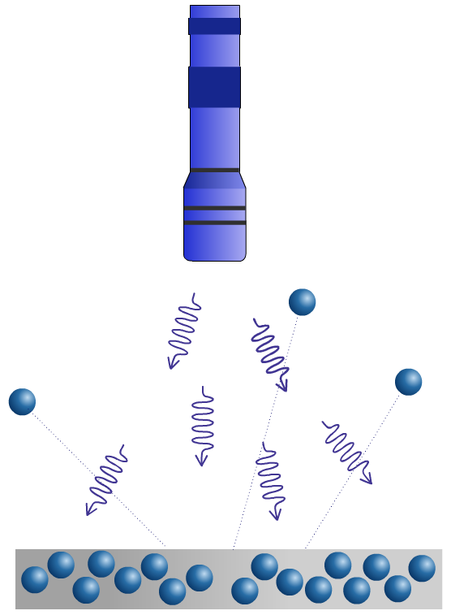
Dependence on frequency
Another surprising observation was that the frequency of the light used affected the results of the experiment.
Light below a certain frequency, however bright, did not cause any electrons to be emitted from the plate.
As the frequency of the light shone on the plate increased, the maximum kinetic energy of the electrons emitted also increased.
These observations could not be explained by Lenard’s idea that the energy of the emitted electrons was stored in the atom.

Slide 8
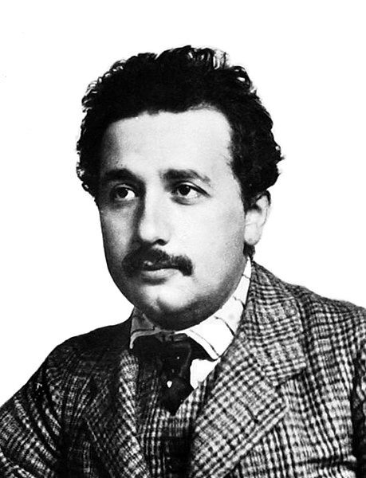
Photons
In 1905, Einstein published a paper that described his theory of “light quanta.” This theory explained the unexpected observations of the photoelectric effect.
Einstein proposed that, although light exhibited wave-like properties, it traveled in discrete “packets” of energy that he called “light quanta.” Today, these particles are known as photons.
At the time, the idea that light behaved as a wave and not like a particle was very well-established. Einstein’s theory was so revolutionary that it took several years and further experimental evidence before it was accepted by the majority of scientists.
Notes:
Teacher notes
Einstein was awarded the Nobel Prize for Physics for his work on the photoelectric effect in 1921, but his theory of the quantization of light remained controversial. It was finally accepted after Arthur Compton’s work on X-ray scattering (the Compton effect).
For more information about the wave and photon models of light, please refer to the Light as Waves and Particles presentation.
This slide covers the Science and Engineering Practices:
Developing and Using Models: Develop, revise, and/or use a model based on evidence to illustrate and/or predict the relationships between systems or between components of a system.
Constructing Explanations and Designing Solutions: Apply scientific ideas, principles, and/or evidence to provide an explanation of phenomena and solve design problems, taking into account possible unanticipated effects.
Photo credit: this image is in the public domain.

Slide 9
Einstein’s explanation of photoelectricity
Einstein’s theory that light comes in discrete quanta, or photons, explained the observations of the photoelectric effect:
observation
Einstein’s explanation
The number of emitted electrons increases with intensity of light.
Each photon causes the emission of a single electron. Increasing intensity increases the number of photons.
The electron’s energy depends on frequency, not intensity.
The energy of the photon depends on its frequency. This energy is equal to the energy of the emitted electron.
If the light is below a certain frequency no electrons are emitted.
If an individual photon does not have enough energy to cause an emission, no electrons will be emitted.
Notes:
This slide covers the Science and Engineering Practices:
Developing and Using Models: Develop, revise, and/or use a model based on evidence to illustrate and/or predict the relationships between systems or between components of a system.
Constructing Explanations and Designing Solutions: Apply scientific ideas, principles, and/or evidence to provide an explanation of phenomena and solve design problems, taking into account possible unanticipated effects.

Slide 10
Einstein’s photoelectric equation
Notes:
This slide covers the Science and Engineering Practice:
Developing and Using Models: Develop and/or use a model (including mathematical and computational) to generate data to support explanations, predict phenomena, analyze systems, and/or solve problems.

Slide 11
The photoelectric effect equation
Notes:
This slide covers the Science and Engineering Practice:
Using Mathematics and Computational Thinking: Apply techniques of algebra and functions to represent and solve scientific and engineering problems.

Slide 12
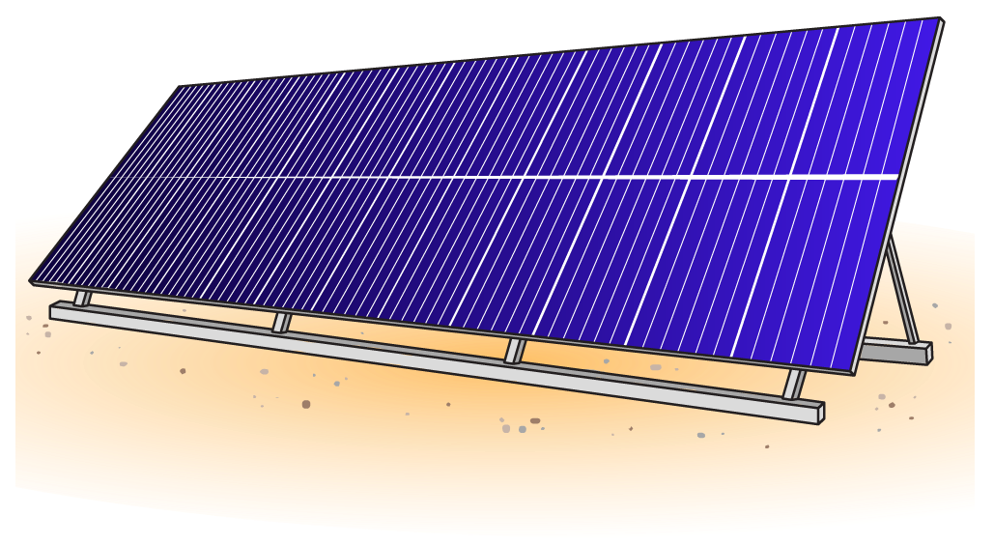
Using the photoelectric effect
Several technological devices use the photoelectric effect, including solar cells, CCDs (charge-coupled devices) in digital cameras and photocells in automatic doors.
Research a device that uses the photoelectric effect. Use your findings to design a leaflet explaining how this device works.
Your leaflet should include:
what the device does
how the device uses the photoelectric effect
what problem or need does the device address.
Notes:
Teacher notes
Some students will need support in order to access this activity. It may be helpful to provide information that has been adapted to an appropriate level for students to use as research material.
For more information about how solar cells use the Sun’s energy to produce electricity, please refer to the Uses of Electromagnetic Waves presentation.
This slide covers the Science and Engineering Practices:
Obtaining, Evaluating, and Communicating Information: Critically read scientific literature adapted for classroom use to determine the central ideas or conclusions and/or to obtain scientific and/or technical information to summarize complex evidence, concepts, processes, or information presented in a text by paraphrasing them in simpler but still accurate terms.
Obtaining, Evaluating, and Communicating Information: Communicate scientific and/or technical information or ideas (e.g. about phenomena and/or the process of development and the design and performance of a proposed process or system) in multiple formats (including orally, graphically, textually, and mathematically).

