Slide 1
Transformers

Slide 2
Information
Using Mathematics and Computational Thinking
Constructing Explanations and Designing Solutions
2. Cause and Effect
3. Scale, Proportion, and Quantity
5. Energy and Matter

Slide 3
Linking circuits with magnetism
Notes:
Teacher notes
In the experiment, a current is induced in the second circuit when the first circuit is switching on or off. In order for power to be transferred continuously between two circuits, the current in the first circuit must be changing continuously. This can be achieved by using an alternating current.
In order for as much power to be transferred as possible, the two circuits must be as closely magnetically linked as possible. This can be achieved by winding the two circuits into tight coils around an iron core. This is how a transformer works.
This presentation is accompanied by the worksheet Transformers.

Slide 4
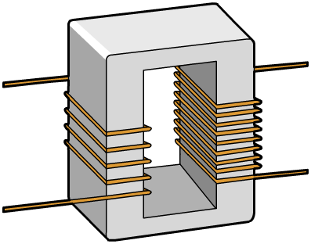
Transformers
Power can be transferred between circuits using two coils of wire wound around a soft iron core. This is called a transformer. An iron core is used as it is easily magnetized.
The alternating current in the primary (input) coil produces an alternating magnetic field.
iron core
This alternating magnetic field induces an alternating current in the secondary (output) coil.
secondary
coil
primary
coil
Notes:
This slide covers the Science and Engineering Practice:
Constructing Explanations and Designing Solutions: Apply scientific ideas, principles, and/or evidence to provide an explanation of phenomena and solve design problems, taking into account possible unanticipated effects.

Slide 5
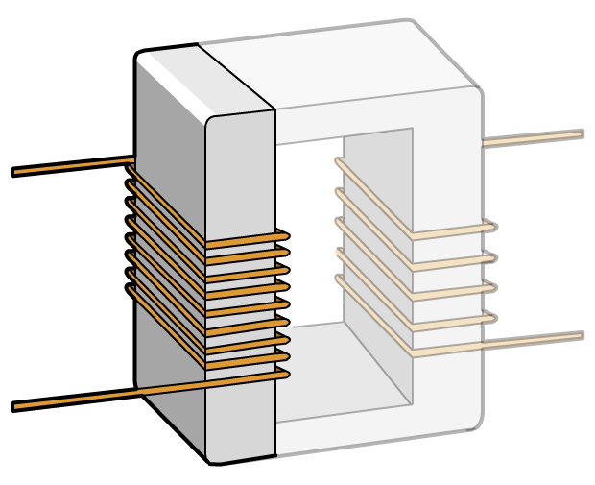
Primary side – how it works
A transformer links two circuits together. To understand how it works, it is important to look at each side separately.
The primary side is simply an electromagnet. By passing an electric current through a coil of wire, it makes a magnetic field, just like the field around a bar magnet.
A direct current makes one end of the iron north, and the other end south. It also causes a potential difference (p.d.) between the ends of the coil.
–
N
What would happen with an alternating current?
S
+
Notes:
Teacher notes
An alternating current would cause both the magnetic field and the potential difference to change direction.
For more information about how a current-carrying wire generates a magnetic field, please refer to the Electromagnetism presentation.
This slide covers the Science and Engineering Practice:
Constructing Explanations and Designing Solutions: Apply scientific ideas, principles, and/or evidence to provide an explanation of phenomena and solve design problems, taking into account possible unanticipated effects.

Slide 6
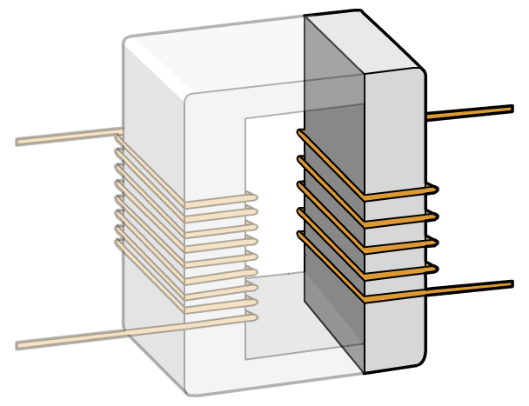
Secondary side – how it works
The secondary side coil is not connected directly to the primary side or any power supply.
The secondary side works using electromagnetic induction. When the magnetic field that is perpendicular to the secondary coil changes, a current is induced in the coil.
When there is an alternating current in the primary side, the magnetic field around the transformer alternates. This induces an alternating current in the secondary side coil, and a potential difference across it.
–
+
Notes:
Teacher notes
For more information about electromagnetic induction, please refer to the The Generator Effect presentation.
This slide covers the Science and Engineering Practice:
Constructing Explanations and Designing Solutions: Apply scientific ideas, principles, and/or evidence to provide an explanation of phenomena and solve design problems, taking into account possible unanticipated effects.

Slide 7
Parts of a transformer
Notes:
Teacher notes
This drop down activity could be used as an introductory or summary exercise on transformers.

Slide 8
Investigating transformers
Notes:
Teacher notes
This virtual experiment illustrates how the output of a transformer is affected by input voltage, current type, frequency and number of turns on the secondary coil. This activity could be used as a precursor to running a practical in the lab, or as a summary exercise.
Students are not required to know how frequency affects output voltage; however, in the lab and in this practical, they may observe that output voltage decreases as frequency decreases. What they are required to know is that transformers cannot transfer power between coils with DC. Since DC can be considered AC with frequency 0 Hz, explain that as frequency decreases, it behaves more like DC and therefore transfers less power. This observation can be used to suggest why high frequency switch mode transformers are able to transfer power more efficiently.

Slide 9
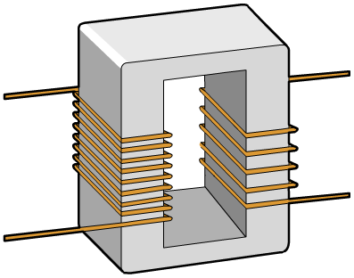
Using a transformer to change p.d.
The p.d. induced in the secondary (output) coil depends on the number of turns on the primary and secondary coils.
A step-up transformer has more turns on the secondary coil and so increases p.d.
A step-down transformer has fewer turns on the secondary coil and so decreases p.d.

Slide 10
Properties of transformers
Transformers transfer power between circuits. The design of a transformer determines the characteristics of the electricity flowing in its secondary circuit.
The frequency of the alternating current in the secondary circuit matches the primary circuit, but what about potential difference?
In an ideal transformer, the potential difference in each circuit is related to the number of coils on each side by the formula:
primary p.d.
primary turns
=
secondary p.d.
secondary turns
V_{p}
N_{p}
=
V_{s}
N_{s}
Notes:
Teacher notes
An ideal transformer has no resistive or magnetic losses; therefore when AC is used, it is assumed that output voltage does not depend on frequency.
This slide covers the Science and Engineering Practice:
Using Mathematics and Computational Thinking: Use mathematical, computational, and/or algorithmic representations of phenomena or design solutions to describe and/or support claims and/or explanations.

Slide 11
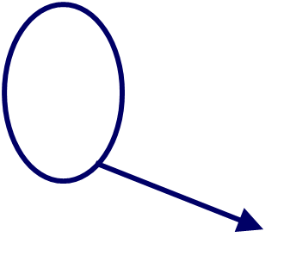
Step-up transformers
Step-up transformers increase the potential difference.
–
The secondary coil has more turns than the primary coil. Since there are more turns, a larger potential difference is generated across the secondary coil.
–
+
+
N_{s}
V_{s}
=
× V_{p}
N_{p}
ratio greater than 1
Notes:
Teacher notes
Remind students that the potential difference alternates because an alternating current is used.
This slide covers the Science and Engineering Practice:
Using Mathematics and Computational Thinking: Apply ratios, rates, percentages, and unit conversions in the context of complicated measurement problems involving quantities with derived or compound units (such as mg/mL, kg/m3, acre-feet, etc.).

Slide 12
Step-down transformers
Step-down transformers decrease the potential difference.
The secondary coil has fewer turns than the primary coil. Since there are fewer turns, a smaller potential difference is generated across the secondary coil.
–
–
+
+
N_{s}
V_{s}
=
× V_{p}
N_{p}
ratio less than 1
Notes:
Teacher notes
Remind students that the potential difference alternates because an alternating current is used.
This slide covers the Science and Engineering Practice:
Using Mathematics and Computational Thinking: Apply ratios, rates, percentages, and unit conversions in the context of complicated measurement problems involving quantities with derived or compound units (such as mg/mL, kg/m3, acre-feet, etc.).

Slide 13
Calculating potential difference
Notes:
Teacher notes
This activity could be used to check students’ understanding of transformer calculations. Students could work individually or in small groups, with mini-whiteboards used to convey the answers.
This slide covers the Science and Engineering Practice:
Using Mathematics and Computational Thinking: Apply techniques of algebra and functions to represent and solve scientific and engineering problems.

Slide 14
Transformer power
Transformers not only change p.d.; they also change current.
For example, if the potential difference increases, such as in a step-up transformer, the current decreases.
This is because for any transformer (providing no energy is lost in the transformer):
–
and:
–
V_{s}
V_{p}
+
This gives:
+
I_{s}
V_{p} × I_{p} = V_{s} × I_{s}
I_{p}
Notes:
Teacher notes
Power in is only equal to power out in a transformer that is 100% efficient.
This slide covers the Science and Engineering Practice:
Using Mathematics and Computational Thinking: Use mathematical, computational, and/or algorithmic representations of phenomena or design solutions to describe and/or support claims and/or explanations.

Slide 15
Transformer power example
A transformer has a primary potential difference of 1,000 V and a primary current of 0.5 A.
If the secondary circuit has a current of 0.01 A flowing, what is the secondary potential difference?
V_{p} × I_{p} = V_{s} × I_{s}
–
I_{p}
–
V_{s}
=
V_{p} ×
V_{s}
I_{s}
V_{p}
+
0.5 A
+
=
1,000 V ×
I_{s}
0.01 A
I_{p}
= 50,000 V
Notes:
This slide covers the Science and Engineering Practice:
Using Mathematics and Computational Thinking: Apply techniques of algebra and functions to represent and solve scientific and engineering problems.

Slide 16
Power loss in wires
Wires have resistance, so power is lost as heat when current flows through them:
power loss = (current)² × resistance
P = I² × R
Power is measured in watts (W).
Current is measured in amps (A).
Resistance is measured in ohms (Ω).
When transmitting electricity, how does a transformer help to minimize the power lost?
Notes:
Teacher notes
To minimize power loss, the current should be as low as possible. A transformer changes the current (as shown by the equation V_{p}I_{p} = V_{s}I_{s}).
This slide covers the Science and Engineering Practice:
Using Mathematics and Computational Thinking: Use mathematical, computational, and/or algorithmic representations of phenomena or design solutions to describe and/or support claims and/or explanations.

Slide 17
Why use high voltages for distribution?
Notes:
Teacher notes
This true-or-false quiz could be used as an introductory activity on electricity distribution. Students could be given colored traffic light cards (red = false, green = true) to vote on the statements shown. To stretch students, they could be asked to explain their voting.

Slide 18
Power loss in cables – example
Notes:
This slide covers the Science and Engineering Practice:
Using Mathematics and Computational Thinking: Apply techniques of algebra and functions to represent and solve scientific and engineering problems.

