Slide 1
Uses of Electromagnetic Waves

Slide 2
Information
Obtaining, Evaluating and Communicating Information
2. Cause and Effect

Slide 3
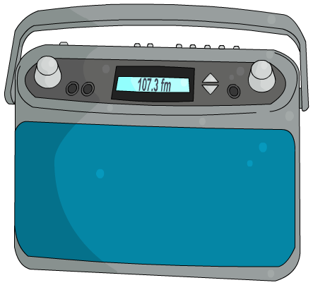
What are radio waves?
The broadcast of every radio and television program involves the use of radio waves.
Radio waves are the type of electromagnetic waves with the longest wavelengths.
micro-
waves
ultra-
violet
radio waves
infrared
1,000 m
1 m
1 mm
0.001 mm
wavelength of electromagnetic waves
Radio waves have a wavelength greater than 30 cm (the length of a standard ruler).
Radio waves have many uses. How many can you think of?
Notes:
Teacher notes
For more information about the types of electromagnetic radiation, please refer to the The Electromagnetic Spectrum presentation.

Slide 4
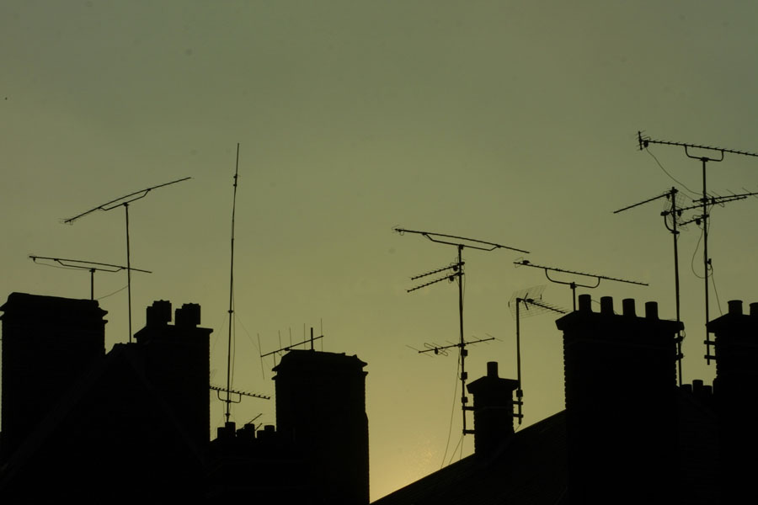
How are radio waves produced?
Radio waves are produced by passing an oscillating electric current through a long wire called an aerial.
The frequency of the radio wave produced is the same as the frequency of the oscillating current.
This allows radio waves of different wavelengths to be produced.
Radio waves of different wavelengths have slightly different properties and are used for different purposes.
Notes:
Photo credit: © photos.com 2018

Slide 5
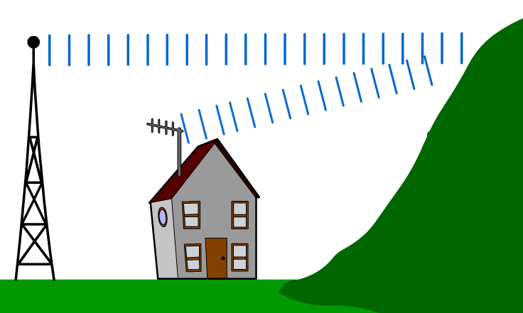
Transmission of radio waves?
Radio waves are not absorbed strongly by walls. They pass through them easily, which is why radio (and television) signals can be received indoors.
Tall objects, like buildings and hills, can prevent radio waves traveling directly from a transmitter, but this is not always a problem.
In some areas, the reflection of waves off other buildings or hills can actually lead to improved radio reception.

Slide 6
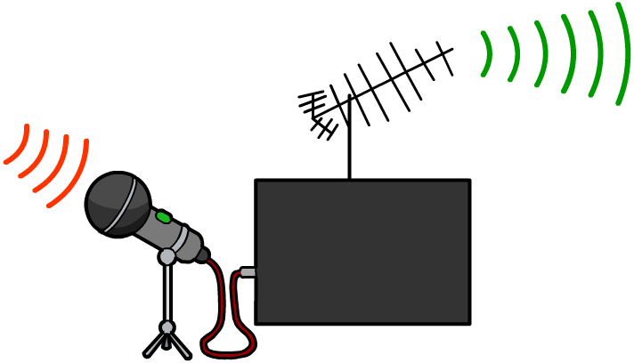
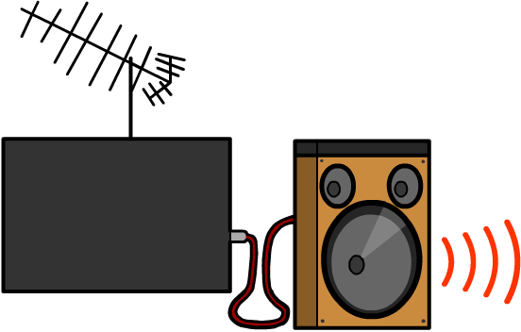
Using radio waves in communications
Different types of radio waves are used to transmit signals for radio, TV, mobile phones, Wi-Fi and satellite communications.
In a transmitter, sound waves are turned into oscillating current, which produces radio waves in an aerial.
In a receiver, radio waves are picked up by another aerial, creating an oscillating current in the aerial, which is turned back into sound waves.
aerial
radio waves
transmitter
receiver

Slide 7
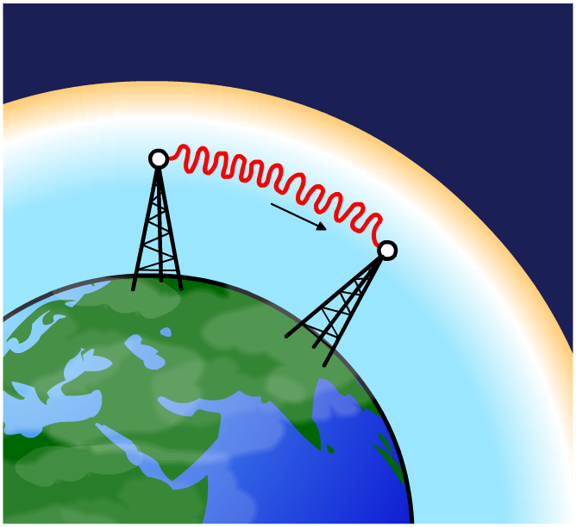
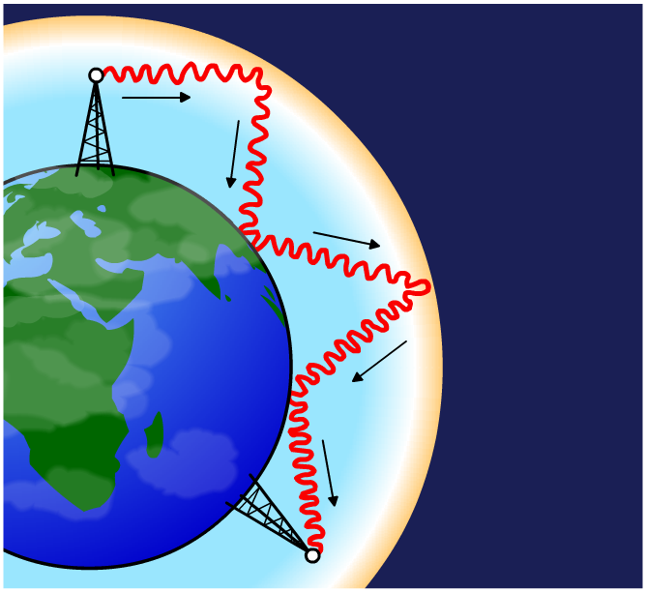
Why do some radio waves travel so far?
Low frequency (up to 3 MHz) radio waves travel along the Earth’s surface and can travel hundreds of miles. These ground waves are used for local and national radio.
ionosphere
Higher frequency radio waves
(3–30 MHz) are reflected off the ionosphere high in the atmosphere. This effect is similar to total internal reflection for light. These sky waves are used for international and amateur radio.

Slide 8
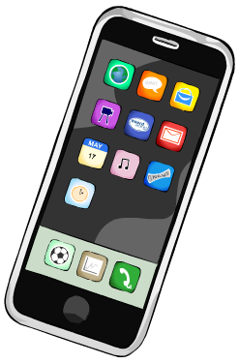
What are microwaves?
Every mobile phone conversation involves the transmission of microwave signals.
Microwaves are a form of electromagnetic radiation, with shorter wavelengths than radio waves.
micro-
waves
ultra-
violet
radio waves
infrared
1,000 m
1 m
1 mm
0.001 mm
wavelength of electromagnetic waves
The wavelength of microwaves ranges from 30 cm (the length of a standard ruler) to 1 mm (about the size of a full stop).
Microwaves have many uses. How many can you think of?
Notes:
Teacher notes
For more information about the types of electromagnetic radiation, please refer to the The Electromagnetic Spectrum presentation.

Slide 9
How are microwaves produced?
Microwaves with different wavelengths have slightly different properties and uses. They are also produced in different ways.
Long-wavelength microwaves are produced by aerials in a similar way to other radio waves. These types of microwaves are used for communications.
Short-wavelength microwaves are produced using a device called a magnetron. These types of microwaves are used by microwave ovens and radar equipment.
The antenna used to produce a wave must be at least ½ its wavelength. Therefore, microwaves have much smaller wavelengths, so they can use smaller antennae than radio waves, which have a much larger wavelength.
Notes:
Photo credit: © highlaz, shutterstock.com 2018

Slide 10
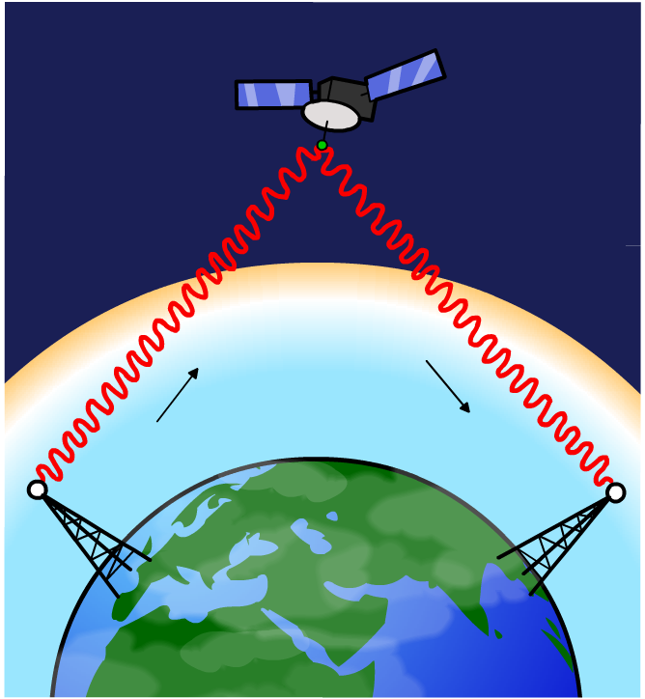
Microwaves and satellite communications
Unlike other radio waves, microwaves are not reflected by the ionosphere but are refracted a little, then pass into space.
This means they can be picked up by satellites, amplified, then transmitted back to Earth. The signal could be retransmitted to another country, thousands of miles from the original transmission. This is how you can call people in China.
ionosphere

Slide 11
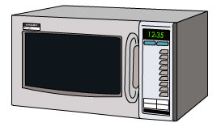
Heating with microwaves
Microwaves also have the special property that they are absorbed by water molecules. This gives the water molecules lots of kinetic energy to vibrate and move around.
This raises the temperature of the water. Because all food contains some water, the whole food heats up as the energetic water transfers heat energy throughout.
Two factors which affect the amount of heating are:
intensity
length of time of heating.
For both factors, the total amount of absorbed radiation increases when either factor is increased.

Slide 12
How does a microwave oven work?
Notes:
Teacher notes
This four-stage animation illustrates how a microwave oven cooks food. When viewing the animation the use of a wave guide, stirrer and metal walls to control and reflect the microwaves could be highlighted.

Slide 13
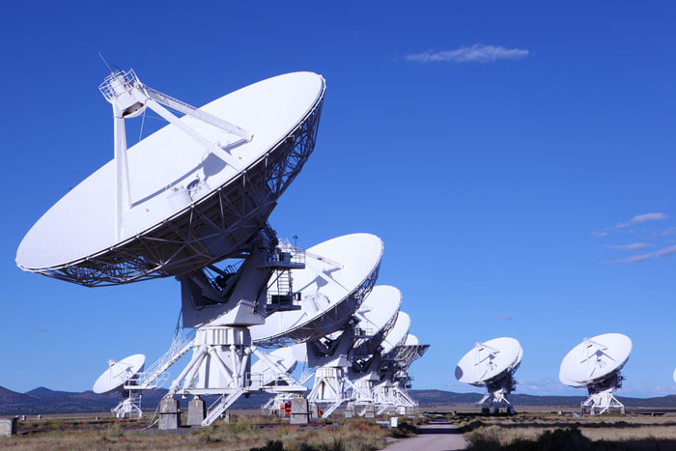
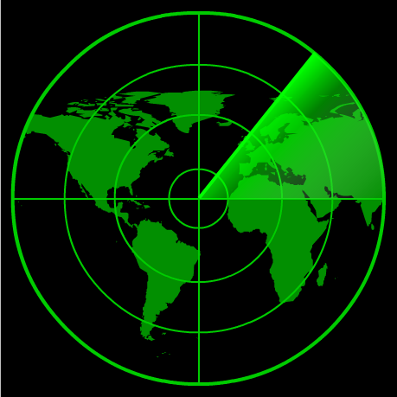
Other uses of microwaves
Astronomy: large microwave receivers called radio telescopes study microwaves emitted from space.
Radar (radio detection and ranging): radar equipment detects moving objects by bouncing microwaves off them.
Notes:
Photo credit: © Manamana, shutterstock.com 2018
Telescopes from the Very Large Array (VLA) radio astronomy observatory in New Mexico, USA. The array of telescopes receive radio waves from space. The received waves are used to make images of astronomical objects that emit radio waves.

Slide 14
What is infrared raditation?
Infrared radiation is emitted by all objects but is not visible to humans. The hotter an object is, the more infrared radiation it emits.
As an object gets hotter, visible light is also emitted. This is what can be seen when an object glows “red hot.”
micro-
waves
ultra-
violet
radio waves
infrared
1,000 m
1 m
1 mm
0.001 mm
wavelength of electromagnetic waves
The wavelength of infrared ranges from 1 mm to 750 nm.
Notes:
Teacher notes
For more information about the types of electromagnetic radiation, please refer to the The Electromagnetic Spectrum presentation.

Slide 15
Infrared around the home

Slide 16
How is infrared used for heating and cooking?
The infrared radiation emitted by the Sun, radiators and fires can be used for heating.
Infrared waves cause the vibration of molecules of a material when absorbed, heating the material.
The heating effect of infrared radiation is detected by temperature sensitive nerve-endings in skin.
Grills, stoves, toasters, campfires and barbecues use infrared radiation to cook food. Heat is transferred through the food by conduction.

Slide 17
How do infrared waves cook food?
Notes:
Teacher notes
This three-part animation illustrates how food is cooked on a grill using infrared radiation. When viewing the animation, it should be stressed that heat is transferred though the meat by conduction.

Slide 18
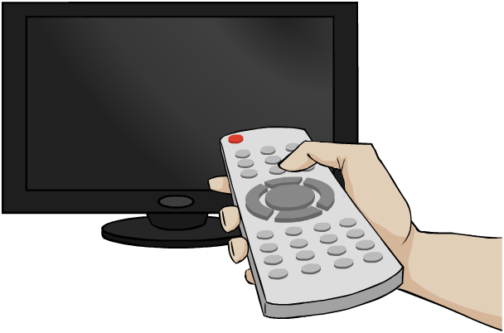
Infrared for communications
Infrared waves can also be produced by Infrared Light Emitting Diodes (IR LEDs). They can then be detected by special circuit components.
These waves will be reflected off walls very easily and so are used for very near range communication.
They are used in remote controls for all sorts of devices including TVs.
You often do not need to point the remote at the TV as the waves bounce off any reflective
surface and eventually reach the TV.

Slide 19
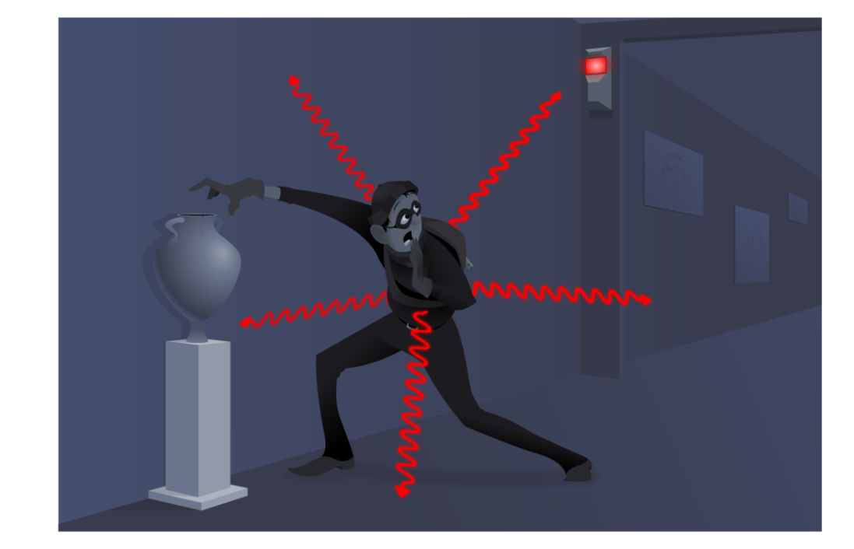
How can infrared waves fight crime?
Devices containing infrared detectors are used for various security purposes.
Sensors in security lights and burglar alarms can detect the infrared radiation given off by an approaching body.
Thermal imaging equipment, as used by the military and police, detects infrared radiation and converts it into an image. Objects such as people and cars, which are hotter than their surroundings,
can be easily tracked even at night.
The emergency services use thermal imaging cameras to help locate people in situations where visibility is low.

Slide 20
Uses of infrared – activity
Notes:
Teacher notes
This activity could be used as an introductory or summary activity to check students’ understanding of the uses of infrared radiation.

Slide 21
What is visible light radiation?
Visible light is possibly the most important kind of radiation for humans. We use it everyday to see.
Visible light electromagnetic radiation that is found between infrared and ultraviolet in the electromagnetic spectrum. Its wavelength ranges from 300 to 700 nm.
ultra-violet
gamma
rays
visible light
X-rays
10^{–3}
10^{–6}
10^{–9}
10^{–12}
wavelength of electromagnetic waves (m)
It is the interaction of EM waves of this wavelength with special cells in our eyes that makes these waves visible.
Notes:
Teacher notes
For more information about the types of electromagnetic radiation, please refer to the The Electromagnetic Spectrum presentation.

Slide 22
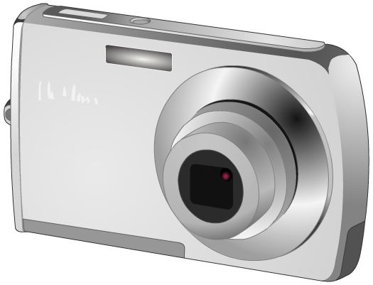
Uses of visible light?
As well as from illuminating objects so that we can see, visible light can also be used for other applications.
Photographs: film reacts to light falling on it, producing an image. Digital cameras contain millions of sensors that record light falling on them.
High speed communication: faster internet is being provided by using optical cables that transfer information with visible light using total internal reflection.
Solar cells: photovoltaic cells use light from the Sun to produce electrical energy.

Slide 23
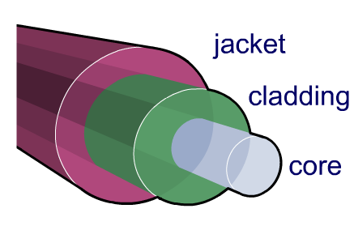
Optical fibers
Optical fibers are thin strands of solid glass which are widely used in communication and medicine.
They use total internal reflection in order to carry light over long distances and along winding paths.
The glass core is often encased in cladding, which prevents light escaping. A protective plastic jacket surrounds this.
Why are the materials used to make the core and cladding of an optical fiber important?
Notes:
Teacher notes
Students should identify the need for the cladding to have a lower refractive index than the core in order for total internal reflection to occur.

Slide 24
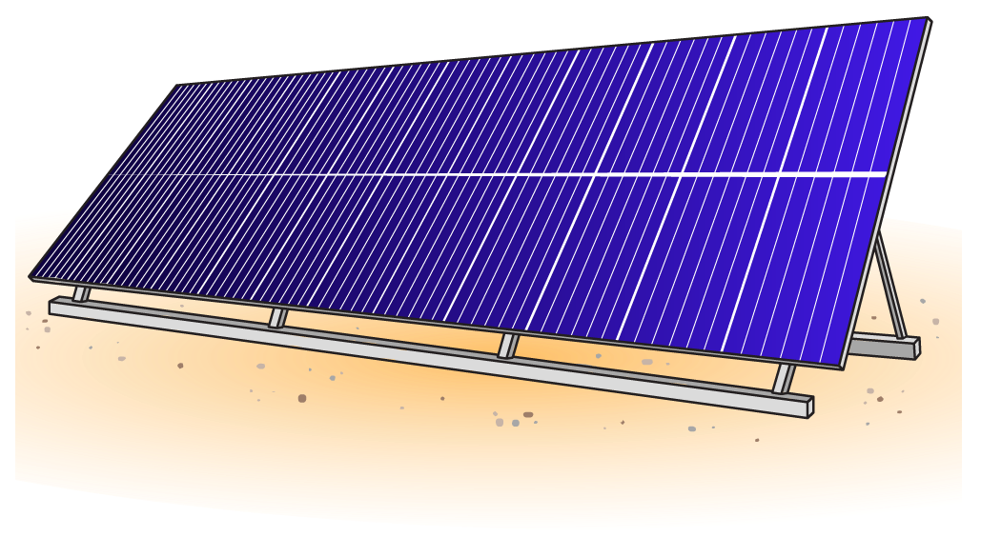
Solar cells
Solar cells are devices that convert energy from the Sun into electrical energy.
Solar cells contain photoelectric materials. Atoms of these materials emit electrons when they absorb sunlight of certain frequencies. Solar cells usually absorb frequencies of visible light and infrared radiation.
The electrons released when solar cells absorb sunlight then flow through a wire. This provides an electric current.

Slide 25
How solar cells work

Slide 26
What is ultraviolet (UV) radiation?
Everyday we are exposed to ultraviolet (UV) radiation emitted by the sun.
UV is high-energy electromagnetic radiation that is found between visible light and X-rays in the electromagnetic spectrum. Its wavelength ranges from 10 to 300 nm.
ultra-violet
gamma
rays
visible light
X-rays
10^{–3}
10^{–6}
10^{–9}
10^{–12}
wavelength of electromagnetic waves (m)
Humans cannot see UV radiation but research has shown that bees, birds, butterflies and other insects can.
Notes:
Teacher notes
For more information about the types of electromagnetic radiation, please refer to the The Electromagnetic Spectrum presentation.

Slide 27
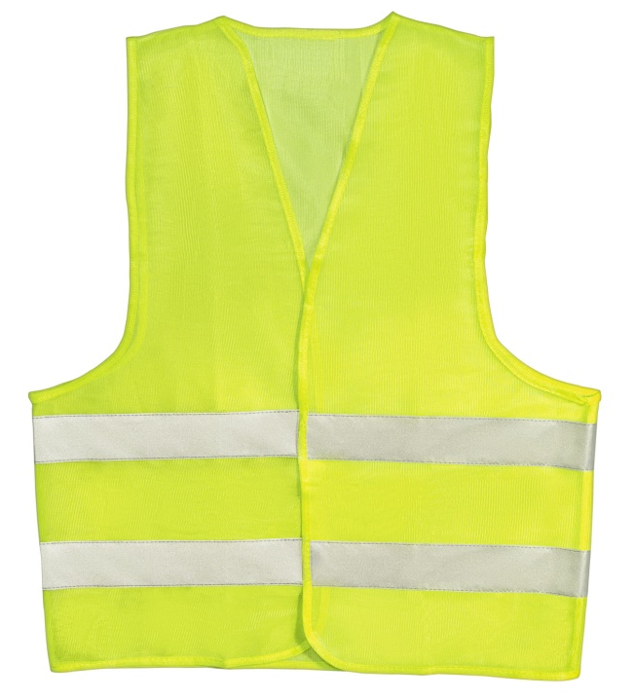
What is UV radiation used for?
Bright clothing: certain chemicals absorb UV radiation and re-emit it as visible light. These chemicals are used in safety clothing, as well as some washing powders to make white material appear whiter in sunlight.
Security marking: special inks that are only visible under UV radiation are used to security mark expensive items.
Tanning: UV radiation in sunlight causes skin to tan. Tanning beds imitate sunlight by emitting artificially-produced UV rays.
Notes:
Teacher notes
Ask students to describe the dangers of UV radiation. UV light is absorbed by our skin. Because of its high energy this can be damaging to ourselves. Our bodies produce special skin pigments to protect our cells which is why fair skin turns brown in the sun. If this is not enough protection, skin cells will become damaged leaving the characteristic red patches of sun burn.
Photo credit: © Gromwell, shutterstock.com 2018

Slide 28
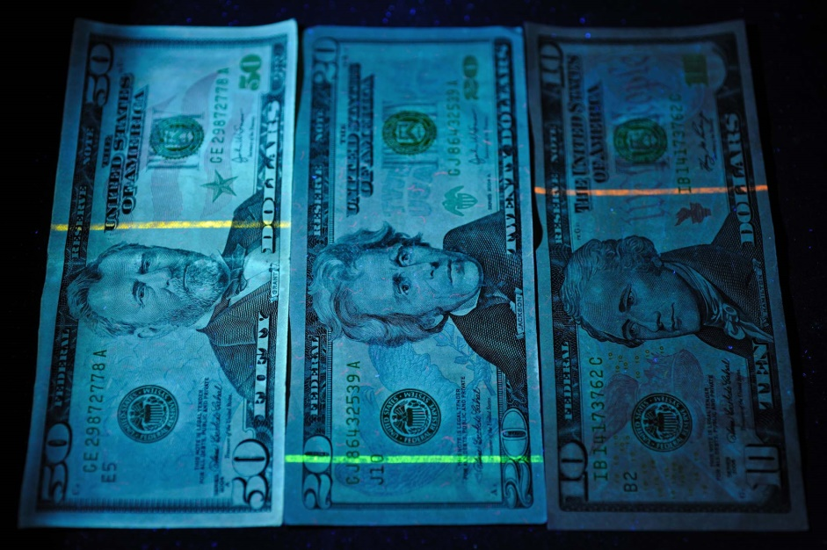
How can UV radiation help prevent fraud?
Chemicals that absorb UV radiation and re-emit it as visible light (which has less energy) are said to be fluorescent. These chemicals are used in inks and in safety clothing.
Fluorescent inks, which are not visible under normal light, are used in banknote production to prevent fraud. The inks glow brightly under UV light.
Fluorescent inks are also used in stamps to distinguish different values for automatic sorting.
Notes:
Photo credit: © kc_film, shutterstock.com 2018 Banknotes in UV light. The design on these banknotes incorporates an invisible security strip that fluoresces brightly in ultraviolet (UV) light. Each denomination of banknote has a different color security strip. This and other security measures are designed to prevent counterfeiting.

Slide 29
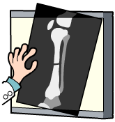
What are X-rays?
Anyone who has been to hospital with a broken bone will have had an X-ray photograph taken.
X-rays are a form of electromagnetic radiation
that are very penetrating. In the electromagnetic spectrum, they are found between UV and gamma rays.
ultra-violet
gamma
rays
visible light
X-rays
10^{–3}
10^{–6}
10^{–9}
10^{–12}
wavelength of electromagnetic waves (m)
X-rays have very short wavelengths between 0.1 and 10 nm. (The size of a water molecule is about 0.3 nm.)
Notes:
Teacher notes
For more information about the types of electromagnetic radiation, please refer to the The Electromagnetic Spectrum presentation.

Slide 30
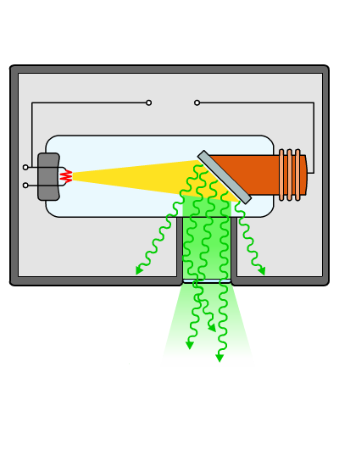
How are X-rays produced?
X-rays are produced artificially using a X-ray tube.
high
voltage
anode
cathode
tungsten
target
lead
shielding
X-rays
Electrons from the hot cathode are fired at the tungsten target at high speed. When these high-energy electrons strike the target, some of their energy is changed into X-rays.

Slide 31
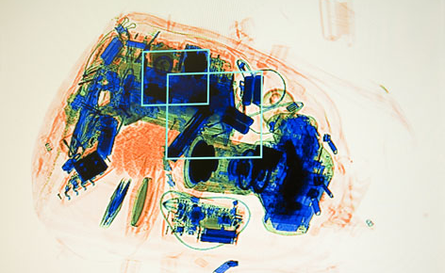
How can X-rays ‘look inside’ objects?
X-rays can pass through certain opaque materials. They can also be absorbed by special film to produce images.
X-rays pass through soft tissue, such as skin and muscle, without being absorbed. Denser tissue, such as bone, can absorb X-rays. Film that is exposed appears black and areas that are not exposed, because of X-ray absorption, are white.
X-rays are used in medicine and in security to check the contents of baggage and vehicles for weapons, drugs and other contraband.
Notes:
Photo credit: © Khafizov Ivan Harisovich, shutterstock.com 2018

Slide 32
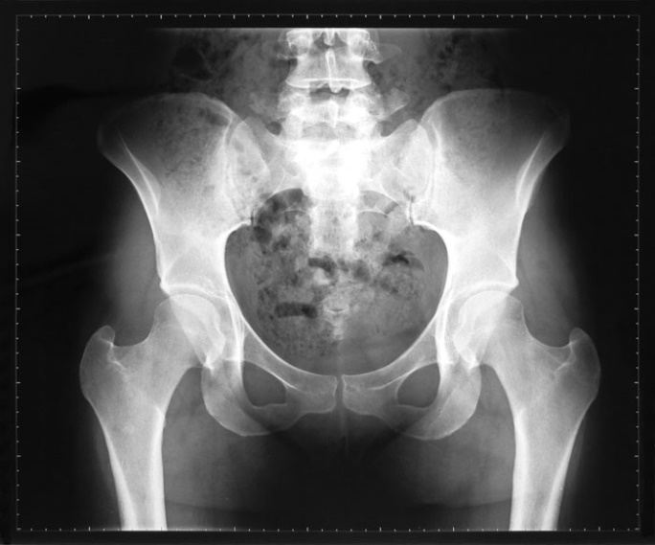
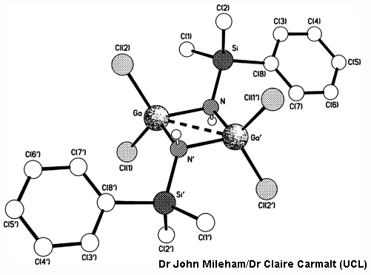
What are X-rays used for?
Imaging: X-rays are very penetrating and can pass through many forms of matter. They are used in medicine, industry and security to take pictures of the inside of objects.
Treating cancer: concentrated beams of short wavelength X-rays can be used to kill cancerous cells.
Crystallography: X-rays are used to work out the arrangement of atoms in various substances, including crystals.
Notes:
Photo credits: x-ray of a woman’s pelvis © ZTS, shutterstock.com 2018, crystal structure of [Cl₂GaNH(SiMe₂Ph)]₂ © Dr John Mileham/Dr Claire Carmalt (UCL)

Slide 33
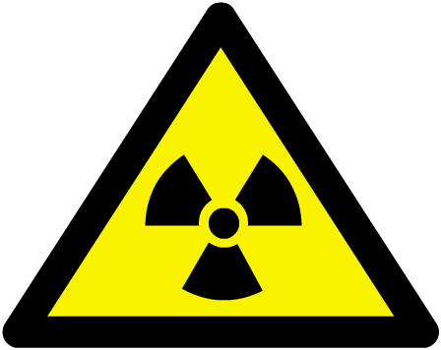
What are gamma rays?
Gamma rays are emitted by certain radioactive materials and have many uses in medicine.
Gamma rays are the highest-energy form of electromagnetic radiation and are above
X-rays in the electromagnetic spectrum.
ultra-violet
gamma
rays
visible light
X-rays
10^{–3}
10^{–6}
10^{–9}
10^{–12}
wavelength of electromagnetic waves (m)
Gamma rays have wavelengths between 0.001 and 0.1 nm (less than the size of an atom), which makes them the form of electromagnetic radiation with the shortest wavelengths.
Notes:
Teacher notes
For more information about the types of electromagnetic radiation, please refer to the The Electromagnetic Spectrum presentation.

Slide 34
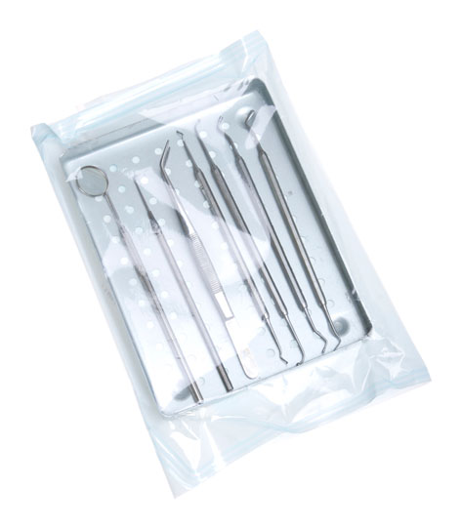
What are gamma rays used for?
Industrial imaging: Gamma rays are even more penetrating than X-rays and can pass through denser materials. They can be used to examine metal castings and welded structures.
Sterilizing: Gamma rays are used to sterilize medical equipment because they are highly penetrating and kill
all living cells.
Medical imaging: A gamma scan is obtained by injecting a radioactive tracer, which concentrates in the area of the body being investigated. Gamma rays emitted from this area are detected by a gamma camera.
Notes:
Photo credit: © photos.com 2018

Slide 35
Using radiation to find leaks
Notes:
Teacher notes
For more information about calculating half-life and how this can be useful, please refer to the Half-life presentation.

Slide 36
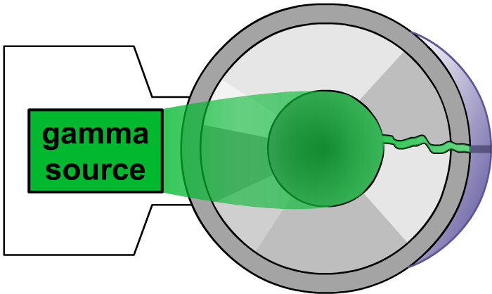
How can radiation detect cracks?
Gamma rays can also be used to detect cracks after an object has been welded.
A gamma source is placed on one side of the welded metal, and a photographic film on the other side.
welded metal pipe
welding flaw
The solid metal blocks the gamma rays, but if there are any cracks, the rays can pass through and show up on the photographic film as dark patches.
photographic film

Slide 37
Researching uses of EM waves
Research a technological device that uses electromagnetic waves to transmit or capture information or energy. Make a presentation to communicate your findings to your class.
Your presentation should answer the following questions:
What type of electromagnetic wave does the device use?
How does the device work?
What wave behavior does the device use?
Notes:
This slide covers the Science and Engineering Practices:
Obtaining, Evaluating, and Communicating Information: Critically read scientific literature adapted for classroom use to determine the central ideas or conclusions and/or to obtain scientific and/or technical information to summarize complex evidence, concepts, processes, or information presented in a text by paraphrasing them in simpler but still accurate terms.
Obtaining, Evaluating, and Communicating Information: Communicate scientific and/or technical information or ideas (e.g. about phenomena and/or the process of development and the design and performance of a proposed process or system) in multiple formats (including orally, graphically, textually, and mathematically).

