Slide 1
Work and Power

Slide 2
Information
Asking Questions and Defining Problems
Using Mathematics and Computational Thinking
Constructing Explanations and Designing Solutions
3. Scale, Proportion, and Quantity
4. Systems and System Models
5. Energy and Matter
7. Stability and Change

Slide 3
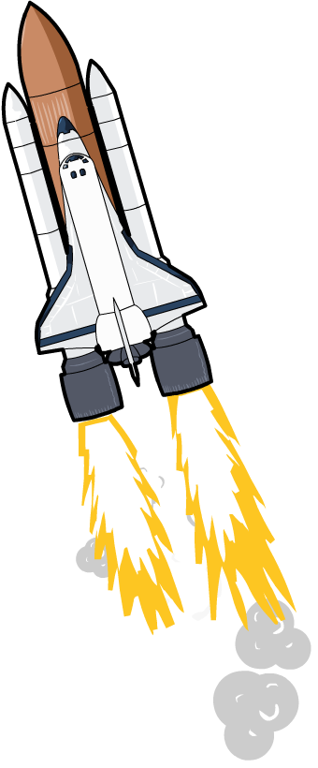
What is work?
What happens when a rocket is launched into space?
When the rocket’s engines are fired, chemical energy in the fuel is transferred to kinetic energy in the rocket.
When energy is transferred, work is done.
Notes:
Teacher notes
For more information about energy transfers, please refer to the Energy Transfers presentation.
This presentation is accompanied by the worksheet Work and Power.

Slide 4
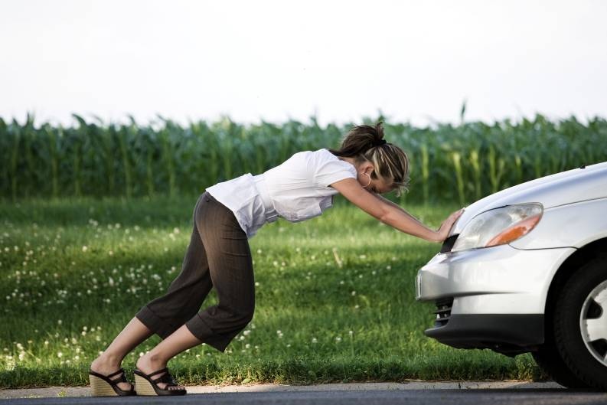
Work and energy
What is the link between work and energy?
work done = energy transferred
This means the units for work are the same as the units for energy, joules.
For example, if a person does 500 J of work pushing a car, then 500 J of energy is transferred.
In the same way, if a person transfers 250 J of energy when they carry a box up some stairs, then 250 J of work is done.
Notes:
Photo credit: © photos.com 2018

Slide 5
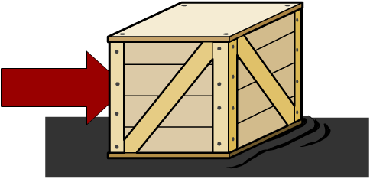
Work against friction
Friction opposes movement. This means that when work is done, not all of the energy is transferred into kinetic energy in the object. Some energy is lost as heat, increasing the temperature of the object and its surroundings.
For example, if you push a glass box 1 m across a polished wooden floor, most of the energy will be transferred into kinetic energy, so only a small force is needed.
If you push a rough wooden box 1 m across a rubber floor, most of the energy will be transferred into heat, so a large force is needed.
In which example is more work done?
Notes:
Teacher notes
More work is done to push the wooden box on the rubber floor, because more of the energy is transferred to heat rather than kinetic energy.
This slide covers the Science and Engineering Practice:
Constructing Explanations and Designing Solutions: Apply scientific ideas, principles, and/or evidence to provide an explanation of phenomena and solve design problems, taking into account possible unanticipated effects.

Slide 6
Work and shuttle re-entry
Notes:
Teacher notes
In reality, space shuttles usually enter the atmosphere upside down and tail first so that the rear thrusters can be used to slow it down. In this animation, the re-entry procedure has been simplified.
Stage 2: You could point out to the students that if the shuttle were to slow itself down to landing speed using thrusters alone, it would need to carry so much fuel that it would be impossible to launch.

Slide 7
What factors affect work done?
Notes:
This slide covers the Science and Engineering Practice:
Asking Questions and Defining Problems: Ask questions to clarify and refine a model, an explanation, or an engineering problem.

Slide 8
How is work calculated?
When a force causes an object to move through a distance, work is done. Work is only done on an object when the force on the object causes a displacement of the object.
The work done depends on the size of the force and the distance moved in the direction on the force. It can be calculated using the equation:
distance moved in direction of force
work done = force ×
Force, F, is measured in newtons (N).
Distance, s, is measured in meters (m).
Work done, W, is measured in joules (J).
Notes:
Teacher notes
It may be worth pointing out to students that the force needed to lift an object at a steady speed is the same as the weight of the object. For example, the force needed to lift a 100 N box is 100 N.
This slide covers the Science and Engineering Practice:
Using Mathematics and Computational Thinking: Use mathematical, computational, and/or algorithmic representations of phenomena or design solutions to describe and/or support claims and/or explanations.

Slide 9
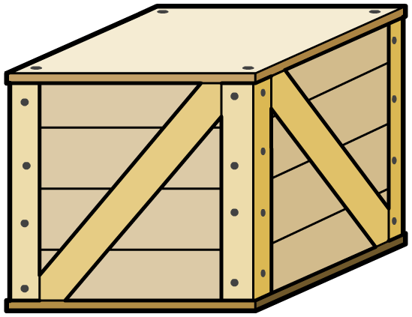
The joule
The work done on an object is measured in joules.
One joule of work is done when a force of one newton causes a displacement of one meter.
This means that one joule is equal to one newton-meter.
A crate is pushed 2 m by a force of 10 N.
work done on the crate
= force × distance
= 10 × 2
= 20 J
= 20 N m
Notes:
This slide covers the Science and Engineering Practice:
Using Mathematics and Computational Thinking: Apply techniques of algebra and functions to represent and solve scientific and engineering problems.
Using Mathematics and Computational Thinking: Apply ratios, rates, percentages, and unit conversions in the context of complicated measurement problems involving quantities with derived or compound units (such as mg/mL, kg/m3, acre-feet, etc.).

Slide 10
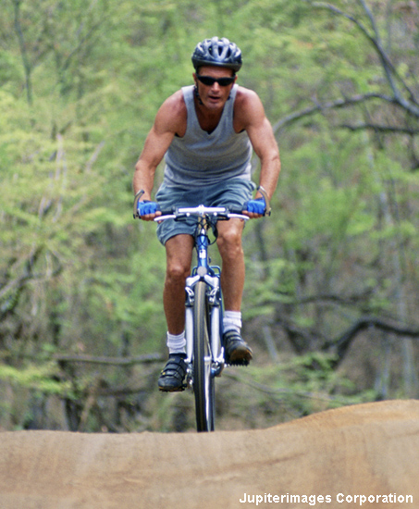
Calculating work done question 1
A cyclist pedals a bicycle with a force of 1,000 N and moves it 250 m.
How much work has been
done by the cyclist?
W = F s
= 1,000 × 250
= 250,000 J = 250 kJ
Notes:
This slide covers the Science and Engineering Practice:
Using Mathematics and Computational Thinking: Apply techniques of algebra and functions to represent and solve scientific and engineering problems.
Photo credit: © Jupiterimages Corporation 2018

Slide 11
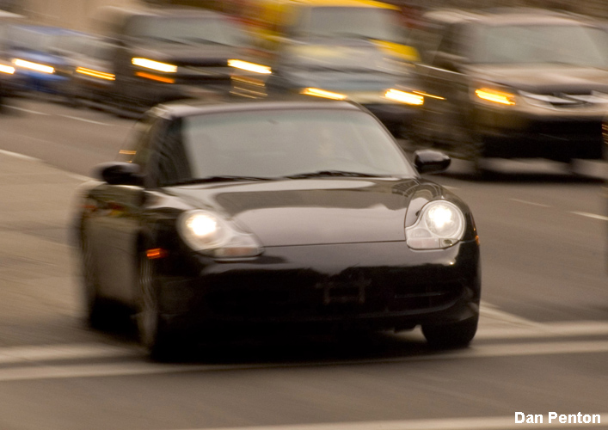
Calculating work done question 2
A car engine moves a car with a force of 10 kN and does 500 kJ of work.
How far has the car traveled?
work done = force × distance
distance =
work done
force
= 500,000
10,000
= 50 m
Notes:
This slide covers the Science and Engineering Practice:
Using Mathematics and Computational Thinking: Apply techniques of algebra and functions to represent and solve scientific and engineering problems.
Photo credit: © Dan Penton

Slide 12
Work, force, distance calculations
Notes:
This slide covers the Science and Engineering Practice:
Using Mathematics and Computational Thinking: Apply techniques of algebra and functions to represent and solve scientific and engineering problems.

Slide 13
Work and energy: true or false?
Notes:
Teacher notes
This true-or-false quiz could be used as a starter exercise to the work and energy topic. Students could be given colored traffic light cards (red = false, green = true) to vote on the statements shown. To stretch students, they could be asked to explain their voting.

Slide 14
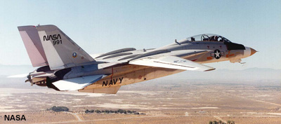
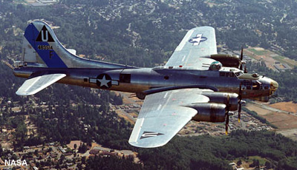
Which is most powerful?
Power is the rate at which energy is transferred. A more powerful engine does work (i.e. transfers energy) faster than a less powerful engine.
Both these planes have about the same mass, but the jet has more powerful engines.
This means that chemical energy in the fuel can be transferred to kinetic energy faster, so the jet will experience a greater acceleration.
Notes:
Photo credit: F-14 Tomcat (top) © NASA Dryden Flight Research Center 2018, B-17 Flying Fortress (bottom) © NASA 2018

Slide 15
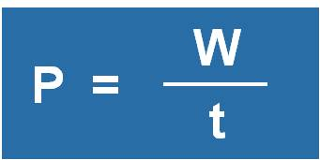
How is power calculated?
The power exerted by an object can be calculated using the equation:
or
Work done, W, is measured in joules (J).
Time, t, is measured in seconds (s).
Power, P, is measured in watts (W).
Notes:
This slide covers the Science and Engineering Practice:
Using Mathematics and Computational Thinking: Use mathematical, computational, and/or algorithmic representations of phenomena or design solutions to describe and/or support claims and/or explanations.

Slide 16
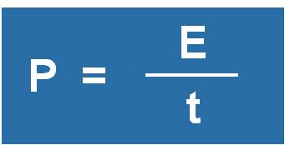
How is power calculated?
Since work done = energy transferred:
or
Energy transferred, E, is also measured in joules (J).
An energy transfer of one joule per second is equal to a
power of one watt.
Notes:
This slide covers the Science and Engineering Practice:
Using Mathematics and Computational Thinking: Use mathematical, computational, and/or algorithmic representations of phenomena or design solutions to describe and/or support claims and/or explanations.

Slide 17
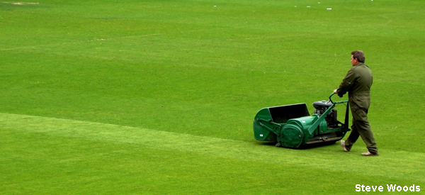
Calculating power question 1
A lawnmower engine does 10 kJ of work in 10 seconds.
What is the power of the engine?
power =
work done
time
= 10,000 / 10
= 1,000 W = 1 kW
Notes:
This slide covers the Science and Engineering Practice:
Using Mathematics and Computational Thinking: Apply techniques of algebra and functions to represent and solve scientific and engineering problems.
Photo credit: © Steve Woods, 2017

Slide 18
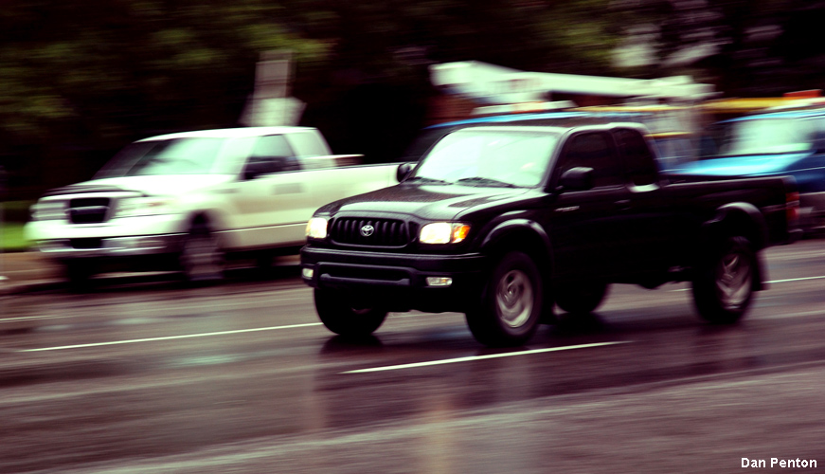
Calculating power question 2
A car transfers 12 MJ of energy in 2 minutes.
What is the power of the car?
power =
work done
time
=
energy transferred
time
= 12,000,000 / 120
= 100,000 W = 100 kW
Notes:
This slide covers the Science and Engineering Practice:
Using Mathematics and Computational Thinking: Apply techniques of algebra and functions to represent and solve scientific and engineering problems.
Photo credit: © Dan Penton, 2018

Slide 19
Power, work and time calculations
Notes:
This slide covers the Science and Engineering Practice:
Using Mathematics and Computational Thinking: Apply techniques of algebra and functions to represent and solve scientific and engineering problems.

